Slide 1
AI-Driven Digital Twin for Smart Factory Operations
Project overview and implementation status
HCLTech Embedded Systems & IoT Project
Akshat Kaushal | B.Tech ECE | ABES Engineering College
Current demonstration: simulated telemetry; physical ESP32 integration pending

Slide 2
Problem Statement
Machine parameters need to be collected and monitored consistently.
The prototype demonstrates telemetry ingestion, cloud storage, AI-assisted classification and dashboard visualization.
The current scope is one logical machine with seven telemetry parameters.

Slide 3
Project Objectives
Receive temperature, pressure, motor speed, vibration, current, voltage and humidity.
Store time-series telemetry in InfluxDB Cloud.
Classify the latest complete sensor vector using a PyTorch prototype model.
Visualize trends and AI status in Grafana.

Slide 4
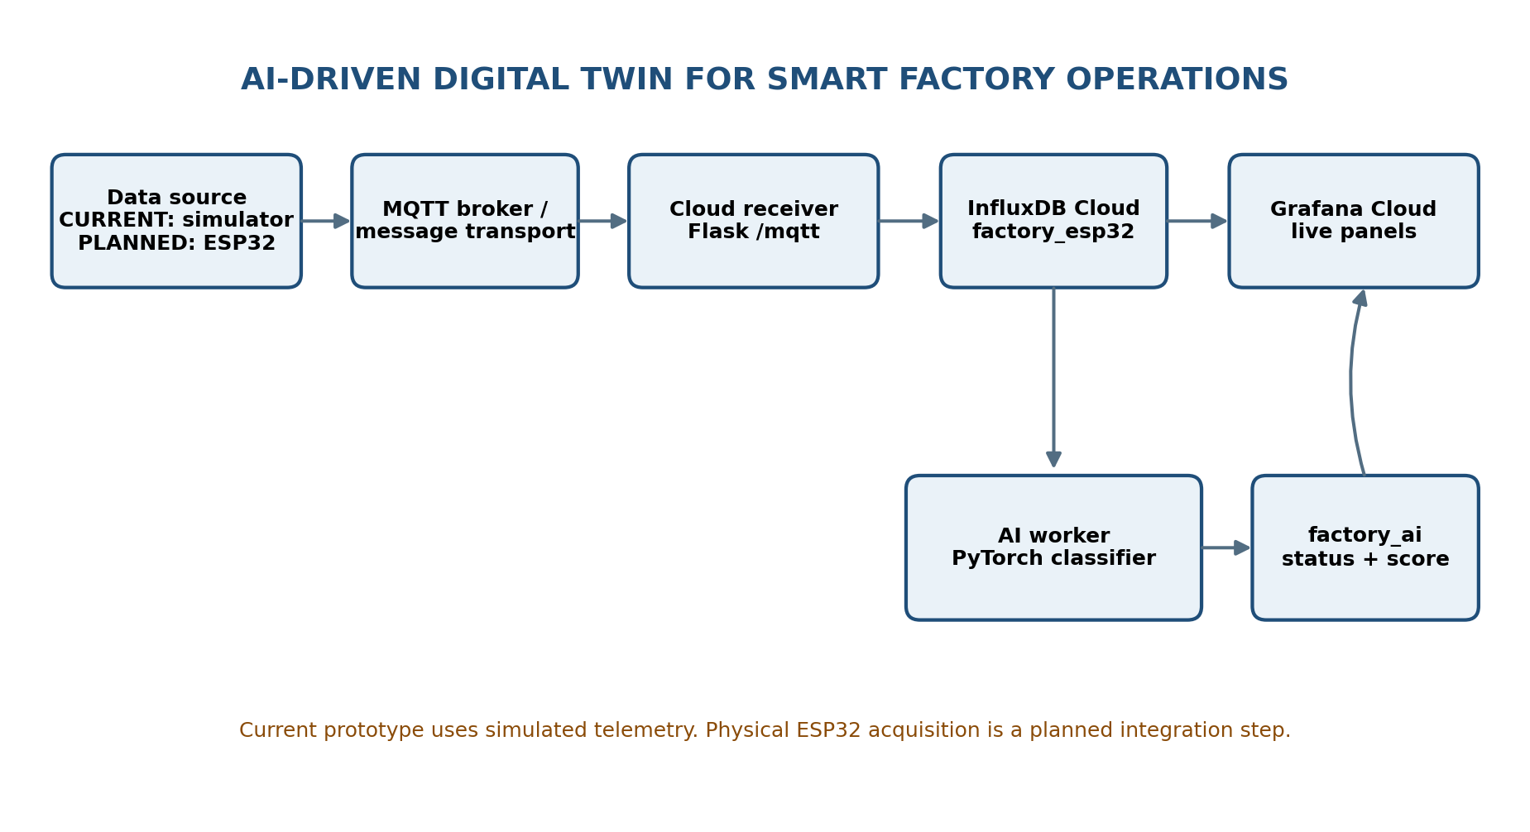
System Architecture

Slide 5
Technology Stack
Python and Flask – cloud receiver/API
MQTT/message transport – telemetry delivery
InfluxDB Cloud – time-series storage
PyTorch – prototype neural-network classifier
Grafana Cloud – monitoring dashboard
ESP32/Arduino – planned physical acquisition integration

Slide 6
AI Classification
Seven input features feed a 7→16→8→1 neural network.
Current training set: 8 hard-coded examples (5 normal, 3 fault).
Prototype status thresholds: NORMAL < 0.50; WARNING 0.50–<0.80; FAULT ≥ 0.80.
Scores are not calibrated industrial failure probabilities; independent validation is still required.

Slide 7
Current Implementation Status
Present in supplied repository: Flask receiver, PyTorch AI worker, InfluxDB integration code, Grafana query notes, README and draft SRS.
Current demo mode: simulated telemetry.
Arduino firmware is stored separately in the local HCL folder and has not yet been reviewed in this audit.
No physical ESP32 test evidence was included in the supplied ZIP.

Slide 8
Testing Plan
Validate accepted and rejected HTTP payloads.
Verify InfluxDB measurements, tags, fields and timestamps.
Verify AI freshness checks and factory_ai writes.
Correct and verify Grafana queries.
Run independent model validation before reporting accuracy.
Record actual evidence; current test cases are marked Not Run.

Slide 9
Limitations and Future Work
Expand and independently validate the labelled training dataset.
Add feature scaling and model versioning.
Improve InfluxDB write error handling.
Integrate and test physical ESP32 sensors and MQTT firmware.
Add multi-machine support and alerting after the core prototype is verified.

Slide 10
Conclusion
The project demonstrates an end-to-end simulated Industrial IoT monitoring pipeline.
It combines cloud time-series storage, prototype AI classification and dashboard visualization.
Next milestone: review local firmware, verify hardware integration and execute the test plan.

