Slide 1
Machine-Level Programming: Procedures Computer Systems Organization Spring 2019, IIIT-H
Instructor: Suresh Purini

Slide 2
Subroutines, Procedures and Functions
Subroutines, Procedures and Functions – Are they any different?
Why Procedures?
Avoid duplication of code within the same program.
Reuse of code across different programs (Libraries?)
Decomposition of a Complex Program into a set of more manageable subroutines.
Information Hiding.
….
Any Disadvantages?

Slide 3
Implementing Subroutine Abstraction
main()
{
int i, sum = 0;
for(i =0; i<100; ++i )
sum = sum +sqr(i);
}
int sqr(int n )
{
return n*n;
}
Questions:
How to implement Control Transfer?
How to pass Parameters?
How to pass back Return Values?

Slide 4
Mechanisms in Procedures
P(…) {
•
•
y = Q(x);
print(y)
•
}
Passing control
To beginning of procedure code
Back to return point
Passing data
Procedure arguments
Return value
Memory management
Allocate during procedure execution
Deallocate upon return
Mechanisms all implemented with machine instructions
x86-64 implementation of a procedure uses only those mechanisms required
int Q(int i)
{
int t = 3*i;
int v[10];
•
•
return v[t];
}

Slide 5
Today
Carnegie Mellon
Procedures
Stack Structure
Calling Conventions
Passing control
Passing data
Managing local data
Illustration of Recursion

Slide 6
x86-64 Stack
Carnegie Mellon
Stack “Bottom”
Region of memory managed with stack discipline
Grows toward lower addresses
Register %rsp contains lowest stack address
address of “top” element
Increasing
Addresses
Stack Grows
Down
Stack Pointer: %rsp
Stack “Top”

Slide 7
x86-64 Stack: Push
Carnegie Mellon
Stack “Bottom”
pushq Src
Fetch operand at Src
Decrement %rsp by 8
Write operand at address given by %rsp
Increasing
Addresses
Stack Grows
Down
Stack Pointer: %rsp
-8
Stack “Top”

Slide 8
x86-64 Stack: Pop
Carnegie Mellon
Stack “Bottom”
popq Dest
Read value at address given by %rsp
Increment %rsp by 8
Store value at Dest (must be register)
Increasing
Addresses
Stack Grows
Down
Stack Pointer: %rsp
+8
Stack “Top”

Slide 9
Storage Lay-out of a Program
Code (Procedures are stored here)
Data Segment (Global variables and static variables are stored here)
Heap (memory allocated through malloc calls come from here)
Stack (Activation records for procedure invocations are stored here)

Slide 10
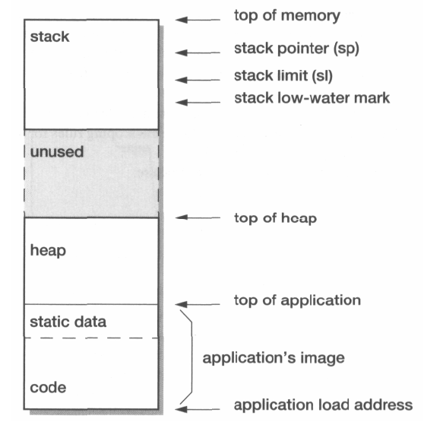
Subroutines – Implementing Control Transfer
Hey, what’s happening? Why are we decrementing the sp register when we want to push a return address onto the stack?
Key Point: Stack is growing from higher memory address to lower memory address.
It is a convention.

Slide 11
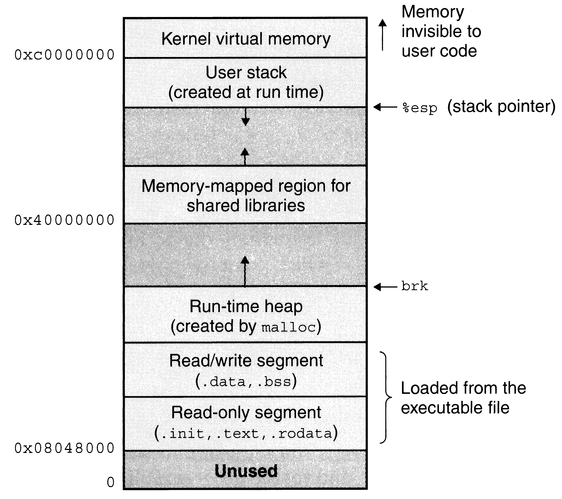
Linux Memory Image

Slide 12
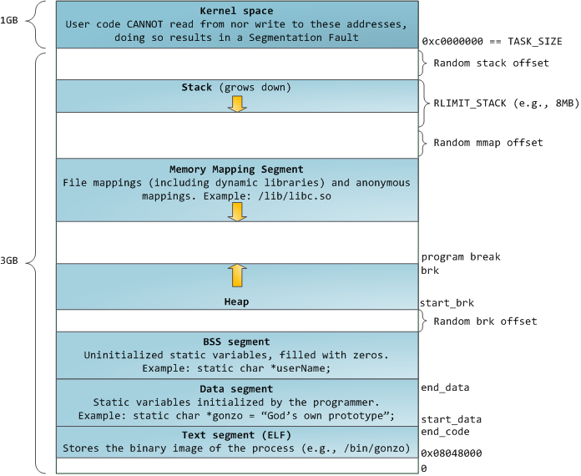
Virtual Address Space Layout of a Linux Process
Taken from: http://duartes.org/gustavo/blog/post/anatomy-of-a-program-in-memory

Slide 13
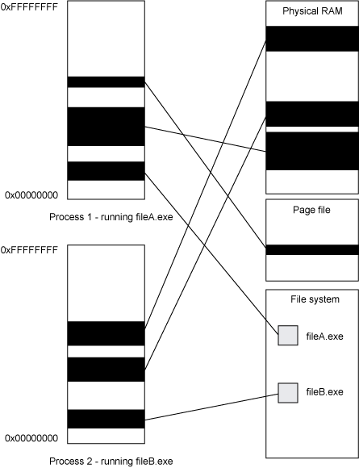
Virtual Address Space versus Physical Address Space
Taken From: http://www.ibm.com/developerworks/aix/library/j-nativememory-aix/index.html

Slide 14
Today
Carnegie Mellon
Procedures
Stack Structure
Calling Conventions
Passing control
Passing data
Managing local data
Illustration of Recursion

Slide 15
Code Examples
void multstore
(long x, long y, long *dest) {
long t = mult2(x, y);
*dest = t;
}
0000000000400540 <multstore>:
400540: push %rbx # Save %rbx
400541: mov %rdx,%rbx # Save dest
400544: callq 400550 <mult2> # mult2(x,y)
400549: mov %rax,(%rbx) # Save at dest
40054c: pop %rbx # Restore %rbx
40054d: retq # Return
long mult2
(long a, long b)
{
long s = a * b;
return s;
}
0000000000400550 <mult2>:
400550: mov %rdi,%rax # a
400553: imul %rsi,%rax # a * b
400557: retq # Return

Slide 16
Procedure Control Flow
Carnegie Mellon
Use stack to support procedure call and return
Procedure call: call label
Push return address on stack
Jump to label
Return address:
Address of the next instruction right after call
Example from disassembly
Procedure return: ret
Pop address from stack
Jump to address

Slide 17
Control Flow Example #1
•
•
•
0x130
0000000000400540 <multstore>:
•
•
400544: callq 400550 <mult2>
400549: mov %rax,(%rbx)
•
•
0x128
0x120
%rsp
0x120
%rip
0x400544
0000000000400550 <mult2>:
400550: mov %rdi,%rax
•
•
400557: retq

Slide 18
Control Flow Example #2
•
•
•
0x130
0000000000400540 <multstore>:
•
•
400544: callq 400550 <mult2>
400549: mov %rax,(%rbx)
•
•
0x128
0x120
0x118
0x400549
%rsp
0x118
%rip
0x400550
0000000000400550 <mult2>:
400550: mov %rdi,%rax
•
•
400557: retq

Slide 19
Control Flow Example #3
•
•
•
0x130
0000000000400540 <multstore>:
•
•
400544: callq 400550 <mult2>
400549: mov %rax,(%rbx)
•
•
0x128
0x120
0x118
0x400549
%rsp
0x118
%rip
0x400557
0000000000400550 <mult2>:
400550: mov %rdi,%rax
•
•
400557: retq

Slide 20
Control Flow Example #4
•
•
•
0x130
0000000000400540 <multstore>:
•
•
400544: callq 400550 <mult2>
400549: mov %rax,(%rbx)
•
•
0x128
0x120
%rsp
0x120
%rip
0x400549
0000000000400550 <mult2>:
400550: mov %rdi,%rax
•
•
400557: retq

Slide 21
Today
Carnegie Mellon
Procedures
Stack Structure
Calling Conventions
Passing control
Passing data
Managing local data
Illustrations of Recursion & Pointers

Slide 22
Procedure Data Flow
Carnegie Mellon
Registers
Stack
First 6 arguments
Return value
• • •
%rdi
%rsi
Arg n
%rdx
• • •
%rcx
%r8
Arg 8
%r9
Arg 7
%rax
Only allocate stack space when needed

Slide 23
Data Flow Examples
void multstore
(long x, long y, long *dest) {
long t = mult2(x, y);
*dest = t;
}
0000000000400540 <multstore>:
# x in %rdi, y in %rsi, dest in %rdx
• • •
400541: mov %rdx,%rbx # Save dest
400544: callq 400550 <mult2> # mult2(x,y)
# t in %rax
400549: mov %rax,(%rbx) # Save at dest
• • •
long mult2
(long a, long b)
{
long s = a * b;
return s;
}
0000000000400550 <mult2>:
# a in %rdi, b in %rsi
400550: mov %rdi,%rax # a
400553: imul %rsi,%rax # a * b
# s in %rax
400557: retq # Return

Slide 24
Today
Carnegie Mellon
Procedures
Stack Structure
Calling Conventions
Passing control
Passing data
Managing local data
Illustration of Recursion

Slide 25
Stack-Based Languages
Carnegie Mellon
Languages that support recursion
e.g., C, Pascal, Java
Code must be “Reentrant”
Multiple simultaneous instantiations of single procedure
Need some place to store state of each instantiation
Arguments
Local variables
Return pointer
Stack discipline
State for given procedure needed for limited time
From when called to when return
Callee returns before caller does
Stack allocated in Frames
state for single procedure instantiation

Slide 26
Call Chain Example
Carnegie Mellon
Example
Call Chain
yoo(…)
{
•
•
who();
•
•
}
yoo
who(…)
{
• • •
amI();
• • •
amI();
• • •
}
who
amI(…)
{
•
•
amI();
•
•
}
amI
amI
amI
amI
Procedure amI() is recursive

Slide 27
Stack Frames
Carnegie Mellon
Previous Frame
Frame for proc
Contents
Return information
Local storage (if needed)
Temporary space (if needed)
Management
Space allocated when enter procedure
“Set-up” code
Includes push by call instruction
Deallocated when return
“Finish” code
Includes pop by ret instruction
Frame Pointer: %rbp
(Optional) x
Stack Pointer: %rsp
Stack “Top”

Slide 28
Example
Carnegie Mellon
Stack
yoo
yoo(…)
{
•
•
who();
•
•
}
yoo
%rbp
yoo
who
%rsp
amI
amI
amI
amI

Slide 29
Example
Carnegie Mellon
Stack
yoo
who
yoo(…)
{
•
•
who();
•
•
}
yoo
who(…)
{
• • •
amI();
• • •
amI();
• • •
}
yoo
who
%rbp
amI
amI
%rsp
amI
amI

Slide 30
Example
Carnegie Mellon
Stack
yoo
who
amI
yoo(…)
{
•
•
who();
•
•
}
yoo
who(…)
{
• • •
amI();
• • •
amI();
• • •
}
yoo
amI(…)
{
•
•
amI();
•
•
}
who
amI
amI
%rbp
amI
%rsp
amI

Slide 31
Example
Carnegie Mellon
Stack
yoo
who
amI
amI
yoo(…)
{
•
•
who();
•
•
}
yoo
who(…)
{
• • •
amI();
• • •
amI();
• • •
}
yoo
amI(…)
{
•
•
amI();
•
•
}
who
amI(…)
{
•
•
amI();
•
•
}
amI
amI
amI
%rbp
amI
%rsp

Slide 32
Example
Carnegie Mellon
Stack
yoo
who
amI
amI
amI
yoo(…)
{
•
•
who();
•
•
}
yoo
who(…)
{
• • •
amI();
• • •
amI();
• • •
}
yoo
amI(…)
{
•
•
amI();
•
•
}
who
amI(…)
{
•
•
amI();
•
•
}
amI
amI
amI(…)
{
•
•
amI();
•
•
}
amI
amI
%rbp
%rsp

Slide 33
Example
Carnegie Mellon
Stack
yoo
who
amI
amI
yoo(…)
{
•
•
who();
•
•
}
yoo
who(…)
{
• • •
amI();
• • •
amI();
• • •
}
yoo
amI(…)
{
•
•
amI();
•
•
}
who
amI(…)
{
•
•
amI();
•
•
}
amI
amI
amI
%rbp
amI
%rsp

Slide 34
Example
Carnegie Mellon
Stack
yoo
who
amI
yoo(…)
{
•
•
who();
•
•
}
yoo
who(…)
{
• • •
amI();
• • •
amI();
• • •
}
yoo
amI(…)
{
•
•
amI();
•
•
}
who
amI
amI
%rbp
amI
%rsp
amI

Slide 35
Example
Carnegie Mellon
Stack
yoo
who
yoo(…)
{
•
•
who();
•
•
}
yoo
who(…)
{
• • •
amI();
• • •
amI();
• • •
}
yoo
who
%rbp
amI
amI
%rsp
amI
amI

Slide 36
Example
Carnegie Mellon
Stack
yoo
who
amI
yoo(…)
{
•
•
who();
•
•
}
yoo
who(…)
{
• • •
amI();
• • •
amI();
• • •
}
yoo
amI(…)
{
•
•
amI();
•
•
}
who
amI
amI
%rbp
amI
%rsp
amI

Slide 37
Example
Carnegie Mellon
Stack
yoo
who
yoo(…)
{
•
•
who();
•
•
}
yoo
who(…)
{
• • •
amI();
• • •
amI();
• • •
}
yoo
who
%rbp
amI
amI
%rsp
amI
amI

Slide 38
Example
Carnegie Mellon
Stack
yoo
yoo
yoo(…)
{
•
•
who();
•
•
}
%rbp
yoo
who
%rsp
amI
amI
amI
amI

Slide 39
x86-64/Linux Stack Frame
Carnegie Mellon
Current Stack Frame (“Top” to Bottom)
“Argument build:” Parameters for function about to call
Local variables If can’t keep in registers
Saved register context
Old frame pointer (optional)
Caller Stack Frame
Return address
Pushed by call instruction
Arguments for this call
Caller
Frame
Arguments
7+
Frame pointer %rbp
Return Addr
Old %rbp
(Optional)
Saved
Registers
+
Local
Variables
Argument
Build
(Optional)
Stack pointer
%rsp

Slide 40
Example: incr
Carnegie Mellon
long incr(long *p, long val) {
long x = *p;
long y = x + val;
*p = y;
return x;
}
incr:
movq (%rdi), %rax
addq %rax, %rsi
movq %rsi, (%rdi)
ret
Register | Use(s)
%rdi | Argument p
%rsi | Argument val, y
%rax | x, Return value

Slide 41
Example: Calling incr #1
Carnegie Mellon
Initial Stack Structure
long call_incr() {
long v1 = 15213;
long v2 = incr(&v1, 3000);
return v1+v2;
}
. . .
Rtn address
%rsp
call_incr:
subq $16, %rsp
movq $15213, 8(%rsp)
movl $3000, %esi
leaq 8(%rsp), %rdi
call incr
addq 8(%rsp), %rax
addq $16, %rsp
ret
Resulting Stack Structure
. . .
Rtn address
15213
%rsp+8
Unused
%rsp

Slide 42
Example: Calling incr #2
Carnegie Mellon
Stack Structure
long call_incr() {
long v1 = 15213;
long v2 = incr(&v1, 3000);
return v1+v2;
}
. . .
Rtn address
15213
%rsp+8
Unused
%rsp
call_incr:
subq $16, %rsp
movq $15213, 8(%rsp)
movl $3000, %esi
leaq 8(%rsp), %rdi
call incr
addq 8(%rsp), %rax
addq $16, %rsp
ret
Register | Use(s)
%rdi | &v1
%rsi | 3000

Slide 43
Example: Calling incr #3
Carnegie Mellon
Stack Structure
long call_incr() {
long v1 = 15213;
long v2 = incr(&v1, 3000);
return v1+v2;
}
. . .
Rtn address
18213
%rsp+8
Unused
%rsp
call_incr:
subq $16, %rsp
movq $15213, 8(%rsp)
movl $3000, %esi
leaq 8(%rsp), %rdi
call incr
addq 8(%rsp), %rax
addq $16, %rsp
ret
Register | Use(s)
%rdi | &v1
%rsi | 3000

Slide 44
Example: Calling incr #4
Carnegie Mellon
Stack Structure
long call_incr() {
long v1 = 15213;
long v2 = incr(&v1, 3000);
return v1+v2;
}
. . .
Rtn address
18213
%rsp+8
Unused
%rsp
call_incr:
subq $16, %rsp
movq $15213, 8(%rsp)
movl $3000, %esi
leaq 8(%rsp), %rdi
call incr
addq 8(%rsp), %rax
addq $16, %rsp
ret
Register | Use(s)
%rax | Return value
Updated Stack Structure
. . .
Rtn address
%rsp

Slide 45
Example: Calling incr #5
Carnegie Mellon
Updated Stack Structure
long call_incr() {
long v1 = 15213;
long v2 = incr(&v1, 3000);
return v1+v2;
}
. . .
Rtn address
%rsp
call_incr:
subq $16, %rsp
movq $15213, 8(%rsp)
movl $3000, %esi
leaq 8(%rsp), %rdi
call incr
addq 8(%rsp), %rax
addq $16, %rsp
ret
Register | Use(s)
%rax | Return value
Final Stack Structure
. . .
%rsp

Slide 46
Register Saving Conventions
Carnegie Mellon
When procedure yoo calls who:
yoo is the caller
who is the callee
Can register be used for temporary storage?
Contents of register %rdx overwritten by who
This could be trouble ➙ something should be done!
Need some coordination
yoo:
• • •
movq $15213, %rdx
call who
addq %rdx, %rax
• • •
ret
who:
• • •
subq $18213, %rdx
• • •
ret

Slide 47
Register Saving Conventions
Carnegie Mellon
When procedure yoo calls who:
yoo is the caller
who is the callee
Can register be used for temporary storage?
Conventions
“Caller Saved”
Caller saves temporary values in its frame before the call
“Callee Saved”
Callee saves temporary values in its frame before using
Callee restores them before returning to caller

Slide 48
x86-64 Linux Register Usage #1
Carnegie Mellon
%rax
Return value
Also caller-saved
Can be modified by procedure
%rdi, ..., %r9
Arguments
Also caller-saved
Can be modified by procedure
%r10, %r11
Caller-saved
Can be modified by procedure
Return value
%rax
%rdi
%rsi
%rdx
Arguments
%rcx
%r8
%r9
%r10
Caller-saved
temporaries
%r11

Slide 49
x86-64 Linux Register Usage #2
Carnegie Mellon
%rbx, %r12, %r13, %r14
Callee-saved
Callee must save & restore
%rbp
Callee-saved
Callee must save & restore
May be used as frame pointer
Can mix & match
%rsp
Special form of callee save
Restored to original value upon exit from procedure
%rbx
%r12
Callee-saved
Temporaries
%r13
%r14
%rbp
Special
%rsp

Slide 50
Callee-Saved Example #1
Carnegie Mellon
Initial Stack Structure
long call_incr2(long x) {
long v1 = 15213;
long v2 = incr(&v1, 3000);
return x+v2;
}
. . .
Rtn address
%rsp
call_incr2:
pushq %rbx
subq $16, %rsp
movq %rdi, %rbx
movq $15213, 8(%rsp)
movl $3000, %esi
leaq 8(%rsp), %rdi
call incr
addq %rbx, %rax
addq $16, %rsp
popq %rbx
ret
Resulting Stack Structure
. . .
Rtn address
Saved %rbx
15213
%rsp+8
Unused
%rsp

Slide 51
Callee-Saved Example #2
Carnegie Mellon
Resulting Stack Structure
long call_incr2(long x) {
long v1 = 15213;
long v2 = incr(&v1, 3000);
return x+v2;
}
. . .
Rtn address
Saved %rbx
15213
%rsp+8
call_incr2:
pushq %rbx
subq $16, %rsp
movq %rdi, %rbx
movq $15213, 8(%rsp)
movl $3000, %esi
leaq 8(%rsp), %rdi
call incr
addq %rbx, %rax
addq $16, %rsp
popq %rbx
ret
Unused
%rsp
Pre-return Stack Structure
. . .
Rtn address
%rsp

Slide 52
Today
Carnegie Mellon
Procedures
Stack Structure
Calling Conventions
Passing control
Passing data
Managing local data
Illustration of Recursion

Slide 53
Recursive Function
Carnegie Mellon
pcount_r:
movl $0, %eax
testq %rdi, %rdi
je .L6
pushq %rbx
movq %rdi, %rbx
andl $1, %ebx
shrq %rdi
call pcount_r
addq %rbx, %rax
popq %rbx
.L6:
rep; ret
/* Recursive popcount */
long pcount_r(unsigned long x) {
if (x == 0)
return 0;
else
return (x & 1)
+ pcount_r(x >> 1);
}

Slide 54
Recursive Function Terminal Case
Carnegie Mellon
/* Recursive popcount */
long pcount_r(unsigned long x) {
if (x == 0)
return 0;
else
return (x & 1)
+ pcount_r(x >> 1);
}
pcount_r:
movl $0, %eax
testq %rdi, %rdi
je .L6
pushq %rbx
movq %rdi, %rbx
andl $1, %ebx
shrq %rdi
call pcount_r
addq %rbx, %rax
popq %rbx
.L6:
rep; ret
Register | Use(s) | Type
%rdi | x | Argument
%rax | Return value | Return value

Slide 55
Recursive Function Register Save
Carnegie Mellon
pcount_r:
movl $0, %eax
testq %rdi, %rdi
je .L6
pushq %rbx
movq %rdi, %rbx
andl $1, %ebx
shrq %rdi
call pcount_r
addq %rbx, %rax
popq %rbx
.L6:
rep; ret
/* Recursive popcount */
long pcount_r(unsigned long x) {
if (x == 0)
return 0;
else
return (x & 1)
+ pcount_r(x >> 1);
}
Register | Use(s) | Type
%rdi | x | Argument
. . .
Rtn address
Saved %rbx
%rsp

Slide 56
Recursive Function Call Setup
Carnegie Mellon
/* Recursive popcount */
long pcount_r(unsigned long x) {
if (x == 0)
return 0;
else
return (x & 1)
+ pcount_r(x >> 1);
}
pcount_r:
movl $0, %eax
testq %rdi, %rdi
je .L6
pushq %rbx
movq %rdi, %rbx
andl $1, %ebx
shrq %rdi
call pcount_r
addq %rbx, %rax
popq %rbx
.L6:
rep; ret
Register | Use(s) | Type
%rdi | x >> 1 | Rec. argument
%rbx | x & 1 | Callee-saved

Slide 57
Recursive Function Call
Carnegie Mellon
/* Recursive popcount */
long pcount_r(unsigned long x) {
if (x == 0)
return 0;
else
return (x & 1)
+ pcount_r(x >> 1);
}
pcount_r:
movl $0, %eax
testq %rdi, %rdi
je .L6
pushq %rbx
movq %rdi, %rbx
andl $1, %ebx
shrq %rdi
call pcount_r
addq %rbx, %rax
popq %rbx
.L6:
rep; ret
Register | Use(s) | Type
%rbx | x & 1 | Callee-saved
%rax | Recursive call return value

Slide 58
Recursive Function Result
Carnegie Mellon
/* Recursive popcount */
long pcount_r(unsigned long x) {
if (x == 0)
return 0;
else
return (x & 1)
+ pcount_r(x >> 1);
}
pcount_r:
movl $0, %eax
testq %rdi, %rdi
je .L6
pushq %rbx
movq %rdi, %rbx
andl $1, %ebx
shrq %rdi
call pcount_r
addq %rbx, %rax
popq %rbx
.L6:
rep; ret
Register | Use(s) | Type
%rbx | x & 1 | Callee-saved
%rax | Return value

Slide 59
Recursive Function Completion
Carnegie Mellon
pcount_r:
movl $0, %eax
testq %rdi, %rdi
je .L6
pushq %rbx
movq %rdi, %rbx
andl $1, %ebx
shrq %rdi
call pcount_r
addq %rbx, %rax
popq %rbx
.L6:
rep; ret
/* Recursive popcount */
long pcount_r(unsigned long x) {
if (x == 0)
return 0;
else
return (x & 1)
+ pcount_r(x >> 1);
}
Register | Use(s) | Type
%rax | Return value | Return value
. . .
%rsp

Slide 60
Observations About Recursion
Carnegie Mellon
Handled Without Special Consideration
Stack frames mean that each function call has private storage
Saved registers & local variables
Saved return pointer
Register saving conventions prevent one function call from corrupting another’s data
Unless the C code explicitly does so (e.g., buffer overflow in Lecture 9)
Stack discipline follows call / return pattern
If P calls Q, then Q returns before P
Last-In, First-Out
Also works for mutual recursion
P calls Q; Q calls P

Slide 61
x86-64 Procedure Summary
Carnegie Mellon
Important Points
Stack is the right data structure for procedure call / return
If P calls Q, then Q returns before P
Recursion (& mutual recursion) handled by normal calling conventions
Can safely store values in local stack frame and in callee-saved registers
Put function arguments at top of stack
Result return in %rax
Pointers are addresses of values
On stack or global
Caller
Frame
Arguments
7+
Return Addr
%rbp
(Optional)
Old %rbp
Saved
Registers
+
Local
Variables
Argument
Build
%rsp

Slide 62
Supplementary Slides

Slide 63
Global Variables versus Local Variables
numarray is allocated memory in .data section.
You can notice this using gdb or objdump
How about the variables i, sum?
Do objdump –D –S a.out
int numarray[8] = {1, 2, 3, 4, 5, 6, 7, 8};
main()
{
int i, sum = 0;
for(i = 0; i <= 7; ++i)
sum+=numarray[i];
}

Slide 64
Stack Frame for a function (Activation)
Associated with each function invocation or Activation an Activation Record (or frame) for the function will be created
Local variables are addressed as
(negative) offsets from the Base Pointer
Register
Why are we wasting one register?
Can’t we use ESP register instead?
What if there is an alloca call? If the stack
frame size is fixed we can possible use EBP
register for some other purposes?
. . . . .
Previous Activation Record
Ret Address
Old EBP
Memory for Local Variables
. . . . .
Current Procedure’s Activation Record
Current EBP
ESP

Slide 65
Local, Static Local and Global Variables
Why can’t we simply allocate memory to all the local variables in the data segement?
Handling recursion could be a problem?
Where memory be allocated to Static Locals?
In the data segment. Why? We should preserve the value of a static local across different procedure activations.

Slide 66
Implementing Function/Procedure Abstraction
Caller – Callee Pact
Caller – Passes Parameters
Callee – Returns a value
Parameter Passing Mechanisms
Call-by-value
Call-by-reference
Call-by-name
Our Focus: On implementing Call-by-Value mechanism

Slide 67
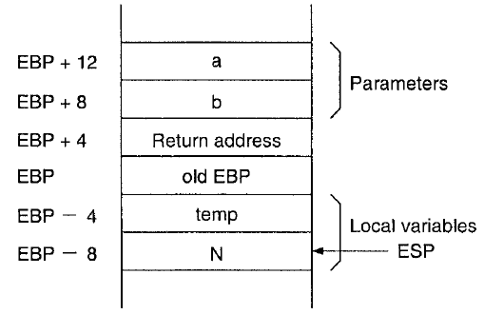
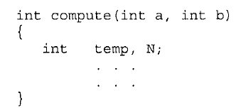
Passing Parameters
We can pass parameters either through
Registers
or through the Stack
or through the both
Question: How do we pass the return values?

Slide 68
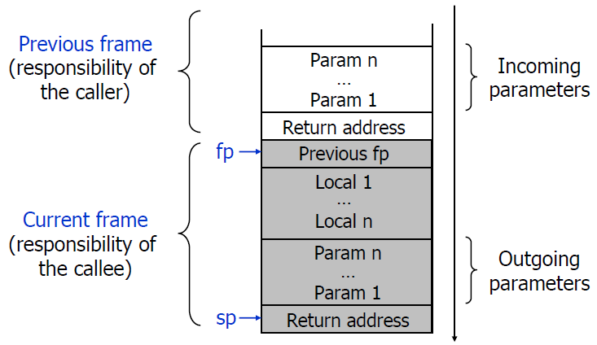
Anatomy of a Stack Frame
ACK: This slide is taken from Tim Teitelbaum’s Compiler’s Course at Cornell University.

Slide 69
Saving Registers
Problem: When a function foo calls a function fun, foo wants the registers it is using to be preserved across the function call to fun.
Solution 1: foo saves all the registers to be preserved across the procedure call to fun on the stack and restores them later.
Solution 2: foo just calls fun. fun saves the registers it is using on the stack and restores them later.
Solution 3: Divide the Register Bank into 2 sets
Caller Saved Registers
Callee Saved Registers
Idea: if fun is a leaf procedure it tries to get its job done using the Caller Saved Registers. Why?
How about non-leaf functions?

Slide 70
Important Advisory
You need not worry about procedure calling conventions if you are not interfacing with external C Libraies
If your Assembly Language Program is interfacing with C Libraries you need to worry about things like..
How to pass parameters?
Order of passing the parameters
How are the return values passed back?
What are the Caller Saved Registers?
What are the Callee Saved Registers?
…..
You have to consult the Application Binary Interface (ABI) Manual

Slide 71
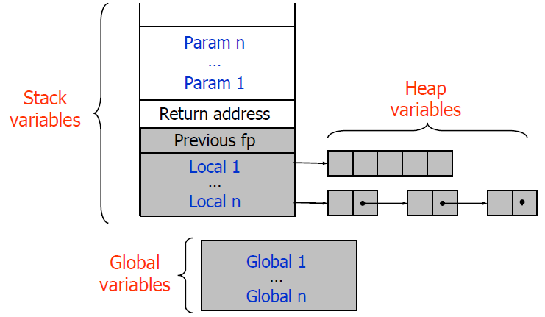
Big Picture: Memory Layout
ACK: This slide is taken from Tim Teitelbaum’s Compiler’s Course at Cornell University.

