Slide 1
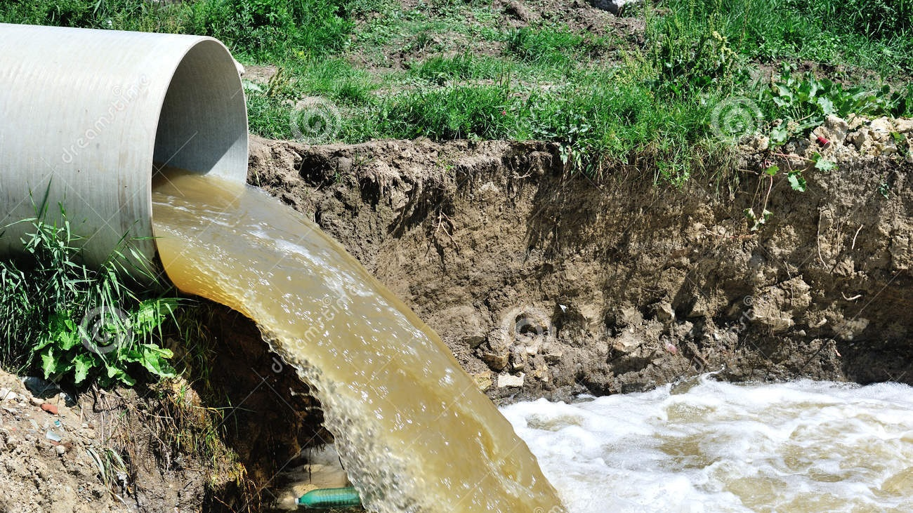





Smart drainage system
Team AKGS
Akshat Goyal
Kanish Anand
Gaurang Tandon
Shivansh

Slide 2
Introduction
Why does flooding happen? 1. Open drains in streets get blocked due to large consumer waste. 2. The sewer pipes do not have sufficient capacity. 3. Poor road and pipe design. We have come up with a solution that utilizes technology like ML, Cloud & IOT to work around the limitations of existing infrastructure while preventing flooding of cities at the same time.

Slide 3
Sewage system ⬄ graph THEORY
The network of drainage pipes in the city's system is represented as a graph. Each intersection of pipes is represented as a node in our graphs, and directed edges represent the pipes. Using the ML models as explained later and fractional opening of valves, we control the amount of water flowing through each pipe.

Slide 4
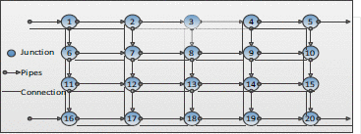

Slide 5
Main factors affecting our algorithm
Weather
Broken Pipes

Slide 6
Broken pipes: detection
We propose the following for detection of broken pipes based on inputs from sensors:
The system combines signal processing techniques and AI software to identify telltale signs of leaks carried via sound in sewage pipes.
The acoustic signatures are recorded by hydrophone sensors that can be easily and inexpensively installed in existing sewage pipes without excavation or taking them out of service.

Slide 7
Broken pipes: FIX
Whenever we get detection of a leaked or broken pipe we will get informed from our sensors and then in our main algorithm of path detection of water flow we will mark that path so that our algorithm for flow of water will not allow flow through that paths.

Slide 8
Weather: Forecast
We will modify our algorithm for the flow of water through sewage pipes based on the weather forecast data we fetch.
For example, if our weather forecast predicts bad weather or say arrival of stormy weather then based on this, our algorithm will send signals to open valves to provide path for large amount of water to flow through, preventing any kind of blockage.

Slide 9
Weather: toggling valves
We will predict the weather at our server end and based on that we will open valves of certain locations by sending command to our IOT enabled actuators present at the valves which will then let water pass through larger area.
Also we will use the GPS sensors at various pipe junctions so that we can sense signals to toggle valves based on weather forecast of a particular location and take decision for a specific valve accordingly.

Slide 10
Machine learning model for rerouting algorithm
MLP Regressor
Sensor Implementation

Slide 11
REROUTING: iOT Sensors
Sensors have been installed at each junction point of the city’s pipe network.
Each sensor relays the volume flowing through it every five minutes to the server.
Wi-Fi connections are assumed to be present throughout the entire city.
ESP32: Microcontroller for valve control and Wi-Fi
Water Level Sensor

Slide 12
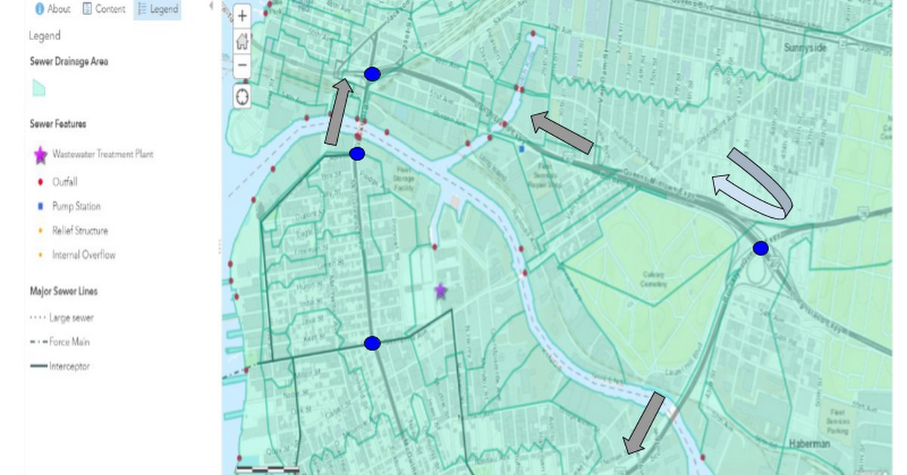
Source: ARCGIS

Slide 13
REROUTING: Ml - INPUT DATA
Each junction point of the city’s pipe network uses a MLP (Multi Layer Perceptron) regressor to decide amount of water flowing the pipes.
The training data for this ML model is obtained from the sensors that were installed earlier. We can track real data for a year, after which we can perform data augmentation and data synthesis to produce extra data for a total of approximately 10000 rows.
Note that we will generate and track data that does not produce an overflow in our pipe systems, thereby we are ensuring that our ML model will give a prediction such that there is no overflow.

Slide 14

REROUTING: Ml - Specs
Count of regressors used = count of junctions in network = 1000 (estimated).
MLP regressor:
parameters: solver: lbfgs, hidden_layer_sizes: (5, 2), activation: relu
hyperparameters decided by random trials.
Estimated training time for one neural network: 100 seconds, given we have 10000 rows of data.
Our training complexity is roughly $O(1000 \text{nodes} × \text{training} \text{time} \text{per} \text{node})$.
Our model trains well within a day on a decent GPU cluster.

Slide 15
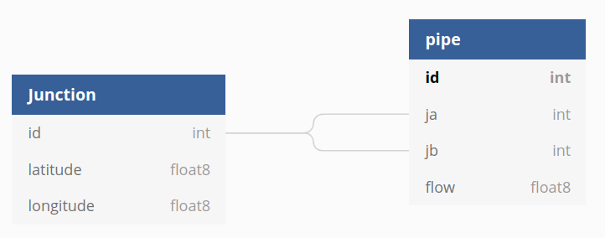
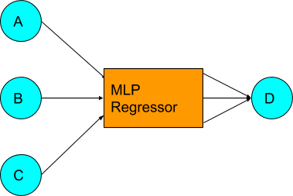
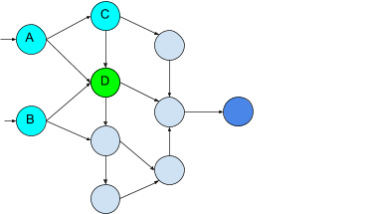

Slide 16
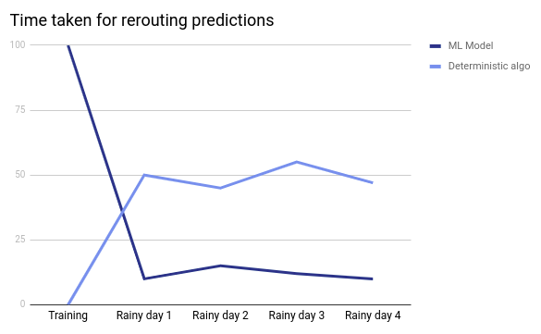

Slide 17

REROUTING: Comparison
Deterministic algorithms such as Ford Fulkerson algorithm have a time complexity of $O(V^{2}E)$, which approximates to $O(V^{4})$ in a decently dense network.
Such a model will take roughly 2-3 hours to run on a decent machine.
Note that the ML model takes a bit more time than the deterministic algorithm.
The ML model is better as once it has been trained, it can be used as many times as we want to provide reasonably good estimates for the network flow. On the other hand, the deterministic algorithm needs to be rerun every single time.

Slide 18



Slide 19
An issue which arises is the blockage of drains due to solid waste.
The solution we present for solving this problem is Automatic Drainage Cleaning

Slide 20
Automatic Drainage Cleaning
The idea is to use a transfer belt driven by a solar powered motor.
The transfer belt is placed inside the drain and the waste collecting bin is placed above the drain.
There are different sized teeth like structures to filter out waste of different sizes.

Slide 21
Automatic Drainage Cleaning
The setup is placed against the water flow. The teeth filter out the waste and dump it into the waste collecting bin.
A microcontroller (e.g. Arduino) can be used to minimize battery consumption by adjusting the speed of rotation according to the amount of waste getting collected and keeping the system idle for around 10-15 minutes followed by 5 mins of uptime.

Slide 22
Main reason for overflow of drainage during Heavy Rains
Under-capacity of drains in terms of the amount of downpour.

Slide 23
Our solution
Add a motor in each of the main trunk sewers to increase volume flow rate of water which will prevent overflowing of drains.

Slide 25
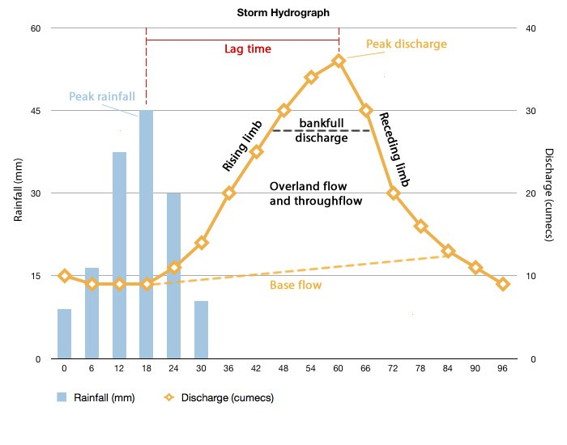

Slide 26
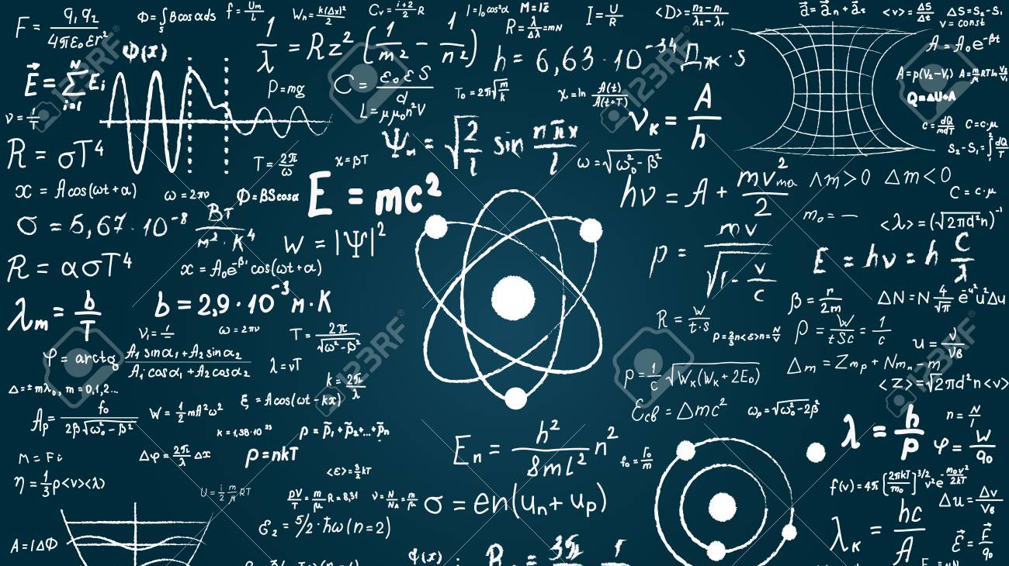
Power approximation
Considering case of Secunderabad,
Highest rainfall recorded in Hyderabad: | 455 mm
Total area: | 64.5x10e6 sq.m
Assuming that actual ground area is one-fourth of the total area,
Total volume of water that needs to be drained: | 7336875 m^3
Considering 1 day,
Volume of water to be drained per minute: | 5095052.083 lpm
Power consumed by the motor: | 19115.82 hp
Pressure = 113.475 kPa (Assuming depth of tunnel to be 4ft)
Pump Efficiency = 75%
Drive Motor Efficiency = 90% (Calculated on: irrigation.wsu.edu)

Slide 27
COST approximation
Price per kWh in Hyderabad for industrial usage: (Source: tserc.gov.in) | ₹ 6.7
Total cost: | ₹ 0.5730376.124 cr
Assuming number of days with storms to be: | 30
Total Cost: | ₹ 17.19112837 cr (ANNUAL)
Approximate cost of one motor (after comparing with similar power machines): | ₹ 25 cr
Number of motors required: | 10
Total cost of purchasing and installation of motors: | ₹ 250 cr (ONE TIME)
Budget alloted by GHMC for Storm Water Drains (2015-16): (Source: ghmc.gov.in) | ₹ 200 cr
Assumed inflation of prices (in %): | 1.15
Budget alloted by GHMC for Storm Water Drains (2019-20): | ₹ 349.80125 cr (ANNUAL)

Slide 28
Thank You!

