Slide 1


Slide 2
For a non-ideal system, where the molar latent heat is no longer constant and where there is a substantial heat of mixing, the calculations become much more tedious.
For binary mixtures of this kind a graphical model has been developed by RUHEMANN, PONCHON, and SAVARIT, based on the use of an enthalpy-composition chart.
It is necessary to construct an enthalpy-composition diagram for particular binary system over a temperature range covering the two-phase vapor-liquid region at the pressure of the distillation.

Slide 3
The following data are needed:
Heat capacity as a function of temperature, composition and pressure.
Heat of mixing and dilution as a function of temperature and composition.
Latent heats of vaporization as a function of composition and pressure or temperature.
Bubble-point temperature as a function of composition and pressure.

Slide 4
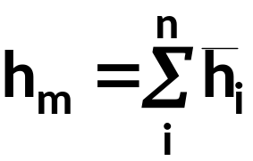
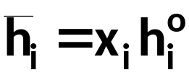
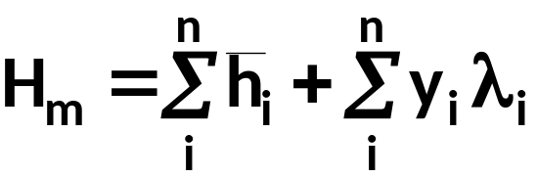
Enthalpy of liquid:
(1)
In “regular” / ideal mixtures:
(2)
For gaseous / vapor mixtures at normal T and P:
(3)

Slide 5
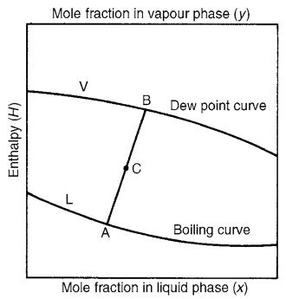
Enthalpy-composition diagram

Slide 6



The equations used to calculate enthalpy of liquid and vapor are:
(3)
(4)
(5)
(6)

Slide 7
EXAMPLE 2
Devise an enthalpy-concentration diagram for the heptane-ethyl benzene system at 760 mm Hg, using the pure liquid at 0°C as the reference state and assuming zero heat of mixing.
SOLUTION
 | heptane | ethyl benzene
TB (°C) | 136.2 | 98.5
C_{P} (cal/mole K) | 51.9 | 43.4
λ (cal/mole) | 7575 | 8600

Slide 8
t, °C | x_{H} | y_{H} | γ_{H} | γ_{EB}
136.2 | 0.000 | 0.000 | -- | 1.00
129.5 | 0.080 | 0.233 | 1.23 | 1.00
122.9 | 0.185 | 0.428 | 1.19 | 1.02
119.7 | 0.251 | 0.514 | 1.14 | 1.03
116.0 | 0.335 | 0.608 | 1.12 | 1.05
110.8 | 0.487 | 0.729 | 1.06 | 1.09
106.2 | 0.651 | 0.834 | 1.03 | 1.15
103.0 | 0.788 | 0.904 | 1.00 | 1.22
100.2 | 0.914 | 0.963 | 1.00 | 1.27
98.5 | 1.000 | 1.000 | 1.00 | --

Slide 9
t = 136.2°C
x_{H} = 0.0 x_{EB} = 1.0
= 0 + 1.0 (43.4) (136.2 – 0) + 0 = 5,911 cal/mole
λ_{mix} = x_{H} λ_{H} + x_{EB} λ_{EB} = 0 + 1.0 (8,600) = 8,600
H = h + λ_{mix} = 5,920 + 8,600 = 14,511 cal/mole

Slide 10
t = 129.5°C
x_{H} = 0.08 x_{EB} = 0.92
= 0.08 (51.9) (129.5) + 0.92 (43.4) (136.2)
= 5,708 cal/mole
λ_{mix} = x_{H} λ_{H} + x_{EB} λ_{EB} = 0.08 (7,575) + 0.92 (8,600) = 8,518
H = h + λ_{mix} = 5,708 + 8,518 = 14,226 cal/mole
The computations are continued until the last point where x_{H} = 1.0 and x_{EB} = 0.0

Slide 11
t, °C | x_{H} | h (cal/mole) | H (cal/mole)
136.2 | 0.000 | 5,911 | 14,511
129.5 | 0.080 | 5,708 | 14,226
122.9 | 0.185 | 5,527 | 13,937
119.7 | 0.251 | 5,450 | 13,793
116.0 | 0.335 | 5,365 | 13,621
110.8 | 0.487 | 5,267 | 13,368
106.2 | 0.651 | 5,197 | 13,129
103.0 | 0.788 | 5,160 | 12,952
100.2 | 0.914 | 5,127 | 12,790
98.5 | 1.000 | 5,112 | 12,687

Slide 12
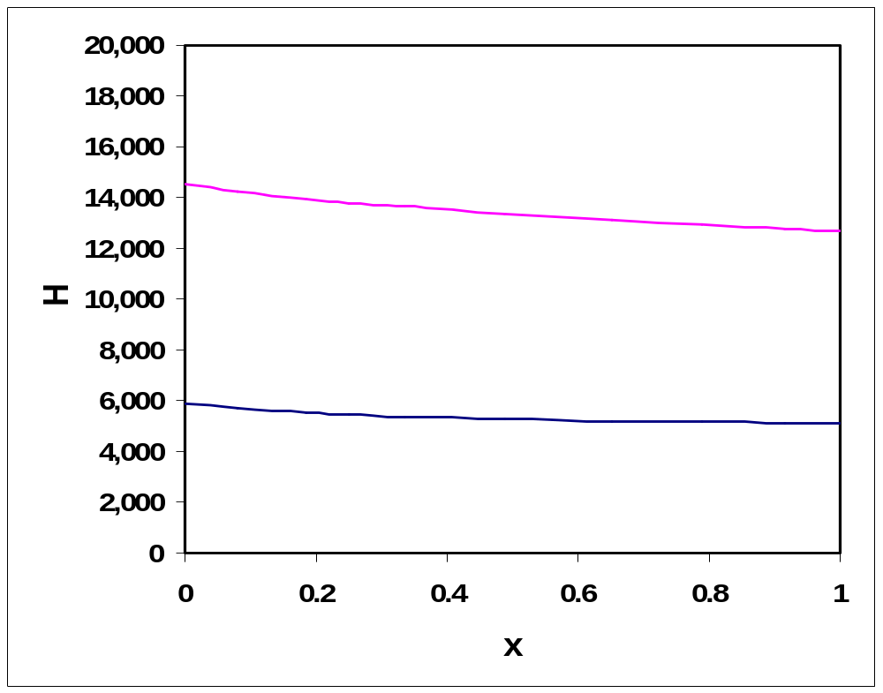
Vapor
Saturated vapor
2 Phase
Liquid
Saturated liquid

Slide 13
The enthalpy-concentration diagram may be used to evaluate graphically the enthalpy and composition of streams added or separated.
Over-all material balance:
V
F = V + L
(7)
Component material balance
F
q
F x_{F} = V y + L x
(8)
Enthalpy balance:
F h_{F} = V H + L h
(9)
L
Steady-state flow system with phase separation and heat added

Slide 14

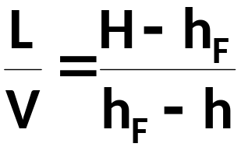
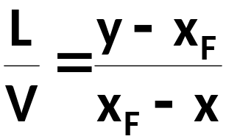
For adiabatic process, q = 0:
Substituting eq. (7) to (9) gives:
V (H – h_{F}) = L (h_{F} – h)
(10)
(11)
Substituting eq. (7) to (8) gives:
V (y – x_{F}) = L (x_{F} – x)
(12)
(13)

Slide 15
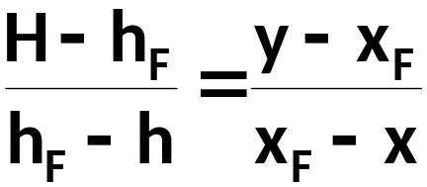
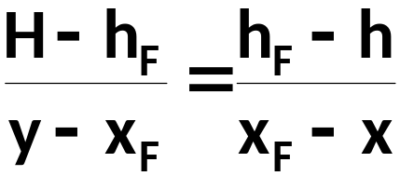
Substituting eq. (12) to (13) gives:
(14)
Eq. (14) can be rearranged:
(15)

Slide 16
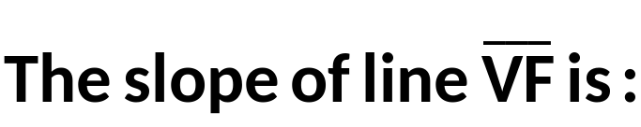
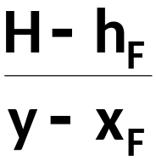
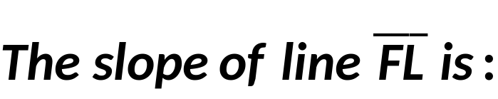
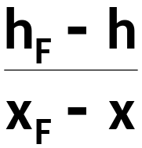
V
H
•
F
h_{F}
•
L
h
•
According to eq. (15), the slopes of both lines are the same.
x
x_{F}
y
Enthalpy-concentration lines – adiabatic, q = 0
Since both lines go through the same point (F), the lines lie on the same straight line.

Slide 17
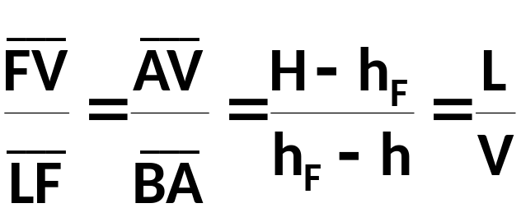
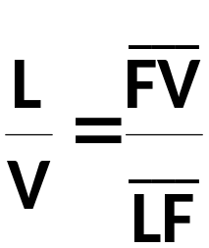
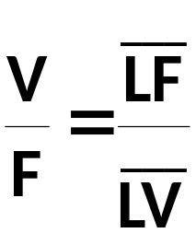
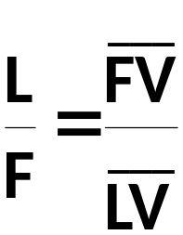
LEVER-ARM RULE PRINCIPLE
V
H
F
Consider triangle LBV
A
h_{F}
L
B
h
x
x_{F}
y
Similarly:

Slide 18
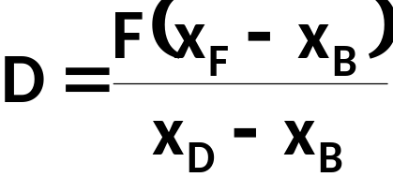

Over-all material balance:
V₁
q_{D}
F = D + B (16)
D, x_{D}, H^{L}_{D}
L₀
x₀
H^{L}₀
Component material balance:
F x_{F} = D x_{D} + B x_{B} (17)
F
x_{F}
H_{F}
F x_{F} = D x_{D} + (F – D) x_{B} (18)
(19)
q_{B}
Enthalpy balance:
B, x_{B}, H^{L}_{B}
(20)

Slide 19
TOTAL CONDENSER
A
q_{D}
Material balance around condenser:
V₁ = L₀ + D
(21)
V₁
D
x_{D}
L₀
Component material balance:
V₁ y₁ = L₀ x₀ + D x₀
(22)
L₁
Enthalpy balance:
q_{D} + V₁ H₁ = L₀ h₀ + D h_{D}
(23)

Slide 20
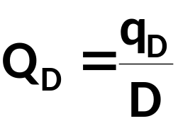
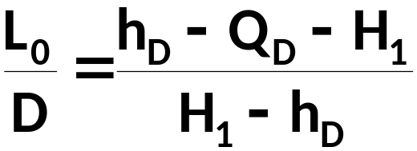
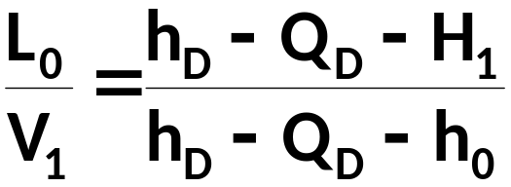
Designating:
V₁ H₁ = L₀ h₀ + D (h_{D} – Q_{D})
(24)
Combining eqs. (21) and (24):
(25)
Internal reflux is shown as:
(26)

Slide 21
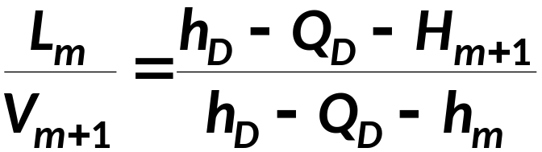
A
q_{D}
Internal reflux between each plate, until a point in the column is reached where a stream is added or removed, can be shown as:
D
x_{D}
L₀
L_{m}
m
V_{m+1}
(27)

Slide 22
(h_{D} – Q_{D}), x_{D}
•
h_{D} – Q_{D} – H₁
H₁
•
H or h
V₁
H₁ – h_{D}
h₀, h_{D}
•
L₀, D
y₁, x₀, x_{D}

Slide 23

PARTIAL CONDENSER
D, y_{D}
Material balance:
A
q_{D}
V₁ = L₀ + D
(28)
Component material balance:
v₁
L₀
y₁ V₁ = x₀ L₀ + y_{D} D
(29)
v₂
Enthalpy balance:
L₁
v₃
q_{D} + V₁ H₁ = L₀ h₀ + D H_{D}
L₂
(30)
Designating:
v_{F}
F
x_{F}
L_{F-1}
V₁ H₁ = L₀ h₀ + D (h_{D} – Q_{D})
(31)

Slide 24

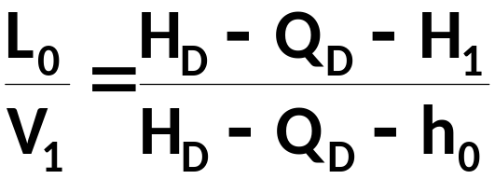
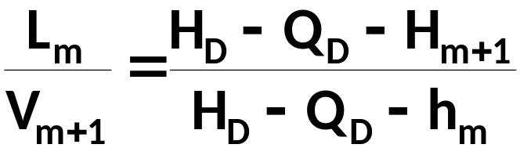
Combining eqs. (28) and (30):
(32)
Internal reflux is shown as:
(33)
Internal reflux between each plate, until a point in the column is reached where a stream is added or removed, can be shown as:
(34)

Slide 25
(H_{D} – Q_{D}), y_{D}
•
H_{D} – Q_{D} – H₁
V₁
D
•
•
H_{D}, y_{D}
H or h
H₁ – h₀
•
h₀, x₀
y₁, x₀, y_{D}

Slide 26
RECTIFYING SECTION
The material balance equation maybe rearranged in the from of difference:
q_{D}
V₁
D
x_{D}
L₀
L₀ – V₁ = L₁ – V₂ = L₂ – V₃
= . . . . = L_{m} – V_{m+1}
= – D = Δ
V₂
L₁
V₃
Δ
L₂
L₀ – V₁ = – D = Δ
(35)
n
V_{n+1}
L_{n}

Slide 27
For the component material balance:
L₀ x₀ – V₁ y₁ = L₁ x₁ – V₂ y₂
= L₂ x₂ – V₃ y₃ = . . . .
= L_{m} x_{m} – V_{m+1} y_{m+1}
= – D x_{D} = Δ x_{Δ}
L₀ x₀ – V₁ y₁ = – D x_{D} = Δ x_{Δ}
(36)
Combining eqs. (35) and (36):
x_{D} = x_{Δ}
(37)

Slide 28
For the enthalpy balance:
L₀ h₀ – V₁ H₁ = L₁ h₁ –V₂ H₂ = L₂ h₂ –V₃ H₃ = . . . .
= L_{m} h_{m} – V_{m+1} H_{m+1} = – D (h_{D} – Q_{D}) = Δ h_{Δ}
(38)
Combining eqs. (23) and (35):
h_{Δ} = h_{D} – Q_{D}
(39)
These 3 independent equations [eqs. (35), (36), and (37)] can be written for rectifying section of the column between each plate.
On the enthalpy scale and on the composition scale, the differences in enthalpy and in composition always pass through the same point, Δ ([x_{D}, (h_{D} – Q_{D})]
This is designated as point Δ, the difference point, and all lines corresponding to the combined material and enthalpy balance equations (operating line equations) for the rectifying section of the column pass through this intersection.

Slide 29
PLATE-TO-PLATE GRAPHICAL PROCEDURE FOR DETERMINING THE NUMBER OF EQUILIBRIUM STAGES:
Use R, x_{D}, H_{D} or h_{D} to establish the location of point Δ with x_{Δ} = x_{D} and h_{Δ} = h_{D} – Q_{D} or h_{Δ} = H_{D} – Q_{D}
Use Equilibrium data alone to establish the point L₁ at (x₁, h₁). Since L₁ is assumed to be a saturated liquid, x₁ must lie on the saturated-liquid line.
Draw the operating line between L₁ and Δ. This line intersects the saturated-vapor line at V₂ (y₂, H₂).
Repeat steps 2 and 3 until the feed plate is reached.

Slide 30
•
Δ (x_{Δ}, h_{Δ})
V₄
V₃
V₂
V₁
H or h
D
L₂
L₁
L₃
x or y

Slide 31







STRIPPING SECTION
m
N
q_{B}
B
x_{B}

Slide 32



The material balance equation maybe rearranged in the from of difference:
(40)

Slide 33



For the component material balance:
(41)
Combining eqs. (40) and (42):
(42)

Slide 34



For the enthalpy balance:
(43)
Combining eqs. (40) and (43):
(44)

Slide 35
These 3 independent equations [eqs. (40), (41), and (43)] can be written for stripping section of the column between each plate.
On the enthalpy scale and on the composition scale, the differences in enthalpy and in composition always pass through the same point, [x_{B}, (h_{B} – Q_{B})].
This is designated as point , the difference point, and all lines corresponding to the combined material and enthalpy balance equations (operating line equations) for the stripping section of the column pass through this intersection.

Slide 36

Q_{B} is usually not known. It can be derived from over-all material balance:
F = D + B
(45)
Combining eq. (45) with eqs. (35) and (40) gives:
(46)
Equation (46) implies that lies on the extension of the straight line passing through F and Δ.

Slide 37


PLATE-TO-PLATE GRAPHICAL PROCEDURE FOR DETERMINING THE NUMBER OF EQUILIBRIUM STAGES:
Draw a straight line passing through F and Δ.
Draw a vertical straight line at x_{B} all the way down until it intersects the extension of line FΔ in
Assuming the reboiler to be an equilibrium stage, the vapor V_{M+1} is in equilibrium with the bottom stream.
Use equilibrium data alone to establish the value of y_{m+1} on the saturated-vapor line.
Draw the operating line between L_{m}(x_{m}, h_{m}) and V_{M+1}. This line intersects the saturated-liquid line at
Repeat steps 4 and 5 until the feed plate is reached.

Slide 38




h_{B}
L_{M}
L_{M-1}
H or h
x or y
•

Slide 39
TOTAL COLUMN
The construction may start from either side of the diagram, indicating either the condition at the top or the bottom of the column.
Proceed as explained in previous slides.
In either case, when an equilibrium tie line crosses the line connecting the difference points through the feed condition, the other difference point is used to complete the construction.
V₁
q_{D}
D
L₀
Δ
F
q_{B}
B

Slide 40
Δ
H or h
2
1
9
8
7
6
5
4
3
•
F
x_{F}
x_{D}
x_{B}

Slide 41
V₁
L₁
H or h
y₁
x₁

Slide 42
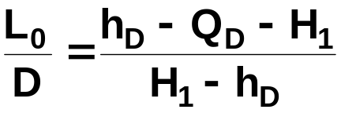
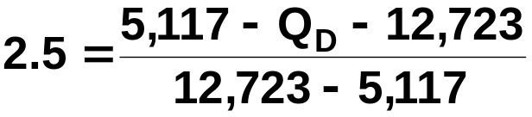
EXAMPLE 3
Using the enthalpy-concentration diagram from Example 2, determine the following for the conditions in Example 1, assuming a saturated liquid feed.
The number of theoretical stages for an operating reflux ratio of R = L₀/D = 2.5
Minimum reflux ratio L₀/D.
Minimum equilibrium stages at total reflux.
Condenser duty feeding 10,000 lb of feed/hr, Btu/hr.
Reboiler duty, Btu/hr.
SOLUTION
(a)
From the graph: h_{D} = h₀ = 5,117 cal/mole
H₁ = 12,723 cal/mole
Q_{D} = – 26,621 cal/mole

Slide 43
The coordinate of point Δ is:
x_{Δ} = x_{D} = 0.97
h_{Δ} = h_{D} – Q_{D} = 5,117 – (– 26,621) = 31,738 cal/mole
Draw a straight line passing through Δ and F.
Extend the line until it intersects a vertical line passing through x_{B}, at
Draw operating lines and equilibrium lines in the whole column using the method explained in the previous slides.
Number of stages = 11

Slide 44
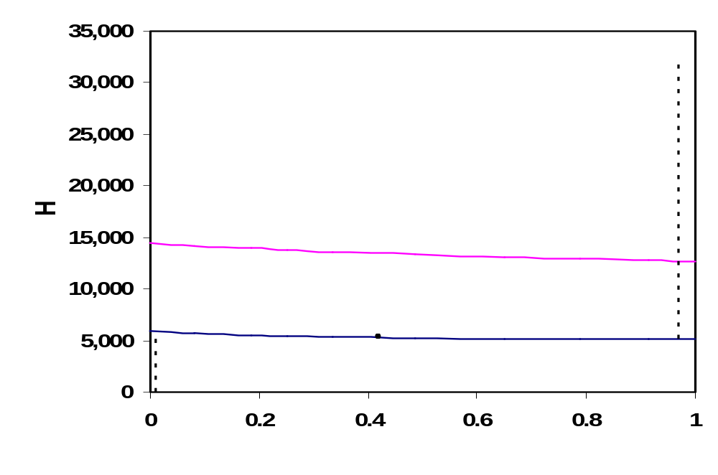
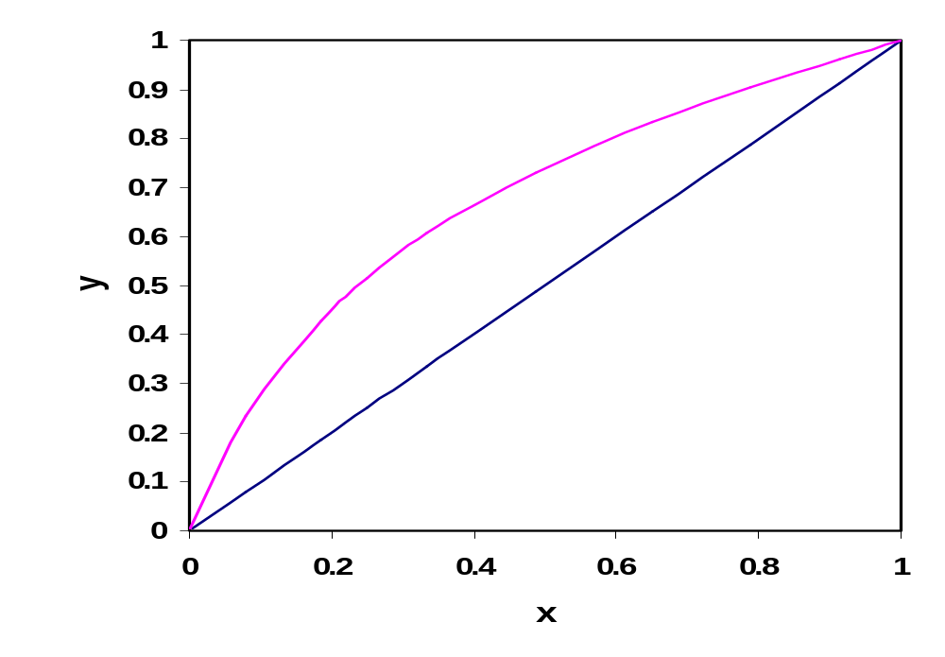

Δ
F

Slide 45
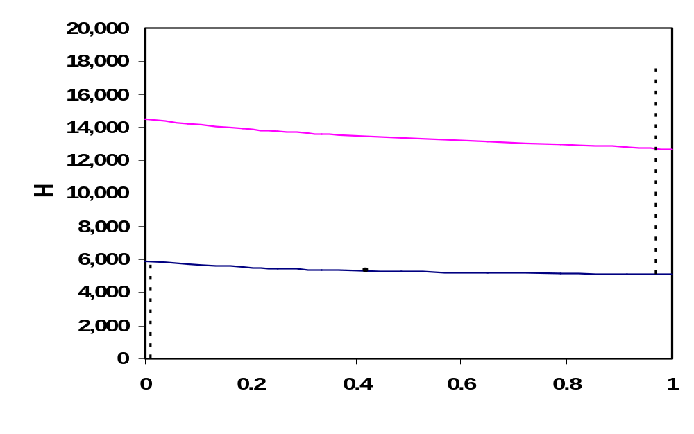
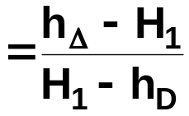
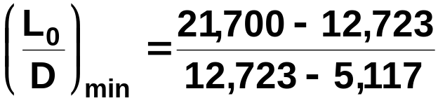
Δ = 21,700 cal/mole
(b)
F
= 1.18

Slide 46
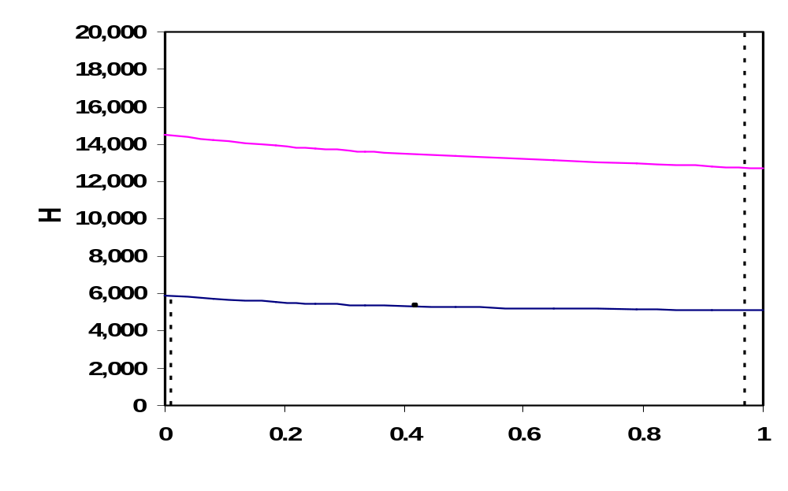
(c)
7
6
5
4
3
2
1
F
N = 7

Slide 47
(d)
h_{D} – Q_{D} = h_{Δ} = 31,738 cal/mole
h_{D} = 5,117 cal/mole
Q_{D} = – 26,621 cal/mole
= – 1,981,843 Btu/hr
(e)
h_{B} – Q_{B} = – 14,350 cal/mole
h_{B} = 5,886 cal/mole
Q_{B} = 14,350 + 5,886 = 20,236 cal/mole
= 2,631,751 cal/mole

