Slide 1

Project Domain – Game Theory
Project Title
Game Theory Using Coordinate System In Java

Slide 2
Group 12 – The Fab 5
NAME | ROLL NUMBER
Prasham Mehta Vatsal Barai | AU2040102 AU2040099
Akshat Shah | AU2040052
Razin Karimi | AU2040230
Manav Yagnik | AU2040040
The Fab 5

Slide 3
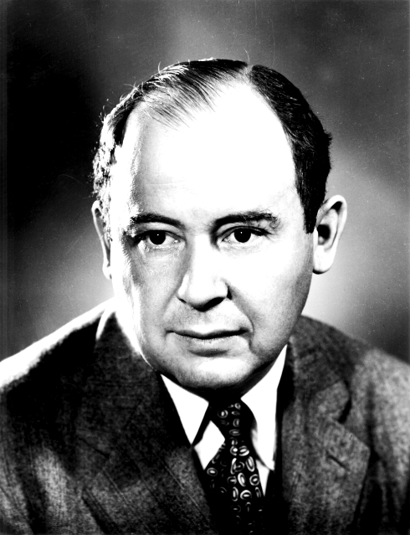
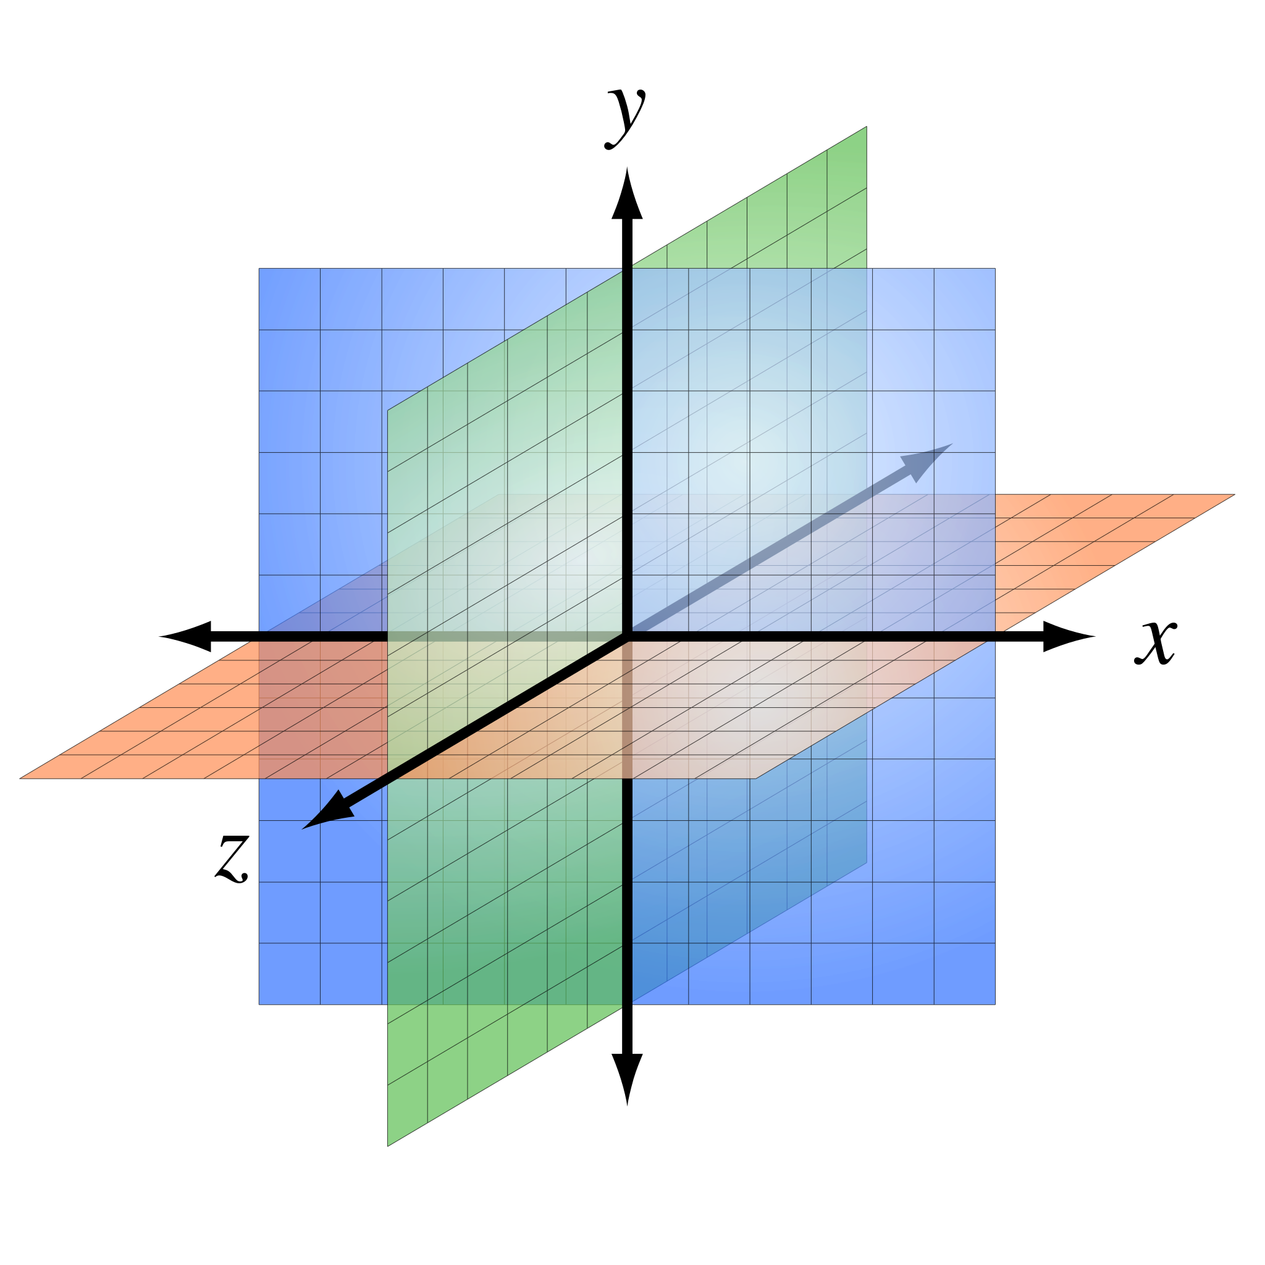
Background
Game theory is largely attributed to the work of mathematician John von Neumann and economist Oskar Morgenstern in the 1940s and was developed extensively by many other researchers and scholars in the 1950s. It remains an area of active research and applied science to this day.
We will use concepts of linear algebra like vector space, coordinate systems, and 3D geometry.
We will use the coordinate system for locating the trajectory of the ball. We will treat the lower-left corner of the screen as the origin(0,0) of our coordinate system, with x increasing towards the right and y increasing as we move towards the top of the screen. So we can represent the ball’s position by the coordinate pair(x,y).
The Fab 5

Slide 4

The main motive of the player(user) in this game is to hit the maximum number of balls. So the concept of “ Best Possible Case” and “Worst Case” of hitting the balls in the programming is also applied. Players also have an option of collecting some of the checkpoints and power ups in the game (after a certain interval of time), which boosts the balls to hit hard and return slower. Players may collect such points and improve the amount of progress in the game. Players can collect the virtual coins as they play more and more games and it may give them some perks in clearing various levels of the game. Hence, it eventually makes the game interesting.
The Fab 5

Slide 5

Literature Survey
As game theory is wide topic and one can find many interesting and innovative games.
This project will employ unique technologies to build the mathematical model of the computer code that is also suitable in more advanced applications.
In addition, the project is in Java will be developed to reduce time consumption and make it more efficient. Furthermore, libraries used in this project to build the GUI of the game.
The Fab 5

Slide 6
Problem Statement
In today’s world, games are played on computers, and some of the most attractive, engaging games are bouncing balls. In these, the ball/s is/are shot on the targets above. The target is to break as many balls as we can before they come down. So for these real-life problems, we are going to use vector space and 2d geometry.
The Fab 5

Slide 7

We came across many games but Bouncing Ball was such a game which we had played once in childhood but now came to know concept behind the seen.
We discover that the vector spaces, vectors, coordinate geometry associated with the ball’s trajectory and rebounding of the ball
The concepts of linear algebra used in a game which we played in the childhood is surely interesting to learn and exciting to work
The Fab 5

Slide 8
Reproduced Work
We have take the work of Amazon AppStore where they have put their code of Bouncing Ball.
We will put the end line or say boundary line and from these the ball will be get shoot.
We will be modifying the code and add some fun elements such as if some ball burst then the ball will get big.
We will also introduce the infinite arcade in which until any ball touches the boundary line then the game is over.
The Fab 5

Slide 9
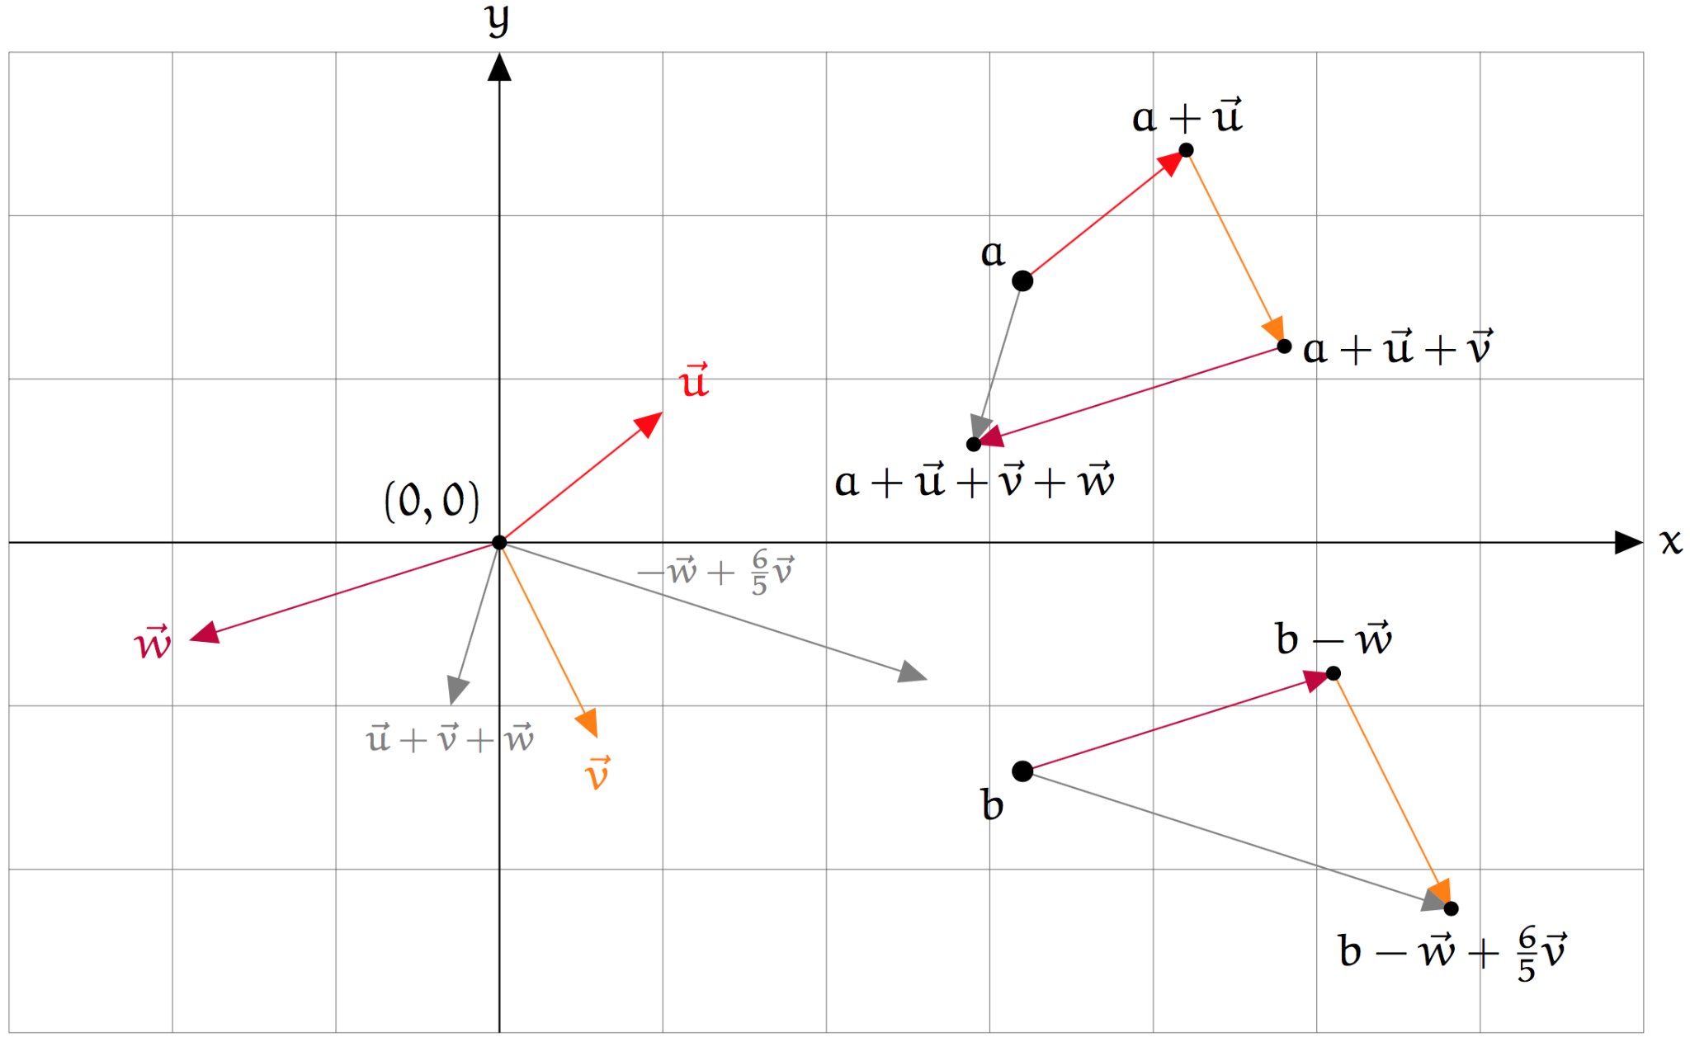
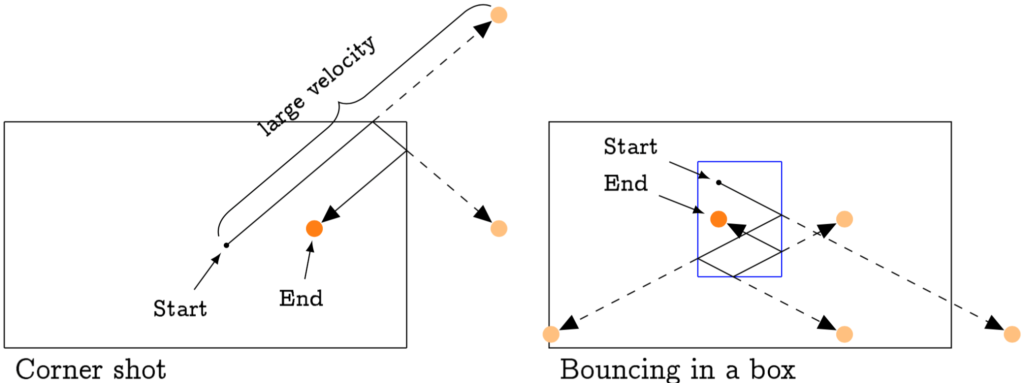
The Fab 5

Slide 10
Contribution
Prasham Mehta : Your Result, Problem Statement
Vatsal Barai : Brief Introduction,Action Plan, Motivation(work).
Razin Karimi : Background, Problem Statement, Editing
Akshat Shah : Plan Of Action, Title Slide, Literature Survey.
5. Yagnik Manav : Your Result, References.

Slide 11
To start game you first need to run code then press an arrow key.
Ball will be of RGB color and it will bounce on when it comes closer to paddle or
Bricks.
Every time when it comes closer to bricks that particular brick will get removed
And score will increase by 5.
If ball reaches y coordinate higher than paddle then game will get over you will lose the game
Every time no of bricks will be different so its depend on your luck whether you will get hard game or easy game.

Slide 12
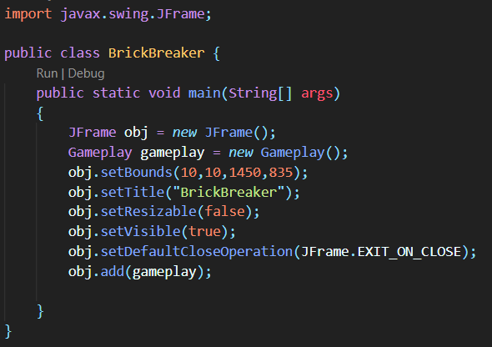
This Code will run the game.

Slide 13
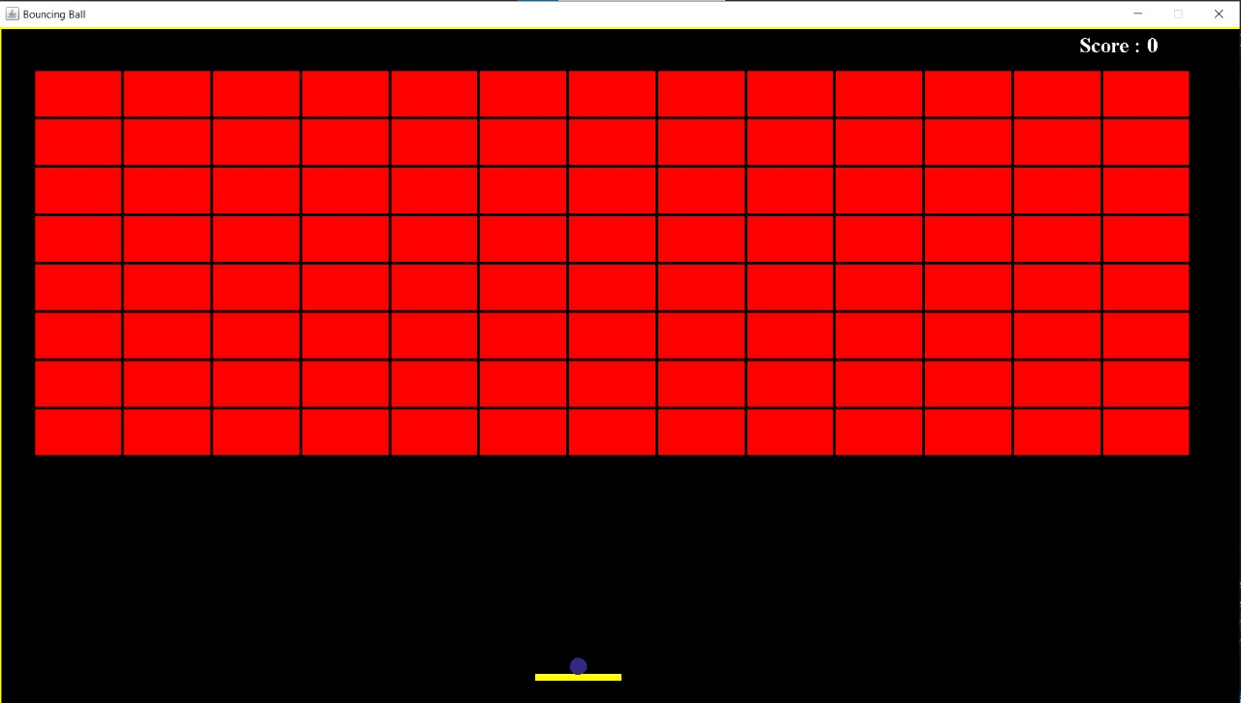

Slide 14
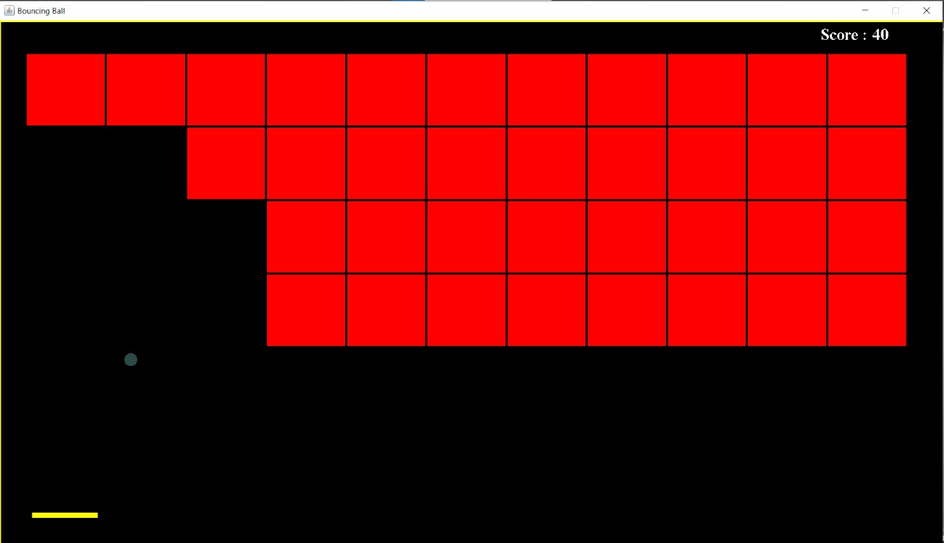

Slide 15
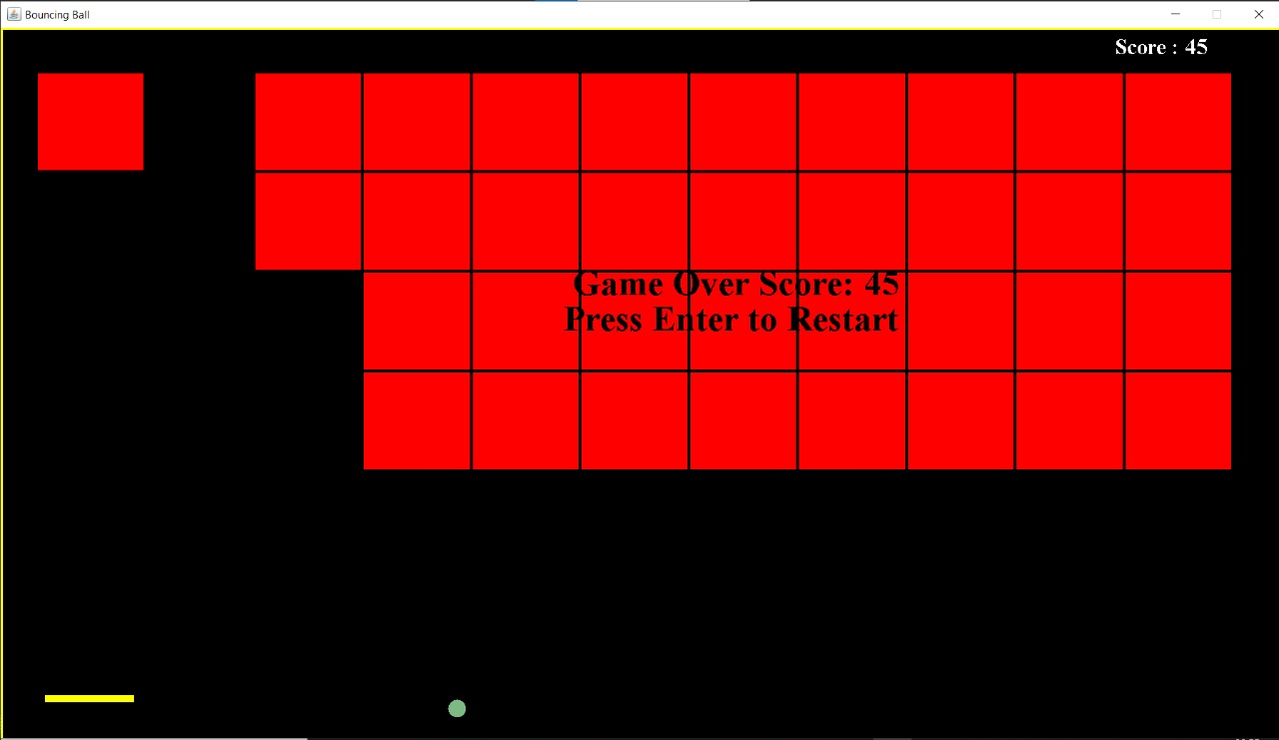

Slide 16
Plan Of Action
We are planning to do some interesting things so gamers have more interested to play games like we will introduce levels, bonus points level, powerups,ball themes and many more things.
Will use many libraries to make game’s GUI more interesting for gamer. So they will love to play game and playing games can be a great stress reliever.
We can use the concept of Data Structure and Algorithms of Worst Case and Best Possible Case of targeting the balls and also to find the time complexity .
The Fab 5

Slide 17
References
https://en.wikipedia.org/wiki/Game_theory#Game_types
https://www.geeksforgeeks.org/game-theory/
https://www.geeksforgeeks.org/python-catching-the-ball-game/
https://developer.amazon.com/blogs/appstore/post/a07ab562-0609-4519-a2ba-9b15d69ea62b/introduction-to-game-math-raw-and-cooked
The Fab 5

Slide 18
Thank
You

Slide 19
Mathematical Model
We used Matrix system in our code to generate and arrange the bricks.
We also used Coordinate system in our code
First we put the ball at a fixed position using coordinate system
We have also used coordinate system in an if loop i.e. if the ball goes below a certain coordinate in the Y-axis, the game will get over.
If coordinates of balls are nearly equal to coordinates of fixed brick
then the brick will get deleted score of game will
increase

