Slide 1
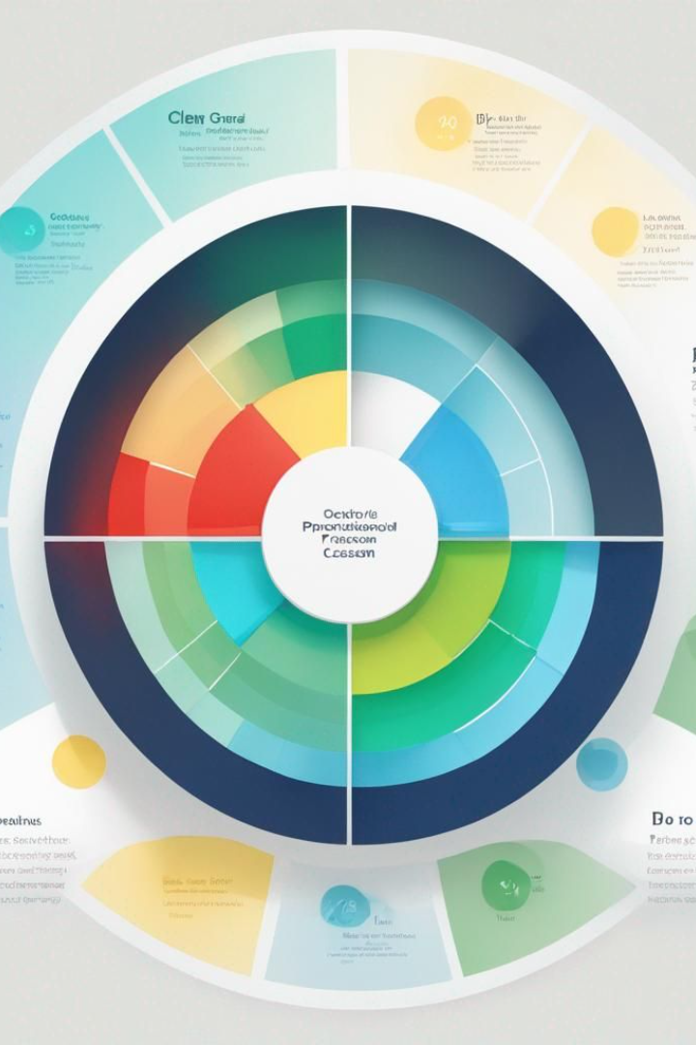


Sentiment Analysis Overview
Our comprehensive Sentiment Analysis reveals the diverse experiences of our customers. It provides valuable insights into their perceptions and satisfaction levels across various touchpoints.
by Akshat Upadhyay

Slide 2
Sentiment Analysis
52%
22%
26%
Negative Sentiment
Neutral Experience
Positive Sentiment
Approximately 52% of the people have had a negative or very negative sentiment.
Around 22% of the people had a neutral experience.
Only about 26% of the total callers had a positive or a very positive experience.
Findings: The percentage-wise distribution of the sentiments of customer remains almost the same irrespective of the reason for contact or the channel of communication.

Slide 3
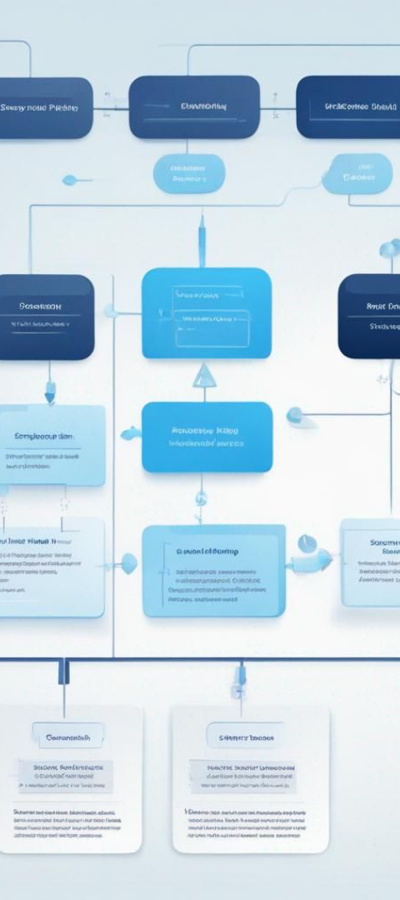
Root Cause Analysis
From the data it can be concluded that most number of contacts made via any means of communication of customer care is done because of the problems/doubts faced by the customers related to billing.
1
Proactive Billing Process
2
Step-by-Step Tutorial
Nile should proactively make their billing process easier to understand and navigate.
Introducing a tutorial for newcomers using their platform could help reduce contacts made due to billing issues.
Findings:
Issues related to Service Outage were handled through Chatbot, Email, and Web.
While Billing queries were handled by all channels.
Payment issues were addressed only through Call-Center.

Slide 4

Service Response Time Analysis
1
SLA Compliance
Approximately 87.5% of the issues are resolved within the Service Level Agreement (SLA) time frame.
2
Exceeding SLA
About 12.5% of the total number of issues are taking more time than the SLA to resolve.
Finding: The distribution of issues being handled Above SLA, Below SLA, or Within SLA remains almost constant irrespective of the reason for contact, channel of contact, or Call-Center to which the contact is forwarded.

Slide 5
Customer Segmentation: Communication Channel Preference
Call-Center
Chatbot
Email & Web
The most preferred communication channel is the Call-Center, indicating a strong desire for direct human interaction.
Following behind is the Chatbot, which offers a balance of convenience and quick responses.
Email and Web are also utilized, handled by customer service associates, highlighting the need for comprehensive training to improve the overall customer experience.
Findings: All payment-related queries were handled through Call-Center, while service outage issues were not addressed through this channel.

Slide 6
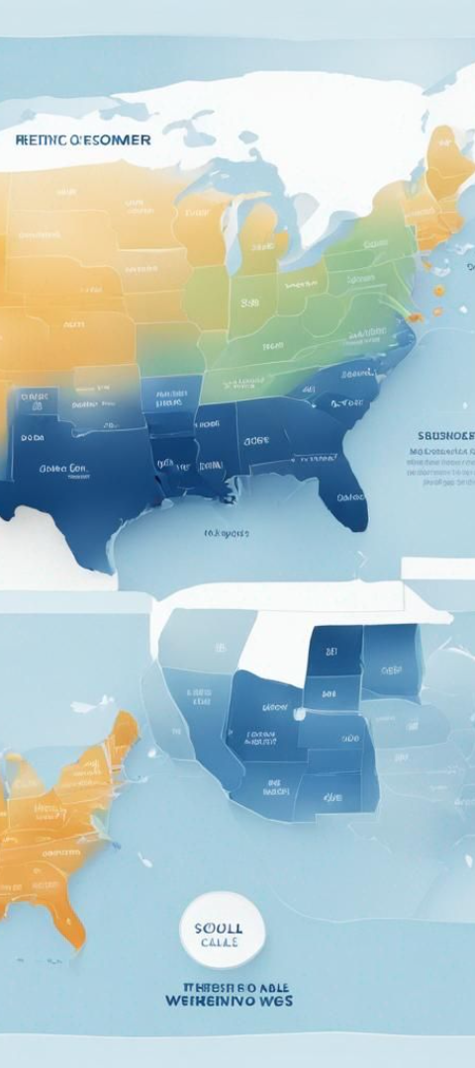


Customer Segmentation: Demographic Analysis
City-Based Segmentation
Segmentation based on the city is not very effective due to the overwhelming amount of data, making it difficult to derive actionable insights.
State-Based Segmentation
State-based segmentation provides a better macro picture, allowing us to focus on the top states from which calls originate and tailor solutions accordingly.
Beyond this, there is hardly anything that can be done, given the large amount of data to be processed.

Slide 7
Analysis to Identify Trends and Patterns
Baltimore & Los Angeles
1
Call centers in Baltimore and Los Angeles handle approximately 75% of the customer queries.
2
Chicago & Denver
Call centers in Chicago and Denver are advised to increase their capacity to handle more customer queries.
On the basis of this analysis we can say that the Call centers of Chicago and Denver need to -
3
Increase the number of Customer service associates to handle customer queries on call.
4
Once the above 2 steps(mentioned in point 3) are taken care of then more calls can be routed to them and their percentage in the queries handled can be increased.
Actively upgrade their servers that handle the customer queries related to email/chatbot/web.
We can note that all channels have an equal proportion of contacts to different call centers, suggesting balanced resource allocation.

