Slide 1

Optimal Product Price Analyzing System
SRM INSTITUTE OF SCIENCE AND TECHNOLOGY
SCHOOL OF COMPUTING
DEPARTMENT OF NETWORKING AND COMMUNICATIONS
18CSP109L - PROJECT
Review No -1
29 -01-2022
RA1811030010069 – AKSHAT GOEL
RA1811030010085 – SACHIN VERMA
Dr. S. Prabakeran, Assistant Professor
Department of Networking and Communications

Slide 2
Table of contents
Introduction – Problem statement
Objectives
Literature Survey
Architecture diagram
Diagrams
Algorithms used
Modules Description
50% implementation
Results and Discussion
References

Slide 3
Introduction
The Low-Cost Product Price Analyzing System is used to fetch the lowest price available of a product from the internet.
It involves the usage of modern technologies like web scrapping, Data Science and Data Analytics.
By applying the Low-Cost Product Price Analyzing System you’ll not only be able to tell the lowest price of a product but also be able to analyze the product data available on the internet.

Slide 4
Objectives
The main aim of Low-Cost Product Price Analyzing System is to find the optimal price of the product from Ecommerce websites like Amazon, Flipkart, Snapdeal, Paytm, Croma etc.
It comprehensively includes a variety of important techniques, such as analyzing, modeling, visualization and evaluating.
It has broad application prospects in areas such as price monitoring, news monitoring, trend recognition and lead generation.

Slide 5
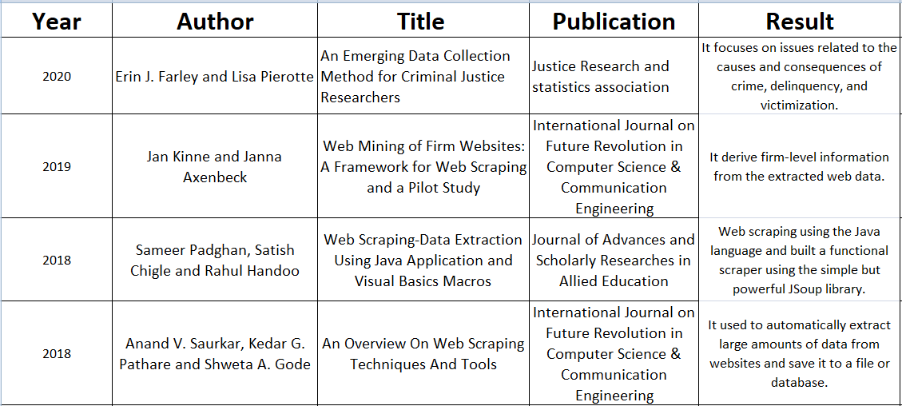
Literature Survey
Inference

Slide 6
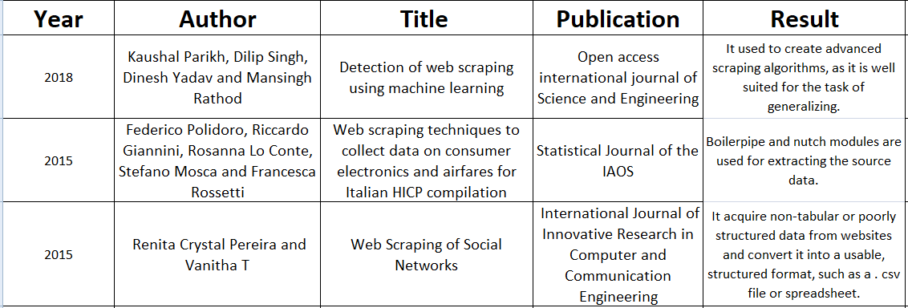
Literature Survey

Slide 7
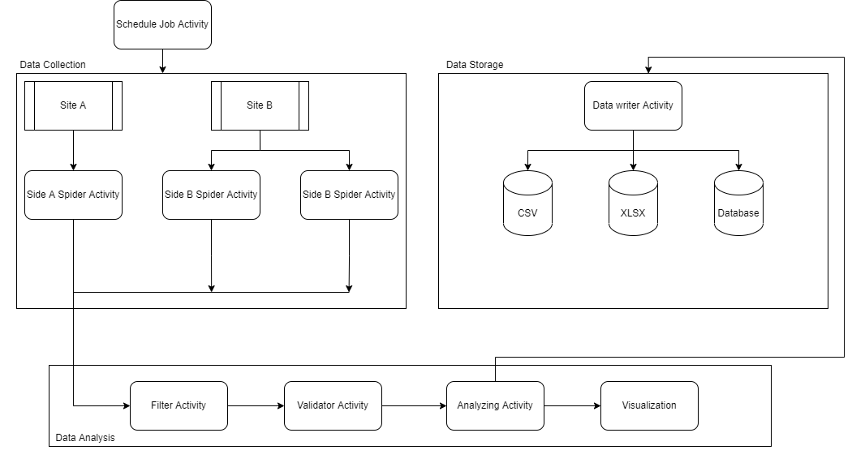
Architecture diagram

Slide 8
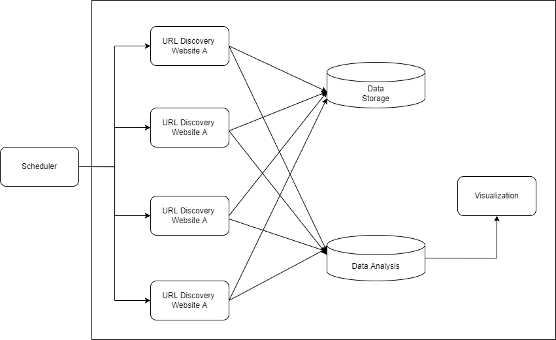
Diagram
Use Case Diagram

Slide 9
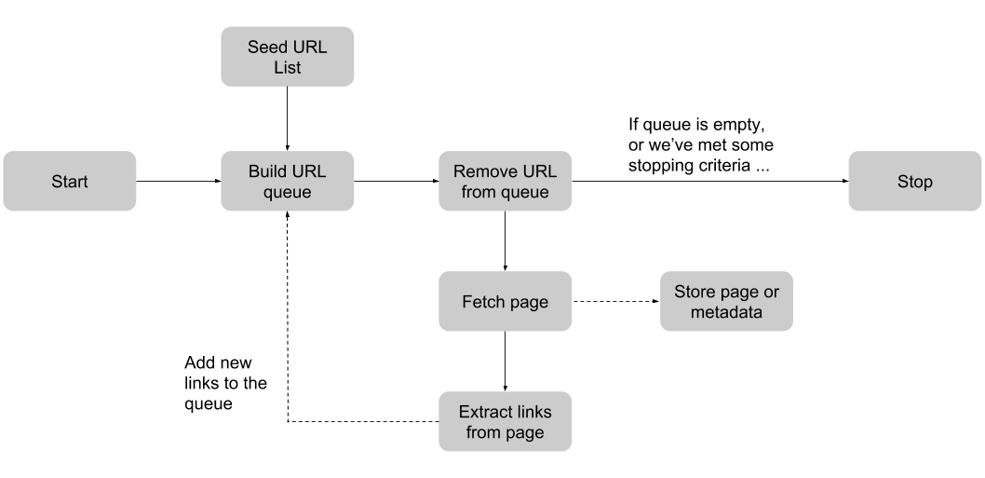
Diagram
Data Flow Diagram

Slide 10
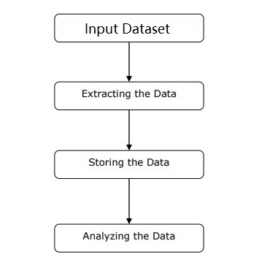
Algorithm
Product Price Analyzing System is a web automation system which is used to extract as well as analyze the optimal product price.
It is divided into 5 steps:-
- Basic Data
- Fetching Raw Data
- Appling Filter
- AVE of Data
- Data Concluder

Slide 11
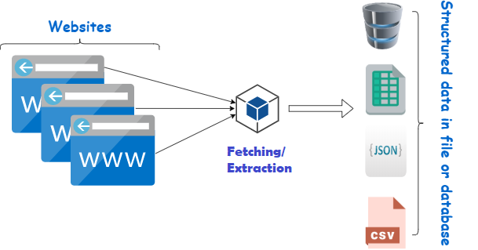
Algorithm
First, user need to collect the basic information such as product type, product name, websites on which product is available. This is one time process.
The next step is to collect raw data of the product, which is the structured web data from E-commerce websites such as Amazon, Flipkart etc.

Slide 12
Algorithm
The following steps are:-
Identify the target website.
Collect URLs of the pages where you want to extract data from.
Make a request to these URLs to get the HTML of the page.
Use locators to find the data in the HTML.
Save the data in a JSON or CSV file or some other structured format.
There are times when collected data may contains useless information, then we need to apply some filters to exclude those information.

Slide 13
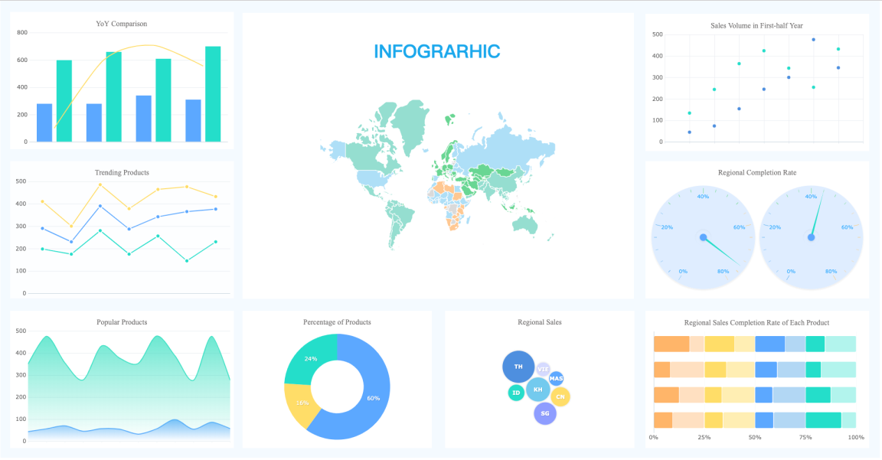
Algorithm
AVE of data includes Analyzing, Visualization and Evaluating of data which helps the end user to get optimal information in more refined manner. And also it help the strategist or data concluder to take further steps in optimizing the product.

Slide 14
Modules Description
The main modules that we use in Product Price Analyzing System :-
Info. Dataset– It the dataset of product items which are used to extract the raw information from the internet
URL Crawler– It is used to crawl the web pages of a domain to extract the URLs which are indexed on search engine.
XPath Locator– XPath Locator is to find the element in the webpage .
Firefox Webdriver– It is used to provide a link between test cases and the firefox browser. We use GeckoDrive in this case.
Analyzing Module – It help the user with complex mathematical operations on arrays and matrices.
VE Module – It provide graphical plotting functionality to the interpreted data.
Concluder – It helps the end user in concluding with output data and also help in formulating strategic decisions.

Slide 15
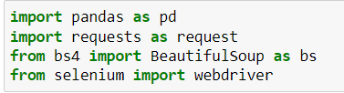
Implementation
Import Modules :-
Establishing connection with firefox :-
driver = webdriver.Firefox()

Slide 16
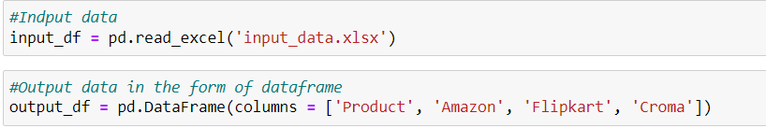
Implementation
Import Dataset :-
Identify the target website
Collect URLs of the pages where you want to extract data from
Make a request to these URLs to get the HTML of the page
Use locators to find the data in the HTML
Save the data in a JSON or CSV file or some other structured format
Input_data.xlsx is the dataset which we are using to extract data from the internet. Output_df is the dataframe which will store the filtered data.

Slide 17
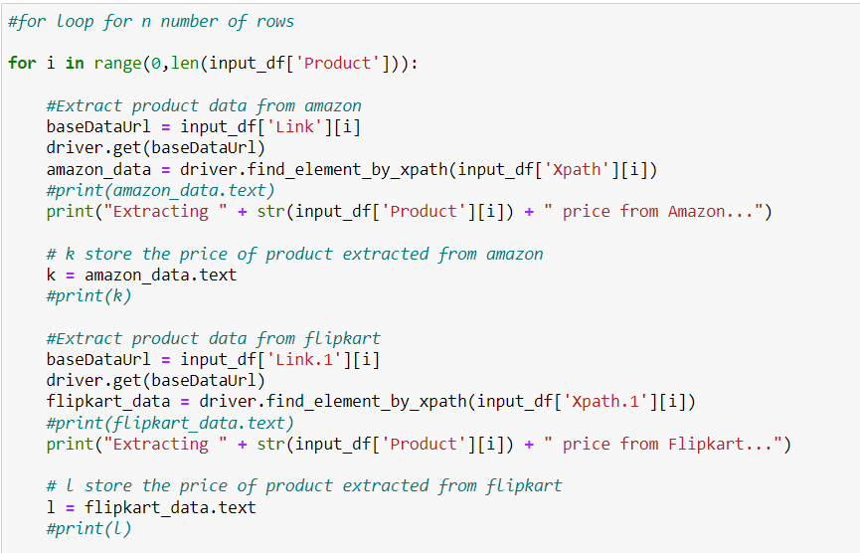
Implementation

Slide 18
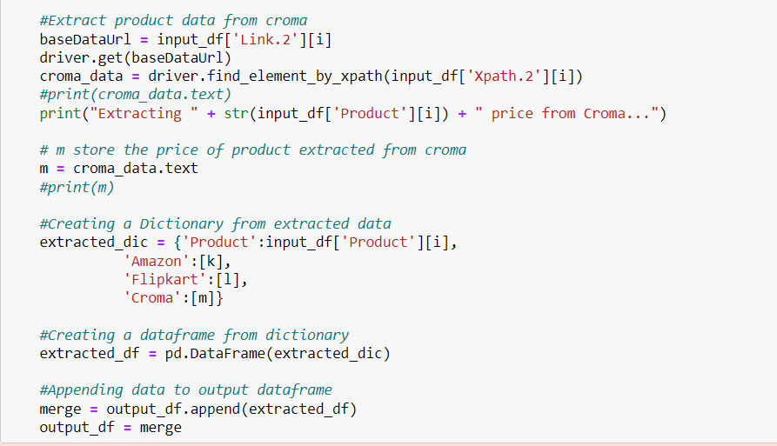
Implementation
Filtering/ Appending the raw data:-

Slide 19
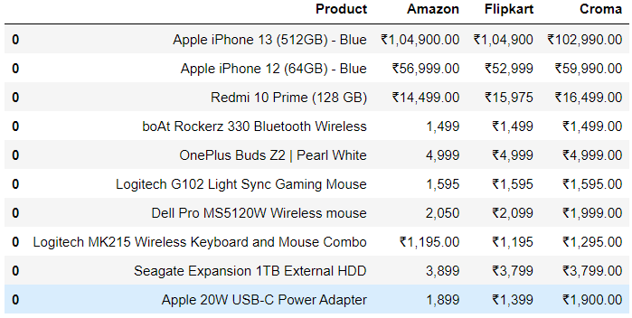
Results & Discussion
Output :-

Slide 20
References
Renita Crystal Pereira and Vanitha T, “Web Scraping of Social Networks,” International Journal of Innovative Research in Computer and Communication Engineering, pp. 237-240, Vol. 3, 2015.
Federico Polidoro, Riccardo Giannini, Rosanna Lo Conte, Stefano Mosca and Francesca Rossetti, “Web scraping techniques to collect data on consumer electronics and airfares for Italian HICP compilation,” Statistical Journal of the IAOS, pp. 165-176, 2015.
Kaushal Parikh, Dilip Singh, Dinesh Yadav and Mansingh Rathod, “Detection of web scraping using machine learning,” Open access international journal of Science and Engineering, pp.114-118, Vol. 3, 2018.
Anand V. Saurkar, Kedar G. Pathare and Shweta A. Gode, “An Overview On Web Scraping Techniques And Tools,” International Journal on Future Revolution in Computer Science & Communication Engineering, pp. 363-367, Vol. 4, 2018.
Sameer Padghan, Satish Chigle and Rahul Handoo, “Web Scraping-Data Extraction Using Java Application and Visual Basics Macros,” Journal of Advances and Scholarly Researches in Allied Education, pp. 691-695, Vol.15, 2018.
Jan Kinne and Janna Axenbeck, “Web Mining of Firm Websites: A Framework for Web Scraping and a Pilot Study for Germany,” 2019.
Erin J. Farley and Lisa Pierotte, “An Emerging Data Collection Method for Criminal Justice Researchers,” Justice Research and statistics association, pp. 1-9, 2020.

Slide 21
Thanks

