Slide 1

Optimal Product Price Analyzing System
SRM INSTITUTE OF SCIENCE AND TECHNOLOGY
SCHOOL OF COMPUTING
DEPARTMENT OF NETWORKING AND COMMUNICATIONS
18CSP109L - PROJECT
Review No -2
17 -03-2022
RA1811030010069 – AKSHAT GOEL
RA1811030010085 – SACHIN VERMA
Dr. S. Prabakeran, Assistant Professor
Department of Networking and Communications

Slide 2
Table of contents
Introduction – Problem statement
Objectives
Algorithms used
Modules Description
80% implementation
Results and Discussion
Screenshots

Slide 3
Introduction
The Optimal Product Price Analyzing System is used to fetch the lowest price available of a product from the internet.
It involves the usage of modern technologies like web scrapping, Data Science and Data Analytics.
By applying the Optimal Product Price Analyzing System you’ll not only be able to tell the lowest price of a product but also be able to analyze the product data available on the internet.

Slide 4
Objectives
The main aim of Optimal Product Price Analyzing System is to find the best price of the product from Ecommerce websites like Amazon, Flipkart etc.
It comprehensively includes a variety of important techniques, such as analyzing, modeling, visualization and evaluating.
It has broad application prospects in areas such as price monitoring, news monitoring, trend recognition and lead generation.

Slide 5
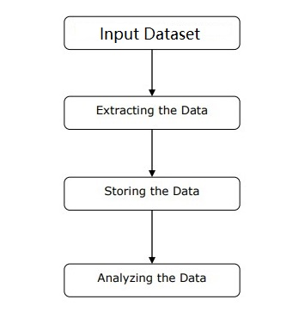
Algorithm
Product Price Analyzing System is a web automation system which is used to extract as well as analyze the optimal product price.
It is divided into 5 steps:-
- Basic Data
- Fetching Raw Data
- Appling Filter
- AVE of Data
- Data Concluder

Slide 6
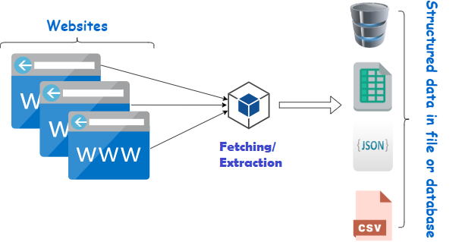
Algorithm
First, user need to collect the basic information such as product type, product name, websites on which product is available. This is one time process.
The next step is to collect raw data of the product, which is the structured web data from E-commerce websites such as Amazon, Flipkart etc.

Slide 7
Algorithm
The following steps are:-
Identify the target website.
Collect URLs of the pages where you want to extract data from.
Make a request to these URLs to get the HTML of the page.
Use locators to find the data in the HTML.
Save the data in a JSON or CSV file or some other structured format.
There are times when collected data may contains useless information, then we need to apply some filters to exclude those information.

Slide 8
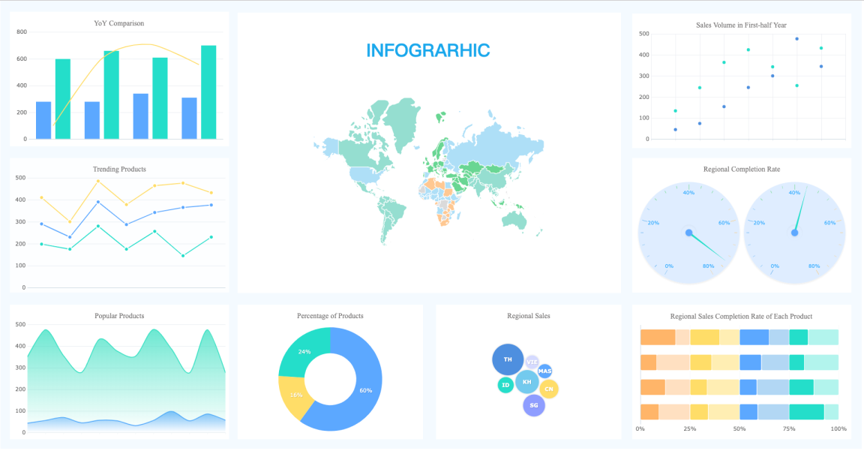
Algorithm
AVE of data includes Analyzing, Visualization and Evaluating of data which helps the end user to get optimal information in more refined manner. And also it help the strategist or data concluder to take further steps in optimizing the product.

Slide 9
Modules Description
The main modules that we use in Product Price Analyzing System :-
Info. Dataset– It the dataset of product items which are used to extract the raw information from the internet
URL Crawler– It is used to crawl the web pages of a domain to extract the URLs which are indexed on search engine.
XPath Locator– XPath Locator is to find the element in the webpage .
Exception Handler – This module is used to check whether the URL & Xpath is working or not.

Slide 10
Modules Description
Firefox Webdriver– It is used to provide a link between test cases and the firefox browser. We use GeckoDrive in this case.
Analyzing Module – It help the user with complex mathematical operations on arrays and matrices.
VE Module – It provide graphical plotting functionality to the interpreted data.
Concluder – It helps the end user in concluding with output data and also help in formulating strategic decisions.

Slide 11
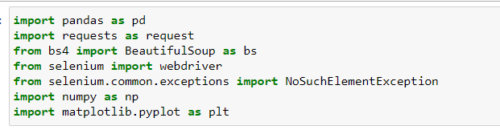
Implementation
Import Modules :-
Establishing connection with firefox :-
driver = webdriver.Firefox()

Slide 12
Implementation
Import Dataset :-
Identify the target website
Collect URLs of the pages where you want to extract data from
Make a request to these URLs to get the HTML of the page
Use locators to find the data in the HTML
Save the data in a JSON or CSV file or some other structured format
Input_data.xlsx is the dataset which we are using to extract data from the internet. Output_df is the dataframe which will store the filtered data.
input_df = pd.read_excel('input_data.xlsx')

Slide 13
Implementation
Output_df is the data frame which contains the extracted data from webpages.
output_df = pd.DataFrame(columns = ['Product', 'Amazon_price', 'Amazon_rating', 'Amazon_rating_count', 'Flipkart_price', 'Flipkart_rating', 'Flipkart_rating_count'])
LOG_df is a kind of log file which contains the error while extracting the data from webpages.
LOG_df = pd.DataFrame(columns = ['Product', 'Amazon_link', 'Amazon_price_xpath', 'Amazon_rating_xpath', 'Amazon_rating_count_xpath', 'Flipkart_link', 'Flipkart_price_xpath', 'Flipkart_rating_xpath', 'Flipkart_rating_count_xpath'])

Slide 14
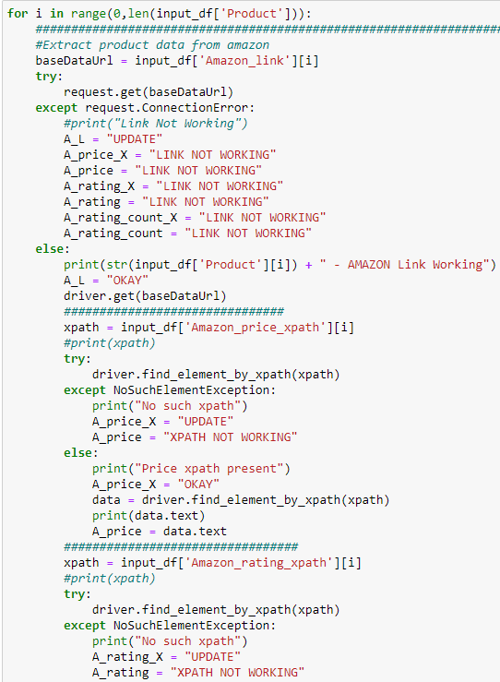
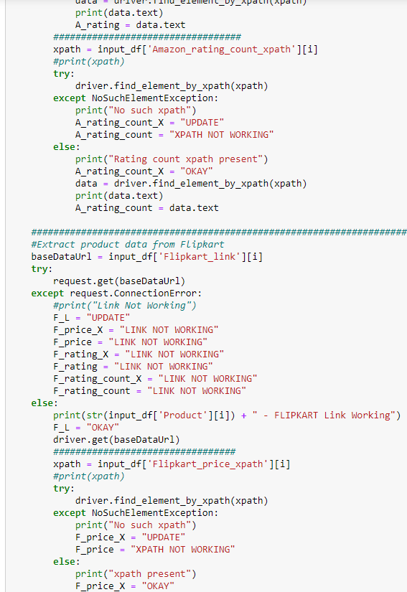
Implementation

Slide 15
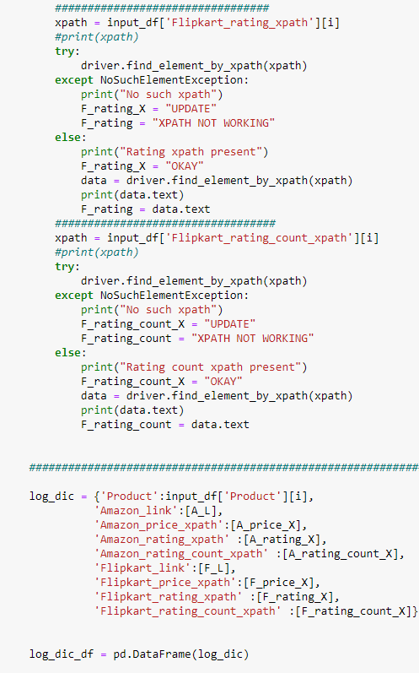
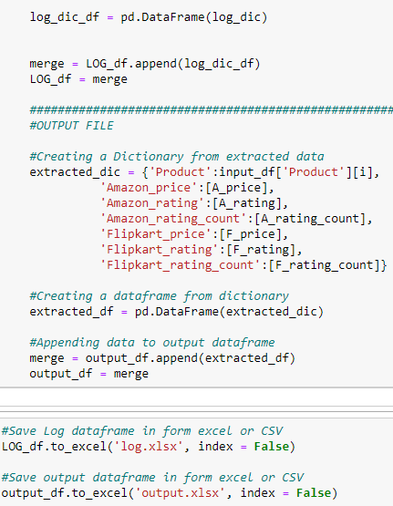
Implementation

Slide 16
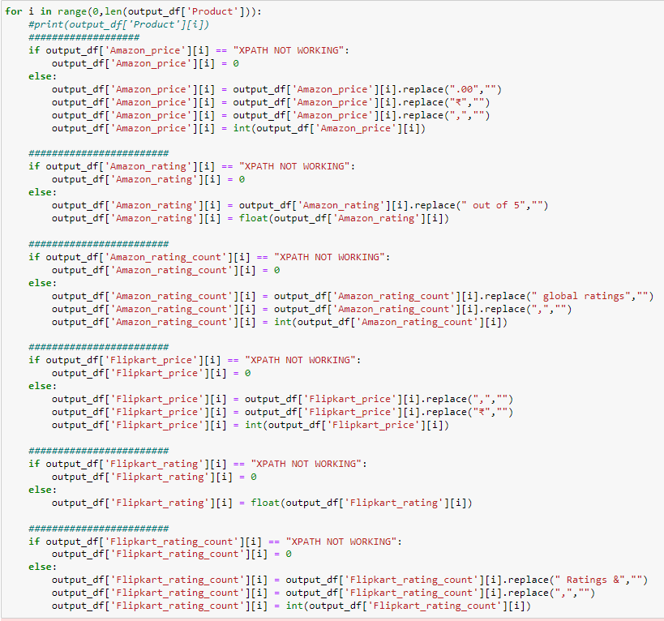
Implementation
Filtering/ Appending the raw data:-

Slide 17
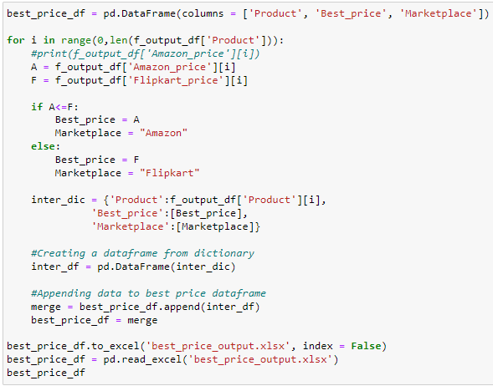
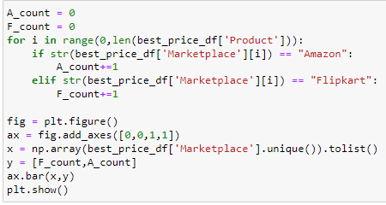
Implementation
Best Price Analyzing:-

Slide 18
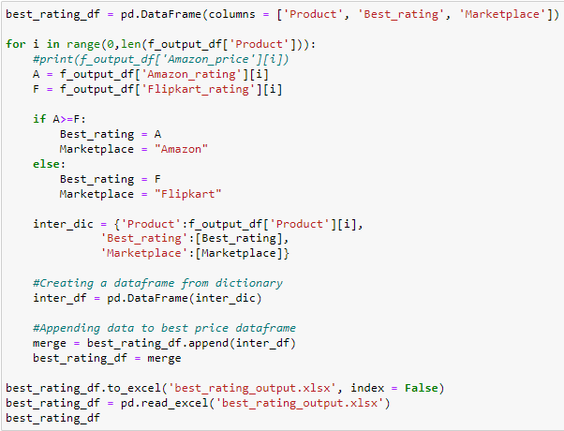
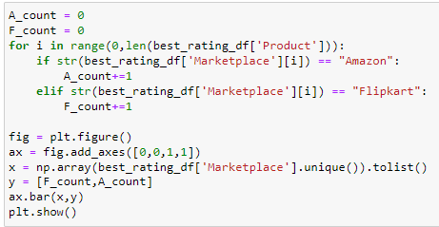
Implementation
Best Rating Analyzing:-

Slide 19
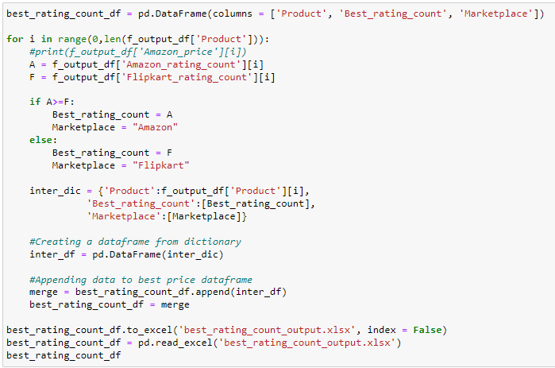
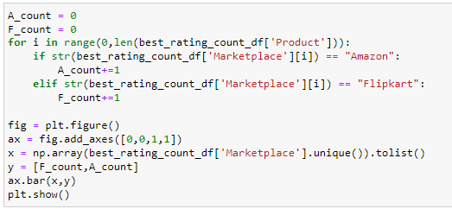
Implementation
Best Rating Count Analyzing:-

Slide 20
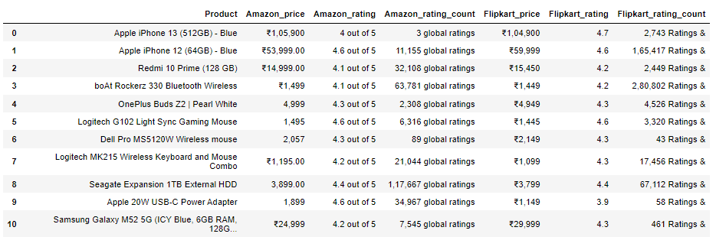
Results & Discussion
Extracted data:-
This is the Raw data which is extracted with the help of product
link & xpath locator. We need to filter this data to make it useful
for the user.

Slide 21
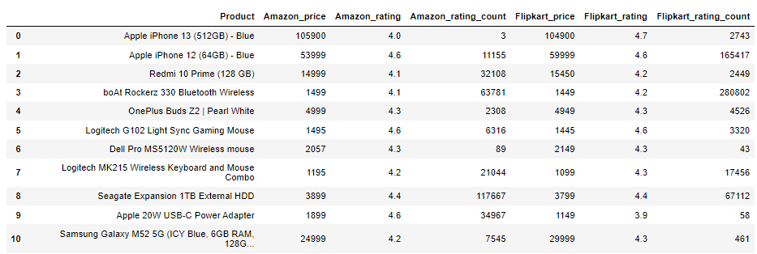
Results & Discussion
Filtered data:-
This is filtered data, free from garbage value and unnecessary
Information. This data will serve as base dataset for analyzing
system.

Slide 22
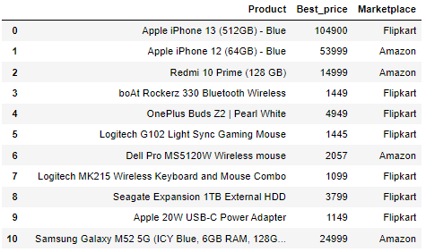
Results & Discussion
Best Price Analysis:-
Best Price analysis helps in providing the best price available for
a product and it also suggest the corresponding marketplace.

Slide 23
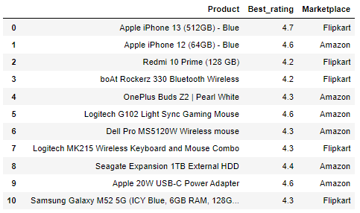
Results & Discussion
Best Rating Analysis:-
Best Rating analysis helps in providing the rating available for
a product and it also suggest the corresponding marketplace.

Slide 24
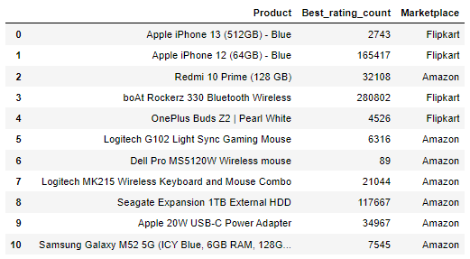
Results & Discussion
Best Rating count Analysis:-
Rating count analysis tells us the best marketplace to buy a product or the marketplace users are more likely to buy a particular product.

Slide 25
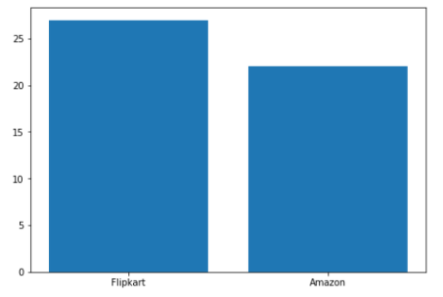
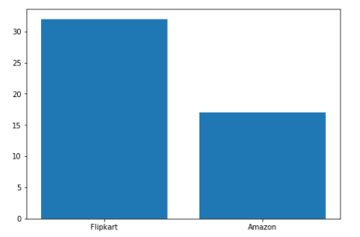
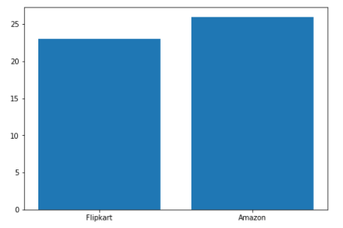
Screenshots
Best Price
Best Rating
Best Rating Count

Slide 26
Thanks

