Slide 1








×
Hack Day
12 hours. Open-source AI. Real problems.
ClaimSentry · Problem 2: Triage That Tests The Claims
31 OCT – 1 NOV
SONIPAT
NST · RISHIHOOD UNIVERSITY
Notes:
Welcome everyone to Hacktoberfest Hack Day Sonipat at Rishihood University, hosted by Newton School of Technology, with Hacktoberfest presented by DigitalOcean with MLH and DEV, and our partners Gemma and WeMakeDevs. Over the next day we will hear Open Source talks, then hack through the night with open-source AI.

Slide 2
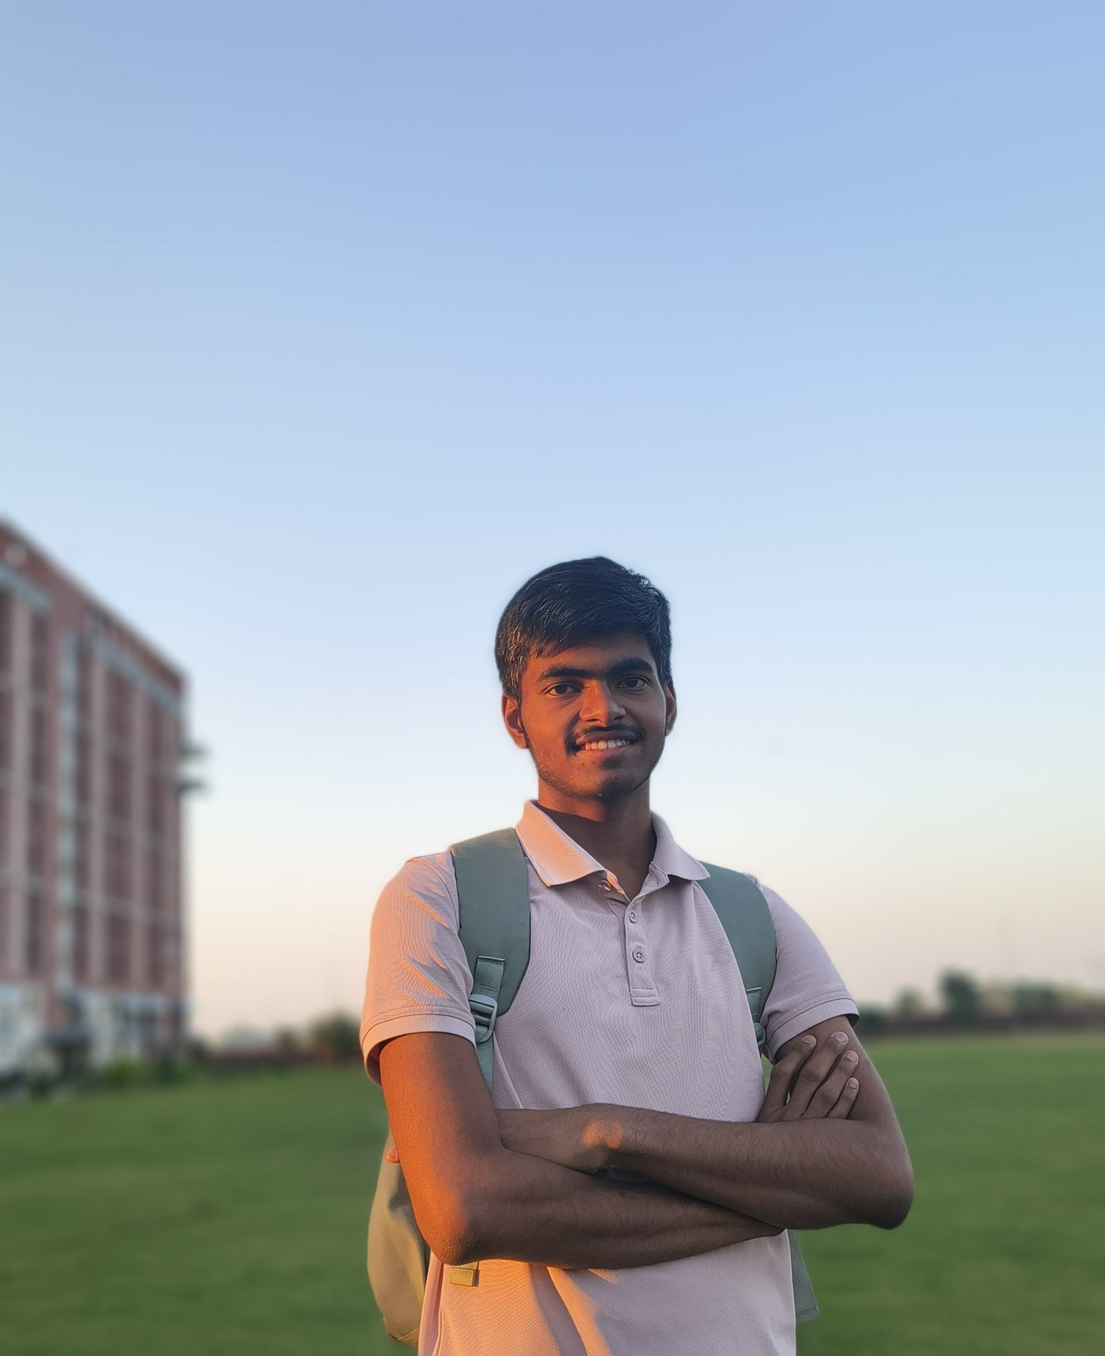
HACKTOBERFEST HACK DAY · SONIPAT
TEAM MEMBER // SYSTEM & AST ENGINE
Akshat Kumar
First Year Student · Newton School of Technology
Rishihood University, Sonipat
akshat.k26018@nst.rishihood.edu.in
github.com/Akshat-xe
NST · RISHIHOOD UNIVERSITY
Notes:
Host: please welcome Abhishek Rathi, Director of Newton School of Technology, to open Hacktoberfest Hack Day Sonipat.

Slide 3
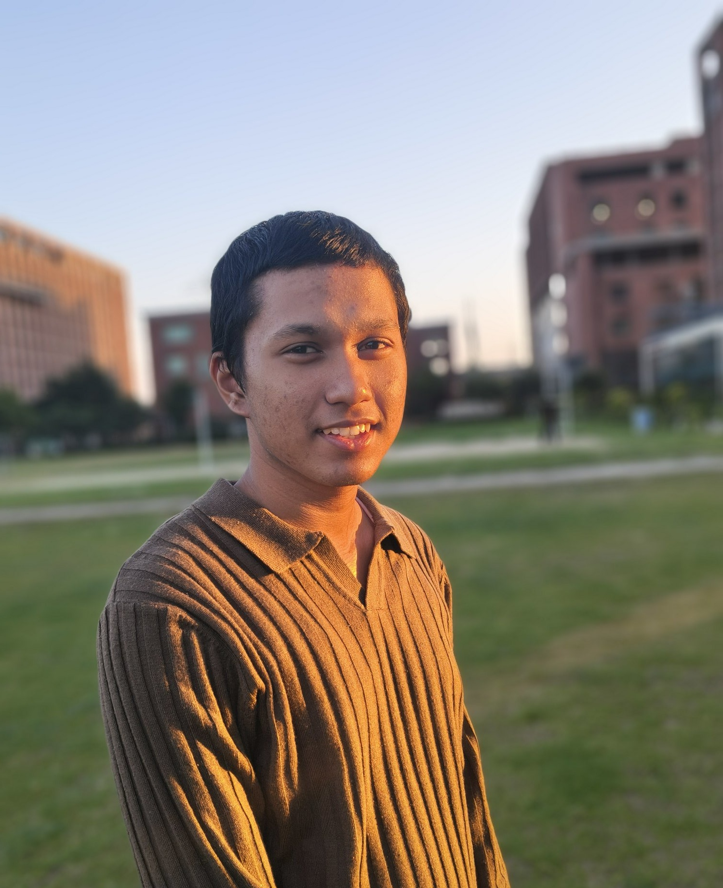
HACKTOBERFEST HACK DAY · SONIPAT
TEAM MEMBER // ARCHITECTURE & CI
Swapnil Pradhan
First Year Student · Newton School of Technology
Rishihood University, Sonipat
swapnil.p26358@nst.rishihood.edu.in
github.com/suwupnil
NST · RISHIHOOD UNIVERSITY
Notes:
Host: please welcome Anuj, NST faculty. He is an IIT Roorkee alumnus with seven years in tech, at Flipkart, Adobe, Blinkit and Microsoft. He talks about how MLH, NST and WeMakeDevs come together, and life beyond academics at NST, then leads our young folks’ round table.

Slide 4


HACKTOBERFEST HACK DAY · SONIPAT
PROBLEM 2
Triage that tests the claims
BUG REPORT
EVIDENCE
“Crash on long URLs”
✓ Reproduced on 2.4.1
YOUR GITHUB APP
SECURITY REPORT
Test the claim
EVIDENCE
“RCE in parse_url_v2()”
✗ parse_url_v2() does not exist
Isolated sandbox · no secrets · no network
PULL REQUEST
EVIDENCE
“Fixes #120, adds tests”
! No test covers the change
You build: a GitHub App that checks whether a report is true, safely, and shows maintainers the evidence.
NST · RISHIHOOD UNIVERSITY
Notes:
Problem 2. Maintainers spend hours disproving reports. Don’t judge who wrote a report; test what it claims. A bug report is reproduced in a sandbox, a security report is checked against the real code, a pull request is checked against what it says it does. Maintainers get short evidence, like reproduced on 2.4.1, or this function does not exist.

Slide 5
HACKTOBERFEST HACK DAY · SONIPAT
The “Laboratory Inspector” Principle
❌ PASSIVE LLM GUESSING
✅ CLAIMSENTRY AIR-GAPPED LAB
Unverifiable Chatbot Guessing
Autonomous Laboratory Inspector
• Prompts cloud LLMs: "Does this look like a bug?"
• Hallucinated CVEs & fake bug reports get marked critical
• Untested PRs merged because explanation sounds clever
• Leaks private repository secrets & costs cloud API tokens
➔ Fails maintainers: produces zero reproducible proof.
• Air-Gapped Sandbox: 0.00 MBPS network, 0 secrets, 5s timeout
• Synthesizes minimal reproduction script in isolated subprocess
• In-memory AST symbol audit across 6 languages in < 0.1ms
• Computes mathematical diff-coverage intersection on PRs
➔ Verifiable proof: exit code 1, stack traces, symbol graphs.
PIPELINE: GitHub Ingest ➔ RAM AST Indexer ➔ 4 Autonomous Verifiers ➔ Sandbox Exec ➔ SSE Stream
LOCAL RUNTIME: Apple Silicon M5 Metal GPU (Qwen 2.5 Coder 7B + Apple Neural Engine Vision OCR)
NST · RISHIHOOD UNIVERSITY
Notes:
The point of this hackathon is open-source AI. Models your product uses at runtime are worth up to 15 points: open-weight models like Llama, Gemma, Qwen, Mistral or DeepSeek count, run locally or on our model server. Closed APIs such as OpenAI, Claude or Gemini score zero on this criterion, and because our test machines have no API keys, they can’t run in automated testing. Declare every model and why in HACKATHON.md. If you claim an open model your code doesn’t actually use, you get zero here and lose 5 more points overall. AI coding assistants used to write the code are fine; name them in each pull request.

Slide 6

HACKTOBERFEST HACK DAY · SONIPAT
Autonomous Verifiers: Bug & Security Triage
VERIFIER A · BUG REPRODUCTION
VERIFIER B · AST SINK AUDITOR
AIR-GAP
LOCKDOWN
0.00 MBPS
0 Secrets
Minimal Repro Synthesizer + Adaptive Healing
Multi-Language AST Symbol & Fake CVE Resolver
1. LLM Script Synthesis: Qwen 2.5 Coder 7B writes minimal Python reproducer on Metal GPU.
2. Adaptive Self-Healing: Auto-repairs synthetic syntax slips and missing imports in 1 loop.
3. Sandbox Execution: Executes in isolated subprocess (0 network, 0 secrets, 5s timeout).
4. Verified Outcome: Captures exact terminal exit code 1, exception type, and stacktrace.
1. In-Memory AST Indexer: Scans Python, TypeScript, Rust, Swift, Go, C/C++ in < 0.1ms.
2. Hallucination Hunter: Cross-examines claimed functions against true AST symbols.
3. Reachability Analysis: Traces whether unauthenticated input sinks reach vulnerable code.
4. Verified Outcome: Unmasks fake CVE spam: "✗ parse_url_v2() does not exist [AI SLOP]".
5.0s Timeout
NST · RISHIHOOD UNIVERSITY
Notes:
Your first commit, before any building, adds HACKATHON.md naming the problem statement you picked, the models you are using and why, your team name and every team member. Your last commit is the end commit, pushed by 6:30 AM. We fetch every repo at 6:30 AM, and that version is the one scored. Submit the repo link through the QR code by 8:30 PM.

Slide 7
HACKTOBERFEST HACK DAY · SONIPAT
Diff Coverage, Multimodal AI & Sandbox
01
02
03
Verifier C · PR Diff Coverage
Verifier D · Multimodal Vision
Air-Gapped Process Sandbox
• 0.00 MBPS Network: Monkeys-patches socket creation in child processes to eliminate network leaks.
• Secret Scrubbing: Strips all API keys, tokens, SSH, and AWS credentials from os.environ.
• Timeout Limit: Enforces strict 5.0-second limit to terminate infinite loops and malicious scripts.
• AST Delta Intersector: Extracts modified code lines from git diff.
• Test Line Intersection: Runs pytest under trace coverage to map executed lines.
• Coverage Metric: Mathematically proves diff-coverage % (e.g. 0.0% coverage).
• Verdict: "! No test covers the change [UNTESTED PR]".
• Apple Neural Engine OCR: Native sub-20ms Vision framework text extraction.
• Moondream 1.8B Local AI: Evaluates UI error screenshots and video recordings.
• Code Cross-Check: Matches extracted stack traces against repo symbols to catch fake alien panic images.
COMPLETE VERIFICATION MATRIX: Automatically triages Bug Reports, CVE Slop, PR Diffs, and Visual Media.
NST · RISHIHOOD UNIVERSITY
Notes:
Work like a real open source project. Your first commit, HACKATHON.md, goes straight to main; after that, every change goes through a pull request, with no direct pushes. A GitHub Actions workflow installs your project and runs your tests on every PR; solo teams can merge their own PRs. Every PR description names the models your product uses in that PR and any AI coding assistant that helped write it. This is worth 10 points, and what a PR says about models must match the code.

Slide 8
HACKTOBERFEST HACK DAY · SONIPAT
Empirical Benchmarks & Live Telemetry
Tested continuously all night with 100% CI pass rate, live SSE streaming, and instant maintainer proof.
20 / 20 PASSING CI
REAL-WORLD INGESTION
LIVE SSE DOSSIER
• 100% automated test suite passing in 3.97s.
• Verifies sandbox network block (0.00 MBPS), secret sanitization, AST scanning, and OCR.
• Zero test flakes across all 4 verification modules.
• Ingests and shallow clones real repositories (pallets/flask, url_toolkit) in < 6 seconds.
• Parses 1,445+ AST symbols into RAM in < 0.1ms.
• Zero cloud AI API dependencies — 100% local.
• Real-time Server-Sent Events (SSE) streaming terminal output directly to maintainer.
• Telemetry bar monitors 0.00 MBPS network and 0 secrets.
• 1-Click Technical Proof cards with reproducible commands.
CONCRETE EVIDENCE: Maintainers receive verifiable exit codes, stack traces, and line-level diff coverage.
NST · RISHIHOOD UNIVERSITY
Notes:
Our scripts and reviewers look at every repo through the night and score the version frozen at 6:30 AM. Three things make that fair. HACKATHON.md, your first commit. A GitHub Actions CI workflow that installs your project and runs your tests; it must pass on your final commit, which proves it installs and runs on a clean machine. And an examples folder with a sample input and the real output your tool produced. We check that CI passes, that features are really built rather than stubbed, your tests, that there are no secrets, and that the models you name are really used. The judges then see it live at your presentation.

Slide 9
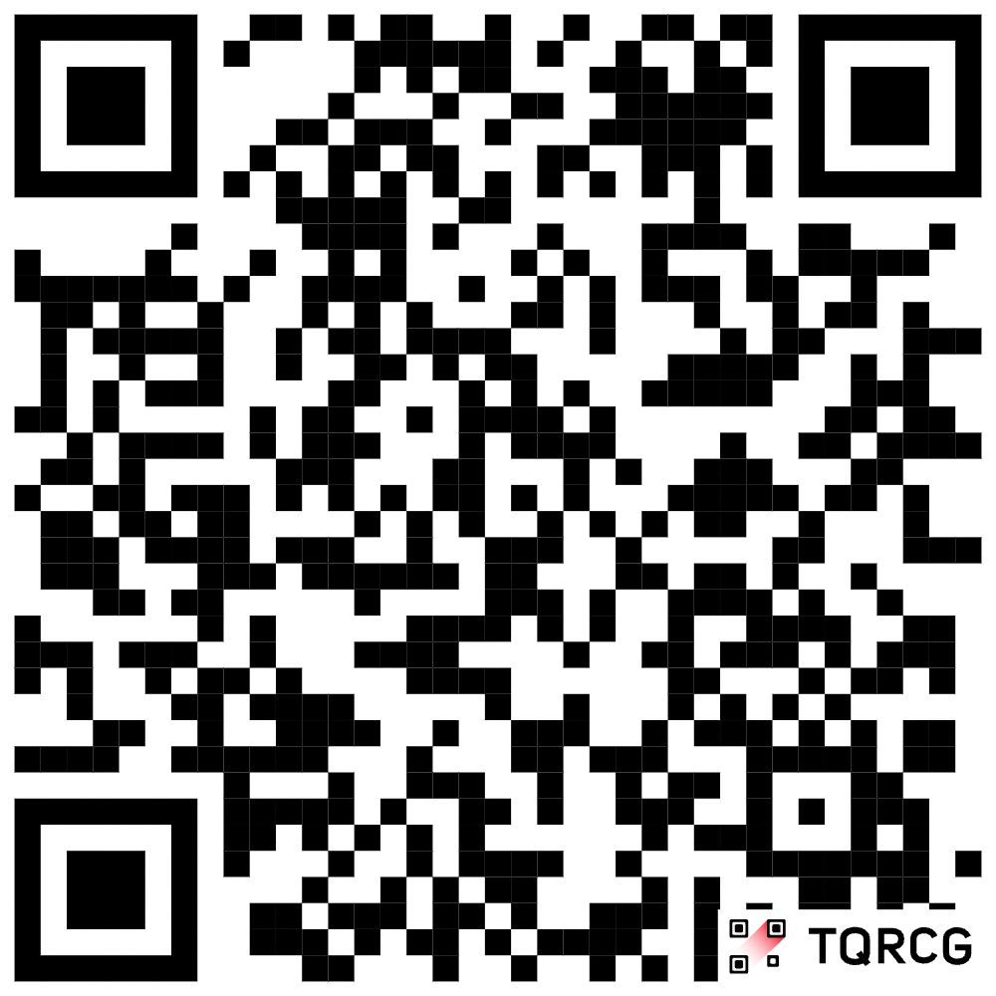

HACKTOBERFEST HACK DAY · SONIPAT
Thank You Judges, Mentors & Volunteers!
CLAIM-SENTRY // TRIAGE THAT TESTS THE CLAIMS
Team Zig2: Akshat Kumar & Swapnil Pradhan
First Year Students · Newton School of Technology, Rishihood University
GitHub Repository: https://github.com/suwupnil/hacktoberfest
Team Contacts: akshat.k26018@nst.rishihood.edu.in • swapnil.p26358@nst.rishihood.edu.in
Track: Problem 2 · 12 Hours · 100% Local AI (0 Cloud APIs) · 20/20 CI Passed
NST · RISHIHOOD UNIVERSITY
Notes:
Problem 8 is the Gemma track, worth 5,000 rupees. Build any original project where Gemma does the core AI work: a multimodal tool, something for learning, creativity or your community, or an offline helper for maintainers. The one big rule: Gemma runs on your own laptop, through Ollama, llama.cpp, LM Studio or transformers, with no cloud AI APIs. Your app can use the internet for other things, but never for the AI. Using any other model or cloud AI disqualifies the team. Problem 8 teams compete only for the Gemma prize.

