Slide 1
Problem statement
01 NOVUS · FINANCE, PLAYED
India opened 26 crore trading accounts. Nobody opened a practice account.
26 cr
27%
trading accounts on the NSE, June 2026
of adults are financially literate
The last crore was added in under four months. Demat accounts stand at 23.4 crore.
33% urban, 24% rural. NCFE Financial Literacy and Inclusion Survey, 2019.
The gap is not information. It is practice — and one habit nobody corrects: judging a decision by how it turned out instead of by what was knowable when it was made. A lucky bet is filed as skill, a sound call that lost money is filed as a mistake, and the lesson lands upside down. Institutional trading simulators teach the difference; they are priced far past any student.
Notes:
26 crore accounts, 27% literacy. The missing piece is practice with consequences, and the outcome bias nobody trains out.

Slide 2
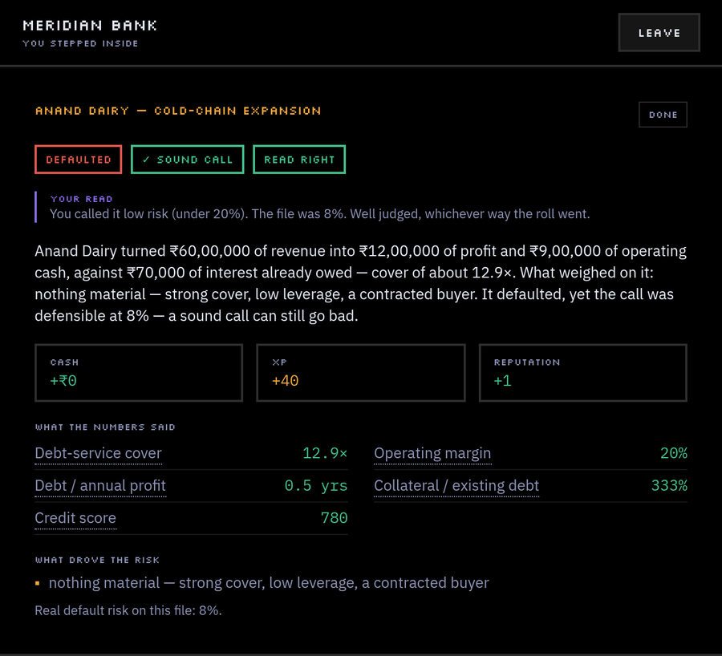
Proposed solution
02 NOVUS · FINANCE, PLAYED
A trading floor you can open in a browser tab — graded on reasoning, never on luck.
THE BANK
Judge loan files on real figures
Revenue, cash flow, debt, collateral, a credit score. Commit a risk read, then approve, cut, lend against collateral, or reject.
THE EXCHANGE
Trade a market that ticks every second
Twelve invented companies. Every move splits into drift, noise and news, so you can see what was signal.
RISK & COMPLIANCE
Find the tells in a set of accounts
Real warning signs among decoys that only look odd. Each file echoes a collapse the game names afterwards.
THE ACADEMY
Practise, and keep the record
Modules, drills, replays of Satyam and IL&FS, and a transcript anyone can verify with a code.
Anand Dairy: an 8% risk file, correctly approved, that defaulted anyway. Every file has a hidden risk and the outcome is a roll against it — the call is scored against the risk, never the roll. Seeded, so a class can replay the same day and argue about the same decision.
Notes:
Four desks, one city — and the single claim the product rests on: a sound call that defaulted is still sound.

Slide 3
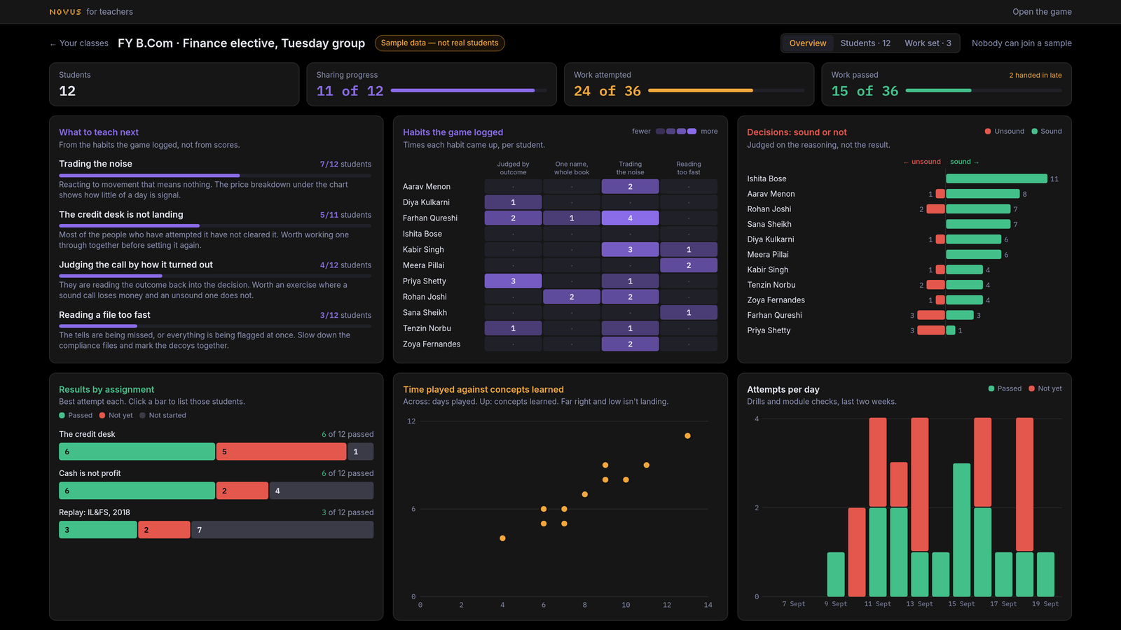
Target users or use case
03 NOVUS · FINANCE, PLAYED
Three people, one record.
STUDENTS
TEACHERS AND COLLEGES
FIRST-TIME INVESTORS
Commerce and finance undergraduates
They have the vocabulary and no reps. Novus gives them decisions with consequences before the first salary arrives.
A class, set work, and a habit report
Create a class, share a join code, set drills with due dates, and open one screen that says what the class is getting wrong.
Practice before real money
A market that moves for reasons you can inspect, and a day-end debrief that names the mistake.
THE USE CASE
One term, one class, one artifact
A student plays through a week of decisions. The teacher sees the habits the game logged, not a quiz score — who is late, who has not started, and what at least a quarter of the class keeps getting wrong.
At the end the student issues a transcript, and anyone — a recruiter, a parent, the college — can verify it with a code, in a browser, with no sign-in.
Notes:
Students practise, teachers see habits, and the transcript is the thing that leaves the classroom.

Slide 4
Role of Machine Learning or AI
04 NOVUS · FINANCE, PLAYED
The grade stays deterministic. The AI reads and writes.
WHAT STAYS RULES-BASED
LIVE TODAY · WORDING ONLY
Everything that produces a number
Risk, scoring, market ticks and the day-end report are plain, seeded TypeScript. No model touches them.
An assessment you cannot reproduce is not an assessment: a transcript has to mean the same thing twice, and a class has to be able to replay the same day and get the same result.
A model may rephrase a write-up, never produce a figure
It gets numbers the simulation already computed, invents nothing, and every path has written fallback text if the model is off or slow.
PROPOSED · GRADE THE REASON
Players already type one line of why before they decide. It is stored and ungraded. A model can score that sentence against the drivers the file actually had.
PROPOSED · PREDICT THE NEXT SLIP
The attempt log keeps every try, not just the best. A model over that log can tell a teacher which concept a student is about to fail.
PROPOSED · AGENTS THAT SOURCE FACTS
TinyFish agents gather and verify the real-case material the Casebook is built on — the next slide.
Notes:
Deterministic where a number is produced, AI where language is read or written.

Slide 5
Proposed technical approach
05 NOVUS · FINANCE, PLAYED
Three layers that cannot reach into each other.
sim/
All rules, money and randomness
May never import React, Phaser or fetch, and may never call Math.random — the seeded generator only.
THE STACK
Vite · React 19 · TypeScript (strict) · Tailwind v4 · Phaser 4 · Zustand · Supabase with row-level security. Deployed as one container behind Caddy on a small VPS.
world/
Draws the city and moves the player
May never decide anything about money.
2.0 MB
bundle, 554 KB gzipped
ui/
Shows state and sends actions
May never do money maths itself.
1 second
of real time per game minute
paise
money stored as whole integers
They meet in one store. Phaser reaches the rest of the app through a single bridge file, and privacy between a teacher and a student is enforced in Postgres row-level security, not in the client. Money is stored as whole paise and formatted in one place, so no screen can round it differently.
v6
save migrations, old saves still load
Notes:
The layer rule is why the market is testable and why a save replays exactly.

Slide 6
Proposed TinyFish integration
06 NOVUS · FINANCE, PLAYED
Agents that do the homework the game cannot.
FETCH + SEARCH
MONITOR
Sourced fact packs for the Casebook
Filings, regulator orders and news archives pulled as structured JSON, so every figure in a real case lands with its citation attached. The draft banner on that content comes off.
Watch the pages that make new cases
A standing watch on regulator and exchange pages. When a concluded event appears, we are told, and a new drill gets written from it — triggered by the alert, authored by a human.
AGENT + TINYVAULT
BROWSER
Reach the college systems that have no API
A goal-driven agent signs in to a department portal and files a class’s results, with credentials held in the vault and never seen by the model.
Keep the citations honest
A nightly pass opens every source link in the Casebook and flags the ones that moved, changed or died, so study material cannot rot quietly.
TinyFish never touches the playable market. It feeds the study material and the teacher’s workflow — the companies you trade stay invented, because a learning game with real tickers is advice.
Notes:
Four uses, two of which fix problems already written down in the repo: unsourced Casebook figures, and getting results into college systems.

Slide 7
Expected impact
07 NOVUS · FINANCE, PLAYED
A record of judgement, not a high score.
12
9
5
6
concepts
case files
drills
real collapses
FOR A STUDENT
FOR A TEACHER
FOR A COLLEGE
Something to show for the practice
Concepts met, every decision with its risk-read accuracy, modules passed and mistakes logged — issued as a transcript with a code anyone can check in a browser, with no sign-in.
Next week’s lesson, written by the class
One screen: who has done the work, who is late, and the habits at least a quarter of them share — "trading the noise, 7 of 12 students". Built from how they played, not from a quiz score.
A pilot that costs a browser tab
No per-seat licence, no lab to set up, nothing to install. The sample class is open to any teacher who wants to see the dashboard before creating one.
Free, in a browser, on a phone-grade connection: the cost of trying it is one tab.
Notes:
Impact is the record and the teacher view, not a user count.

Slide 8
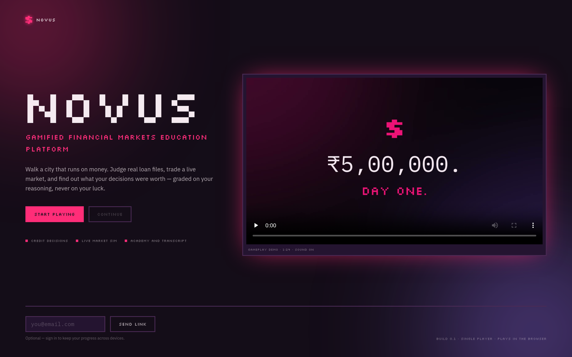
Feasibility
08 NOVUS · FINANCE, PLAYED
It already runs — at game.akshatchowdhary.online.
LIVE TODAY
WHAT IT TAKES TO RUN
Playable now, with no install and no sign-in to start
Cloud saves, verifiable transcripts and named awards, all live
A teacher dashboard with a labelled sample class anyone can open
An 84-second gameplay trailer on the landing page
Hosted as one container behind Caddy on an existing VPS
A browser tab, and a container that costs nothing extra
The build is one static bundle; Supabase’s free tier covers saves, transcripts and classes for a pilot-sized cohort.
CONTENT ACCURACY
The six real cases keep a draft banner until their figures pass a source check. TinyFish is how that check gets done rather than skipped.
NO MOBILE LAYOUT YET
It is built for a laptop screen. A phone layout is scoped, not written.
NO TEST SUITE YET
The rules are pure and seeded, which makes them easy to test — the tests are simply not written.
Notes:
Honest risks: unsourced case figures, no mobile layout, no tests. Everything else is deployed.

Slide 9
Future scope
09 NOVUS · FINANCE, PLAYED
Where it goes next.
NEXT TERM
THE YEAR AFTER
IF IT WORKS
Reasoning graded by a model, against the drivers the file had
A phone layout, and a first-run tutorial
A test suite over the seeded rules
Casebook figures sourced and the draft banner removed
An arc that runs across weeks, not days
The three desks that are still nameplates: insurance, payments, the FinTech floor
A case library that grows from monitored events
Classroom pilots with a college, measured against a control group
Novus as a practical paper in a commerce course
Transcripts a recruiter recognises
An open case format, so a teacher can write their own file
The engine is finished. What is left is content, reach, and proof from a real classroom — play a day of it at game.akshatchowdhary.online
Notes:
Near-term work is content and polish; the longer bets are the classroom pilot and the growing case library. Close by opening the game.

