Slide 1
Text-Based Prediction of Book Review Popularity
A Machine Learning Approach to Predicting Goodreads Review Engagement
Presented by: Akshat Agarwal (PES1UG24AM024) & Ayushi Kumari (PES1UG24AM061)

Slide 2
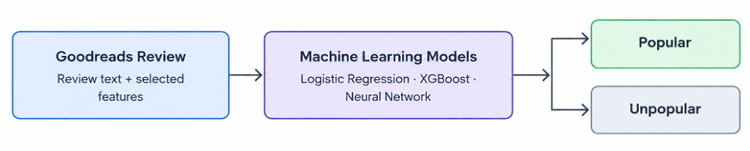
Problem Statement
Goodreads contains millions of book reviews, but not all reviews receive the same level of engagement. Predicting whether a review will become popular can help us understand the factors associated with reader engagement.
Objectives
Classify book reviews as popular or unpopular.
Explore review text and numerical book/review features.
Compare different feature representations and machine learning models.
Evaluate performance using classification metrics and visualizations.

Slide 3
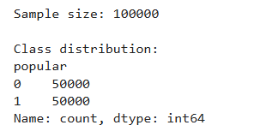
Dataset and Target Variable
Reference: Bridget Daly, Stanford CS229 Project Report
Source: Goodreads book reviews dataset.
Task: Binary classification — popular vs. unpopular reviews.
Engagement: Review likes and comments are used to calculate engagement.
Target definition: A review is labelled popular when its within-book engagement share exceeds 0.02.
The target represents review engagement, not whether the reviewer liked the book.

Slide 4
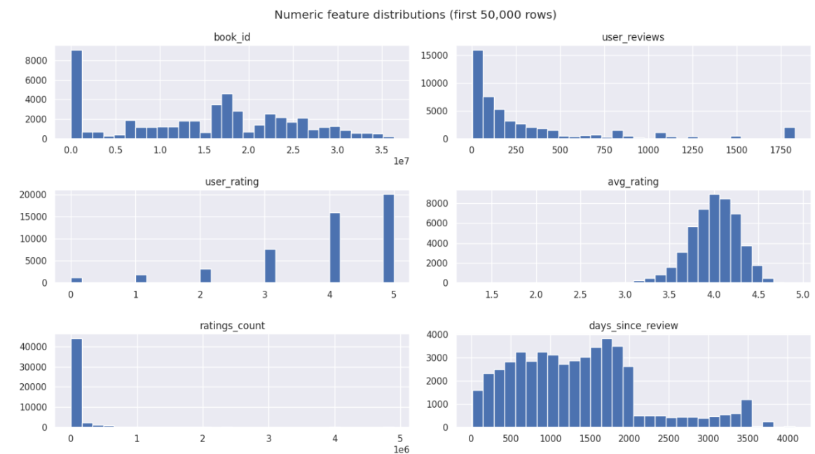
Data Preprocessing and Feature Engineering
Notebook: goodreads_preprocessing.ipynb
Validation notebook: book_review_validation.ipynb
Paper-style feature engineering: feature_engineering.ipynb
The dataset was prepared through the following steps:
Data extraction: Processed the large Goodreads JSON dataset incrementally.
Data cleaning: Inspected data types, missing values, and relevant columns.
Language filtering: Used FastText for English-language detection.
Target creation: Calculated within-book engagement share and assigned the popularity label.
Feature engineering: Extracted text, review-length, linguistic, sentiment, and numerical features.
Leakage prevention: Excluded engagement variables used to create the target from the model inputs.
Feature examples
Text: review content
Numerical: user rating, average book rating, ratings count
Linguistic: review length, sentence characteristics, sentiment, POS proportions

Slide 5
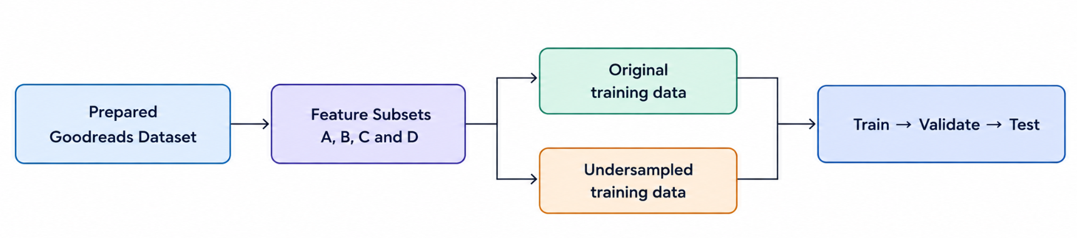
Experimental Design
Notebook: model_training.ipynb
The paper-style workflow compared models across different feature configurations.
Feature subsets A–D: Tested different combinations of input features, from non-text features to text representations and engineered features.
Data splitting: Used separate training, validation, and test sets.
Class imbalance: Compared selected experiments using the original training distribution and undersampling.
Model selection: Used validation performance to compare experiments.
Final evaluation: Used test-set metrics to assess generalization.
The notebook's pilot configuration used a 100,000-row sample and a 70% / 15% / 15% train-validation-test split.

Slide 6
Models and Experimental Setup
We evaluated multiple machine learning approaches to predict whether a Goodreads review is popular or unpopular.
Models evaluated
Logistic Regression: Linear classification baseline.
Linear SVM: Separates classes by finding a decision boundary with a maximum margin.
XGBoost: Gradient-boosted decision trees that learn non-linear patterns.
Neural Network (MLP): Learns complex patterns through interconnected layers.
Experimental variations
Feature configurations: A, B, C and D.
Text representations include Bag of Words (BoW) and TF-IDF.
Selected experiments compare original and undersampled training data.
Confusion matrices, ROC curves, and other plots are used to assess model behaviour.
Notebooks
book_review_final_evaluation.ipynb
model_training.ipynb
evaluation_and_submission_deliverables).ipynb

Slide 7
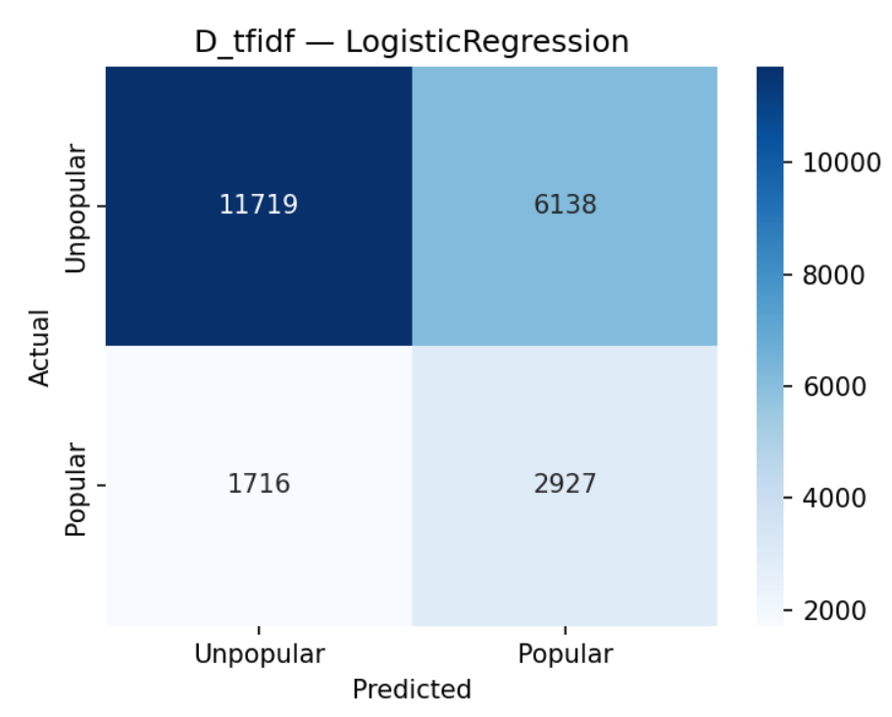
Logistic Regression
Logistic Regression estimates the probability that a review belongs to the popular class. It provides a useful baseline for comparing more complex models.
Experiments
Evaluated using different feature representations.
Compared across feature subsets.
Tested within the paper-style experimental workflow.
Evaluation
Confusion matrices show correct and incorrect predictions for each class.
ROC curves show the model's ability to distinguish popular from unpopular reviews.
Performance depends on the features and sampling strategy used.
Interpretation: Logistic Regression is a strong baseline, but its results should be evaluated using popular-class precision, recall, F1-score, and ROC-AUC, not accuracy alone.

Slide 8
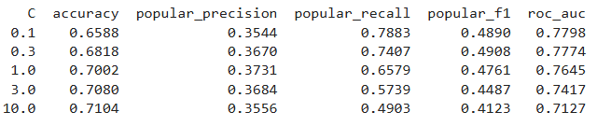
Hyperparameter Tuning: Effect of C
Notebook: book_review_final_evaluation.ipynb
The parameter C controls the strength of regularization in Logistic Regression.
Small C: Stronger regularization, which constrains model complexity.
Large C: Weaker regularization, allowing the model to fit the training data more closely.
Changing C can affect the balance between underfitting and overfitting.
We can compare model performance at different C values using evaluation metrics.
Objective: To investigate how regularization affects the performance of the Logistic Regression classifier.

Slide 9
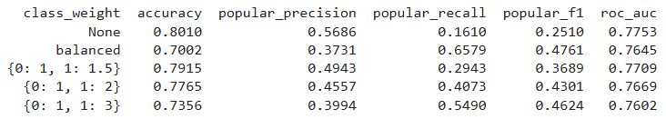
Handling Class Imbalance
Class imbalance can make a model favour the more frequent class. Class weighting changes the penalty assigned to classification errors during training.
Without class weighting: The model uses its default error weighting.
With balanced class weights: The model increases the relative importance of errors involving less-represented classes.
Evaluation: Compare precision, recall, F1-score and the confusion matrix to understand how predictions change.
Key takeaway: Class weighting may improve the detection of popular reviews, but it can also increase false positives. Its effect must be assessed using the actual experimental results.

Slide 10
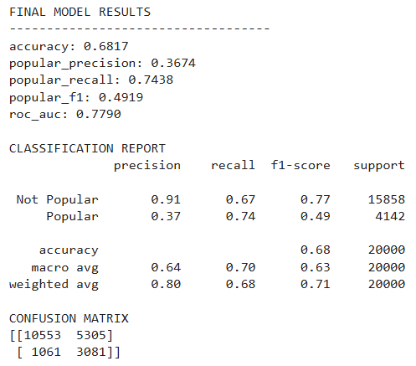
Combining Text and Numerical Features
This experiment combines review text with numerical metadata to provide the classifier with more information than text alone.
Text features
TF-IDF representation of review content.
Numerical features
User rating
Average book rating
Number of ratings received by the book
Days since the review
Why combine them?
Text captures the language and content of a review, while numerical features provide additional context about the review and book.
The combined model tests whether these complementary sources of information improve the prediction of review popularity.

Slide 11
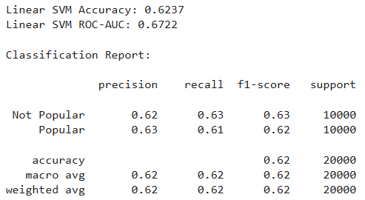
Linear Support Vector Machine
Linear SVM was evaluated in book_review_final_evaluation.ipynb as an alternative to Logistic Regression for text-based classification to observe the difference between the two models.
How it works
Finds a separating boundary between popular and unpopular reviews.
Uses a maximum-margin objective to separate the classes.
Can work well with high-dimensional text representations such as TF-IDF.
Why include it?
Provides a useful traditional text-classification comparison.
Helps assess whether a different decision boundary improves class discrimination.
Complements the later paper-style experiments with XGBoost and Neural Networks.
Important: The SVM results came from a different experimental workflow. They should not be ranked directly against the paper-style results unless the target definition, features, data split, and evaluation procedure are aligned.

Slide 12
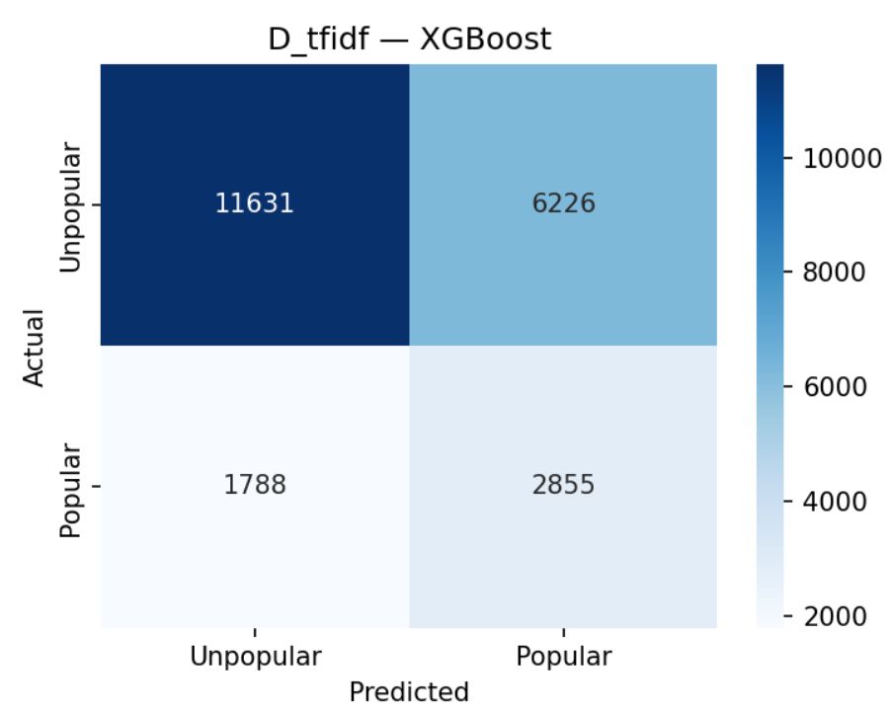
XGBoost
XGBoost combines decision trees sequentially, with each new tree attempting to correct errors made by the previous trees.
Experiments
Compared feature subsets and training-data configurations.
Evaluated original and undersampled training data in selected experiments.
Generated confusion matrices, ROC curves, and feature-importance plots.
What we analyse
Whether XGBoost identifies popular reviews effectively.
How the feature representation affects classification.
Which features contribute most to model predictions.
Whether undersampling improves popular-class detection while affecting overall accuracy.
Key point: A more complex model does not automatically outperform Logistic Regression. Its performance depends on the data representation, class imbalance, and experimental configuration.

Slide 13
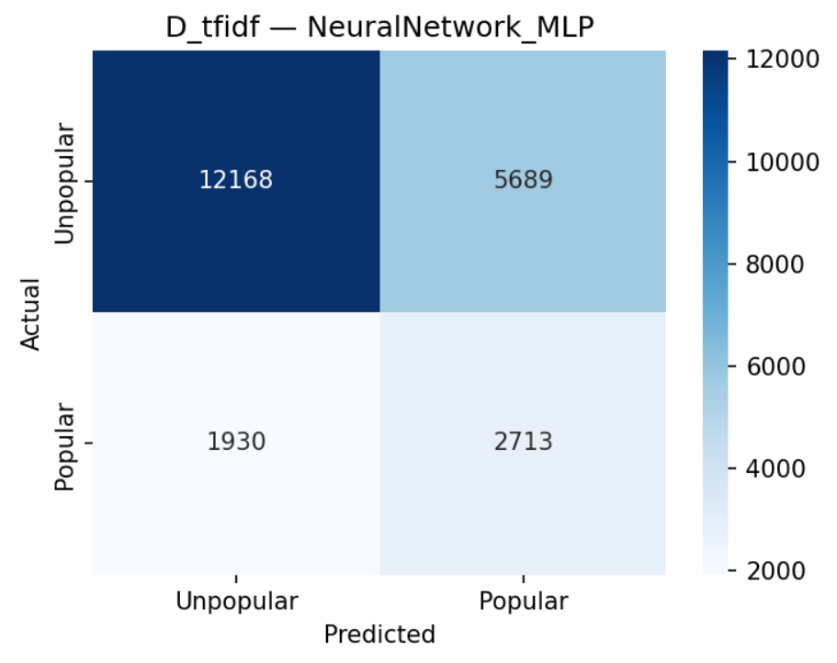
Neural Network (MLP)
The feed-forward neural network learns patterns by passing input features through interconnected layers and adjusting its weights during training.
Experiments
Compared different feature subsets.
Evaluated original and undersampled training configurations where available.
Generated confusion matrices, ROC curves, and learning curves.
Learning-curve analysis
Training and validation curves help show how model performance changes during training.
A large gap between training and validation performance may indicate overfitting.
Poor performance on both may indicate underfitting or insufficient predictive information.
Interpretation: Neural networks can model complex relationships, but their results depend on feature quality, training settings, and generalisation to unseen data.

Slide 14
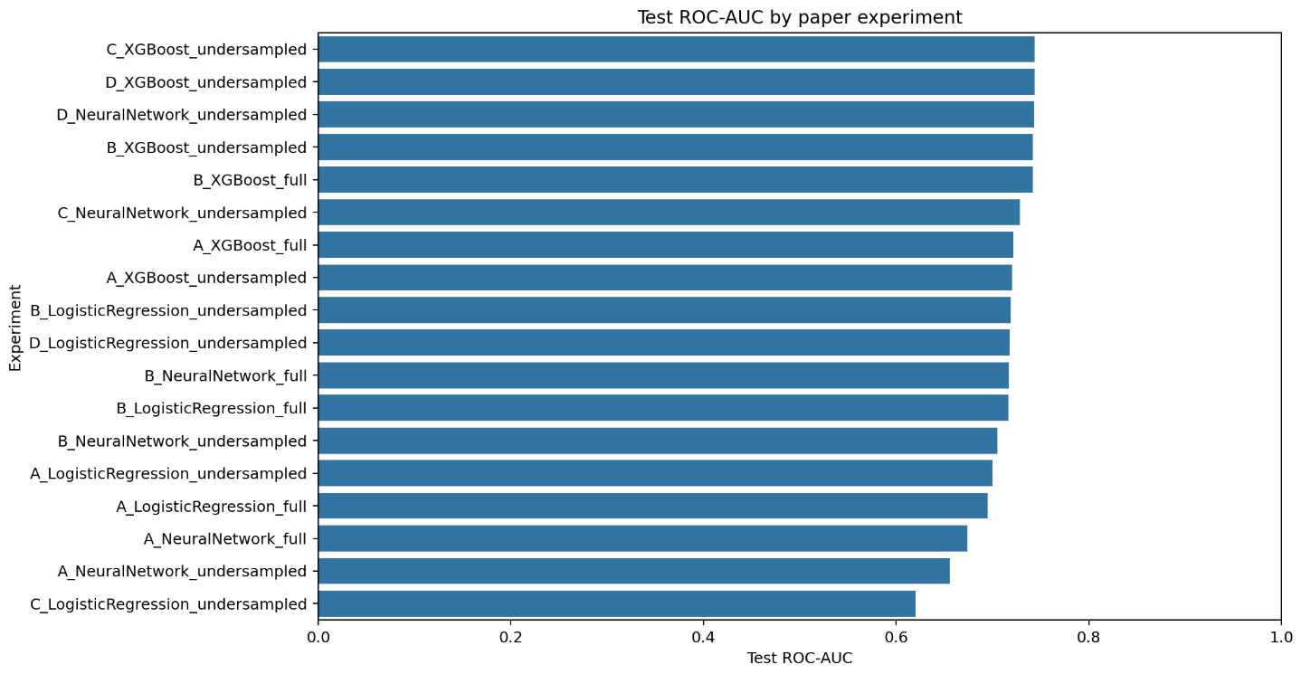
Overall Model Comparison
The project compares multiple approaches to identify the model and feature configuration that best captures review popularity.
Evaluation criteria
Accuracy: Overall proportion of correct predictions.
Precision: How many predicted-popular reviews are actually popular.
Recall: How many actual popular reviews are correctly detected.
F1-score: Balance between precision and recall.
ROC-AUC: Ability to distinguish the two classes across classification thresholds.
What we learned
Accuracy alone can be misleading when the target classes are imbalanced.
A model may achieve higher recall but produce more false positives.
Text representations and engineered numerical features can affect the models differently.
A model's complexity does not guarantee better performance.
The preferred model should be selected using a consistent evaluation setup and the metric that best reflects the project's objective.

Slide 15
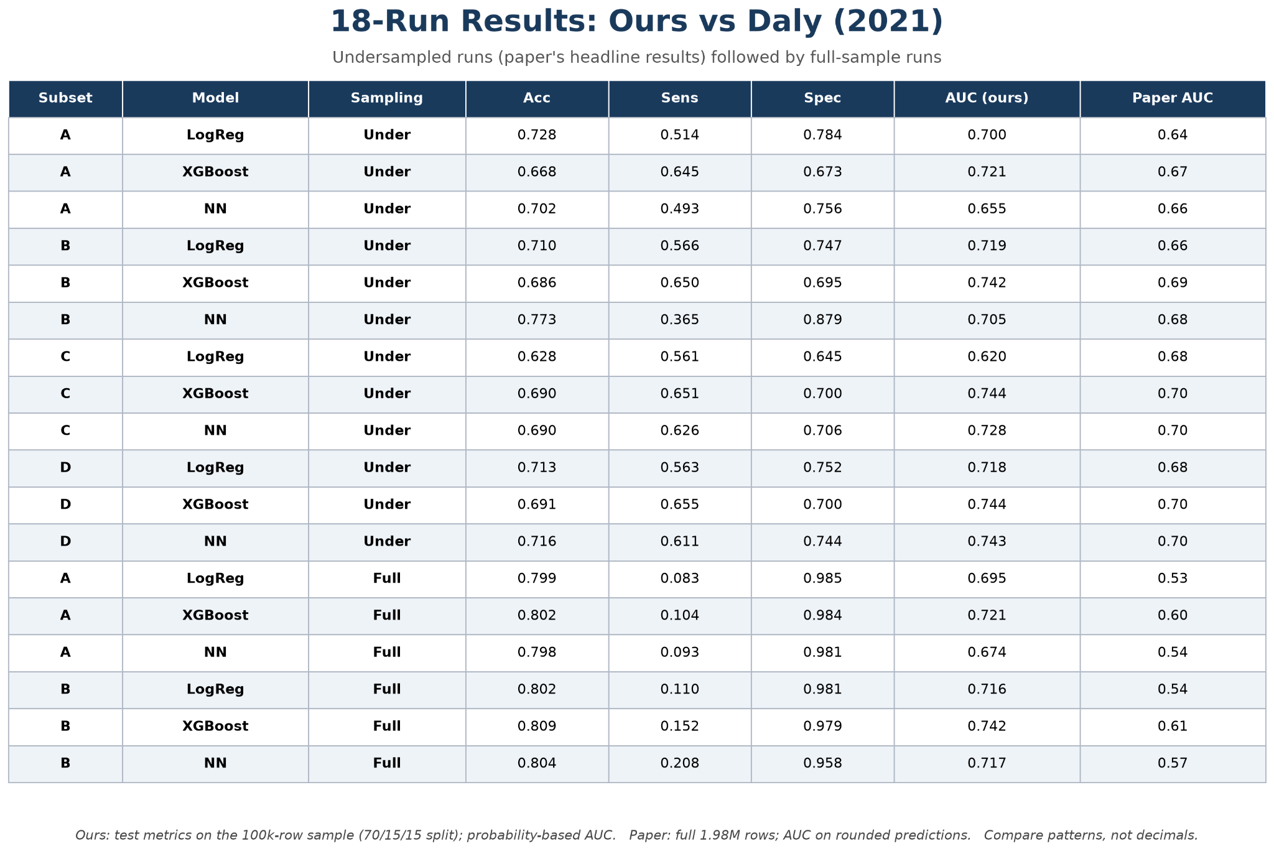

Slide 16
Conclusion and Future Work
Conclusion
Goodreads review popularity can be modelled as a binary classification problem.
The project explored text, numerical, and engineered linguistic features.
Logistic Regression and Linear SVM were evaluated in an earlier workflow.
Logistic Regression, XGBoost, and Neural Networks were compared in the paper-style workflow.
Confusion matrices and ROC curves provided insight beyond accuracy alone.
Limitations
Popularity depends on the chosen engagement-share threshold.
The target distribution is imbalanced.
Pilot experiments use a sample rather than the full dataset.
Results depend on the features, sampling strategy, and model configuration.
Results from different workflows are not directly comparable.
Future work
Run larger-scale experiments.
Tune model hyperparameters more systematically.
Use a consistent, untouched test set for final comparisons.
Investigate feature contributions and ways to improve popular-class precision.
Reference: Bridget Daly, Text-Based Prediction of Book Review Popularity, Stanford CS229 Project Report.
Repository: github.com/Akshat1686/ML-MINI-Project

