Slide 1
BILLUPS DATA SCIENCE CHALLENGE
Akshat Mathur

Slide 2
Objective
The objective is to analyze the library's data to understand and identify any factors contributing to this issue. Based on the findings, actionable recommendations will be provided to the library to mitigate late returns and develop a proactive monitoring strategy.
Key Questions:
What is the rate of late returns?
What percentage of total check-outs are late returns?
What factors are connected with late returns?
Do borrower demographics (e.g., age group, gender, region) correlate with late returns?
What recommendations can be made to mitigate the risk of late returns?
Are there policy changes or incentives that could reduce late returns?
Should the library implement reminders or penalties to encourage timely returns?
Can the library optimize their monitoring system to identify potential late returns earlier?

Slide 3
Overview
Data Provided -
Libraries - 18 records
Checkouts - 2000 records
Customers - 2000 records
Books - 240 records
*Note: The Books data is not mapped to the checkouts data and hence, cannot be used to determine late returns.
Assumptions made on missing data -
Checkout date - No information available on the borrowing date (Unknown)
Return date - Assuming books that are currently out and not yet returned (Not Returned Yet)
Return date earlier than Checkout date (System Error)
Libraries postal code - Imputed with random 5 digit codes
Region and City of libraries - imputed with default values of OR and Portland since we are dealing with a local libraries

Slide 4
Basic Observations
BOOKS
LIBRARIES
Prices range from $5.99 to $721
Avg. number of pages - 587
Categories of top 5 books borrowed - Business & Economics, Advertising, Medicine, Science, Technology & Engineering
Only 15/18 library data was recorded with customer data
CHECKOUTS
CUSTOMERS
On Time - 1319/2000
Late - 317/2000
System Error - 241/2000
Unknown - 65
Not Returned Yet - 58
Gender:
Male - 967 | Female - 932 | Unknown - 101
Education:
High School - 506 | Others - 476
College - 461 | Graduate Degree - 453 | Unknown - 104
Occupation:
Admin & Support - 301 | Education & Health - 275
Others - 269 | Blue Collar - 265 | Tech - 263 | Sales - 261
Business & Finance - 259 | Unknown - 107

Slide 5
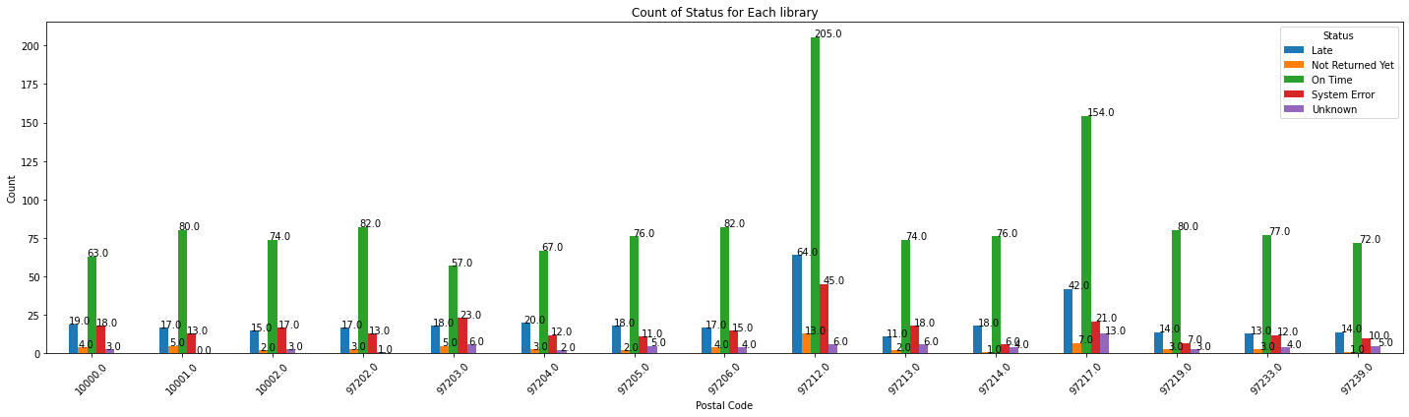
Library vs Return statuses
The libraries at postal code 97212 and 97217 have the highest number of late returns among all libraries. The total counts also say that these 2 are the most visited since they have the highest number of books rented out.

Slide 6
On Time Returns: The highest count of 'On Time' returns is in the postal code 97212 with 205 returns, accounting for 61.5% of its total transactions. The lowest is in 97203 with 57 returns, which represents 52.3% of its transactions.
Late Returns: Postal code 97212 also has the highest number of 'Late' returns with 64, which is 19.22% of its total transactions. The lowest is in 97213 with 11 late returns, making up 9.9% of its transactions.
System Error: Postal code 97212 has the most 'System Error' entries with 45, representing 13.5% of its transactions. The lowest is in 97214 with 6 errors, making up 5.71% of its transactions.
On the other hand, considering the ratio of Timely returns and Late returns, the best performing library is 97219 while the worst is 97203 with relatively higher late returns and fewer timely returns.

Slide 7
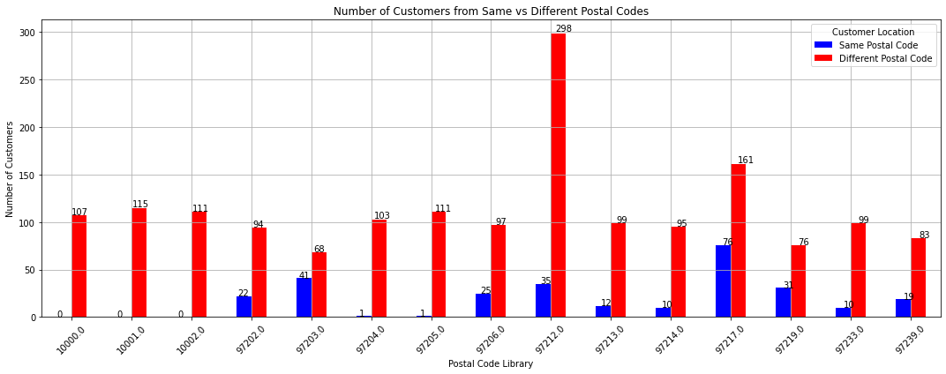
Library vs Customers renting books
Most customers visit the library in a different location rather than the one near their residence.
Customers residing in 97213 are visiting the library in 97212 instead. No one from 97204 is going to the library present in that area (maybe not a residential area). Great amount of people from 97202 are going to 97206 and 97214. 97217 is a well-established library, potentially offering a variety of services and resources that meet diverse needs. Hence a large number of visits.

Slide 8
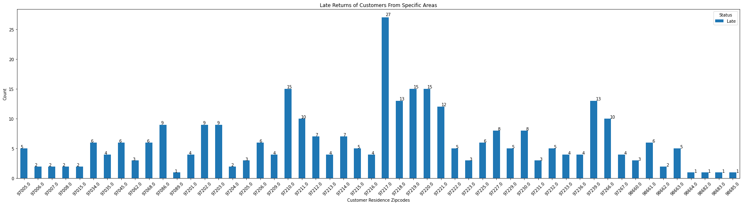
Return status vs Customer demographics
The most amount of late returns are from customers residing in area 97217 and have visited libraries in 97217 itself and 97212. Late returns are not dependant on customer’s occupation and education.

Slide 9
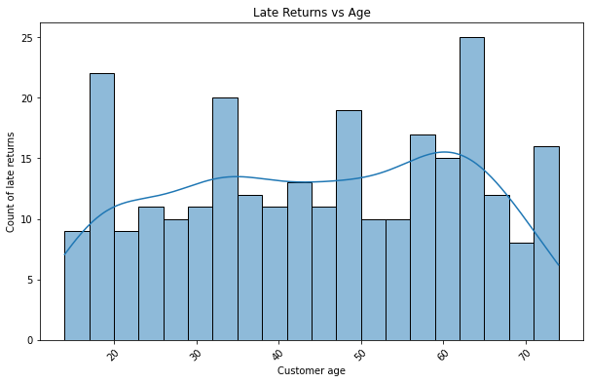
Age: < 20 - This age group likely consists of school children. These young borrowers may not be fully aware of the library's 28-day return policy or may be more carefree about their responsibilities.
Age: early 30's and late 40's - This age group primarily comprises professional working individuals. Due to their busy work schedules and numerous responsibilities, these individuals might frequently forget to return their books on time. Their late returns are likely due to the demands of balancing work and personal life.
Age: early 60's - This age group generally includes retired individuals. Retired people, who have more free time, might borrow books to enjoy during their leisure. However, they may also forget to return books on time, possibly due to a relaxed lifestyle or other personal engagements.
Remedy - By providing clear reminders for younger borrowers, sending frequent notifications to busy professionals, and offering flexible return options for retired individuals could be effective measures.

Slide 10
Implications of the status of returns
On Time Returns (1319)
Indicates the majority of borrowers adhere to return policies
Late Returns (317)
Needs strategies to improve timely returns
Possible causes: borrower forgetfulness, lack of reminders, or leniency in enforcement (no late fee imposed on borrowers)
System Errors (241)
Critical to address for accurate data tracking
May require system updates or training for staff on correct data entry procedures
Unknown Borrow Dates (65)
Hinders effective tracking and management of library resources
Not Returned Yet (58)
Reflects ongoing borrowing activity

Slide 11
General recommendations
Enhanced Reminder Systems - Implement automated reminders for due dates to reduce late returns
Audit and correct existing system errors - Regular training for staff on proper data entry
Reinforce policies to encourage timely returns - Consider fines or penalties for late returns
Ensure all borrow and return dates are accurately recorded - Investigate and resolve reasons for 'Unknown' status
(Unknown) Only certain books might be returned late since they had too many pages to read that used to take more than 28 days to cover.

Slide 12
Additional analysis steps (future work)
Analyze Late returns of the aforementioned age groups in the libraries with the most amount of books borrowed from.
Get the ratio of people traveling from a different region and also have returned books late.
Come up with an easier way to showcase and visualize the counts of customers visiting a library in their neighbour hood vs a different location.
Calculate distances people have travelled to visit a library.

