Slide 1
MediCompare
Medicine prices you can trace to a source. Software proposes, a person decides.
Working, tested prototype. Not deployed. Real prices are NPPA legal maximums. Shop prices shown are fictional demo data.
Notes:
Say at the start that this is a prototype, and that brand data is fictional.

Slide 2
Cheaper medicine is valuable. A wrong match is dangerous
Prices vary
Prescriptions are hard
Trust is hard
The same molecule at the same strength can cost very different amounts by brand.
Handwriting, and brand versus generic names, make it hard to know what you were prescribed.
Is that a shop price, a legal maximum or a catalogue listing? How old is it? Where did it come from?
Similar names are not the same medicine. An app that confidently suggests a wrong "equivalent" could harm someone.
Notes:
The risk is the design driver. No user research has been done: this comes from desk research.

Slide 3
A neutral tool for a better conversation with your doctor
What it does
What it is not
Search by brand, generic or ingredient, with typo tolerance
Show prices with type, source and date
List options with every difference flagged
Find Jan Aushadhi listings and Kendras, with no stock claims
Read prescriptions, with a person confirming each medicine
Pharmacist review, a shareable summary, and three languages
A pharmacy, seller, prescriber, diagnostic tool, dosing advisor or emergency service. Payments and partnerships never influence results.
Notes:
It sells nothing, and ranking has no commercial input.

Slide 4
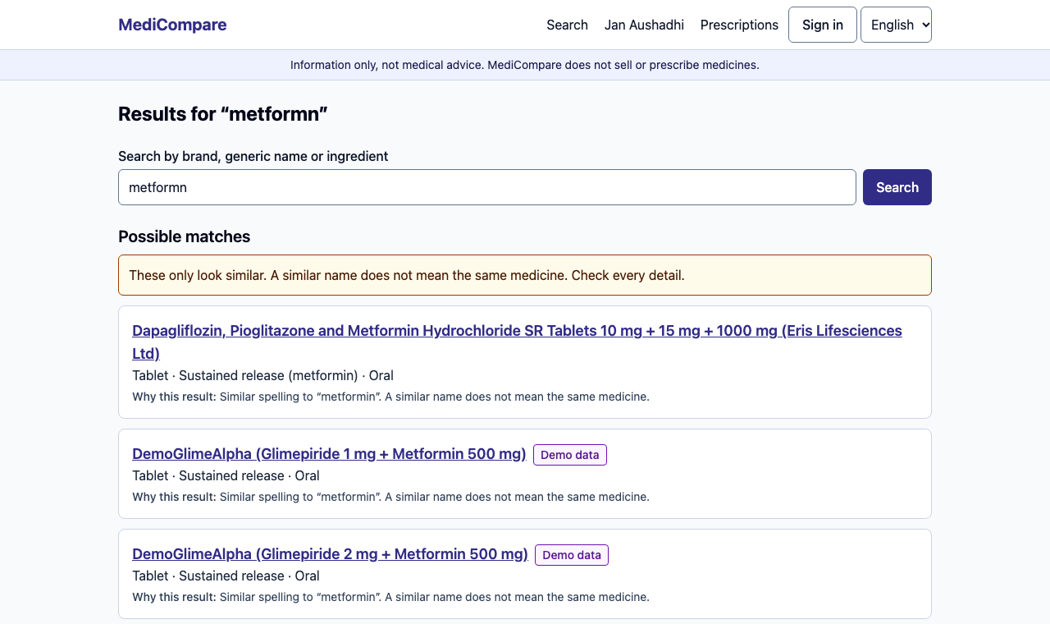
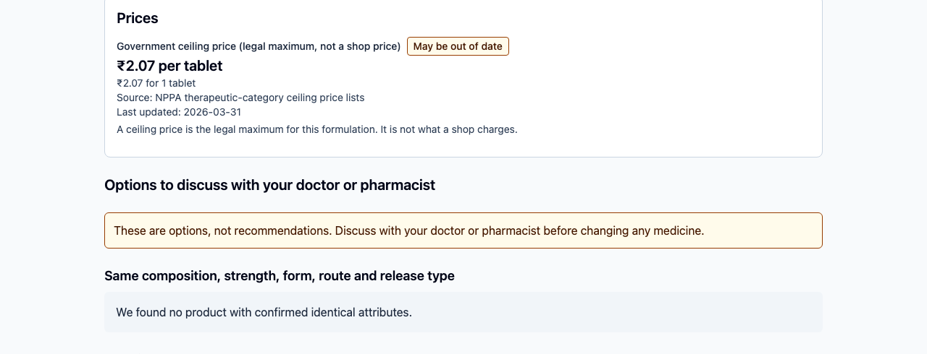
Search explains itself and labels every price
A typo finds possible matches, each with its reason and a warning.
A real NPPA ceiling price, labelled as a legal maximum and flagged as possibly out of date.
Notes:
Show that possible matches are separated, and that a ceiling price is labelled as a legal maximum.

Slide 5
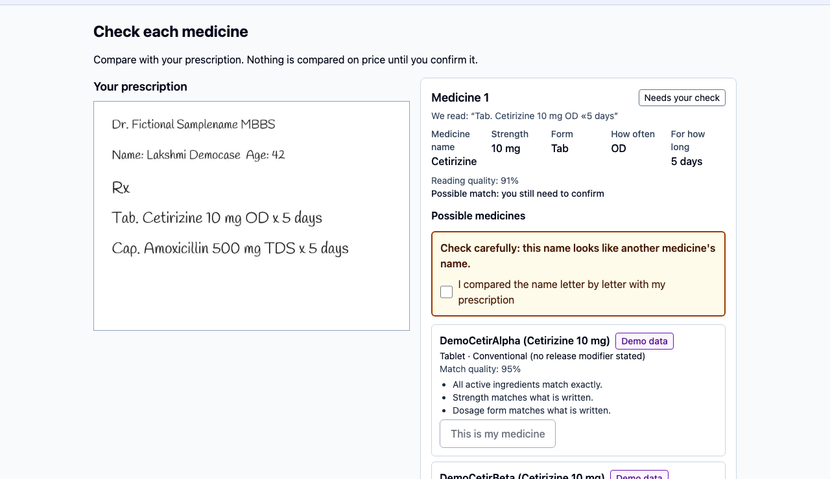
A person confirms every medicine before any price appears
The image sits beside what was read
Unreadable fields say "Unclear" or "Not found", and are never guessed
Candidates explain themselves, and none is pre-selected
Look-alike names lock confirmation until checked
Personal details are left out of extracted text
Notes:
This is the core flow. The look-alike check locks confirmation until it is acknowledged.

Slide 6
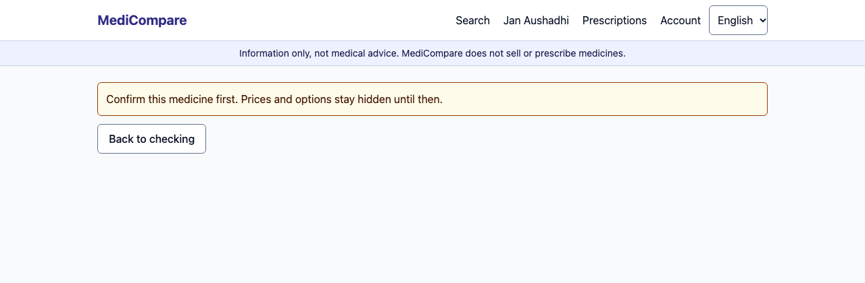
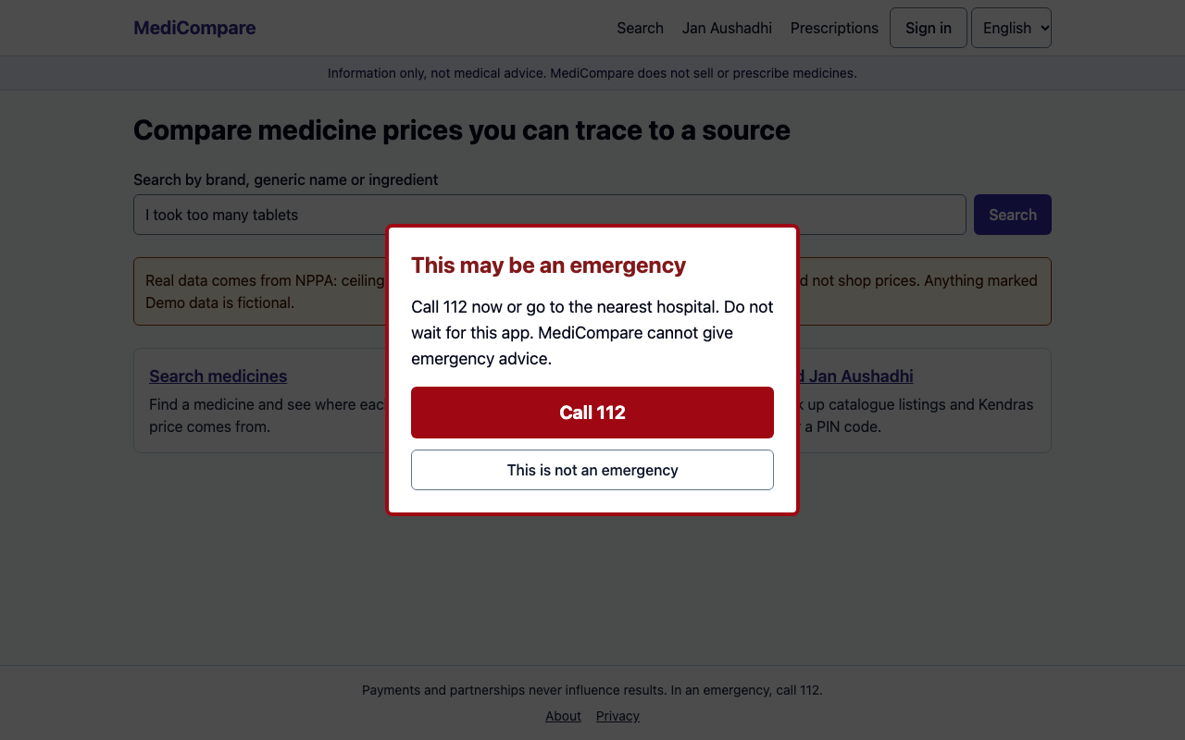
The server refuses, and emergencies interrupt
Unconfirmed item: prices stay hidden, even by direct API call (HTTP 409).
Emergency language in search, typing or OCR text shows 112, in English, Hindi and Tamil.
Notes:
The gate returns a 409 even for direct API calls. Emergency detection works in three languages but is pattern based.

Slide 7
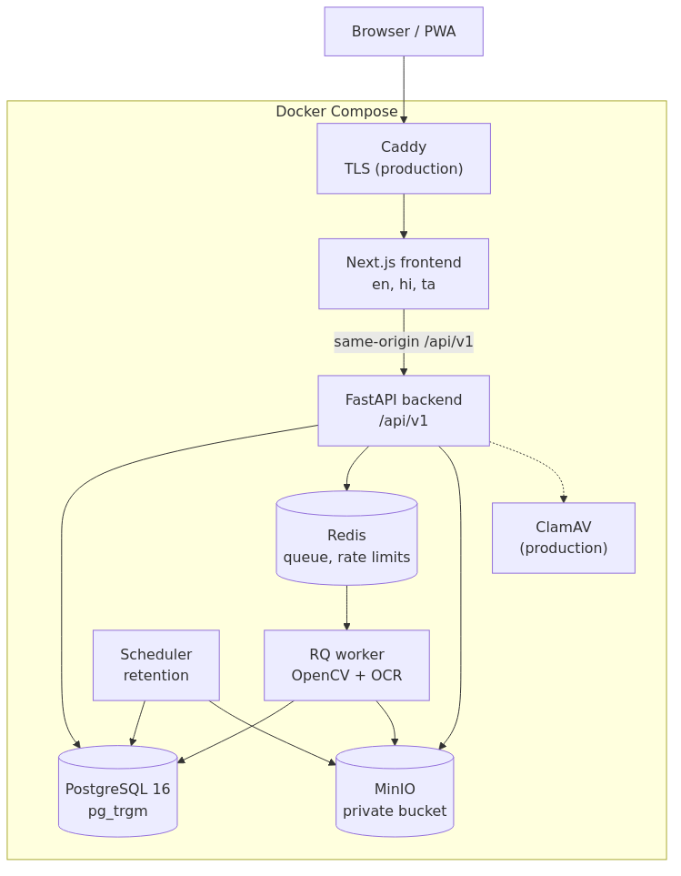
A modular monolith, with OCR isolated in a worker
Pure core
Safety, matching and pricing depend on no web or database code.
Provenance
352 real NPPA rows with batch and row links. 38 sent to review, not guessed.
Notes:
Safety, matching and pricing are pure, strictly typed modules.

Slide 8
Safety rules are enforced in code, and tested
Rule | How it is enforced
Unverified items never reach comparison | Server gate, database constraint, API bypass tests
Similar names are not the same medicine | Equivalence takes attributes, never names
An unstated salt form proves nothing | Refused, with the reason shown
Nothing is guessed | Fields are visible, unclear or unknown
Text in files is data, not instructions | No instruction channel exists in the pipeline
A ceiling price is not a shop price | Labelled, and no savings across price types
Notes:
99 tests in the safety suite.

Slide 9
On synthetic data, about 1 in 5 raw top matches was wrong
1/67
17.4%
false matches, tesseract, calibrated
of readable lines get a suggestion
Synthetic fonts are easier than real handwriting. This does not show real-world accuracy. The 95% upper bound is 8%. The engines cannot be told apart at this sample size.
Notes:
This is why a person must confirm. Synthetic handwriting is easier than the real thing, so these numbers do not show real-world accuracy.

Slide 10
17 of 17 automated gates pass from one command
295
99
40
530 ms
backend tests, 98.3% coverage
safety invariant tests
end-to-end runs with axe, on two viewports
search p95, local load test, 0 failures
Testing caught real mistakes
Partial words classed as exact matches ("met" for metformin and metoprolol). Demo accounts that could not sign in. Rate limits that would have grouped all users as one address. A virtual environment copied into images, more than doubling their size.
Notes:
Numbers are from VERIFICATION_REPORT.md. The load test ran on one laptop and is not a production capacity figure.

Slide 11
What is not done yet matters most
Data
Evidence
Shop prices are fictional. Real data is NPPA's legal maximums for part of the market. Jan Aushadhi data needs PMBI's permission.
No real handwriting evaluation. No users, no user research and no measured savings.
Review
Operations
No legal review, including whether this is medical device software. Hindi and Tamil need native review.
Not deployed. CI has not run on GitHub. No penetration test, and no test on a real low-end phone.
Notes:
State these without being asked.

Slide 12
What comes next
1
Get real shop prices, and permission from PMBI
2
Get legal review, starting with device classification
3
Run a consented, ethics-approved real-data evaluation
4
Test with pharmacists and patients

