Slide 1
Overview
Introduction
Stability Plasticity Dilemma
CLS Theory
3 Scenarios of CL.
4.1 Task Incremental Learning
4.2 Domain Incremental Learning
4.3 Class Incremental Learning
Strategies to prevent catastrophic forgetting
Mitigating forgetting without CL
Approaches to CL
Flashcards

Slide 2
Continual Learning & Catastrophic Forgetting

Slide 3
1. Introduction
The ability to continually learn over time by accommodating novel information while retaining previously learned experiences
Lifelong learning remains a long-standing challenge for machine learning and neural network models.

Slide 4
Challenges Faced
Prone to catastrophic forgetting i.e., training a model with new information interferes with previously learned knowledge.
This was also referred to as the stability-plasticity dilemma in Abraham and Robins [2005].

Slide 5
2.1 Stability - Plasticity Dilemma
The extent to which a system must be plastic in order to integrate novel information and
Stable in order not to catastrophically interfere with consolidated knowledge is known as the stability–plasticity dilemma.

Slide 6
2.2 Stability – Plasticity Balance In Our Brain
For a stable continuous lifelong process, two types of plasticity are required:
(i) Hebbian plasticity (Hebb, 1949) for positive feedback instability, and
(ii) Compensatory homeostatic plasticity which stabilizes neural activity.

Slide 7
3. CLS Theory – The Traditional Way
The CLS theory defines the complementary contribution of the hippocampus and the neocortex in learning and memory.
The hippocampal system exhibits short-term
The neocortex is characterized by a slow learning rate

Slide 8
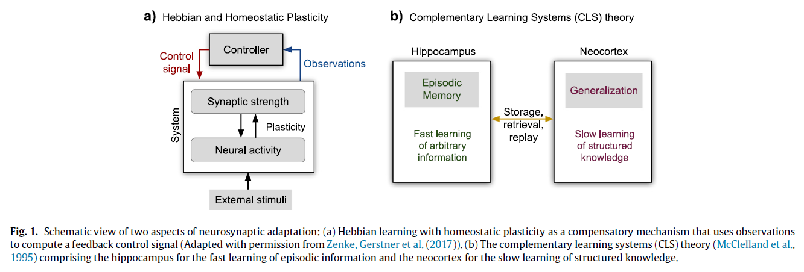

Slide 9
Three Scenarios of CL

Slide 10
4. Three Scenarios of CL
4.1 Task Incremental Learning
4.2 Domain Incremental Learning
4.3 Class Incremental Learning

Slide 11
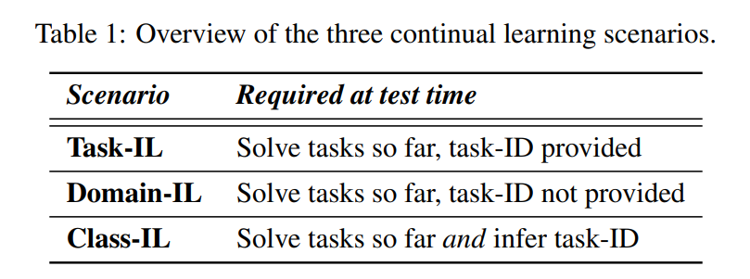
Source : Gido M. van de Ven, Andreas S. Tolias , Three scenarios for continual learning, [v1] Mon, 15 Apr 2019

Slide 12
4.1 Task Incremental Learning
Comparison with Single-Headed vs Multi-Headed Categorization Scheme
Models are always informed about which task needs to be performed
Task Identity is always provided
It is possible to train models with task-specific components
A typical network architecture used in this scenario has a “multi-headed” output layer, meaning that each task has its own output units but the rest of the network is (potentially) shared between tasks.
Multi-headed layout requires task identity to be known, while
a single-headed layout does not.
Source : Gido M. van de Ven, Andreas S. Tolias , Three scenarios for continual learning, [v1] Mon, 15 Apr 2019

Slide 13
4.2 Domain Incremental Learning
Task identity is not available at test time.
Models however only need to solve the task at hand; they are not required to infer which task it is.
Typical examples of this scenario are protocols whereby the structure of the tasks is always the same, but the input-distribution is changing.
A relevant real-world example is an agent who needs to learn to survive in different environments, without the need to explicitly identify the environment it is confronted with.
Source : Gido M. van de Ven, Andreas S. Tolias , Three scenarios for continual learning, [v1] Mon, 15 Apr 2019

Slide 14
4.3 Class Incremental Learning
Models must be able to both solve each task seen so far and infer which task they are presented with.
We refer to this scenario as class-incremental learning (Class-IL), as it includes the common real-world problem of incrementally learning new classes of objects.
Source : Gido M. van de Ven, Andreas S. Tolias , Three scenarios for continual learning, [v1] Mon, 15 Apr 2019

Slide 15
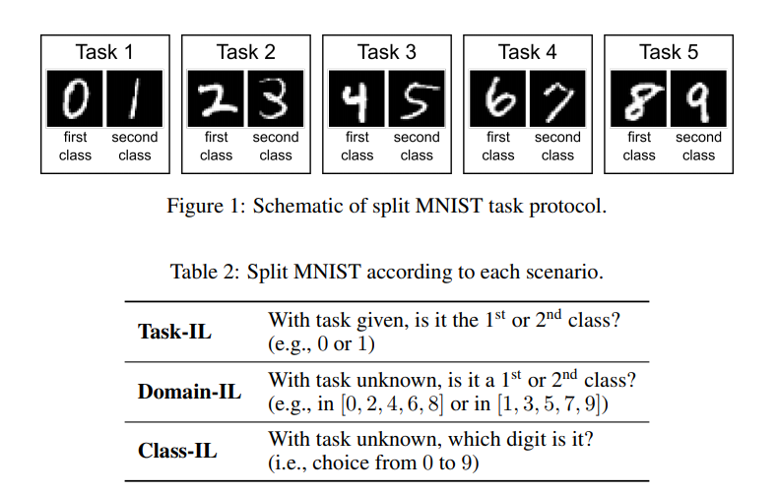
Source : Gido M. van de Ven, Andreas S. Tolias , Three scenarios for continual learning, [v1] Mon, 15 Apr 2019

Slide 16
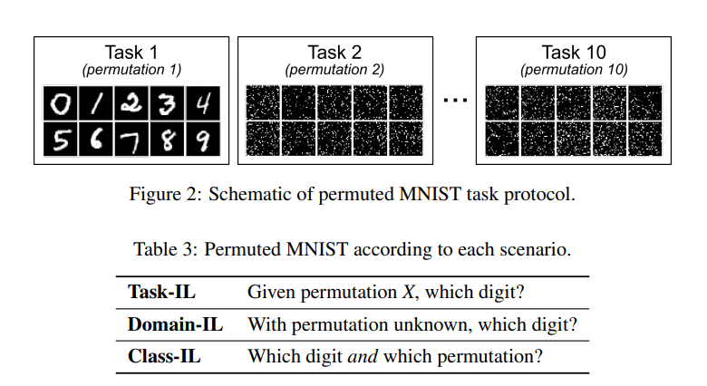
Task Bounderies
If there are no such boundaries between tasks—for example because transitions between tasks are gradual or continuous—the scenarios we describe here no longer apply, and the continual learning problem becomes less structured and potentially a lot harder.
Source : Gido M. van de Ven, Andreas S. Tolias , Three scenarios for continual learning, [v1] Mon, 15 Apr 2019

Slide 17
5. Strategies to prevent catastrophic forgetting
5.1 Task-specific Components
5.2 Regularized Optimization
5.3 Modifying Training Data
5.4 Using Exemplars

Slide 18
5.1 Task-specific Components
5.2 Regularized Optimization
Not optimizing the entire network on each task could be one strategy for alleviating catastrophic forgetting.
Several recent papers use this strategy, with different approaches for selecting the parts of the network for each task.
Regularizing the network’s parameters during training on each new task, which is EWC and SI.
Estimating for all parameters of the network how important they are for the previously learned tasks and penalize future changes to them accordingly .
Source : Gido M. van de Ven, Andreas S. Tolias , Three scenarios for continual learning, [v1] Mon, 15 Apr 2019
Notes:
A simple explanation for catastrophic forgetting is that after a neural network is trained on a new task, its parameters are optimized for the new task and no longer for the previous one(s).

Slide 19
5.3 Modifying Training Data
5.4 Using Exemplars
An alternative strategy for alleviating catastrophic forgetting is to complement the training data for each new task to be learned with “pseudo-data” representative of the previous tasks.
This strategy is referred to as replay.
Store data from previous tasks.
Use stored data as “exemplars” during execution.

Slide 20
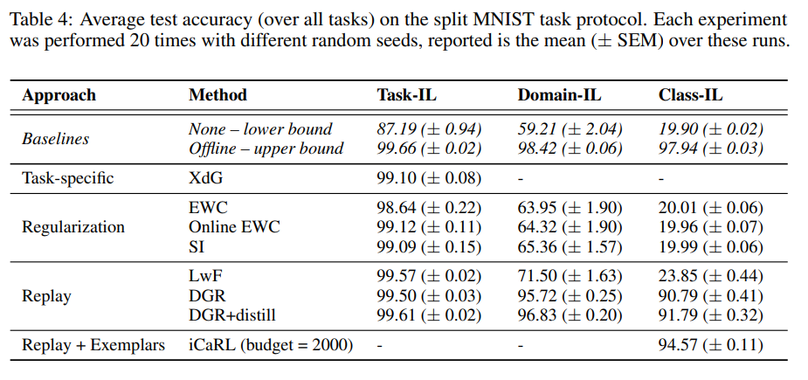
Source : Gido M. van de Ven, Andreas S. Tolias , Three scenarios for continual learning, [v1] Mon, 15 Apr 2019

Slide 21
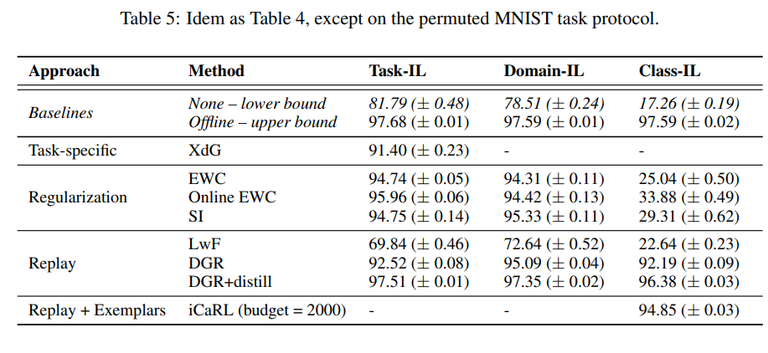
Source : Gido M. van de Ven, Andreas S. Tolias , Three scenarios for continual learning, [v1] Mon, 15 Apr 2019

Slide 22
Some conclusions
For the class-incremental learning scenario, currently only replay-based methods are capable of producing acceptable results.
The good performance of LwF (i.e., replaying inputs from the current task) on the split MNIST task protocol suggests that even if the quality of replayed samples is not perfect, they could still be very helpful.
Source : Zhiyuan Chen and Bing Liu, Lifelong Machine Learning,Morgan & Claypool, Second Edition, 2018

Slide 23
6. How To Mitigate Forgetting (without using CL)
Train from scratch with new and old data
Drawbacks
Many industry networks take days-weeks to train
Waste of computation power
Original training data may be unavailable
Replay old training data with new data
Drawbacks
Requires storing old data
Storage costs grow linearly with tasks

Slide 24
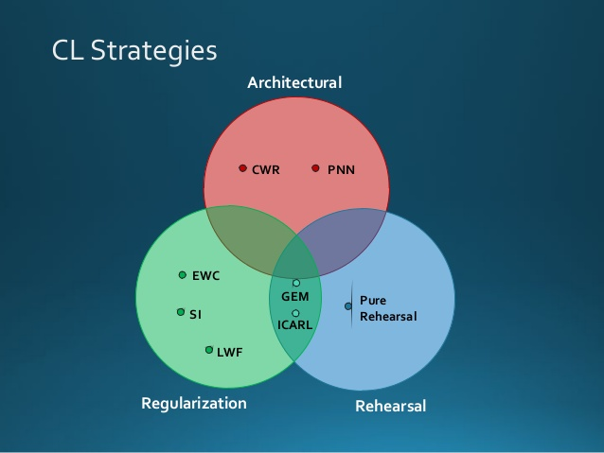
7. Approaches Using Continual Learning
Parameterized Approach (basic)
Regularization Approach
2.1 Supervised learning
2.2 Unsupervised learning
2.3 Reinforcement learning
Dynamic Architectures(add neurons)
3.1 Progressive Neural Networks
Generative Replay
4.1 Generative Adversarial Networks
4.2 Generative Replay

Slide 25
7.1 Parameterized Approach
Li and Hoiem [2016] presented an excellent overview of the traditional methods for dealing with catastrophic forgetting. They characterized three sets of parameters in a typical approach:
ϴ_{s}: set of parameters shared across all tasks;
ϴ_{o}: set of parameters learned specifically for previous tasks; and
ϴ_{n}: randomly initialized task-specific parameters for new tasks.

Slide 26
Approach Used
Feature Extraction : both ϴ_{s} and ϴ₀ remain the same while the outputs of some layers are used as features for training ϴ_{n} for the new task.
Fine-tuning : ϴ_{s} and ϴ_{n} are optimized and updated for the new task while ϴ₀ remains fixed.
Joint Training : All the parameters ϴ_{s ,} ϴ_{0 ,} ϴ_{n} are jointly optimized across all tasks.

Slide 27
7.2 Regularization Approach
2.1 Supervised learning
2.1.1 Learning without forgetting(LWF Theory)
2.1.2 Elastic Weight Consolidation (EWC Theory)
2.2 Unsupervised learning
2.2.1 Goodrich and Arel [2014] unsupervised online clustering
2.3 Reinforcement learning
2.3.1 Mankowitz et al. [2018] proposed a continual learning agent architecture called Unicorn.

Slide 28
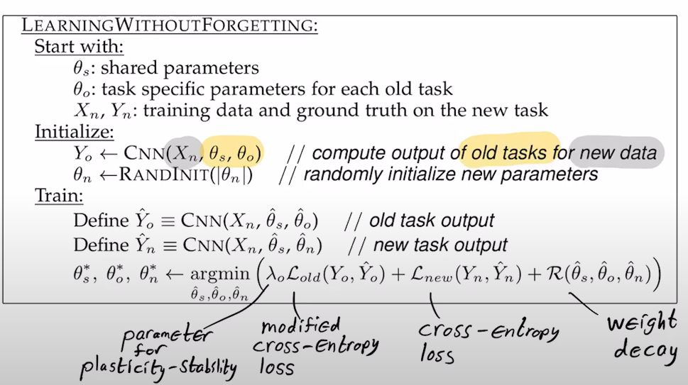
2.1.1 Learning without forgetting(LWF)
Update network weights or parameters, but, penalize changes in order to minimize forgetting
Consider a predictor with shared params across tasks and some task specific params.

Slide 29
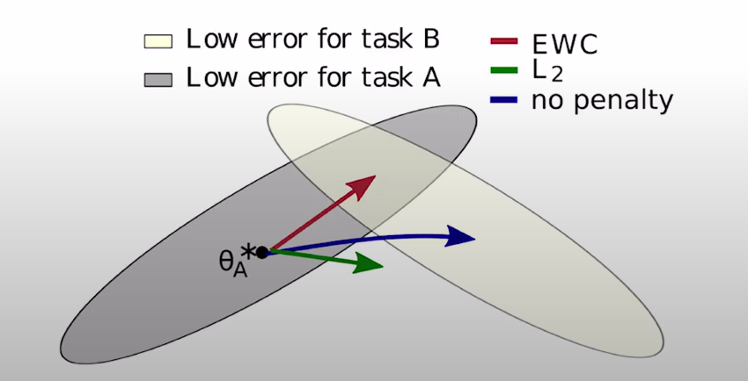
2.1.2 Elastic Weight Consolidation (EWC Theory)
Kirkpatrick et al. [2017] illustrated their idea using an example consisting of two tasks A and B
the loss function of EWC is given by
L(θ) = L_{B}(θ) + Σ [λ/2(F_{i}(θ_{i} − θ*_{A,i})²)] ,
where, F_{i} = E_{x}(d_{θi} log P_{θ}(x))

Slide 30
2.2.1 Goodrich And Arel [2014] Unsupervised Online Clustering
Goodrich and Arel [2014] studied unsupervised online clustering in neural networks to help mitigate catastrophic forgetting.
They proposed building a path through the neural network to select neurons during the feed-forward pass.
In the new task, when a sample arrives, only the neurons whose cluster centroid points are close to the sample are selected.

Slide 31
2.3.1 Unicorn
Mankowitz et al. [2018] proposed a continual learning agent architecture called Unicorn.
The Unicorn agent is designed to have the ability to simultaneously learn about multiple tasks including the new tasks.
The agent can reuse its accumulated knowledge to solve related tasks effectively.

Slide 32
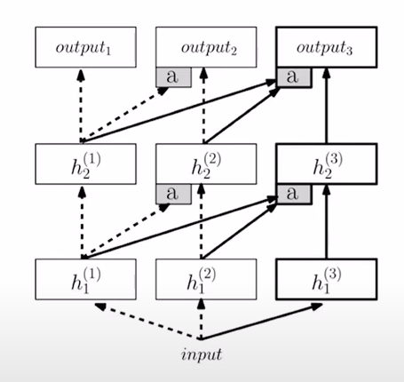
3.1 Progressive Neural Networks
For each new task,
Add neurons
Add output layer
Add lateral connections
Don’t modify old weights

Slide 33
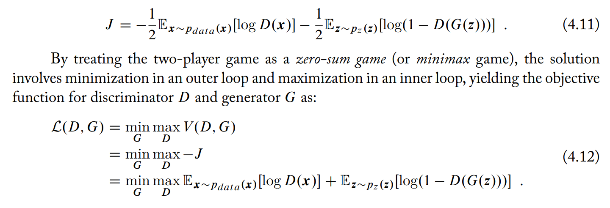
4.1 Generative Adversarial Networks
In GANs, there are two players: a generator and a discriminator.
Generator creates samples that mimic training data, i.e., drawing samples from the similar (ideally same) distribution as the training data.
The discriminator classifies the samples to tell whether they are real (from real training data) or fake (from samples created by the generator).
Cost Function

Slide 34
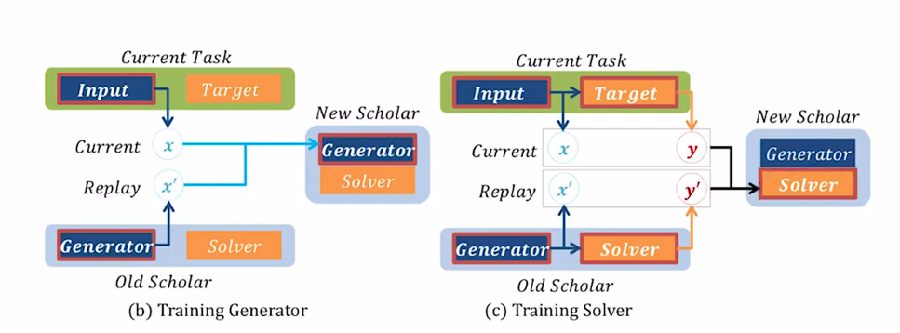
4.2 Generative Replay
Train a generative model to output synthetic data that follows the same distribution as training data.
The model contains a generator G and a solver S with parameters ϴ.

Slide 35
8. Flashcards

Slide 36
Moving towards Continual Learning
Deep neural networks :-
Successful in a variety of applications, such as computer vision.
But:-
Difficult to extract and reuse the knowledge embedded in the representations learned by the model.
Hence deep neural networks fail to learn continually without catastrophically forgetting the past sequences (tasks).
Approaches like transfer learning or knowledge distillation enables functional transfer of knowledge from one model to other.
But none of these satisfy all CL(continual learning) requirements.
Hence:-
Flashcards
Source: Saisubramaniam Gopalakrishnan , Pranshu Ranjan Singh , Haytham Fayek , Savitha Ramasamy, Arulmurugan Ambikapathi
Knowledge Capture and Replay for Continual Learning, 2020

Slide 37
Continual Learning Requirements
Knowledge retention
Knowledge transfer
Parameter efficiency
Model expansion
There is a need of methods that can effectively capture and repurpose knowledge ; And hence flashcards.
Source: Saisubramaniam Gopalakrishnan , Pranshu Ranjan Singh , Haytham Fayek , Savitha Ramasamy, Arulmurugan Ambikapathi
Knowledge Capture and Replay for Continual Learning, 2020

Slide 38
Why Flashcards ?
Prevents Catastrophic forgetting.
Only need to be constructed just before learning a new task.
Works well irrespective of the number of tasks trained before.
Irrespective of number of tasks trained before, hence task agnostic.
There are studies proving that CL algorithm with flashcards as a replay strategy perform better than other state-of-the-art replay methods.
Source: Saisubramaniam Gopalakrishnan , Pranshu Ranjan Singh , Haytham Fayek , Savitha Ramasamy, Arulmurugan Ambikapathi
Knowledge Capture and Replay for Continual Learning, 2020

Slide 39
“Flashcards”
Knowledge Skimmers
Captures knowledge as representation from trained AE network.
Passing that “captured knowledge” alone(Rather than the initial data) with new data to the train network.
Having performance close to network trained with original data.
USECASES
Training a different architecture (bigger or smaller) by just using the representations captures from the current network.
In a CL scenario to remember information related to previous tasks, etc.
Source: Saisubramaniam Gopalakrishnan , Pranshu Ranjan Singh , Haytham Fayek , Savitha Ramasamy, Arulmurugan Ambikapathi
Knowledge Capture and Replay for Continual Learning, 2020

Slide 40
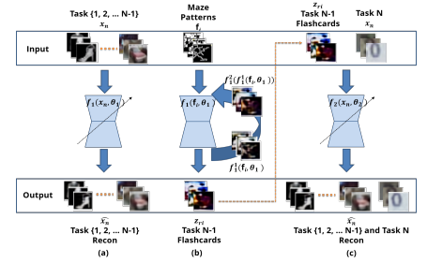

Understanding the construction
The Auto-Encoder is trained on some data to finally approximate function
We basically train for task 1 to N-1.
And the function is able to reconstruct the
distribution with the error bounded between [є1, є2].
Source: Saisubramaniam Gopalakrishnan , Pranshu Ranjan Singh , Haytham Fayek , Savitha Ramasamy, Arulmurugan Ambikapathi
Knowledge Capture and Replay for Continual Learning, 2020

Slide 41
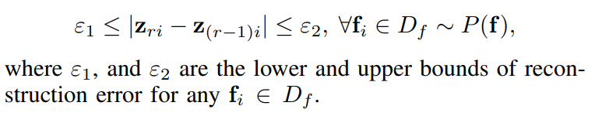


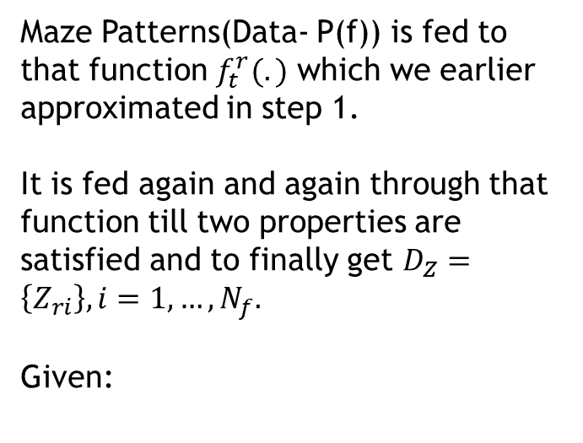
Understanding the construction
Maze Patterns(Data- P(f)) is fed to that function $f_{t}^{r}(.)$ which we earlier approximated in step 1.
It is fed again and again through that function till two properties are satisfied and to finally get $D_{Z}=\left\{Z_{ri}\right\}, i=1,…,N_{f}.$
Given:
Source: Saisubramaniam Gopalakrishnan , Pranshu Ranjan Singh , Haytham Fayek , Savitha Ramasamy, Arulmurugan Ambikapathi
Knowledge Capture and Replay for Continual Learning, 2020

Slide 42
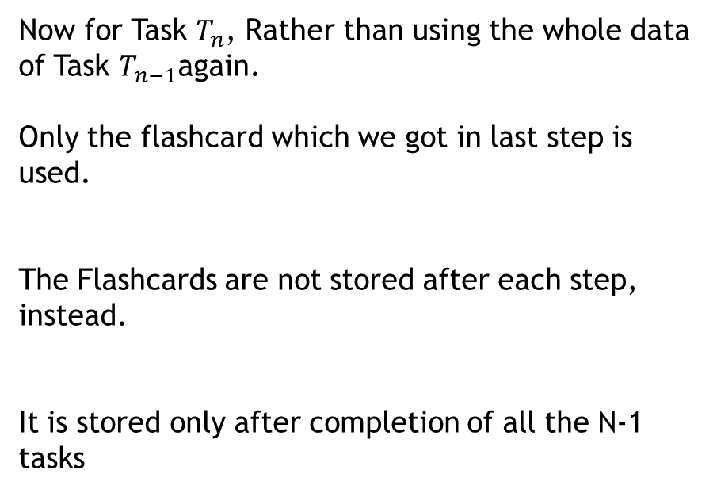
Understanding the construction
Now for Task $T_{n}$, Rather than using the whole data of Task $T_{n−1}$again.
Only the flashcard which we got in last step is used.
The Flashcards are not stored after each step, instead.
It is stored only after completion of all the N-1 tasks
Source: Saisubramaniam Gopalakrishnan , Pranshu Ranjan Singh , Haytham Fayek , Savitha Ramasamy, Arulmurugan Ambikapathi
Knowledge Capture and Replay for Continual Learning, 2020

Slide 43
Pluses
Storing of dataset again and again is not required, Instead a flashcards(knowledge representation of the dataset) can be constructed as an alternative.
Flashcards can be used to transfer model to bigger models.
Continual Denoising
Source: Saisubramaniam Gopalakrishnan , Pranshu Ranjan Singh , Haytham Fayek , Savitha Ramasamy, Arulmurugan Ambikapathi
Knowledge Capture and Replay for Continual Learning, 2020

Slide 44
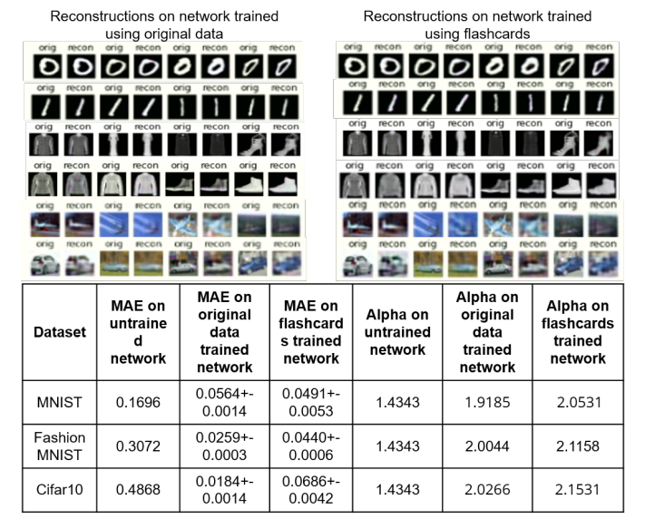
Source: Saisubramaniam Gopalakrishnan , Pranshu Ranjan Singh , Haytham Fayek , Savitha Ramasamy, Arulmurugan Ambikapathi
Knowledge Capture and Replay for Continual Learning, 2020

Slide 45
THANK YOU
Akshat Sharma 19BAI1080
Karan Yuvraj Singh 19BLC1097

