Slide 1
SENTIBot
MENU
ANALYSIS
CONTACT
sentibot
Akshat Saklani 502004128
Ritik Raina 502004131

Slide 2
What is Sentibot?
MENU
ANALYSIS
CONTACT
sentibot
Sentibot does smart Sentiment Analysis which is a set of tools to identify and extract opinions and use them for the benefit of the Business Operation.

Slide 3
Introduction
Menu
ANALYSIS
CONTACT
sentibot
What is Sentiment Analysis
Sentiment analysis refers to identifying as well as classifying the sentiments that are expressed in the text source. Tweets are often useful in generating a vast amount of sentiment data upon analysis. These data are useful in understanding the opinion of the people about a variety of topics.
Therefore we need to develop an Automated Machine Learning Sentiment Analysis Model in order to compute the customer perception. Due to the presence of non-useful characters (collectively termed as the noise) along with useful data, it becomes difficult to implement models on them.

Slide 4
WORKFLOW
MENU
ANALYSIS
CONTACT
sentibot
We aim to analyze the sentiment of the tweets provided from the Sentiment140 dataset by developing a machine learning pipeline involving the use of three classifiers -
Logistic Regression
Bernoulli Naive Bayes
SVM
along with using Term Frequency- Inverse Document Frequency (TF-IDF). The performance of these classifiers is then evaluated using accuracy and F1 Scores.

Slide 5
Problem statement
MENU
ANALYSIS
CONTACT
sentibot
In this project, we try to implement a Twitter Sentiment Analysis model that helps to overcome the challenges of identifying the sentiments of the tweets. The necessary details regarding the dataset are:
The dataset provided is the Sentiment140 Dataset which consists of 1,600,000 tweets that have been extracted using the Twitter API. The various columns present in the dataset are:

Slide 6
Problem statement - columns
target
id’S
date
flag
user
text
MENU
ANALYSIS
CONTACT
sentibot
The polarity of the tweet (positive or negative)
Unique id of the tweet
The date of the tweet
It refers to the query. If no such query exists then it is NO QUERY.
It refers to the name of the user that tweeted
It refers to the text of the tweet

Slide 7
Project pipeline
MENU
ANALYSIS
CONTACT
sentibot
Import Necessary Dependencies
01
02
Read and Load the Dataset
04
03
Data Visualization of Target Variables
Exploratory Data Analysis
05
06
Data Preprocessing
Splitting our data into Train and Test Subset

Slide 8
Project pipeline
MENU
ANALYSIS
CONTACT
sentibot
Transforming Dataset using TF-IDF Vectorizer
07
08
Function for Model Evaluation
10
09
Conclusion
Model Building

Slide 9
Step I - Import Necessary Dependencies
MENU
ANALYSIS
CONTACT
sentibot
Importing necessary libraries namely –
re
numpy
pandas
seaborn
WordCloud
matplotlib
nltk
sklearn

Slide 10
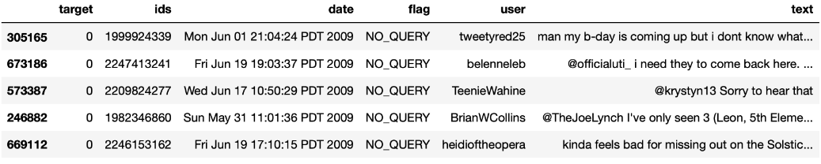
Step Ii - Read and Load the Dataset
MENU
ANALYSIS
CONTACT
sentibot
Reading the dataset and loading into python environment

Slide 11
Step Iii - Exploratory Data Analysis
MENU
ANALYSIS
CONTACT
sentibot
Exploring the dataset for its Features and any Anomalies
Checking Column, Index, Length, Shape and Info
Checking column types
Checking for Null Values
Checking Unique Target Values
Checking the number of target values

Slide 12
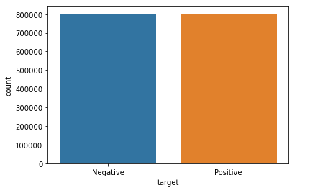
Step IV - Data Visualization
MENU
ANALYSIS
CONTACT
sentibot
Distribution of data
Distribution of data into Positives and Negatives

Slide 13
Step v - Data Preprocessing
MENU
ANALYSIS
CONTACT
sentibot
Before training the model, we have performed various pre-processing steps on the dataset that mainly dealt with removing stop words, removing emojis. The text document is then converted into the lowercase for better generalization.
Subsequently, the punctuations were cleaned and removed thereby reducing the unnecessary noise from the dataset. After that, we have also removed the repeating characters from the words along with removing the URLs as they do not have any significant importance.
At last, we then performed Stemming (reducing the words to their derived stems) and Lemmatization (reducing the derived words to their root form known as lemma) for better results.

Slide 14
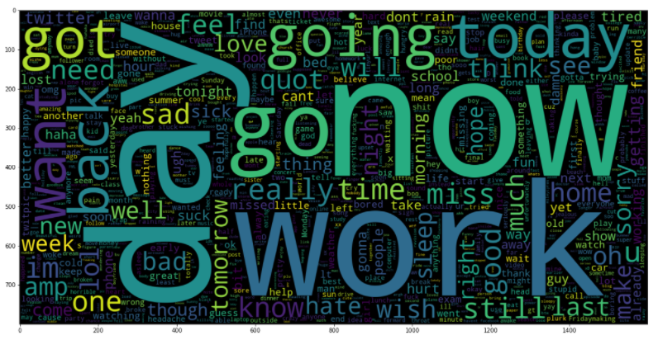
Step v - Data Preprocessing
MENU
ANALYSIS
CONTACT
sentibot
Plotting data
Cloud of words for Negative tweets

Slide 15
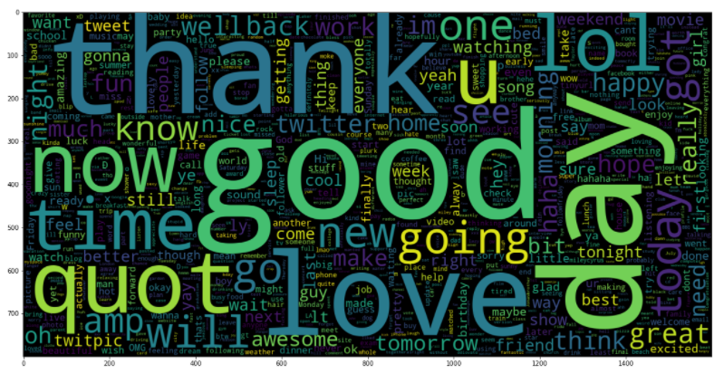
Step v - Data Preprocessing
MENU
ANALYSIS
CONTACT
sentibot
Plotting data
Cloud of words for Positive tweets

Slide 16
Step vi - Splitting data
Step vii - Transforming Dataset
MENU
ANALYSIS
CONTACT
Data ANALYSIS
Separating 95% data for training and 5% data for testing
Fitting the TF-IDF Vectorizer which Transforms text to feature vectors that can be used as input to estimator.

Slide 17
Step viii - Function For Model Evaluation
MENU
ANALYSIS
CONTACT
sentibot
After training the model we then apply the evaluation measures to check how the model is performing. Accordingly, we use the following evaluation parameters to check the performance of the models respectively :
Accuracy Score
Confusion Matrix with Plot
ROC-AUC Curve

Slide 18
Step ix - Model Building
MENU
ANALYSIS
CONTACT
sentibot
In the problem statement we have used three different models respectively :
Bernoulli Naive Bayes
SVM (Support Vector Machine)
Logistic Regression
The idea behind choosing these models is that we want to try all the classifiers on the dataset ranging from simple ones to complex models and then try to find out the one which gives the best performance among them.

Slide 19

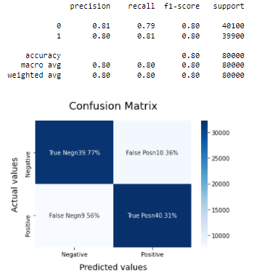
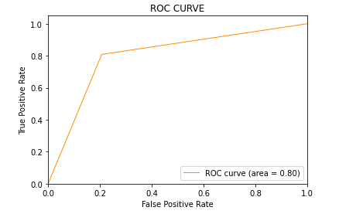
MENU
ANALYSIS
CONTACT
sentibot
BnB Model

Slide 20
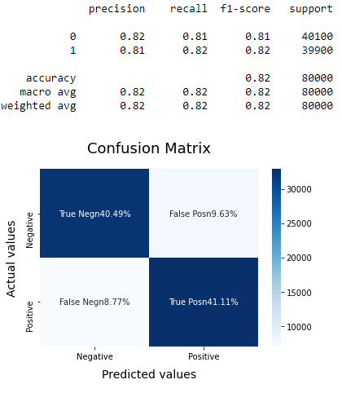
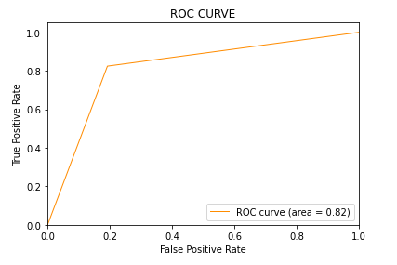
SVM Model
MENU
ANALYSIS
CONTACT
sentibot

Slide 21
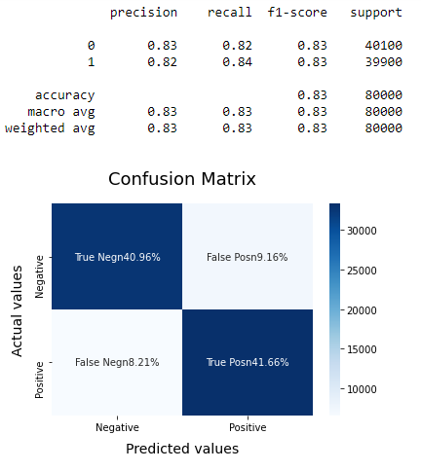
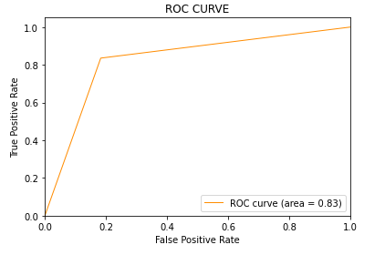
LR Model
MENU
ANALYSIS
CONTACT
sentibot

Slide 22
Step x - Conclusion
MENU
ANALYSIS
CONTACT
sentibot
Upon evaluating all the models we can conclude the following details i.e.
Accuracy: As far as the accuracy of the model is concerned Logistic Regression performs better than SVM which in turn performs better than Bernoulli Naive Bayes.
F1-score: The F1 Scores for class 0 and class 1 are :
(a) For class 0: Bernoulli Naive Bayes(accuracy = 0.90) < SVM (accuracy =0.91) < Logistic Regression (accuracy = 0.92)
(b) For class 1: Bernoulli Naive Bayes (accuracy = 0.66) < SVM (accuracy = 0.68) < Logistic Regression (accuracy = 0.69)
AUC Score: All three models have the same ROC-AUC score.
We, therefore, conclude that the Logistic Regression is the best model for the above-given dataset.

Slide 23
THANK YOU
MENU
ANALYSIS
CONTACT
sentibot

