Slide 1

DMSNet : Dual multi-scale networks for diabetic foot ulcer segmentation using contrastive learning
Machine Intelligence for Medical Image Analysis
Presented by Akshat Dhamale (20BAI1308)

Slide 2
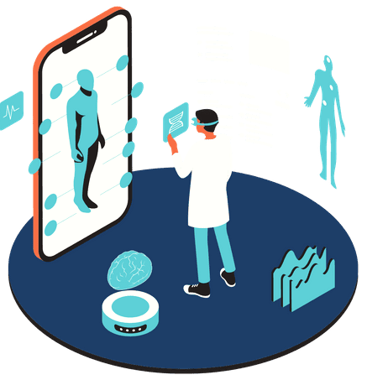
INTRODUCTION
About 60% of diabetics will develop neuropathy, eventually leading to a foot ulcer.
Around 15 to 25% of patients with diabetes mellitus will develop a diabetic foot ulcer during their lifetime.
They may lead to lower limb amputation.
Effective way to detect and monitor ulcer treatment is required

Slide 3
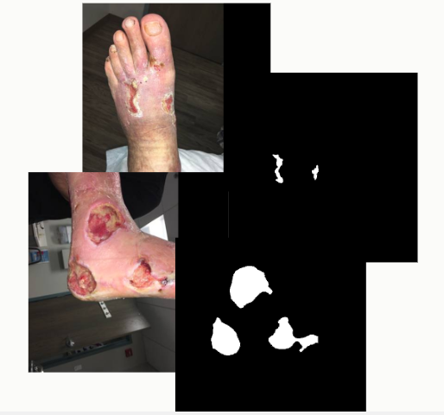
DATASETS
1
2
3
Medetek daabase : contains free stock images of all types of open wounds such as arterial leg ulcers pressure ulcers (pressure sores), diabetic ulcers and other miscellaneous wound types, all of which may be regularly encountered by a wound care practitioner.
Foot ulcer segmentation challenge 2021 : The goal of this challenge is to segment the wound area from natural images during clinical visits. In the dataset provided, over 1000 images are collected over 2 years from hundreds of patients.
AZH dataset : collected over a two-year clinical period at the AZH Wound and Vascular Center in Milwaukee, Wisconsin. The dataset includes 730 wound images in .jpg format.

Slide 4
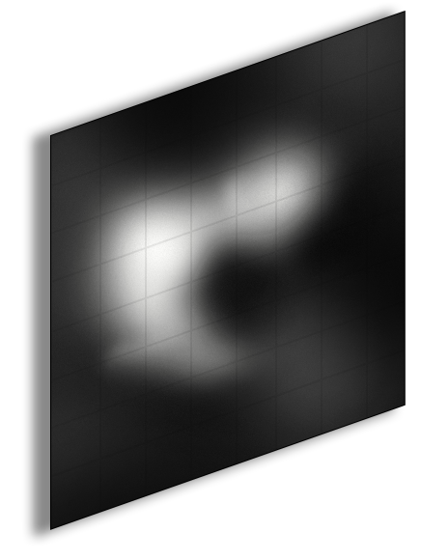
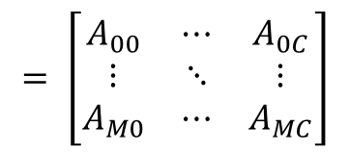


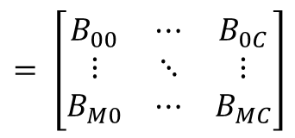
Mapping to supervised learning
$$= \left[\begin{matrix}A_{00} & ⋯ & A_{0C} \\ ⋮ & ⋱ & ⋮ \\ A_{M0} & ⋯ & A_{MC}\end{matrix}\right]$$
$$\left\{Z^{+}\right\}$$
$$= \left[\begin{matrix}B_{00} & ⋯ & B_{0C} \\ ⋮ & ⋱ & ⋮ \\ B_{M0} & ⋯ & B_{MC}\end{matrix}\right]$$
$$\left\{Z^{−}\right\}$$
1 × M × M

Slide 5
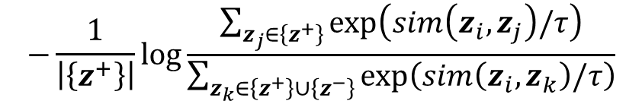
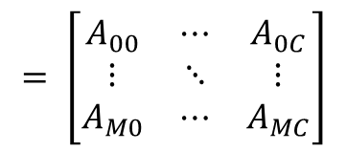
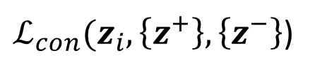


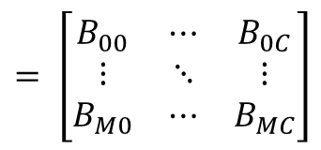
Mapping to supervised learning
$$= \left[\begin{matrix}A_{00} & ⋯ & A_{0C} \\ ⋮ & ⋱ & ⋮ \\ A_{M0} & ⋯ & A_{MC}\end{matrix}\right]$$
$$\left\{Z^{+}\right\}$$
$ℒ_{con}(z_{i}, \left\{z^{+}\right\},\left\{z^{−}\right\}$)
$$−\frac{1}{\left|\left\{z^{+}\right\}\right|}log⁡\frac{\sum_{z_{j}∈\left\{z^{+}\right\}}{exp⁡\left(sim\left(z_{i}, z_{j}\right)/τ\right)}}{\sum_{z_{k}∈\left\{z^{+}\right\}∪\left\{z^{−}\right\}}{exp⁡\left(sim\left(z_{i}, z_{k}\right)/τ\right)}}$$
$$= \left[\begin{matrix}B_{00} & ⋯ & B_{0C} \\ ⋮ & ⋱ & ⋮ \\ B_{M0} & ⋯ & B_{MC}\end{matrix}\right]$$
1 × M × M
$$\left\{Z^{−}\right\}$$

Slide 6









Segmentation model
INPUT IMAGE
MODEL OUTPUT
3 × H × W
1 × H × W

Slide 7
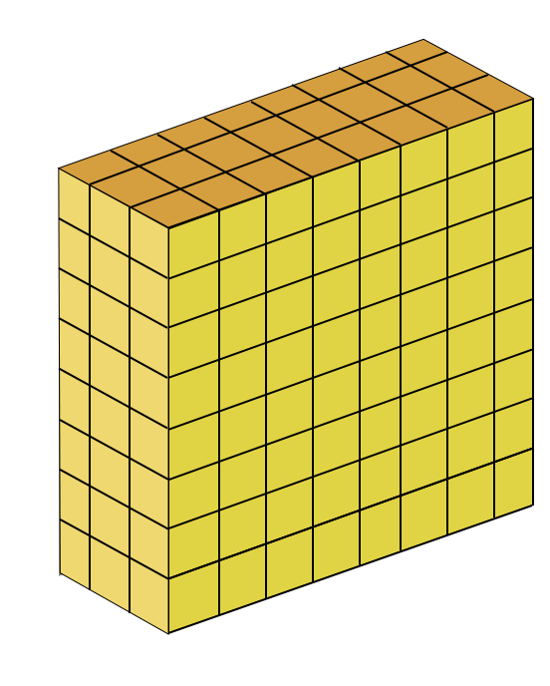

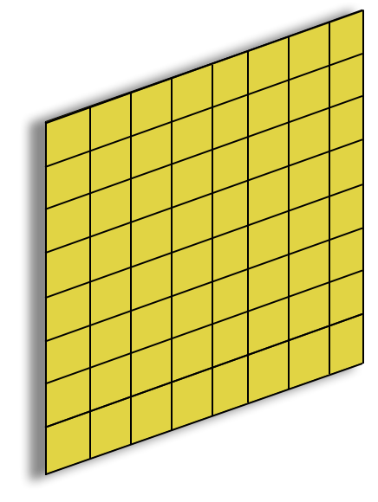
Segmentation model
INPUT IMAGE
MODEL OUTPUT
3 × H × W
1 × H × W
EMBEDDED FEATURE
OUTPUT MASK
BOUNDARY AWARE SAMPLING

Slide 8
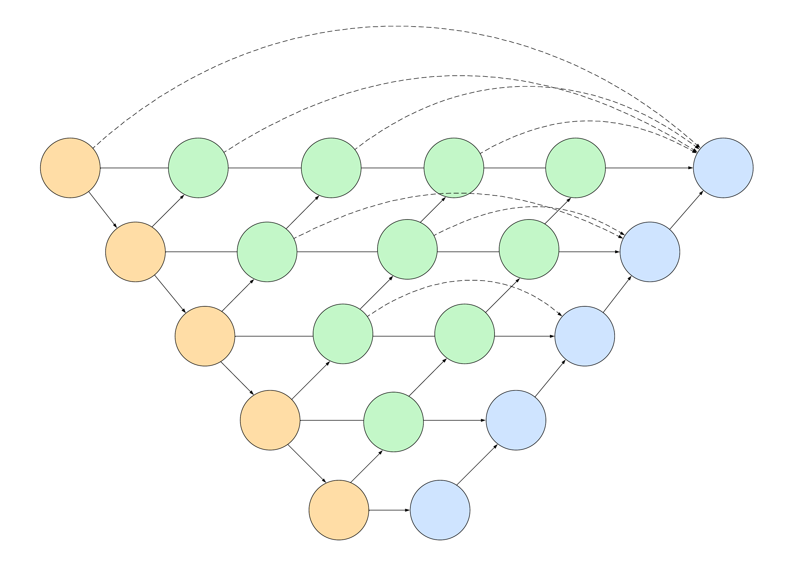
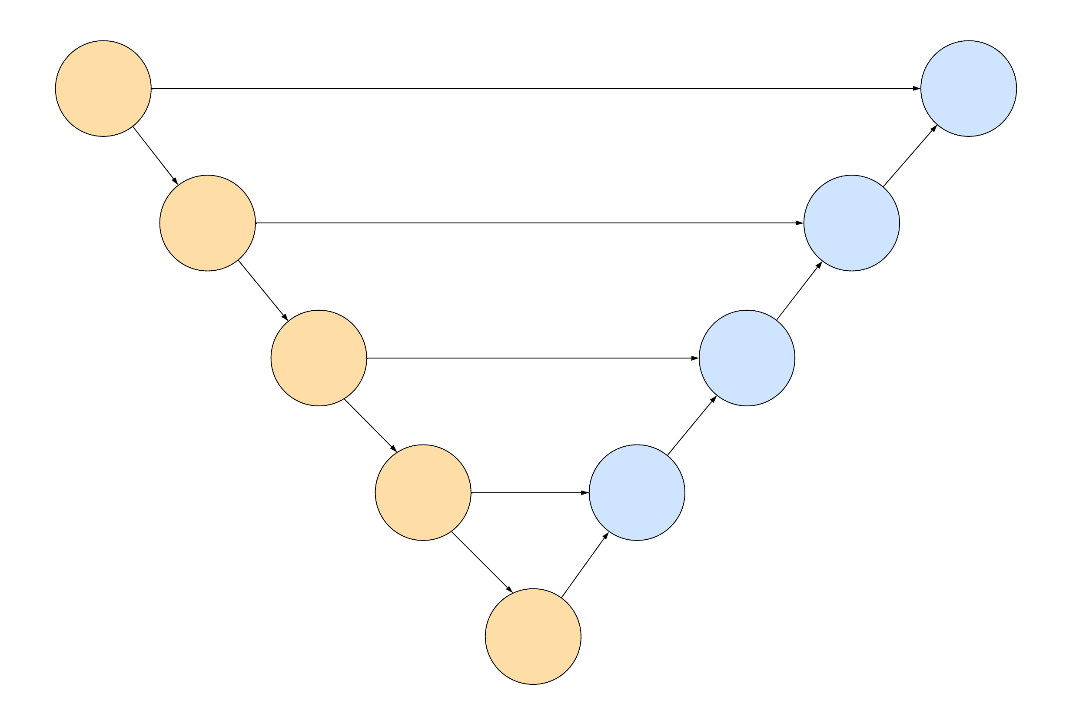
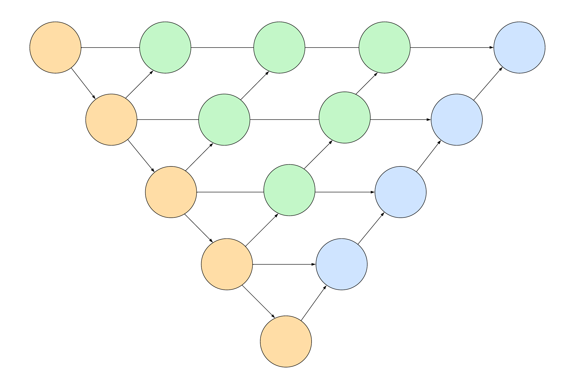
Inspiration
U-Net
U-Net++
MSNet

Slide 9
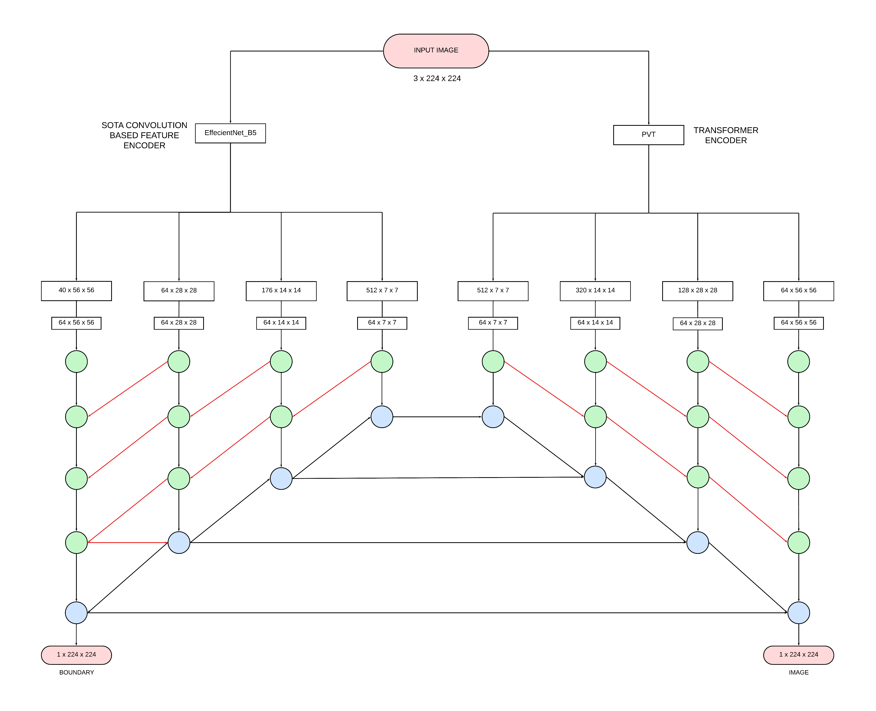
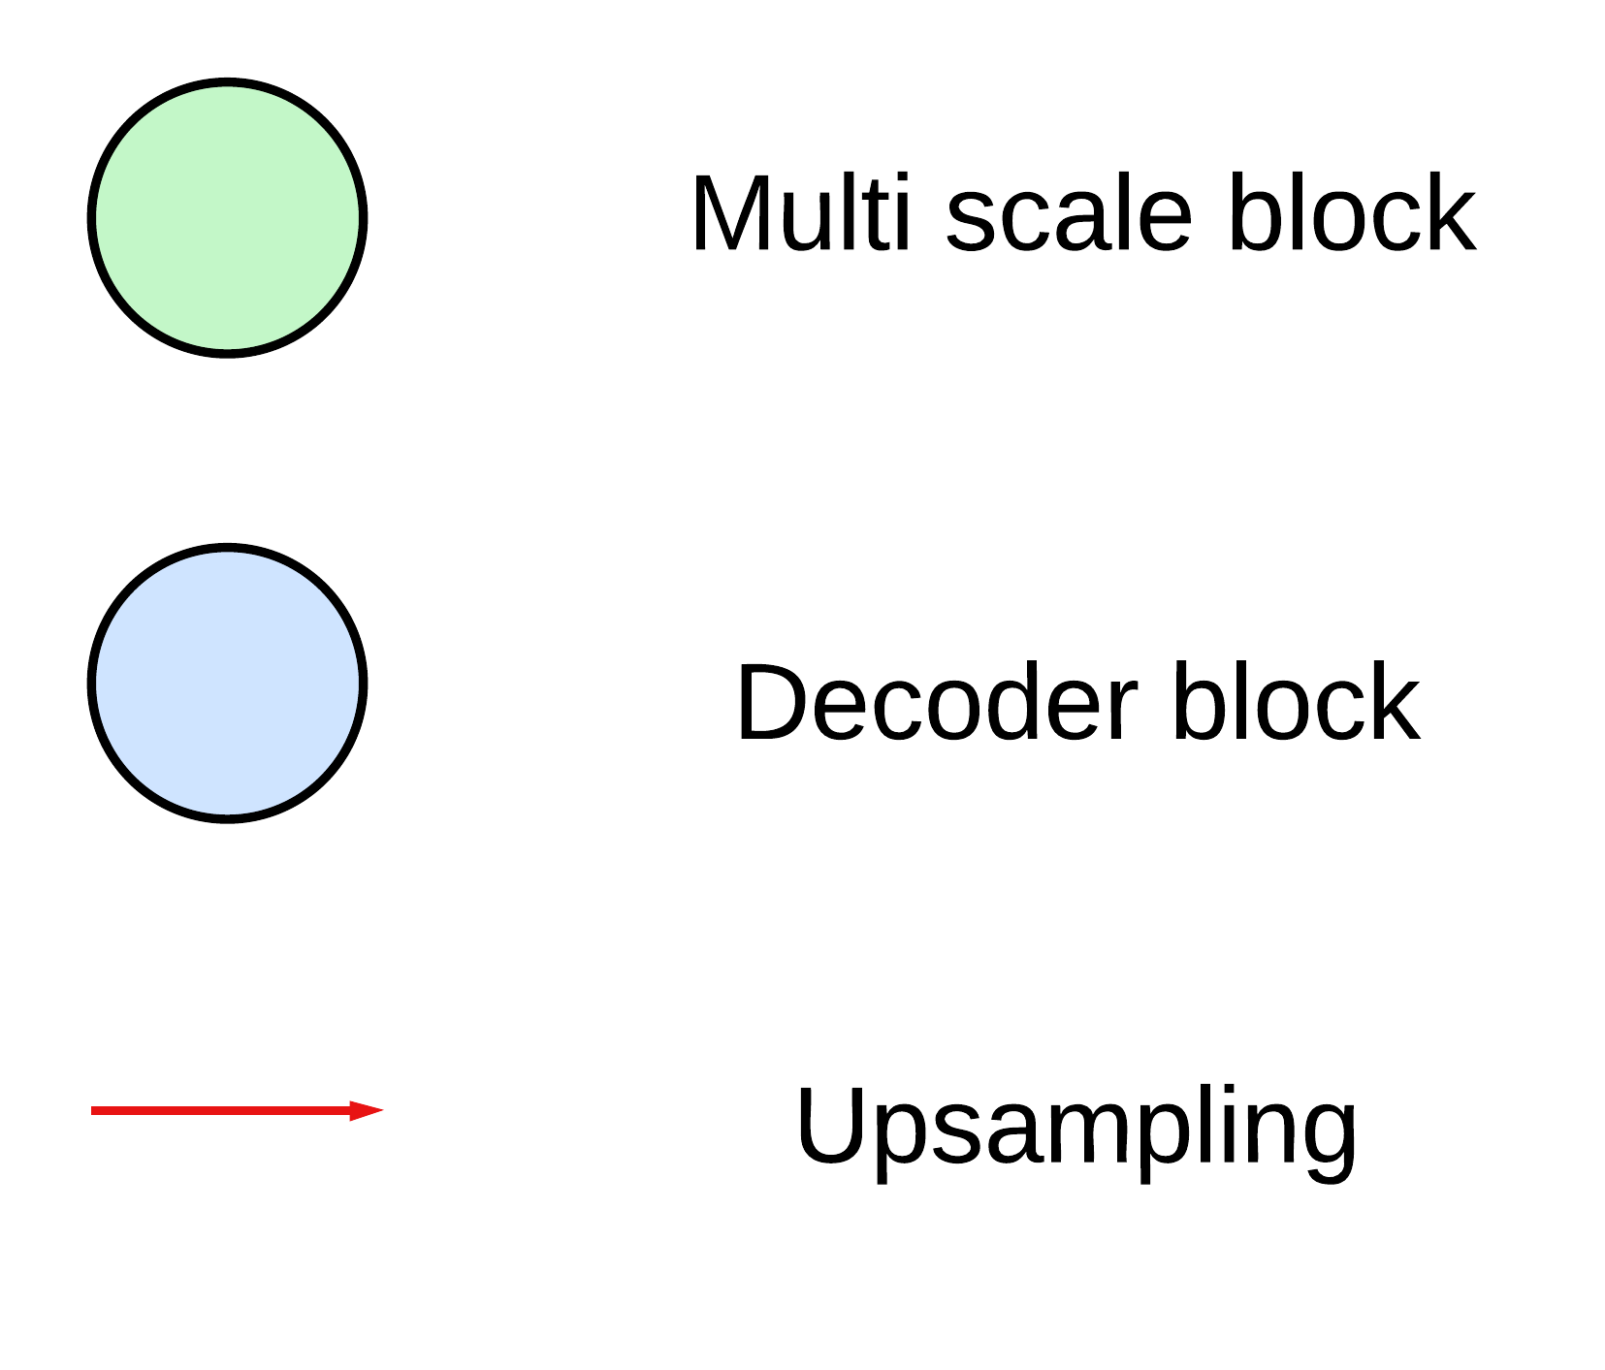
DMSNet

Slide 10
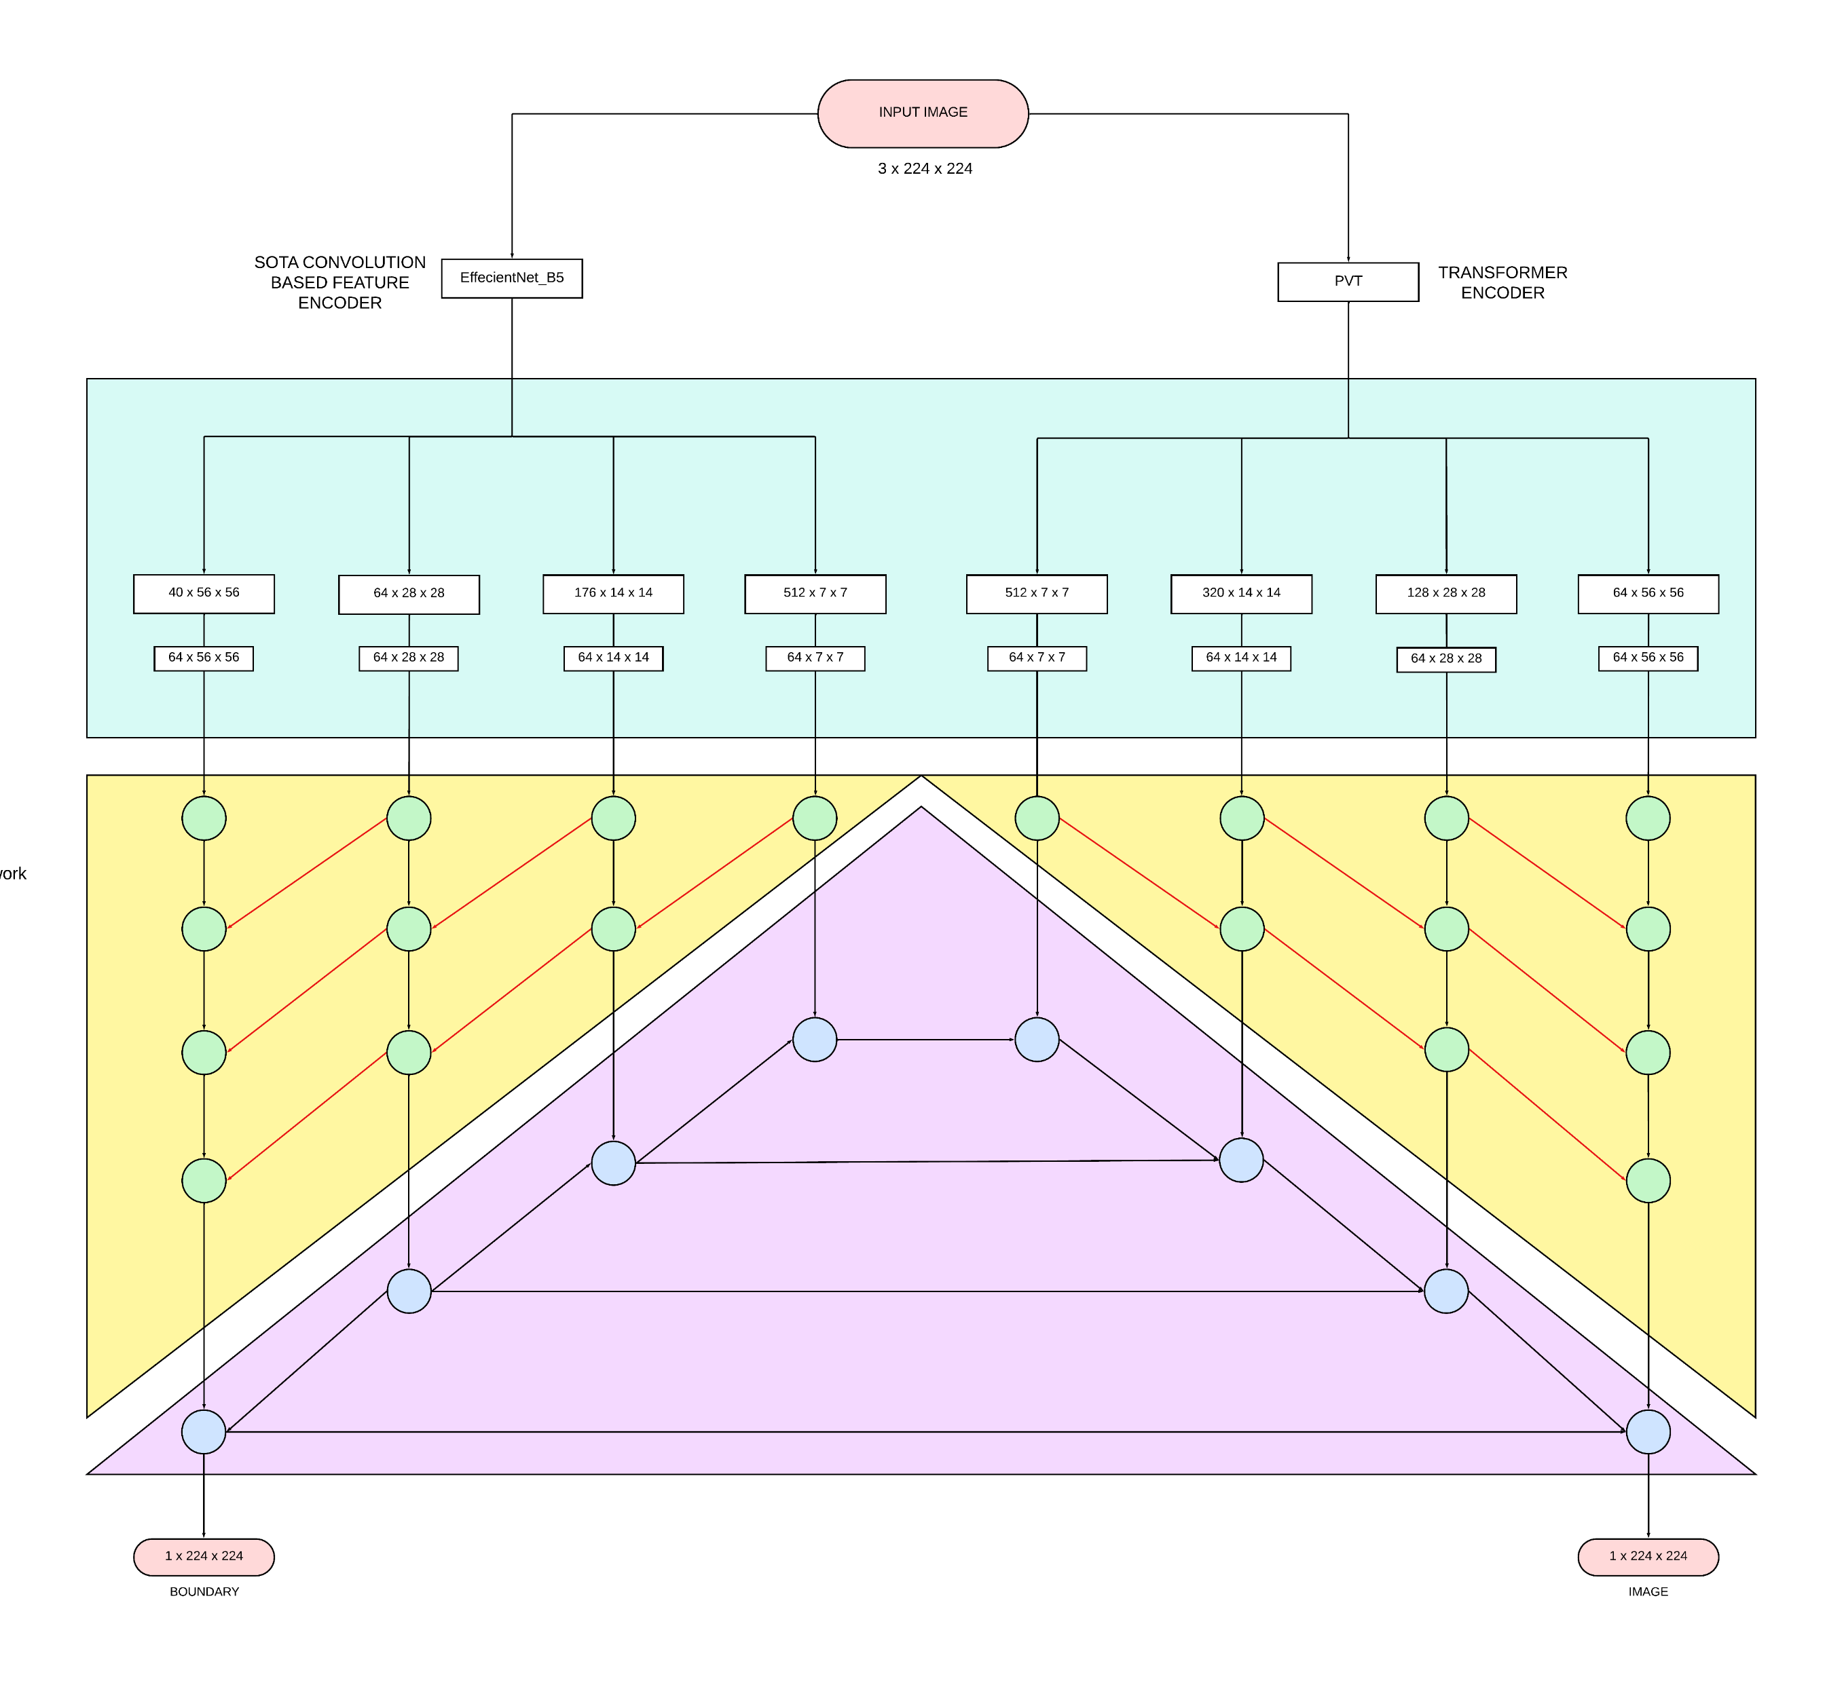
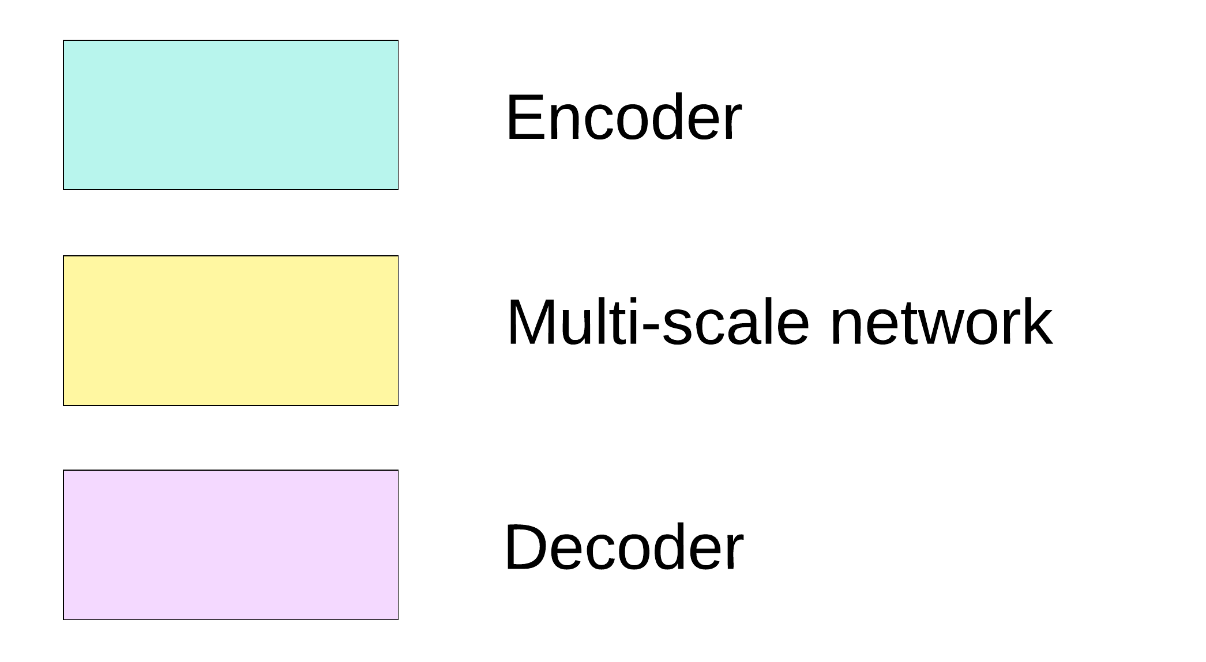
DMSNet

Slide 11
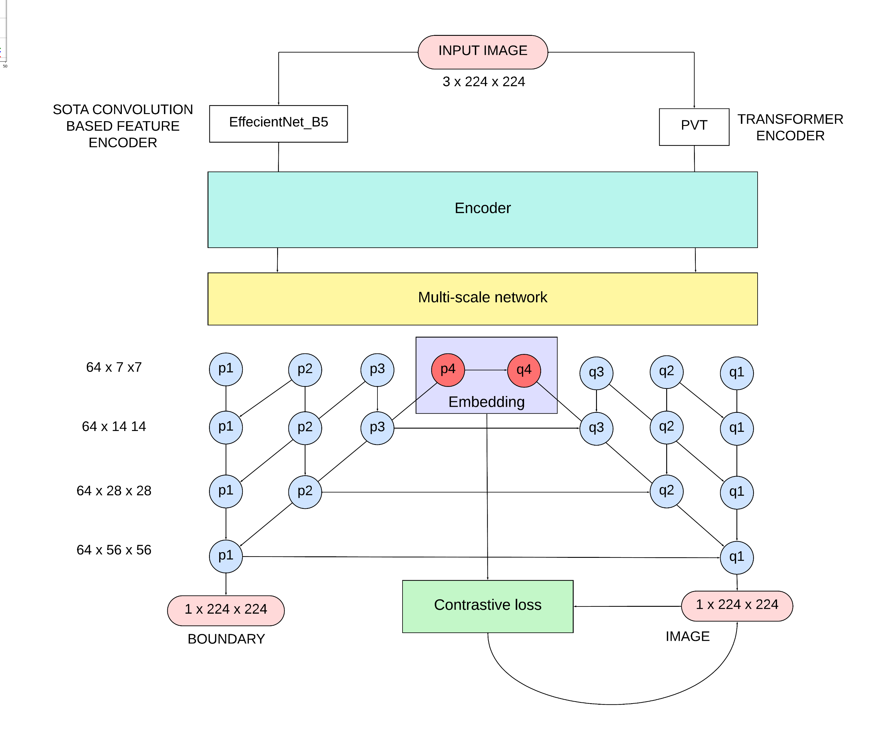
DMSNet

Slide 12
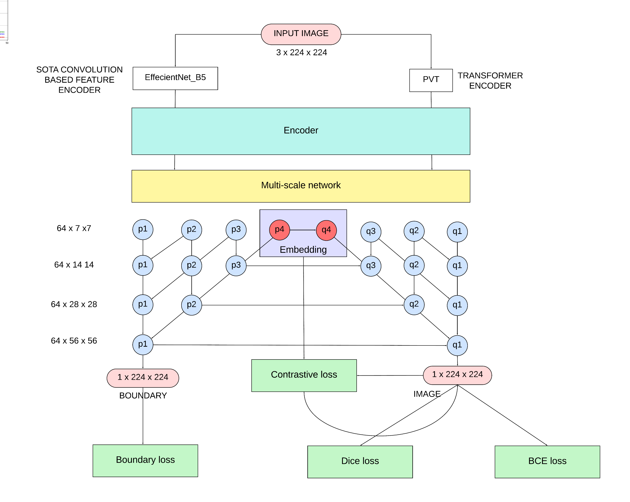
DMSNet

Slide 13
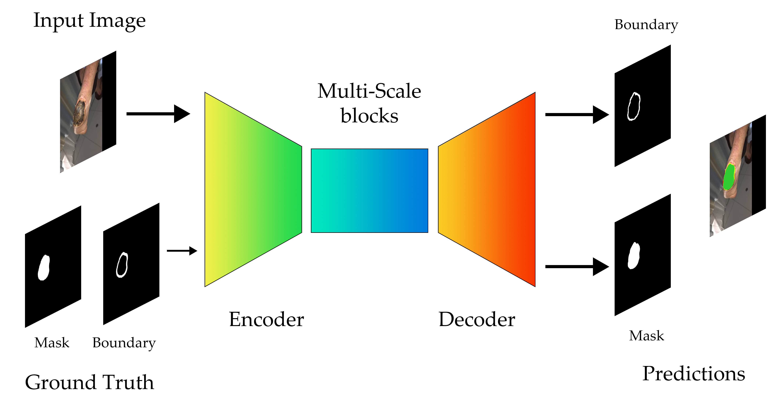
Boundaries and GT

Slide 14
Results
Model | Dice | IOU | Accuracy | MAE | AvgF | WFM | SM | EM
UNET + PCL | 0.8072 | 0.7158 | 0.9961 | 0.0039 | 0.8361 | 0.8681 | 0.8244 | 0.9145
UNET + RES2NET | 0.7905 | 0.6986 | 0.9966 | 0.0034 | 0.8121 | 0.8432 | 0.8157 | 0.9083
Unet++ | 0.7547 | 0.6552 | 0.9947 | 0.0053 | 0.7822 | 0.8097 | 0.8062 | 0.8993
MSNet | 0.8058 | 0.7149 | 0.9968 | 0.0032 | 0.8341 | 0.8736 | 0.8346 | 0.9387
PVT | 0.7896 | 0. 6893 | 0.9945 | 0.0045 | 0.8012 | 0.8408 | 0.7968 | 0.9001
DMSNet | 0.8171 | 0.7321 | 0.9969 | 0.0031 | 0.8315 | 0.8595 | 0.8422 | 0.9426
DMSNet + PCL | 0.8335 | 0.7565 | 0.9979 | 0.0021 | 0.8374 | 0.8684 | 0.8569 | 0.9483

Slide 15
PCL Results
Model | Dice | IOU | Model | Dice | IOU
Unet | 0.7698 | 0.6895 | Unet | 0.8072 | 0.7158
Unet++ | 0.7547 | 0.6552 | Unet++ | 0.7834 | 0.6813
MSNet | 0.8058 | 0.7149 | MSNet | 0.8135 | 0.7243
PVT | 0.7896 | 0. 6893 | PVT | 0.7965 | 0.6945
DMSNet | 0.8171 | 0.7321 | DMSNet | 0.8335 | 0.7565

Slide 16
Ablation results
Model | Dice | IOU | Accuracy | MAE | AvgF | WFM | SM | EM
PVT + Resnet | 0.7896 | 0. 6893 | 0.9945 | 0.0045 | 0.8012 | 0.8408 | 0.7968 | 0.9001
PVT + Res2Net | 0.7967 | 0. 7036 | 0.9956 | 0.0040 | 0.8125 | 0.8498 | 0.8034 | 0.9120
Swin + EfficientNet | 0.7836 | 0. 6783 | 0.9942 | 0.0047 | 0.7986 | 0.8386 | 0.7864 | 0.8867
PVT + EfficientNet | 0.8335 | 0.7565 | 0.9979 | 0.0021 | 0.8374 | 0.8684 | 0.8569 | 0.9483

Slide 17
References
[1] Anisuzzaman DM, Patel Y, Rostami B, Niezgoda J, Gopalakrishnan S, Yu Z. Multi-modal wound classification using wound image and location by deep neural network. Sci Rep. 2022 Nov 21;12(1):20057. doi: 10.1038/s41598-022-21813-0. PMID: 36414660; PMCID: PMC9681740.
[2] Rania N, Douzi H, Yves L, Sylvie T. Semantic Segmentation of Diabetic Foot Ulcer Images: Dealing with Small Dataset in DL Approaches. Image and Signal Processing. 2020 Jun 5;12119:162–9. doi: 10.1007/978-3-030-51935-3_17. PMCID: PMC7340957.
[3] Oliver TI, Mutluoglu M. Diabetic Foot Ulcer. [Updated 2023 Aug 8]. In: StatPearls [Internet]. Treasure Island (FL): StatPearls Publishing; 2023 Jan-. Available from: https://www.ncbi.nlm.nih.gov/books/NBK537328/
[4] S. Lee, Y. Lee, G. Lee and S. Hwang, "Supervised Contrastive Embedding for Medical Image Segmentation," in IEEE Access, vol. 9, pp. 138403-138414, 2021, doi: 10.1109/ACCESS.2021.3118694.
[5] Khosla, Prannay, et al. "Supervised contrastive learning." Advances in neural information processing systems 33 (2020): 18661-18673.

Slide 18
Thank you

