Slide 1

HS101 SPOKEN AND WRITTEN COMMUNICATION
Course Instructor :- Dr. Aman Deep Singh

Slide 2
Introduction of Group Members 1B Group 8
Mangalam Pandey 201951089 CSE
Manjot Singh 201951090 CSE
Mansi Tundele 201951091 CSE
Dhruv Gandhi 201951187 CSE
Raykanth Reddy 201951088 CSE

Slide 3

ANDHADHUN
Directed By:
Sriram Raghvan
Produced By:
Viacom 18 Motion
Pictures

Slide 4
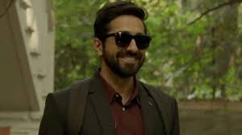
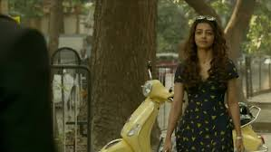

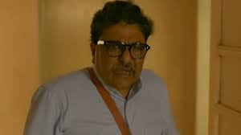
Main Characters:
Ayushmann Khurrana
(Akash)
Radhika Apte
(Sophie)
Tabu
(Simi)
Zakir Hussain
(Dr . Swami)

Slide 5
Why Andhadhun ?
It depicts human conditions such as ‘SYMPATHY’ of people for physically or mentally disabled person.
Some people who are fit ,they disguised themselves as disabled one and use others sympathy for their success and benefit .
To abuse this sympathy for your own greed is downright evil.

Slide 6
PLOT :
Akash, a piano player disguised to be visually impaired.
He unwillingly becomes entangled in a number of problems.
As he witnesses the murder of a former film actor.

Slide 7
STORY :
Akash is a pianist lives in a NGO .
He disguised him as a blind to achieve success .
A boy often tries to find out whether Akash is really blind or not.
He is in search of an opportunity to go to London.
One day while crossing a road ,he was knocked by Sophie by her scooter.

Slide 8
Continuation…
Sophie was impressed by his talent and introduce him to his father who owned a bar named Franco’s.
Their relationship begins and soon sympathy turns into love.
Akash is invited by Pramod Singh ,a former actor to perform on his wedding anniversary at his flat for surprising his wife Simi.

Slide 9
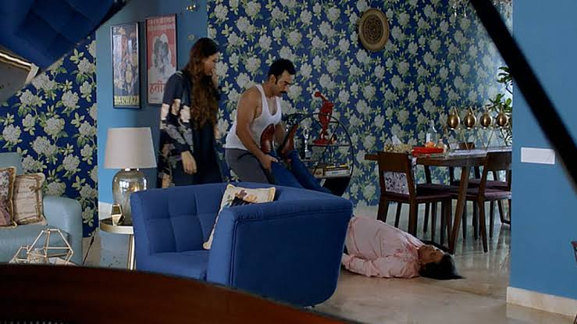
Continuation…
Akash arrives at Sinha’s flat .
Simi , convinced that Akash is blind , lets him play the piano .
Akash sees a dead body nearby but pretends ignorance and continue to play.
He also sees Manohar hiding in the bathroom.
Akash tries to report the murder but he could not.

Slide 10
Continuation…
He admits faking his blindness when simi threatens him.
Simi secretly gave drugs to Akash which makes him completely blind.
Manohar decides that blinding Akash is insufficient , so he tries to kill him.
Akash struggles to the roads , faints and is taken to an illegal organ harvesting clinic.

Slide 11
Continuation …
Dr. Swami along with his assistants Murli and Saku decide to spare Akash and helps him to reverse his blindness.
They kidnaps simi , and they creates suicide scene and starts blackmailing Manohar.
Murli and Saku however ties Akash along with Simi and plans to take the money themselves leaving Akash.
By the time of receiving money ,Murli gets shooted by Manohar .

Slide 12
Continuation…
Murli is rushed to hospital and Saku traps Manohar.
Meanwhile Akash and Simi are trying to escape.
Simi backstabs Akash and hits him with crutches.
Dr. Swami then save Akash, but ends up being saved
by him .
By now Murli is dead , Dr. Swami and Akash escape taking
Simi.

Slide 13
Continuation…
Akash is playing piano as a blind, the very peace he was trying to finish “Ek savli si ladki”.
Sophie sees him, where he tells her that he really became blind. He also tells the story how Simi tries to kill him and dies in process.
At last he kicks the can while walking .It tells that Akash and the doctor did exactly what they planned.

Slide 14
Alternative Ending :
When Simi makes noise from trunk and the doctor tries to make her unconscious at that time somehow she escapes by giving injection to Dr. Swami.
After driving for some distance she went to police station and confesses her crime.
Dr. Swami is found and arrested so is Saku they all are arrested for respective crimes.

Slide 15
Akash is also taken in under the charges of insulting the rights of the physically challenged.
After making up for his crimes he peruses his dreams and succeeds at his dream and passion of playing and creating his own musical piece.

Slide 16
Thank You

