Slide 1
Foundations of Data Science & Analytics (DSCI 633)
Nidhi Rastogi
Assistant Professor, GCCIS
Rochester Institute of Technology
August 26, 2021

Slide 2
Course Updates
GitHub link - https://github.com/aiforsec/RIT-DSCI-633-FDS
All lectures will be recorded, both in-person and zoom
TA – Rigved Rakshit, GitHub- rigved
Assignment 1 added
Note about Class participation: At end of each class, pop-up quiz (except today)
This week is to familiarize ourselves with the course
Etiquette Slide added

Slide 3
Class Etiquettes
Please raise your hands if you have questions anytime during the class
This applies during zoom classes as well
Do not interrupt others
No question is pointless, it’s a learning opportunity for you and your peers

Slide 4
Lecture Objectives
Understand trends and skills required for Data Scientist Jobs
Review one use case, end-to-end

Slide 5
Data Science vs. Machine Learning
At its core, data science is a field of study that aims to use a scientific approach to extract meaning and insights from data.
Data science is “a combination of information technology, modeling, and business management” - Dr. Thomas Miller, Northwestern University
Machine learning, on the other hand, refers to a group of techniques used by data scientists that allow computers to learn from data.
*https://www.mastersindatascience.org/learning/data-science-vs-machine-learning/

Slide 6
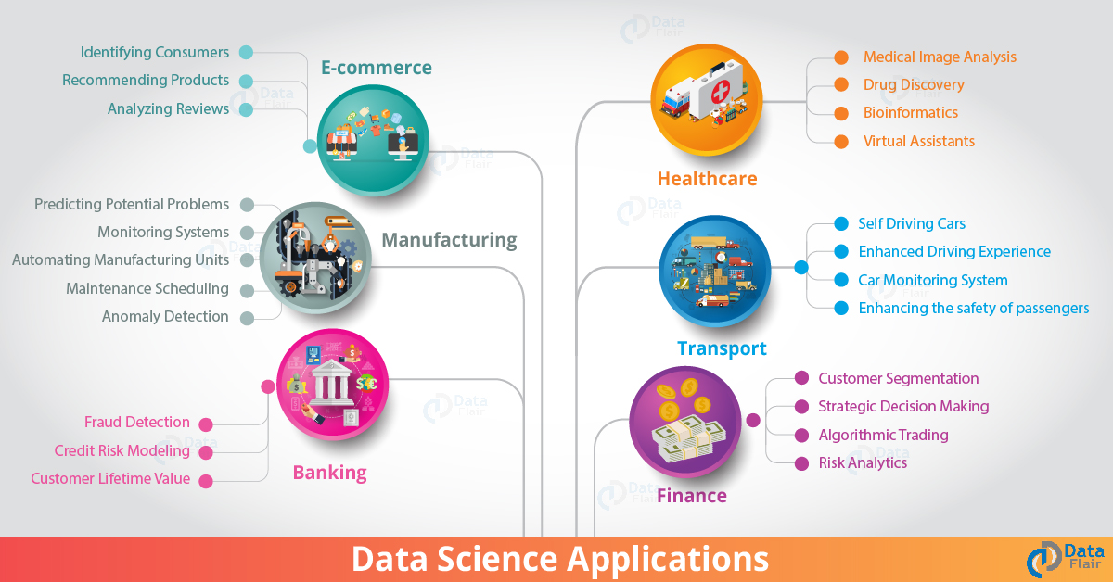
Overview
Discuss five exciting applications of Data Science
What qualifies as DS applications?
Notes:
HINT: Healthcare, Sentiment Analysis, Stock Market analysis, Computer Vision, Sports, Business, Bots, Cybersecurity

Slide 7
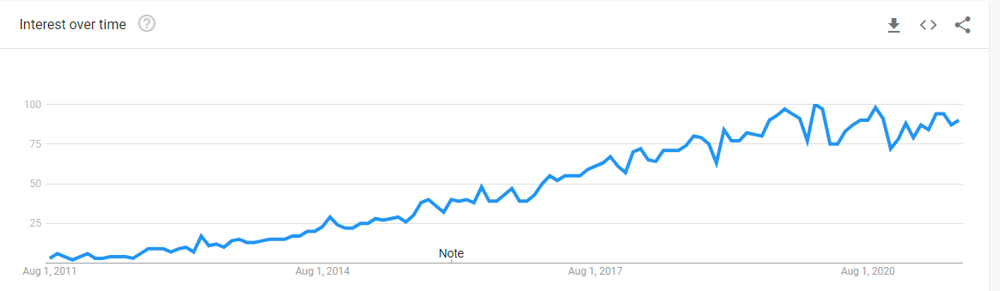
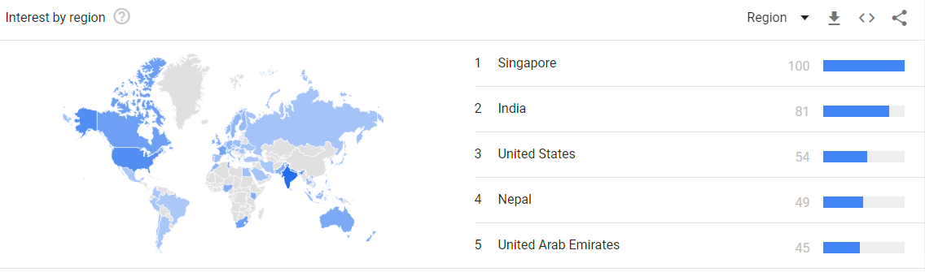
Data Scientist Jobs
Steady increase in demand as observed on Google Trends
Worldwide interest
2011-2021
Notes:
HINT: Healthcare, Sentiment Analysis, Stock Market analysis, Computer Vision, Sports, Business, Bots, Cybersecurity

Slide 8
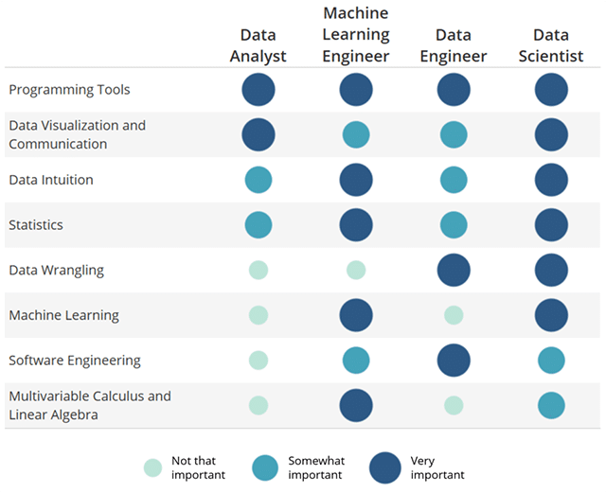
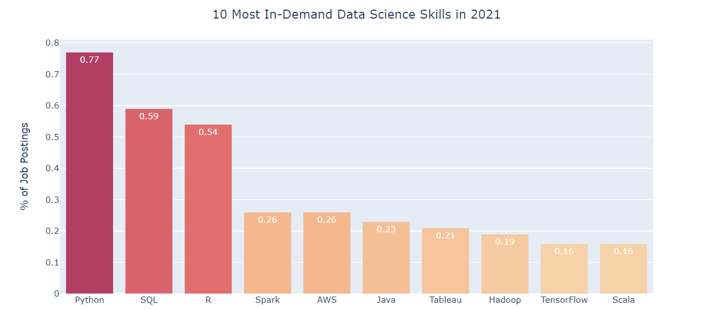
Skills required for Data Scientist
Credit: udacity.com
Credit: Terence Shin, towardsdatascience.com

Slide 9

Landing the Data Scientist job
Take DSCI-633 at RIT
Ask questions in class, work on assignments and projects sincerely
Keep other skills sharp – see previous slide for a list of necessary skills
Best way is to work on projects, participate in competitions (Kaggle, ..), work with other faculty members in the coming semesters
Define a clear target role and work towards it
Companies, industry, skillsets needed
Look for job requirements for those roles
Work on projects that minimize the existing gap
Work on your online presence – LinkedIn
Rookie mistake – doing too many things at the same time, gain suffient expertise in one and build on top of it.
Anything else?

Slide 10
Where to begin?
Motivating Questions Asked
Which models should I learn?
Can I use the data for any task
Should I start with Machine learning or Deep learning first?
How to get good at Data Science
…?

Slide 11
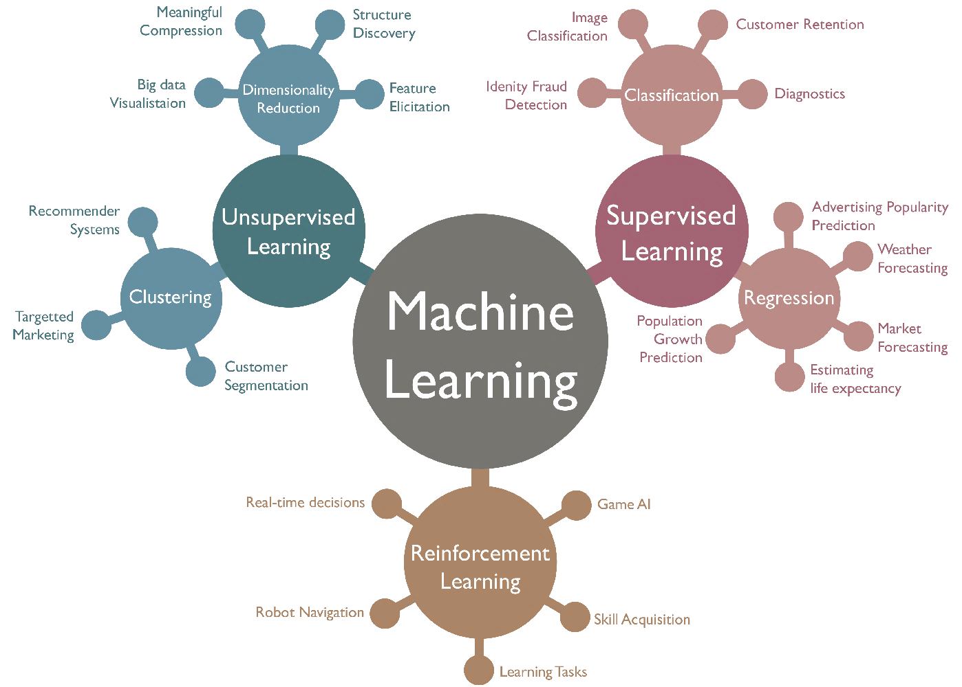
Refresher from last class

Slide 12
Use Case
Software Defect Prediction

Slide 13
Task: Given a piece of code, predict whether it has defects or not.
Binary Classification
int minval(int *A, int n) {
int currmin;
for (int i=0; i<n; i++)
if (A[i] < currmin)
currmin = A[i];
return currmin;
}
Model
Bug?

Slide 14
Data Availability
Supervised Learning
10 different software projects
Each has 5 releases
Each release has around 100 code modules
All code modules are labeled as buggy or non-buggy
Around 20% code modules have bugs

Slide 15
Task Specification
Within-project prediction
For project i, given past releases as training data, predict code modules in current release.
Cross-project prediction
For project i, given other projects as training data, predict defect code modules in project i.

Slide 16
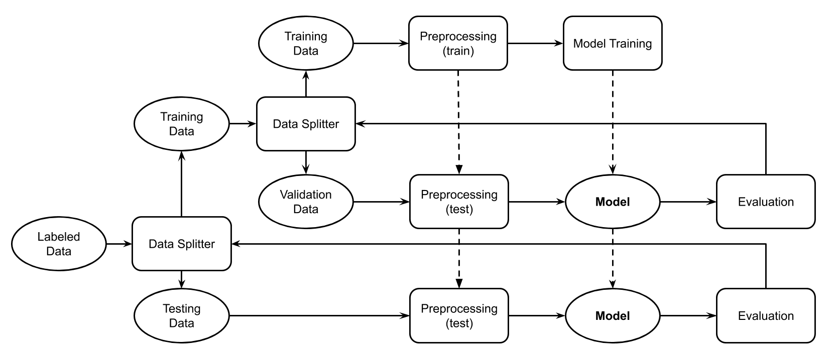
Within-Project Prediction
Release j < i
Release 1 to m-1
Release i
Release
m

Slide 17
Cross-Project Prediction
Other Projects
Other Projects
Project i
Project k

Slide 18
Evaluation
Precision
Recall
F1
AUC
For the buggy class!!!

Slide 19
Preprocessing
Very domain-specific
Best way to start:
Understand baseline approaches
Review existing models (github, Kaggle, …)
check how other researchers featurize the code modules

Slide 20
Preprocessing
Software metrics:
E.g. lines of code, number of inputs
Only has abstract information
Can use tools to extract
Low dimensionality (10 - 20)
Text mining features:
Treat codes as natural language
High dimensionality (thousands to millions)

Slide 21
Software Metrics
Normalize on columns
name | loc | wmc | dit | noc | cbo | rfc | lcom
org.apache.lucene.analysis.WhitespaceAnalyzer | 10 | 2 | 2 | 0 | 3 | 4 | 1
org.apache.lucene.search.QueryTermVector | 278 | 10 | 1 | 0 | 4 | 37 | 0
org.apache.lucene.analysis.PorterStemmer | 1174 | 27 | 1 | 0 | 1 | 43 | 13

Slide 22
Text Mining Features
Normalize on rows
int minval(int *A, int n) {
int currmin;
for (int i=0; i<n; i++)
if (A[i] < currmin)
currmin = A[i];
return currmin;
}
int minval int a int n int currmin for int i 0 i n i if a i currmin currmin a i return currmin
Term Frequency
Tokenize
int | minval | a | n | currmin | for | i | 0 | if | return
5 | 1 | 3 | 1 | 4 | 1 | 5 | 1 | 1 | 1

Slide 23
Preprocessing
Data Balancing:
Target is minority
Data Balancing is critical
Dimensionality Reduction?
Principal Component Analysis (PCA)
Linear Discriminant Analysis (LDA)

Slide 24
Model
Linear SVM
Multinomial Naive Bayes
Random Forest
Decision Tree

Slide 25
Model / Parameter Selection
Tuning:
Evolutionary algorithms (GA, SA, DE, ...)
Grid search / Random search
Surrogate models (Bayesian Optimization)

Slide 26
Testing
Collect performance metrics on test data
Discuss with customer to check whether the results satisfy the requirements
Make improvements based on customer feedback

Slide 27
Assignment
All assignments will be shared on Thursdays Due at 7:59am before next Tuesday class
If you have any issues, report on course slack channel before Friday, 5:00pm
#dsci-633-2211
Do NOT send me individual emails, Please!

Slide 28
Next Lecture
Naïve Bayes

Slide 29
Open Floor

