Slide 1
NS3 Based Simulation of Computer Networks
Advisor:
Dr. B.N. Jain
Group Members
Abhinav Kumar Saxena (2022018)
Akshat Gian(2022018)

Slide 2
Topology Implemented
A
1 Mbps
R1
Number of Nodes: 9
5 Mbps
R0
B
1 Mbps
1 Mbps
D
5 Mbps
5 Mbps
R2
R3
1 Mbps
1 Mbps
C
E

Slide 3
Traffic Matrix with Src/Dest. workstations
Source \ Destination | A | B | C | D | E
A | 0 | 124 | 95 | 56 | 57
B | 83 | 0 | 30 | 17 | 55
C | 78 | 144 | 0 | 84 | 60
D | 59 | 33 | 46 | 0 | 133
E | 23 | 14 | 148 | 44 | 0

Slide 4
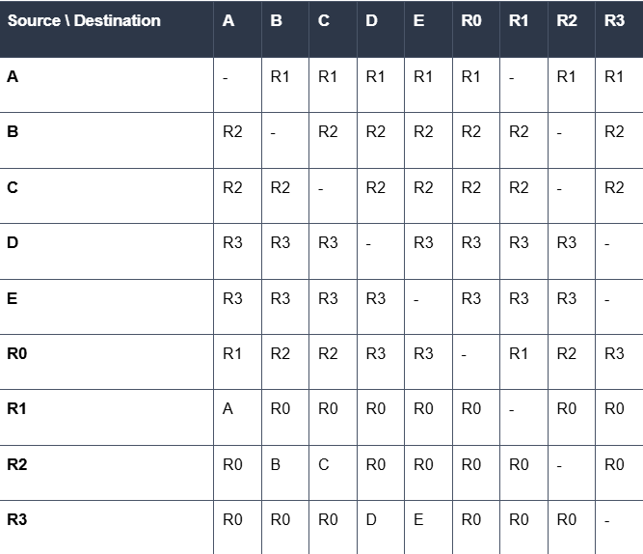
Routing Table

Slide 5
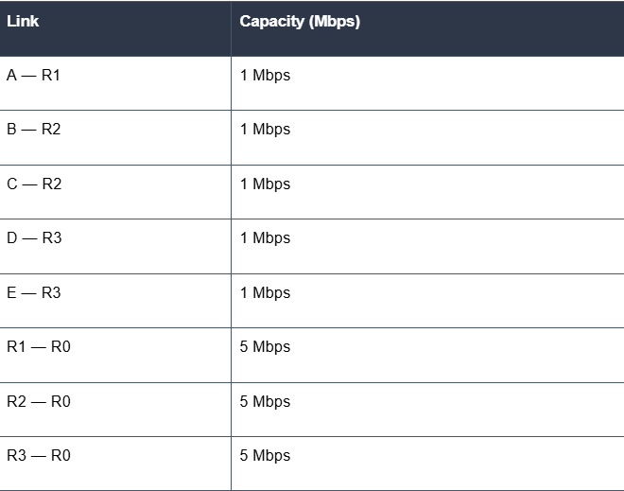
Link Capacity Table

Slide 6
End to End one way delay Matrix
Source \ Destination | A | B | C | D | E
A | 0 | 8.9152 | 8.9152 | 8.9152 | 8.9152
B | 8.9152 | 0 | 6.096 | 8.9152 | 8.9152
C | 8.9152 | 6.096 | 0 | 8.9152 | 8.9152
D | 8.9152 | 8.9152 | 8.9152 | 0 | 6.096
E | 8.9152 | 8.9152 | 8.9152 | 6.096 | 0

Slide 7
Packet Drop Src/Dest. Matrix
Source \ Destination | A | B | C | D | E
A | 0 | 3.7076 | 2.8405 | 1.6744 | 1.7043
B | 2.4817 | 0 | 0.4482 | 0.5083 | 1.6445
C | 2.3322 | 2.15136 | 0 | 2.5116 | 1.794
D | 1.7641 | 0.9867 | 1.3754 | 0 | 1.98702
E | 0.6877 | 0.4186 | 4.4252 | 0.65736 | 0

Slide 8
Queue Lengths at each outgoing link
A
1 Mbps
Queue Length: 50
R1
Queue Length: 50
5 Mbps
Queue Length: 50
R0
Queue Length: 50
B
1 Mbps
1 Mbps
D
5 Mbps
5 Mbps
R2
R3
Queue Length: 50
1 Mbps
1 Mbps
C
E

Slide 9
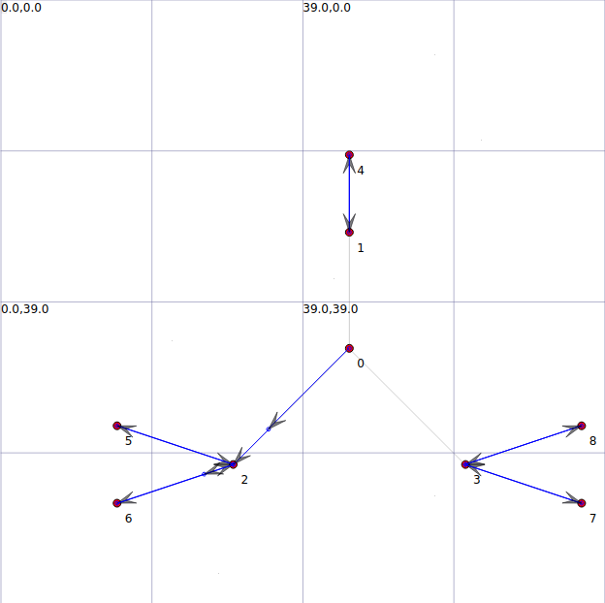
Tracing Packet routes using NetAnim

Slide 10
Thank You

