Slide 1
TCP Socket Programming Implementation
Names: Abhinav Kumar Saxena(2022018), Akshat Gian(2022051)
Instructor: Dr. BN Jain
Course: CSE232

Slide 2
Objectives
To implement and demonstrate the handling and processing of Transmission Control Protocol (TCP) and HTTP requests on both the server and client sides, showcasing efficient communication and data exchange between networked systems.
Scope:
Part 1: Implement TCP web server to process one HTTP request at a time.
Part 2: Extend the TCP Web server to handle multiple requests using multithreading.
Part 3: Implement custom HTTP client to test the server.
Why TCP?
Reliable Data Transmission
Connection-Oriented Communication
Flow and Congestion Control

Slide 3
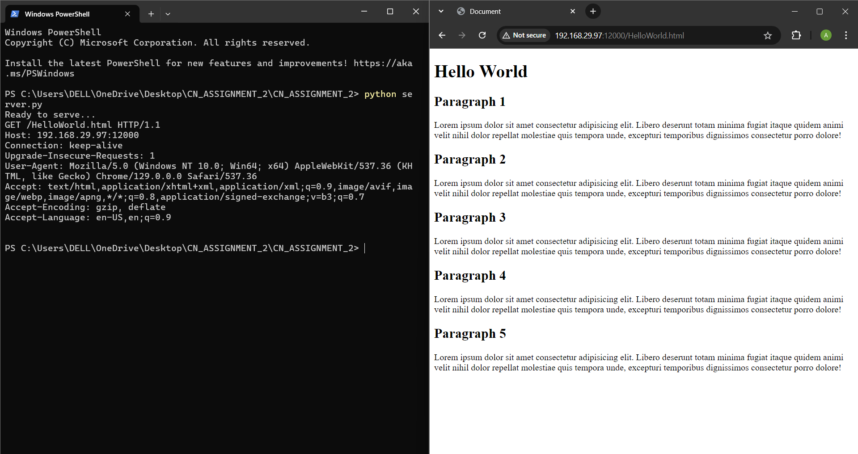
Part A - TCP server Implementation
Requested File is present in the server
Note - In each Image, the left window is the server and the right window is the client .

Slide 4

Part A - TCP server Implementation
Requested File is not present in the server
Note - In each Image, the left window is the server and the right window is the client .

Slide 5
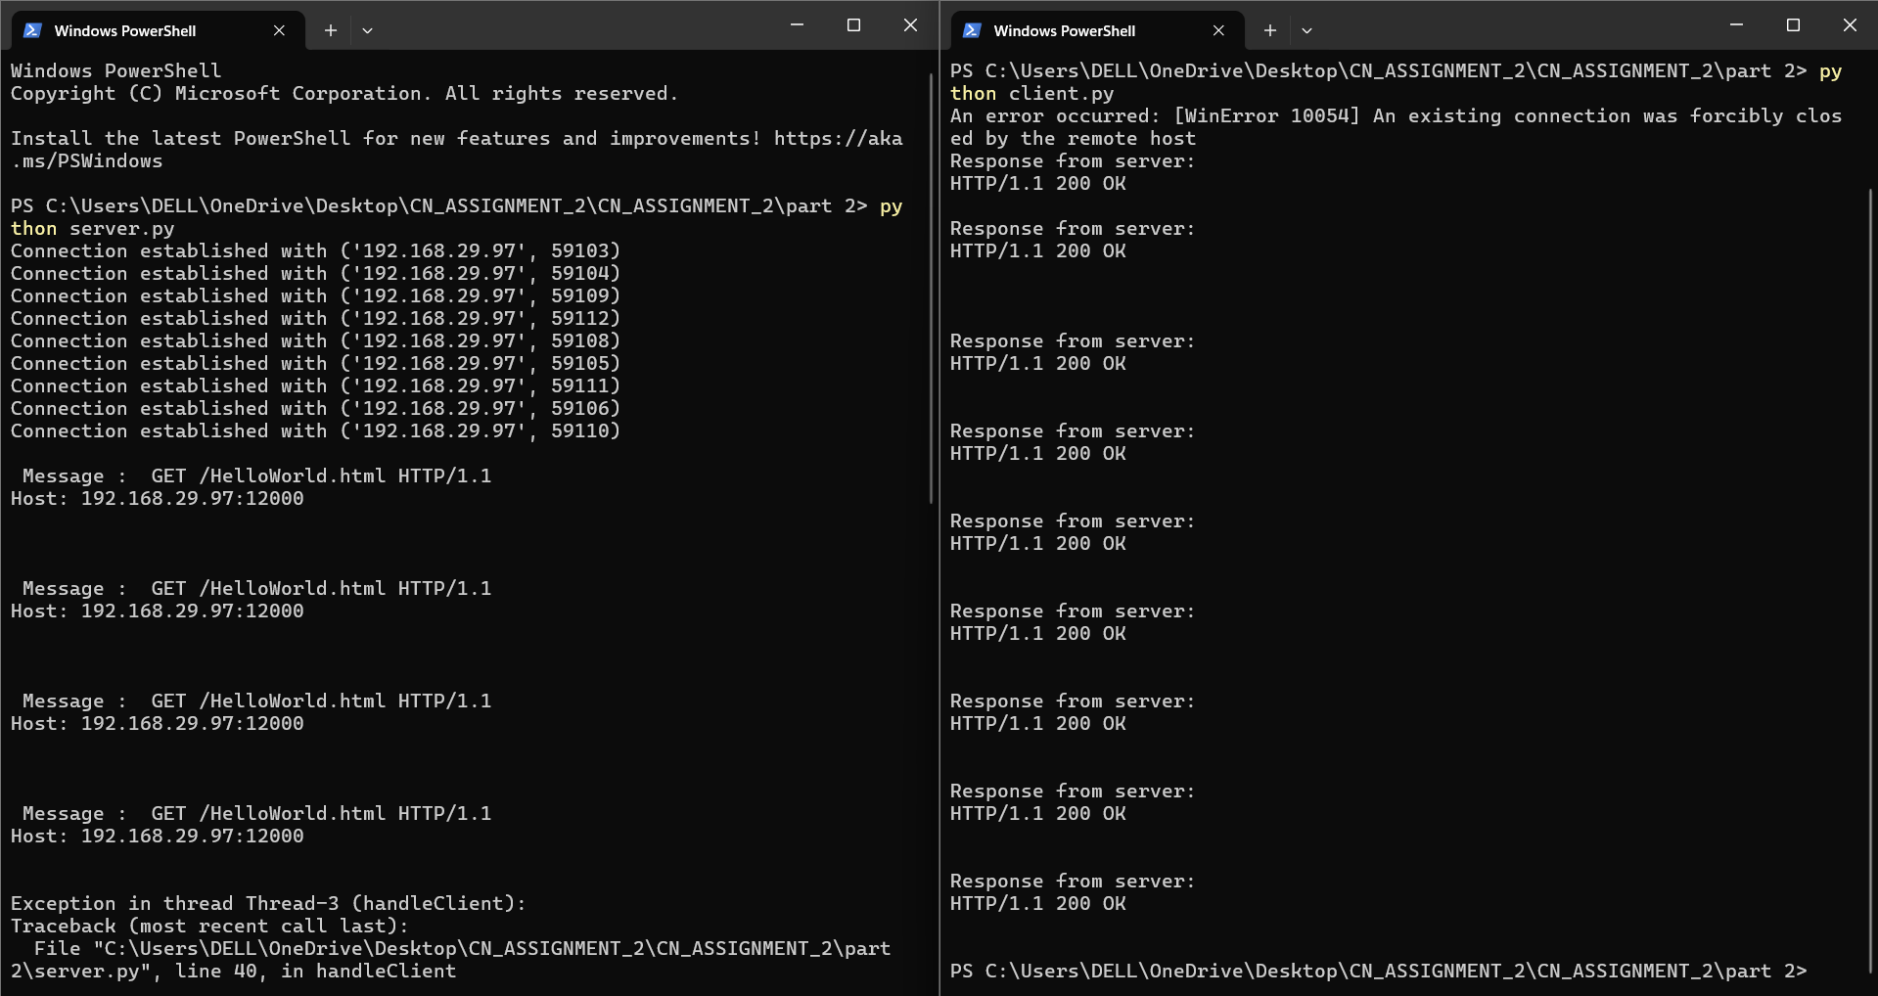
Part B - Multithreaded TCP server
Sending 10 HTTP requests Concurrently from client.py
Note - In each Image, the left window is the server and the right window is the client .

Slide 6
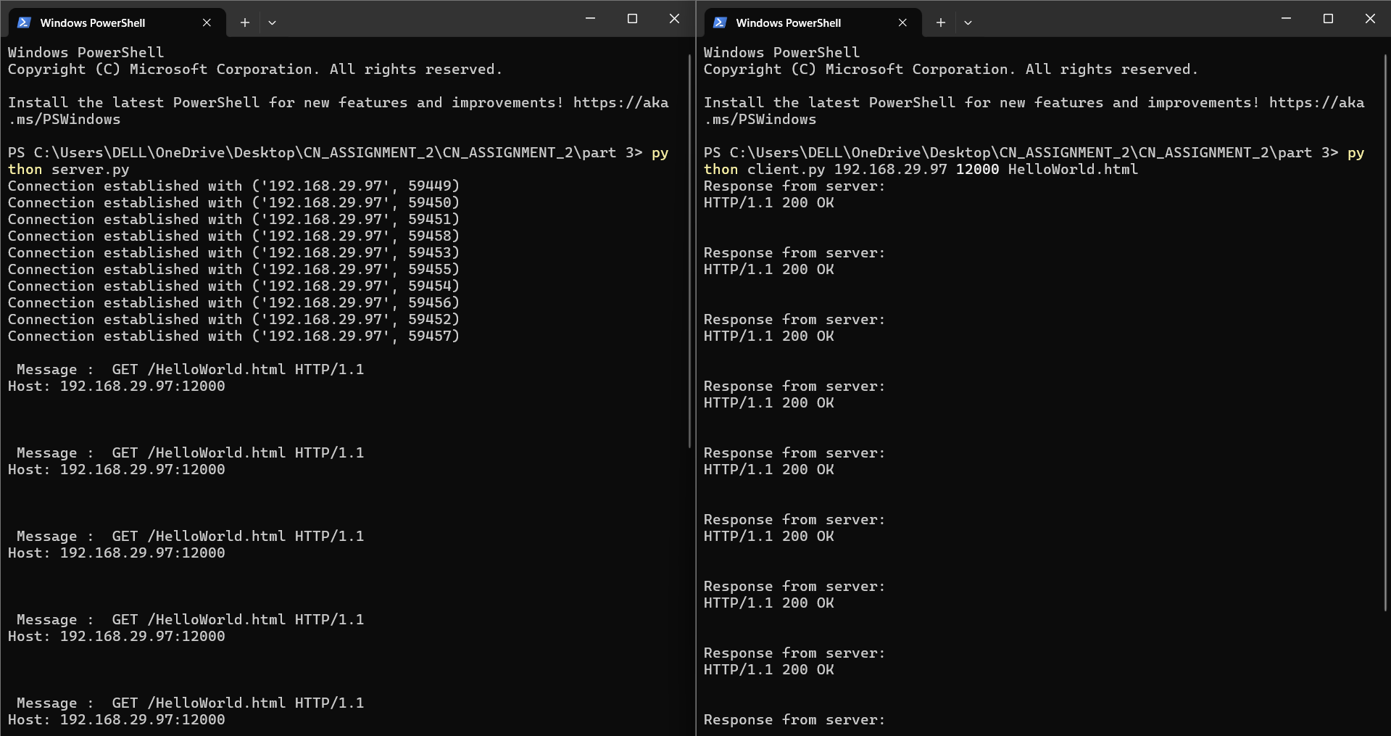
Part C - Custom HTTP Client
Sending 10 HTTP requests from the custom HTTP client.py
Does this client work with servers implemented in Part A and B? - YES

Slide 7
Conclusion and Learnings
TCP Fundamentals: Gained hands-on experience with reliable, connection-oriented communication using TCP, ensuring data integrity with sequence numbers and retransmission.
Single Request Handling: Implemented a basic server that processes one HTTP request at a time, demonstrating the core mechanics of server-client communication.
Multithreaded Server: Built a multithreaded server to handle multiple concurrent HTTP requests, simulating real-world scenarios of web server operation.
Custom HTTP Client: Developed a custom multithreaded client to send simultaneous requests, testing the server's ability to process them concurrently.
Challenges: Observed limitations in handling excessive connections, highlighting the need for better resource management under heavy loads.
Key Learning: Strengthened understanding of TCP, HTTP, and multithreading in network communication.

Slide 8
Thank You

