Slide 1
Phone-Book
Sorting and searching in a phone book directory.
Presented By: Akshat Neolia
RA2211031010080

Slide 2
To this:
From These:

Slide 3
Problem Statement
The problem statement for searching in a phone book directory involves efficiently locating contact information within a large database of names and numbers. With the increasing volume of contacts stored in electronic devices, users often encounter difficulty in swiftly locating specific entries amidst extensive listings. The challenge lies in developing a search mechanism that swiftly retrieves relevant contact details based on partial or exact matches of names, phone numbers, or other associated information. Efficiency, accuracy, and user-friendly interface design are critical factors in addressing this issue and enhancing the user experience of navigating through phone book directories.

Slide 4
Approach

Slide 5
Using Linear search
Initially, we contemplated employing a linear search algorithm for navigating through the phone contact directory. It appeared to be the simplest approach at first glance. However, as we implemented it, we realized that the linear search method consumed a significant amount of time, especially when dealing with a large database. The inefficiency of linear search prompted us to explore alternative approaches that could mitigate the time complexity to O(n), thus enhancing the overall user experience.

Slide 6
Using binary search
Subsequently, we turned our attention to the binary search algorithm, intrigued by its potential to optimize search operations. However, we encountered a fundamental obstacle – the necessity for the list to be sorted. This requirement posed a new challenge as our existing phone book directory lacked any inherent order. Recognizing the need for sorting, we delved into various sorting techniques to establish a sorted structure conducive to binary search.

Slide 7
Insertion Sort
In pursuit of a sorting method compatible with our requirements, we settled upon insertion sort. Its simplicity and efficiency resonated with our objectives, making it an ideal choice for arranging the phone book entries alphabetically. With insertion sort in place, we successfully organized our phone book directory, paving the way for seamless binary search operations. Through this iterative process, we achieved a refined solution that optimized search efficiency while ensuring the directory remained well-organized and easily navigable for users.

Slide 8
Execution

Slide 9
Sorting
Insertion sort is a sorting algorithm that works by iterating through an unsorted list and inserting each element in its correct position among the already sorted elements. This analogy explains how it works:
Imagine you have a stack of unsorted books on a shelf. You want to arrange them alphabetically. Here's how insertion sort works in this scenario:
Start with the first book: Consider the first book as already sorted (a list of one element is always sorted).
Pick the next book: Take the second book in the unsorted pile.
Compare and insert: Compare this book with the one on the shelf (already sorted part). If the new
book's title comes alphabetically before the one on the shelf, shift the shelf book one position to the right and insert the new book in the space.
Repeat: Continue taking books one by one from the unsorted pile, compare them with the sorted shelf, and insert them in their correct positions by shifting elements if necessary.

Slide 10
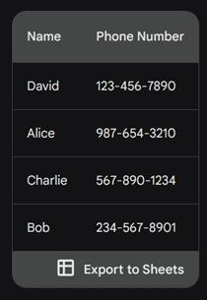
Applying Insertion Sort to Phone Book Directory:
Initial Directory:
This concept can be applied to sorting contact entries in a phone book directory. Instead of sorting books alphabetically, you would sort the contact entries based on their names (or phone numbers depending on your preference).
Here's an example of how insertion sort would work with a phone book directory:

Slide 11
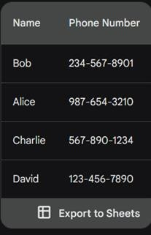


Sorting Process:
Sorted Directory:
Consider "David" already sorted (list of 1).
Compare "Alice" with "David": "Alice" comes before "David" alphabetically, so shift "David" one position down and insert "Alice" in the first position.
Compare "Charlie" with "Alice" and "David": "Charlie" comes after "Alice" but before "David," so no shifting is needed.
Compare "Bob" with "Alice," "David," and
"Charlie": "Bob" comes before all three, so shift all three entries down one position and insert "Bob" in the first position.

Slide 12
Searching Algorithm
Searching algorithms are methods or procedures used to find a specific item or element within a collection of data. These algorithms are widely used in computer science and are crucial for tasks like searching for a particular record in a database, finding an element in a sorted list, or locating a file on a computer.
These are some commonly used searching algorithms:
1. Linear Search: In this simple algorithm, each element in the collection is sequentially checked until the desired item is found, or the entire list is traversed. It is suitable for small-sized or unsorted lists, but its time complexity is O(n) in the worst case.
2. Binary Search: This algorithm applies only to sorted lists. It repeatedly compares the middle element of the list with the target element and narrows down the search range by half based on the comparison result. Binary search has a time complexity of O(log n), making it highly efficient for large sorted lists

Slide 13
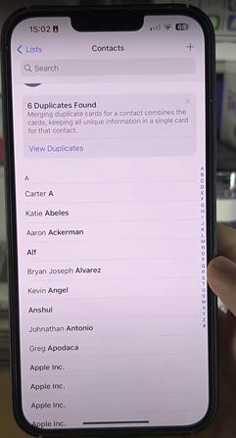
Applying Linear Searching
The first, obvious one is linear search.
● You start from the first name, check if this is John Johnson or not. If it is, you get the phone number. Else you read the next word. If there are 1000 names in the phone contacts ., you would have to read 1000 words. A damn hard job.

Slide 14
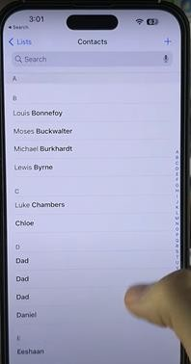
Applying Binary Search
Phone contacts are ordered in ascending order. It begins with names starting from 'A'. Aaron, Adam, Addison, and so on, and the last page contains names ending with 'Z', like Zoey, and Zora. So you check (almost) the middle page in your address book.
Let's say it was 'M'. Now you know that John will be in the part to the left of the current page. So you don't need the second half which is to the right of the current page.
Now you limit your search to the left half. You find its middle, say 'G'. The right name should be on the right half of the current part.
So you keep restricting your search to one-half of the search space every time. If the phone book contains 1000 names, you have to search just 10 times (log 1000, base 2).
The benefit is, that if there are 1 million names, You have to do 1 million searches with linear search, while just 20 searches with binary search.

