Slide 1

Road Traffic Violation Detection System
Faculty Name: Dr. Angayarkanni S
Team Members Info-
Akshat Neolia (RA2211031010080)
Priyanshu Kumar (RA2211031010084)
Tarang Bhargava (RA2211031010099)
Rajeev Singh (RA2211031010120)

Slide 2
Problem Statement
In modern urban environments, managing traffic efficiently while ensuring safety is a critical challenge. Traditional traffic monitoring systems, which rely on human intervention, often struggle to maintain accuracy due to varying lighting conditions, camera placements, video quality, and the dynamic nature of traffic flow. These systems are particularly challenged in detecting traffic light violations, which are a significant cause of accidents and congestion. There is a need for an automated, scalable traffic monitoring solution that can operate autonomously, adapt to changing environmental conditions, and accurately detect violations in real-time. The goal is to develop a system that reduces reliance on human resources while improving the precision and reliability of traffic violation detection, contributing to safer and more efficient urban traffic management.

Slide 3
List the topic’s significance and SDG
Significance:
1. Enhanced Traffic Safety: By accurately detecting traffic light violations in real-time, the system can significantly reduce the occurrence of accidents at intersections, thereby improving overall road safety.
2. Reduction in Human Error: The automated system minimizes the need for human intervention, reducing the chances of errors that can occur due to fatigue or oversight, leading to more reliable traffic monitoring.
3. Scalability for Urban Growth: As cities continue to grow, the system’s ability to scale and handle large volumes of traffic data ensures that it can be deployed across multiple locations without compromising performance.
4. Adaptability to Environmental Changes: The system's ability to adjust to varying lighting conditions, camera angles, and other environmental factors makes it versatile and effective in diverse urban settings, ensuring consistent accuracy day and night.
5. Real-Time Data Processing: Utilizing Apache Kafka and Apache Spark enables the system to process and analyze traffic data in real-time, providing immediate feedback and response, which is crucial for dynamic traffic management.

Slide 4
6. Improved Traffic Flow: By efficiently detecting and addressing violations, the system helps in reducing congestion, leading to smoother traffic flow and reduced delays for commuters.
7. Cost-Effective Monitoring: Automating traffic violation detection reduces the need for extensive human resources, lowering operational costs while maintaining or even enhancing monitoring capabilities.
8. Foundation for Smart City Development: This system contributes to the broader development of smart city initiatives by integrating advanced technologies into urban infrastructure, paving the way for more intelligent and connected urban environments

Slide 5
Proposed Model
The proposed system is an automatic traffic red-light violation detection solution designed for smart city transportation management.
Utilizing advanced computer vision techniques, the system is implemented using OpenCV in a Python environment. It integrates an object detector and object tracker to monitor vehicle positions accurately.
The primary function of the system is to identify vehicles that violate red lights. By maintaining precise tracking of vehicle locations, the system ensures accurate detection of violations.
The results from initial tests indicate high precision, effectively distinguishing and recording all instances of red-light infractions.

Slide 6
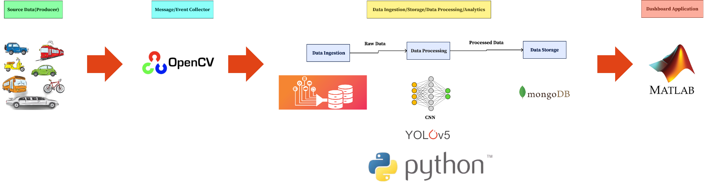
ARCHITECTURE DIAGRAM

Slide 7
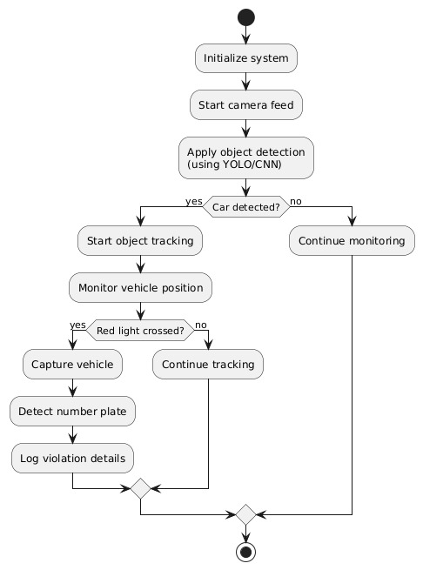

Slide 8
SDG’s
Relevance to Sustainable Development Goals (SDGs)
1. SDG 3: Good Health and Well-being
-Relevance: By reducing traffic violations and improving road safety, the system contributes to lowering the number of road accidents, which enhances public health and well-being. Safer streets lead to fewer injuries and fatalities, directly supporting the goal of promoting good health.
2. SDG 9: Industry, Innovation, and Infrastructure
- Relevance: The implementation of advanced technologies like computer vision, Apache Kafka, and Apache Spark in traffic management fosters innovation and infrastructure development. This aligns with SDG 9 by supporting the creation of resilient, sustainable urban infrastructure and promoting innovation in transportation systems.
3. SDG 11: Sustainable Cities and Communities
- Relevance: The system contributes to building safer and more sustainable cities by improving traffic management, reducing congestion, and enhancing the efficiency of urban transportation networks. These improvements lead to more livable and sustainable urban environments.

Slide 9
4. SDG 13: Climate Action
- Relevance: By reducing traffic congestion and optimizing traffic flow, the system indirectly contributes to lowering vehicle emissions, which supports climate action goals. Efficient traffic management can lead to reduced fuel consumption and lower greenhouse gas emissions.
5. SDG 8: Decent Work and Economic Growth
- Relevance: The system’s automation reduces the need for manual traffic monitoring, which can free up human resources for more value-added tasks, contributing to economic efficiency. Additionally, by supporting safer roads, it fosters a more stable environment for economic activities.
6. SDG 16: Peace, Justice, and Strong Institutions
- Relevance: Enhancing traffic law enforcement through automated detection of violations supports the rule of law and strengthens institutions by ensuring that traffic regulations are followed more consistently. This contributes to the development of safer and more just communities.

Slide 10
References
Bose, S., Kolekar, M. H., Nawale, S., & Khut, D. (2022). LoLTV: A Low Light Two-Wheeler Violation Dataset With Anomaly Detection Technique. IEEE Transactions on Intelligent Transportation Systems, 23(5), 342-356.
Masoud, M. (2021). Machine Learning-Based Modeling of Celeration for Predicting Red-Light Violations. Journal of Transportation Engineering, Part A: Systems, 147(3), 04020098.
Kim, J., Lee, S., & Park, H. (2020). Traffic Light Recognition for Autonomous Vehicles Using CNNs and RGB-D Cameras. IEEE Transactions on Intelligent Vehicles, 5(2), 150-162.
Wong, A. S., Lin, T., & Abdel-Aziz, R. F. (2019). Traffic Light Detection in Real-Time Using YOLO and SSD Frameworks. IEEE Access, 7, 60633-60645.
Sharma, V., Ramesh, P., & Gupta, S. (2021). Super-Resolution Traffic Light Image Enhancement Using SRGAN. IEEE Access, 9, 112304-112316.
Gupta, B., & Zhang, Y. (2022). Anomaly Detection in Traffic Signals Using Deep Reinforcement Learning. IEEE Transactions on Neural Networks and Learning Systems, 33(10), 5212-5223.
Liu, F., & Wang, G. (2020). A Vision-Based System for Real-Time Traffic Light Detection Using R-CNN. Computer Vision and Image Understanding, 193, 102896.

Slide 11
Murthy, T., & Lee, K. S. (2019). Automatic Traffic Light Recognition Using Cascade Classifiers and Color Segmentation. International Journal of Advanced Computer Science and Applications, 10(3), 465-472.
Patel, M., & Shah, S. (2021). Optimized Traffic Signal Control Using Fuzzy Logic and Genetic Algorithms. Expert Systems with Applications, 174, 114772.
Xu, H., & Zhang, L. (2020). Real-Time Object Detection for Autonomous Vehicles: Traffic Light and Sign Recognition Using Transfer Learning. IEEE Access, 8, 72024-72035.
B. Liu, C. -T. Lam, B. K. Ng, X. Yuan and S. K. Im, "A Graph-Based Framework for Traffic Forecasting and Congestion Detection Using Online Images From Multiple Cameras," in IEEE Access, vol. 12, pp. 3756-3767, 2024, doi: 10.1109/ACCESS.2023.3349034.
B. Gong, Z. Xu, C. Lin and D. Wu, "Heterogeneous Traffic Flow Detection Using CAV-Based Sensor With I-GAIN," in IEEE Access, vol. 11, pp. 32616-32627, 2023, doi: 10.1109/ACCESS.2023.3263720.
E. Güney, C. Bayilmiş and B. Çakan, "An Implementation of Real-Time Traffic Signs and Road Objects Detection Based on Mobile GPU Platforms," in IEEE Access, vol. 10, pp. 86191-86203, 2022, doi: 10.1109/ACCESS.2022.3198954.

Slide 12
B. Gong, Z. Xu, C. Lin and D. Wu, "Heterogeneous Traffic Flow Detection Using CAV-Based Sensor With I-GAIN," in IEEE Access, vol. 11, pp. 32616-32627, 2023, doi: 10.1109/ACCESS.2023.3263720.
E. Güney, C. Bayilmiş and B. Çakan, "An Implementation of Real-Time Traffic Signs and Road Objects Detection Based on Mobile GPU Platforms," in IEEE Access, vol. 10, pp. 86191-86203, 2022, doi: 10.1109/ACCESS.2022.3198954.
M. Driss Laanaoui, M. Lachgar, H. Mohamed, H. Hamid, S. Gracia Villar and I. Ashraf, "Enhancing Urban Traffic Management Through Real-Time Anomaly Detection and Load Balancing," in IEEE Access, vol. 12, pp. 63683-63700, 2024, doi: 10.1109/ACCESS.2024.3393981.
P. Liu, Z. Xie and T. Li, "UCN-YOLOv5: Traffic Sign Object Detection Algorithm Based on Deep Learning," in IEEE Access, vol. 11, pp. 110039-110050, 2023, doi: 10.1109/ACCESS.2023.3322371.
X. Mo, C. Sun, C. Zhang, J. Tian and Z. Shao, "Research on Expressway Traffic Event Detection at Night Based on Mask-SpyNet," in IEEE Access, vol. 10, pp. 69053-69062, 2022, doi: 10.1109/ACCESS.2022.3178714.
L. Kessler and K. Bogenberger, "Detection Rate of Congestion Patterns Comparing Multiple Traffic Sensor Technologies," in IEEE Open Journal of Intelligent Transportation Systems, vol. 5, pp. 29-40, 2024, doi: 10.1109/OJITS.2023.3341631.

Slide 13
J. -T. Park, C. -Y. Shin, U. -J. Baek and M. -S. Kim, "User Behavior Detection Using Multi-Modal Signatures of Encrypted Network Traffic," in IEEE Access, vol. 11, pp. 97353-97372, 2023, doi: 10.1109/ACCESS.2023.3311889.
R. Hu, H. Li, D. Huang, X. Xu and K. He, "Traffic Sign Detection Based on Driving Sight Distance in Haze Environment," in IEEE Access, vol. 10, pp. 101124-101136, 2022, doi: 10.1109/ACCESS.2022.3208108.
V. A. Adewopo and N. Elsayed, "Smart City Transportation: Deep Learning Ensemble Approach for Traffic Accident Detection," in IEEE Access, vol. 12, pp. 59134-59147, 2024, doi: 10.1109/ACCESS.2024.3387972.
D. Herzalla, W. T. Lunardi and M. Andreoni, "TII-SSRC-23 Dataset: Typological Exploration of Diverse Traffic Patterns for Intrusion Detection," in IEEE Access, vol. 11, pp. 118577-118594, 2023, doi: 10.1109/ACCESS.2023.3319213.
I. Bisio, C. Garibotto, H. Haleem, F. Lavagetto and A. Sciarrone, "A Systematic Review of Drone Based Road Traffic Monitoring System," in IEEE Access, vol. 10, pp. 101537-101555, 2022, doi: 10.1109/ACCESS.2022.3207282.
Y. Yan, C. Deng, J. Ma, Y. Wang and Y. Li, "A Traffic Sign Recognition Method Under Complex Illumination Conditions," in IEEE Access, vol. 11, pp. 39185-39196, 2023, doi: 10.1109/ACCESS.2023.3266825.

Slide 14
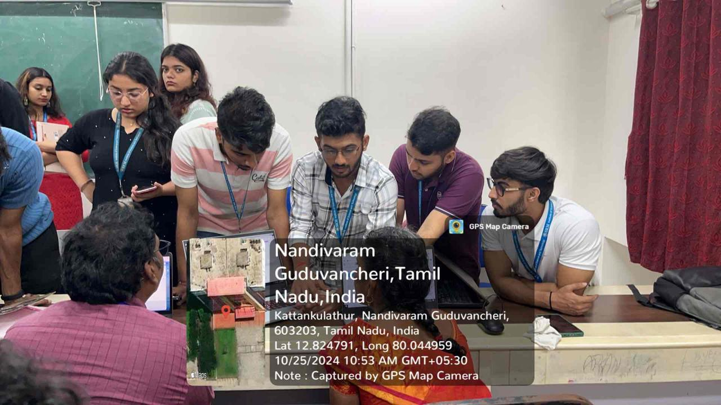
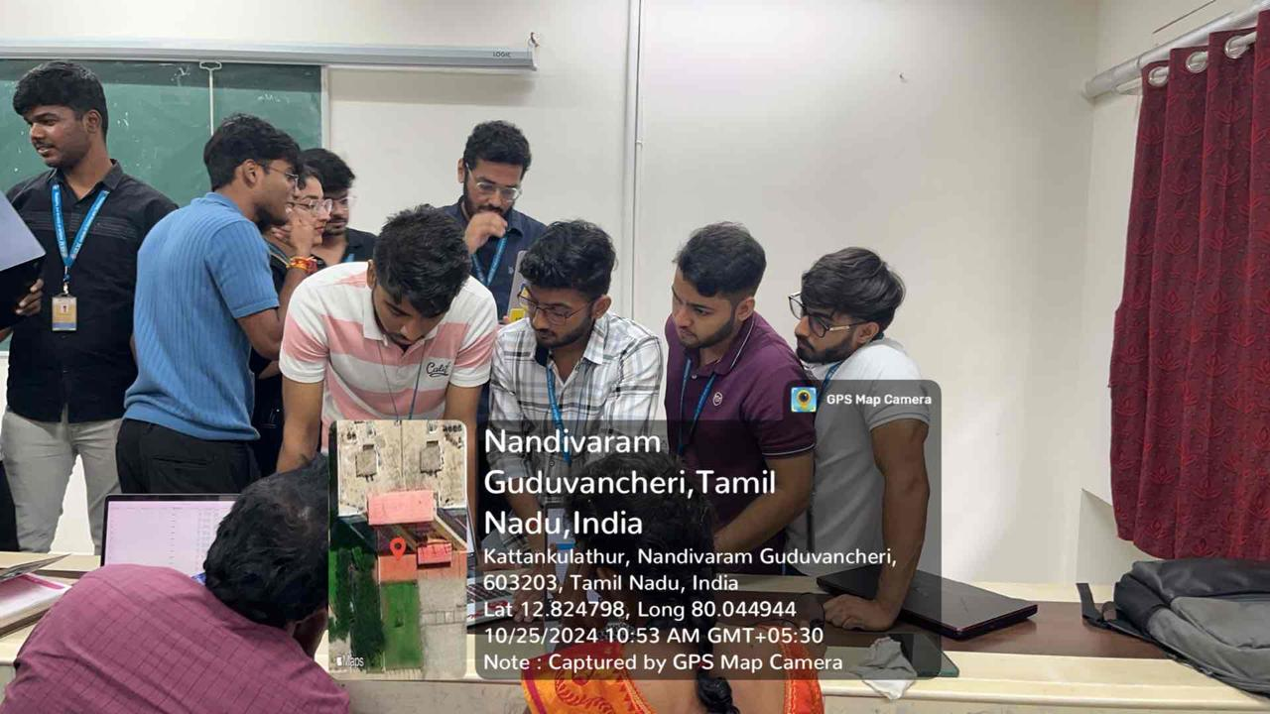
Project Demonstration

Slide 15
THANK YOU

