Slide 1
FINSPEHERE AI

Slide 2
Problem Statement
Traditional Systems vs FinSphere AI
Traditional Approach:
Financial documents and prediction models exist in separate systems.
Analysts manually extract numbers from reports and enter them into forecasting or risk tools.
This process is slow, repetitive, and error-prone.
FinSphere AI Approach:
Automatically reads financial reports.
Extracts relevant information.
Runs risk, forecasting, and anomaly models directly.
Generates a unified financial analysis without manual intervention.
One-Liner:
FinSphere AI bridges the gap between document analysis and predictive modeling by combining both into a single intelligent platform.

Slide 3
Features
Session-Isolated Storage for Raw Financial PDFs (10-Ks, 10-Qs)
Each user's uploaded financial documents are stored in a separate, secure workspace.
Users can only access and query their own reports; documents from other users remain completely isolated.
This ensures data privacy, security, and multi-tenant separation within the platform.
Example:
User A uploads Tesla 10-K → Only User A's AI Copilot can access it.
User B uploads Apple 10-K → User B cannot see or query Tesla's documents.
One-Liner for Slide:
Financial reports are securely stored with user-specific isolation, ensuring private and controlled access to uploaded documents.
10 – K = Annual Report , 10 – Q = Quarterly report

Slide 4
Advanced Deterministic Solvers
1. Altman Z-Score
What it is: A financial formula used to estimate the likelihood of a company going bankrupt.
What it analyzes:
Working Capital
Retained Earnings
Sales
Output:
Safe Zone → Financially healthy
Gray Zone → Moderate risk
Distress Zone → High bankruptcy risk
2. Ridge Regression
What it is: A machine learning algorithm used for predicting continuous values.
In FinSphere AI: It learns from historical revenue data and predicts future revenue trends.
Example:
Q1 = $100M
Q2 = $120M
Q3 = $140M
Q4 = $160M
↓
Predict Q5 Revenue
Why Ridge Regression?
Handles noisy financial data well
Reduces overfitting
Produces stable forecasts
3. Isolation Forest
What it is: A machine learning algorithm designed to detect unusual or abnormal data points (anomalies).
In FinSphere AI:
Normal Company:
Profit Margin = 15%
Debt Ratio = 1.2
Abnormal Company:
Profit Margin = -60%
Debt Ratio = 5.5
↓
Flag as anomaly
Why it is useful: Helps identify:
Suspicious financial records
Accounting irregularities
Potential reporting errors

Slide 5
Introducing the FinSphereAI ReAct Chatbot Agent
Thought
Action
Observation

Slide 6
Introducing the FinSphereAI ReAct Chatbot Agent
LangChain-Orchestrated Agent
LangChain acts as the coordinator that manages AI reasoning, document retrieval, and tool execution to generate intelligent responses.
Binding User Session Context
Ensures the agent only accesses and analyzes documents belonging to the current user, maintaining data isolation and security.
Multi-Turn Chat Memory
Allows the agent to remember previous conversation context, enabling natural follow-up questions without repeating information.
A LangChain-powered agent that securely accesses user-specific data, remembers conversation history, and orchestrates AI reasoning across multiple tools.

Slide 7
System Architecture Flowchart How Information and Decisions Flow Through the Agent
Explain Diagram

Slide 8
Agent Orchestration & Memory Mechanics
Pydantic Schema
A data validation framework that ensures the AI passes correctly formatted and required inputs to Python functions before execution.
Example: The agent must provide:
total_assets
total_liabilities
in the correct format before the bankruptcy tool can run.
One-Liner:
Pydantic validates and structures tool inputs, preventing incorrect or missing parameters during execution.
ConversationSummaryBufferMemory
A LangChain memory mechanism that summarizes older conversations to save tokens while retaining important context.
Why it is used:
Keeps chat history manageable.
Reduces LLM token usage.
Preserves key financial discussion points.
One-Liner:
ConversationSummaryBufferMemory compresses older chat history into concise summaries, enabling long conversations without losing important context.

Slide 9
The Data Ingestion Pipeline & Semantic Parsing
all-MiniLM-L6-v2 Embeddings
A lightweight Sentence Transformer model that converts text into 384-dimensional vector embeddings for semantic search.
In FinSphere AI:
Converts document chunks into numerical vectors.
Stores those vectors in ChromaDB.
Helps find information based on meaning, not just keywords.
Example:
Query:
"financial risk"
Can retrieve:
"rising debt and declining cash reserves"
even if the exact words don't match.
One-Liner:
all-MiniLM-L6-v2 is the embedding model that transforms financial text into 384-dimensional vectors for semantic retrieval.
Maximum Marginal Relevance (MMR)
A retrieval technique that selects document chunks based on both relevance and diversity.
Without MMR:
Top 4 results may all talk about debt.
With MMR:
Chunk 1 → Debt Risk
Chunk 2 → Revenue Trend
Chunk 3 → Liquidity Position
Chunk 4 → Management Concerns
This gives the LLM a broader understanding of the document.
One-Liner:
MMR retrieves relevant yet non-redundant document chunks, providing the AI with more diverse and comprehensive context.

Slide 10
Execution Logic (The Math Offloading Engine)
Explain

Slide 11
System Resilience: Handling Edge Cases & Failures
Explain

Slide 12
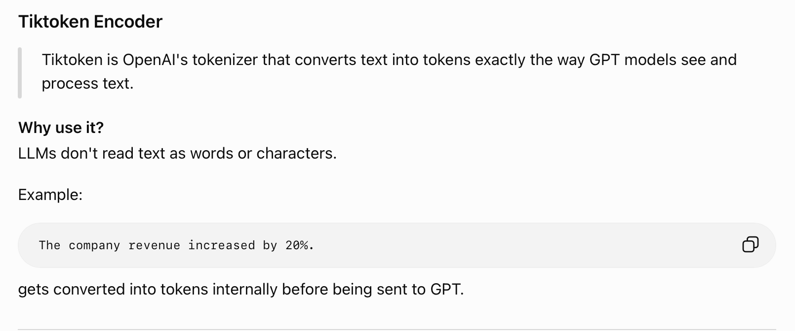
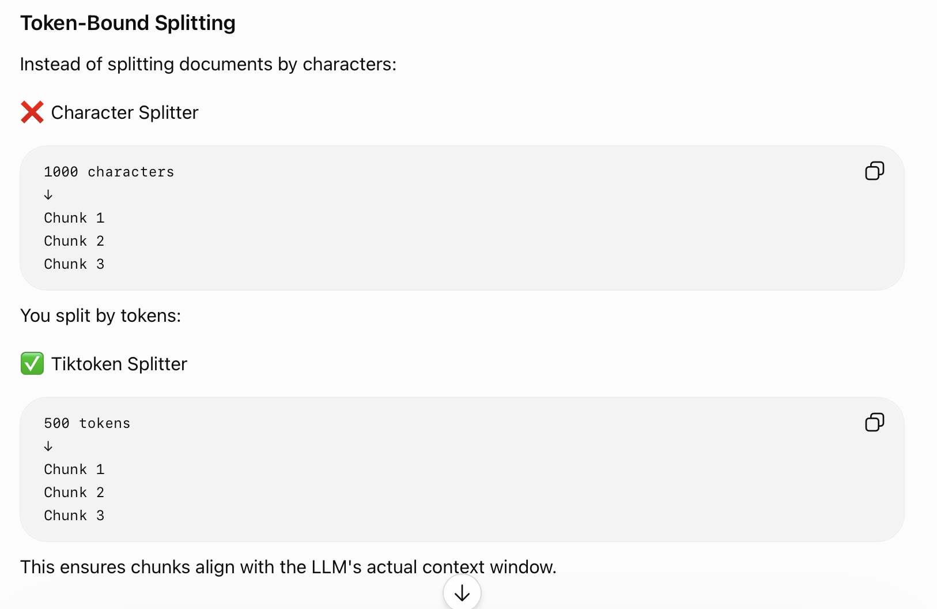
Chatbot Token Optimization Framework

Slide 13
Future Work
Vectorless RAG (GraphRAG)
Uses a Knowledge Graph instead of only vector search, allowing the AI to understand relationships between companies, financial metrics, and business entities for more accurate answers.
Advanced Multi-Agent
Multiple specialized AI agents collaborate together, where each agent handles a specific task such as compliance checking, forecasting, or report generation.
Real-Time Ingestion Pipelines
Automatically fetches and indexes newly released corporate filings (10-Ks, 10-Qs) from SEC sources without requiring manual uploads.

