Slide 2
Ecommerce For Artisans
Submitted to:
Department of Computer Science and Engineering

Slide 3
Supervised by: Dr.Priyanka Jandge
Team Members
1.Aayush Gupta
2.Akshat Singh Gour
3.Akshat Singh Rathore
4.Akshay Keswani

Slide 4
Abstract
An attempt has been made to highlight the role of E-commerce in the development of rural artisans in India by illustrating some efforts of Government and Non-Government agencies, Groups and Individuals in uplifting the socio-economic standard of the rural artisans through E-commerce.

Slide 5
Introduction
To develop an exclusive e-commerce platform for artisans to sell their products. The demand forecast of the items required, automatic quality checks on the items as well as Sentiment analysis with next recommendation actions for the artist shall be added and it also includes the selling raw material.

Slide 6
The Problem Statement
•There is no centralized platform for artisans to showcase their artwork and to sell them.
•Platforms which sell artworks has lack of categories in it.
•Many Indian Artworks are still not recognised .
•There is no exposure for underprivileged artisans.
•Underrepresentation of authentic Indian art.

Slide 7
Survey of Existing Systems
Compare at least 5 existing systems/ software relevant to your project along with their characteristics/advantages/disadvantages.
The comparison should be such that specific gaps could be identified as to have the final project objectives.

Slide 8
Objectives
•To explain the concept of Rural Artisans and Rural Handicraft
•To highlight the role of E-commerce in the development of rural artisans
•To analyze Strength, Weaknesses, Opportunities and Threats/ Challenges faced or to be faced by rural handicraft artisans adopting E-commerce.
•To connect underprivileged artists with an E-commerce platform.
•Shift of emphasis towards “Made in India”.

Slide 9
Requirement Analysis
MongoDB
Express
React
Nodejs
Strape
Stripe
Redux
Rest API

Slide 10
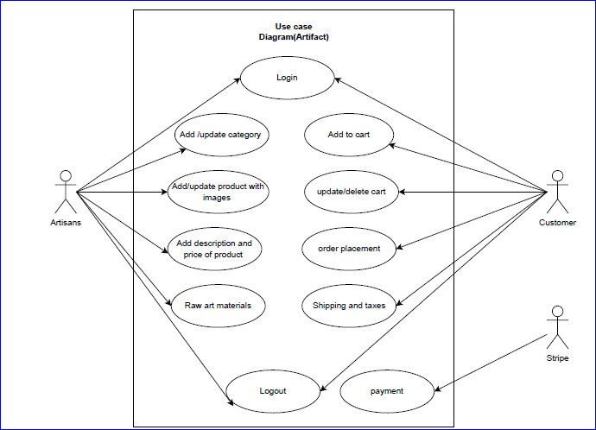
Usecase Diagram

Slide 11
Solution Proposed
•Developing e-commerce web-Application for selling of finished arts projects as well as art material for consumers.
•The web-application will provide the artisans a platform to advertise their products and sell them directly to buyers cutting out the middleman.
•The website will host arts of various kind including Pottery, portrait, sculptures etc.
•Streamline the buying process and make it cheaper for the buyers.
•Simplify the inventory management and exporting process for the artisans.
•Make the whole process more flexible and user friendly.
•Easy availability for the buyers and artisans.

Slide 12
The Outcome Discussion
The project Handicrafts Online was developed by using Html, Sass, ReactJS, Stripe, Strapi and
Javascript. The main aim of developing this project was to help the local artisans grow their
businesses more and bring our traditional culture to light. Through our e-commerce website
people can browse and view the local handicrafts made by our very own Indian Artisans and buy
them at reasonable costs. We hope our project will provide a platform to all the local artists to
display and sell their fine craftsmanship.
We think in today’s world and in this economy it’s very important to support the local craftsmen
and admire their fine art and so this e-commerce website will not only help them but also help
people buy their fine art sitting at home and ordering at their ease instead of going to shop for
them specially.

Slide 13
Conclusion and Limitation
The rural artisans do not get the exposure they deserve and are not very well connected to the wider market of the nation. A normal art lover is not able to buy artwork due to various reasons mainly because of poor access to the market.Local & individual artisans can benefit with the exposure to digital platformOnline retailing removes the need for a middle-man to facilitate the sales.Portal enables sellers to register to sell their products onlineRight marketing will help to reach wider customer bases.Digital platforms are easy to maintain and cater to a variety of people.True skills of artisans would be showcased to earn them the respect that they rightfull deserve.Financial benefit would be marginally better as compared to selling via a middle-man.Shift of emphasis towards “Made in India” products can help gain the required traction.
Product Suitability.It is not possible for people to physically examine the product in eCommerce. In many cases,the original product may not match the picture or specifications in the eCommerce site. Thisabsence of ‘touch and feel’ creates a discouraging effect.Huge Technological Cost.Last but not the least; a lot of money needs to be invested to build up the technical infrastructure needed to runeCommerce business. Moreover, they need to be upgraded to keep abreast with the changing technology.

Slide 14
Q&A

Slide 15
THANKS

