Slide 1
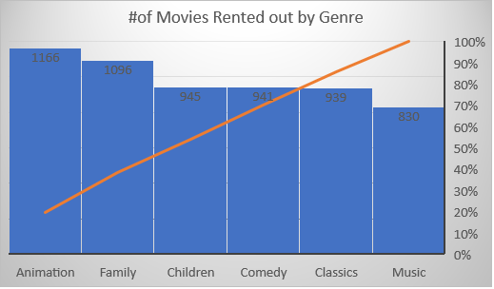
Q1): How many times were ‘Animation Movies’ rented out?
Animation movies was rented out the most followed by family genre. Music genre was the least rented out category among family movies.

Slide 2
Q 2) What is the shortest and longest rental duration?
Shortest rental duration is three days while the longest is seven days. Also seen from the graph, same rental days can be categorized into either 1st or 2nd quartile.

Slide 3
Q 3): Which genre of movie were most checked out in the 4th quartile of rental duration?
In the 4th quartile of longest rented out movies, ‘Animation’ and ‘Family’ movies were the most popular genre.

Slide 4
Q 4):How many rentals did each store process in July and August of 2005?
Both stores performed similar in terms of rentals in both July and August of 2005
*I couldn’t produce the whole data because the Project page was down (It contained ‘papers’ ERD not ‘actors’)
→ This data is from what I jotted down earlier while I was doing the project

