Slide 1
PYTHON PROJECT
NETWORK SERVICE
DISCOVERY AND INVENTORY MANAGER
A Python project that checks selected TCP ports and tracks changes
Presented by : Akshata Lotankar
01

Slide 2
Project overview
What this program does in a few sentences
PURPOSE
RECORD
Check a small set of TCP ports on IP addresses the user explicitly enters.
Save each scan’s results and timestamp in a JSON inventory file.
Then compare the new scan with the previous one to show which services appeared or disappeared.
02

Slide 3
Real Life Problem
A network can have many computers and services. It is easy to lose track of which services are reachable.
WITHOUT A RECORD
PROJECT RESPONSE
A person may not know whether a port was already reachable during an earlier check.
Keep a dated inventory and compare scans to notice changes.
03

Slide 4
Project goals
• Accept specific IP addresses from the user
• Check a small configurable list of TCP ports
• Use a timeout so a slow connection does not wait forever
• Save results as JSON with a scan timestamp
• Compare scans and report new or missing services
04

Slide 5
Scope and safe use
EXPLICIT TARGETS
LIMITED CHECKS
The user provides each IP address. The program does not expand a subnet or discover targets automatically.
Only selected TCP ports are tried. Each attempt uses a short timeout.
Only scan systems you own or have permission to check.
05

Slide 6
Three useful networking terms
HOST
PORT
A computer or device identified here by an IP address, such as 127.0.0.1.
A numbered endpoint used by a network service. Valid TCP port numbers range from 1 to 65535.
SERVICE
A program that listens for network connections on a port, such as a web server.
06

Slide 7
What is a TCP connect check?
The program asks the operating system to connect to one IP address and one TCP port.
• If the connection succeeds before the timeout, the port is recorded as reachable.
• If it fails, the port is not recorded as open.
A failed connection can mean closed, filtered, or unreachable; this project does not tell which.
07

Slide 8
Program workflow
1 INPUT
2 SCAN
3 COMPARE
4 SAVE
IP addresses
Ports and timeout
Try each selected
TCP connection
Check old and new
service lists
Write JSON and
print the summary
This order is coordinated by the command-line entry point.
08

Slide 9
Project file structure
__main__.py
scanner.py
Reads command-line options, validates input, runs the scan, compares results, and prints a summary.
Checks the selected ports on the supplied IP addresses.
inventory.py
tests/test_inventory.py
Loads, saves, and compares JSON inventory snapshots.
Checks inventory behavior and includes a local test-server example.
09

Slide 10
User input from the command line
The program uses argparse to read options
python -m network_service_inventory 127.0.0.1 --ports 8000,8080
IP address
The explicit target to check
--ports
The comma-separated TCP ports to try
--timeout / --inventory
Optional wait time and JSON file location
127.0.0.1 is the local computer and is suitable for a controlled demo.
10

Slide 11
scanner.py: checking one host
scan_host(host, ports, timeout)
1. Validate the IP address with ipaddress.ip_address().
2. Start with an empty list called open_ports.
3. Loop through each requested port and check its range.
4. Try a TCP connection and add successful ports to the list.
Return value example: {"open_ports": [8000]}
11

Slide 12
scanner.py: sockets and timeouts
SOCKET
TIMEOUT
A socket is the Python object used to attempt the TCP connection.
The timeout limits how long the program waits on each port.
CONNECT_EX
EXCEPTION HANDLING
A return value of zero means the connection succeeded; other results are treated as unsuccessful.
Network errors are caught so the program can continue to the next port.
12

Slide 13
scanner.py: checking a list of hosts
scan_hosts(hosts, ports, timeout)
• Loops over each IP address supplied by the user.
• Validates and standardizes each address.
• Skips an address if it was already scanned.
• Calls scan_host() and stores the result for that address.
Finally it returns the results with a IST timestamp and the method name.
13

Slide 14
inventory.py: saving scan results
The inventory is stored as JSON, a text format that represents dictionaries and lists.
{
"scanned_at": "2026-10-21T10:30:00+00:00",
"hosts": {
"127.0.0.1": {"open_ports": [8000]}
}
}
load_inventory() reads the previous file.
save_inventory() writes the latest results.
If the file is missing or invalid, the program starts with an empty baseline.
14

Slide 15
Comparing two inventories
PREVIOUS SCAN
CURRENT SCAN
CHANGES
Port 80
Port 443
Port 443
Port 8080
New: 8080
Disappeared: 80
compare_inventories() converts each scan to host-and-port pairs, then uses set differences to find changes.
15

Slide 16
__main__.py: joining the parts
main() runs the project in this order:
1. Read the options and validate timeout and IP addresses.
2. Load the previous inventory from its JSON file.
3. Call scan_hosts() and compare the two snapshots.
4. Save the current inventory and print the results.
The final `if __name__ == "__main__"` block starts main() when the module is run.
16

Slide 17
Errors and project limitations
INPUT ERRORS
FILE ERRORS
Invalid IP addresses, hostnames, bad port numbers, and unreasonable timeouts are rejected.
If the inventory cannot be read, a warning is shown. If it cannot be saved, the program reports the error.
NETWORK LIMIT
INVENTORY LIMIT
A failed connection does not prove why the service did not respond.
The latest scan replaces the previous snapshot. Copy the JSON file to preserve a longer history.
17

Slide 18
What the project demonstrates
This project demonstrates how Python can:
• Use socket programming to check selected TCP ports
• Handle input, files, exceptions, and timestamps
• Save network results and compare changes
Next are the actual local demo command and results.
18

Slide 19
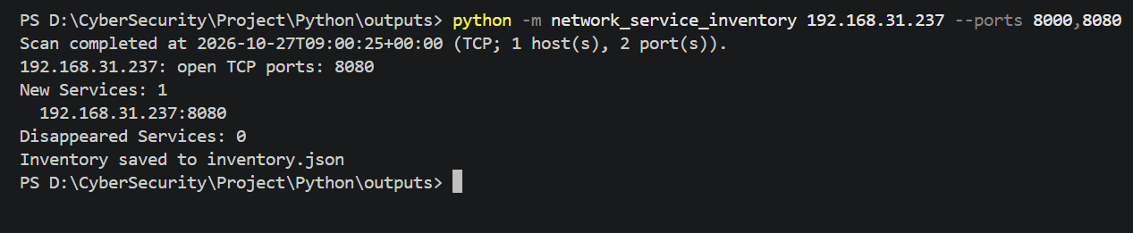
Demo: command and scan output
COMMAND
python -m network_service_inventory 192.168.31.237 --ports 8000,8080
TERMINAL OUTPUT
Scan completed at 2026-10-27T09:00:25+00:00 (TCP; 1 host(s), 2 port(s)).
192.168.31.237: open TCP ports: 8080
New Services: 1
192.168.31.237:8080
Disappeared Services: 0
Inventory saved to inventory.json
Port 8080 was reported as new because the scan immediately before this one checked only port 8000.
19

Slide 20
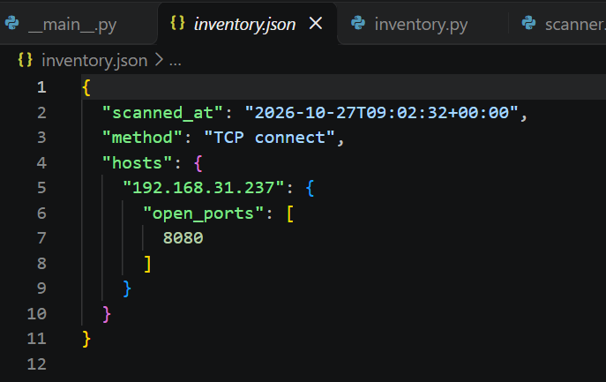
Demo: saved inventory JSON
scanned_at — when the scan ran (IST)
method — the connection method
hosts — the IP address checked
open_ports — ports that accepted a connection
inventory.json
{
"scanned_at": "2026-10-27T09:02:32+00:00",
"method": "TCP connect",
"hosts": {
"192.168.31.237": {
"open_ports": [
8080
]
}
}
}
The inventory is the saved result that the next scan will compare against.
20

Slide 21
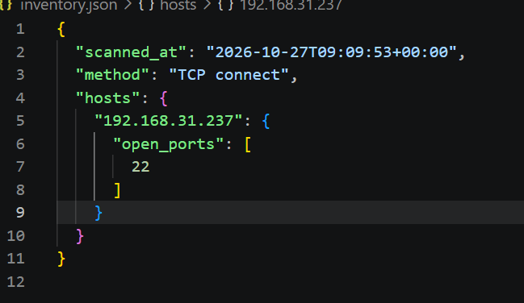
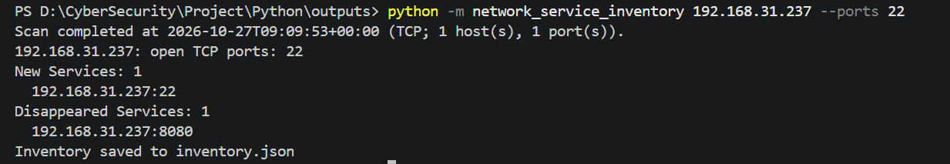
Demo: disappeared-service output
COMMAND
python -m network_service_inventory 192.168.31.237 –ports 22
TERMINAL OUTPUT
Scan completed at 2026-10-27T09:09:53+00:00 (TCP; 1 host(s), 1 port(s)).
192.168.31.237: open TCP ports: 22
New Services: 1
192.168.31.237:22
Disappeared Services: 1
192.168.31.237:8080
Inventory saved to inventory.json
Interpretation: 8080 was omitted from this scan, so it disappeared from the saved snapshot. This does not prove the service stopped; use the same ports in both scans.
21

Slide 22
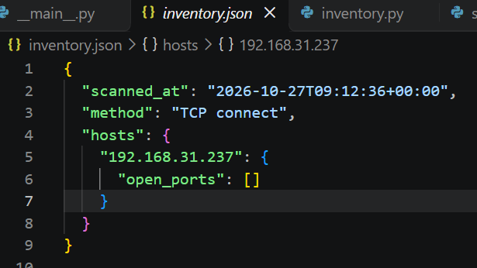
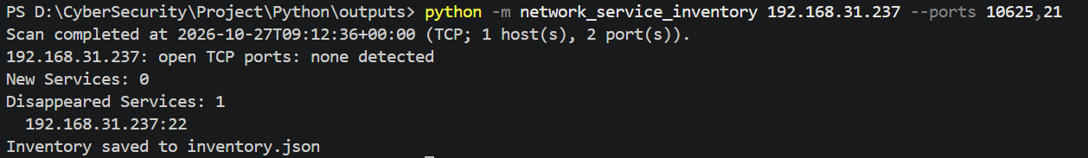
Demo: No port open service output
COMMAND
python -m network_service_inventory 192.168.31.237 --ports 10625,21
TERMINAL OUTPUT
Scan completed at 2026-10-27T09:12:36+00:00 (TCP; 1 host(s), 2 port(s)).
192.168.31.237: open TCP ports: none detected
New Services: 0
Disappeared Services: 1
192.168.31.237:22
Inventory saved to inventory.json
21

Slide 23
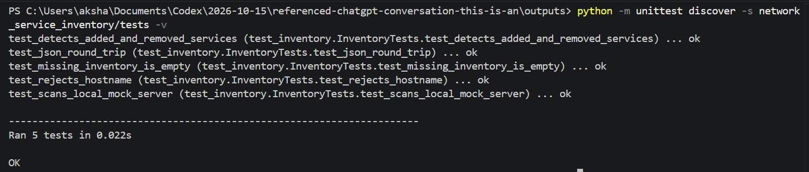
Test results: test_inventory.py
python -m unittest discover -s network_service_inventory/tests -v
The project’s five automated tests all passed.
test_detects_added_and_removed_services ... ok
test_json_round_trip ... ok
test_missing_inventory_is_empty ... ok
test_rejects_hostname ... ok
test_scans_local_mock_server ... ok
Ran 5 tests in 0.018s
These tests cover inventory comparison, JSON storage, missing files, input validation, and a local TCP test server.
22

Slide 24
Challenges faced and how they were resolved
1
Safe scan scope
Used explicit IP addresses, a small port list, and timeouts instead of scanning a whole network.
2
Fair inventory comparison
Different port lists caused a false disappeared-service result. Repeating scans with the same targets and ports makes the comparison meaningful.
3
Testing without public targets
Used the local test server and five automated tests to verify scanning and inventory behavior safely.
23

Slide 25

Thank You

