Slide 1
Abstract
Artificial Intelligence (AI) has rapidly transitioned from a theoretical concept to a critical component of modern digital ecosystems, influencing sectors such as healthcare, finance, governance, and national security. While AI offers transformative advantages—improving efficiency, automating complex tasks, and enabling data-driven decision-making—it simultaneously introduces profound ethical, legal, and cybersecurity risks. This paper presents a comprehensive analysis of the evolving challenges surrounding AI governance, emphasizing the need for transparent, fair, and accountable systems. It examines algorithmic bias, privacy concerns, explainable AI techniques such as LIME and SHAP, and the limitations of current regulatory frameworks including GDPR.

Slide 2
Introduction
Artificial Intelligence (AI) has rapidly evolved from a theoretical idea into a powerful technology that is now deeply embedded in modern society. It is widely used across healthcare, finance, national security, autonomous vehicles, and everyday digital applications. This widespread adoption allows machines to perform tasks traditionally requiring human intelligence, such as decision-making, prediction, and data analysis. While AI offers considerable benefits in terms of efficiency, automation, and the processing of large datasets, its fast-paced growth has introduced serious challenges in areas like ethics, governance, legal regulation, and cybersecurity.

Slide 3
Problem Statement
The rapid expansion of Artificial Intelligence (AI) into essential domains such as healthcare, finance, and national security has created challenges that existing ethical, legal, and cybersecurity frameworks are unable to manage effectively. Modern AI systems are autonomous, opaque, and highly complex, leading to risks such as algorithmic bias, lack of transparency, unclear accountability, and privacy violations. At the same time, AI-powered cyber threats—like polymorphic malware, deepfake impersonation, and automated phishing—are advancing faster than traditional defenses can respond. This widening gap between AI’s technological growth and the slower pace of governance and security adaptation highlights a critical need for robust, adaptive, and internationally aligned frameworks to ensure safe, fair, and secure AI deployment across all sectors.

Slide 4
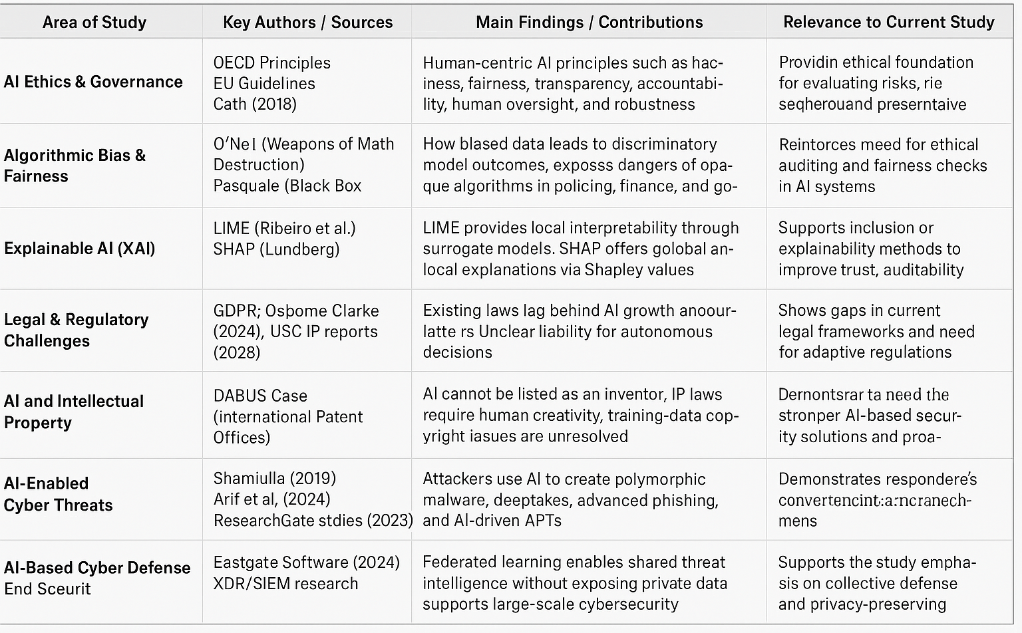
Literature Survey

Slide 5
Objectives
To identify key ethical issues in AI such as bias, transparency, and accountability.
To review major AI governance frameworks and their effectiveness.
To understand the need for Explainable AI using LIME and SHAP.
To analyze legal challenges including liability and IP concerns.
To study AI-based cyber threats like deepfakes and polymorphic malware.
To examine AI-powered cybersecurity defenses.
To highlight the need for strong and adaptive global AI governance.

Slide 6
Proposed Methodology
Literature Review:
Conduct an in-depth study of existing research on AI ethics, governance frameworks, explainability methods (LIME, SHAP), legal challenges, and AI-driven cybersecurity threats.
Problem Identification:
Identify key issues such as algorithmic bias, lack of transparency, legal gaps, and rising AI-enabled cyber threats that hinder safe and ethical AI deployment.
Evaluation of Governance Frameworks:
Analyze international AI governance models (OECD, EU, GDPR) to assess their strengths, limitations, and relevance to modern autonomous AI systems.
Technical Analysis of XAI:
Examine how Explainable AI tools enhance transparency and accountability, and evaluate their applicability to high-risk AI systems.
Cyber Threat & Defense Assessment:
Investigate AI-powered attacks (deepfakes, polymorphic malware, APTs) and evaluate ML-based defensive mechanisms such as behaviour analytics and XDR/SIEM.
Gap Identification & Recommendations:
Compare risks with existing tools/policies to identify gaps and propose an improved, adaptive governance and security framework.

Slide 7
Proposed Work Implementation
Collect and review research on AI ethics, governance, XAI, and cybersecurity threats.
Identify key issues related to bias, transparency, legal gaps, and AI-driven attacks.
Analyze existing governance models and compare their effectiveness.
Apply XAI methods like LIME and SHAP to improve model transparency.
Study AI-based cyber threats and evaluate modern defense techniques.
Propose an integrated framework combining ethics, legal compliance, explainability, and AI-driven security.

Slide 8
Results
dentified major gaps in current AI governance related to ethics, transparency, and accountability.
Found that XAI tools like LIME and SHAP significantly improve model interpretability.
Observed that AI-based cyber threats are more advanced and harder to detect than traditional attacks.
Confirmed that AI-driven defense techniques enhance early detection and automated response.
Noted that federated learning supports secure and privacy-preserving threat intelligence sharing.
Developed an integrated framework that strengthens ethical compliance and cybersecurity readiness.

Slide 9
Conclusion
Artificial Intelligence has become a transformative force across sectors, offering major advancements in automation, decision-making, and large-scale data processing; however, this study shows that these benefits are closely accompanied by significant ethical, legal, and cybersecurity challenges. Existing governance frameworks often fail to address the opacity, autonomy, and unpredictability of modern AI systems, leading to concerns such as bias, lack of transparency, weak accountability, and unclear liability when harm occurs. The analysis highlights that Explainable AI tools like LIME and SHAP are essential for improving model interpretability and ensuring responsible use in high-risk environments. In parallel, the rise of AI-driven cyber threats—including deepfakes, polymorphic malware, and automated APTs—demonstrates how attackers now exploit AI for speed, scale, and precision. Defensive mechanisms using machine learning, behavioural analytics, and federated intelligence sharing show strong potential to counter these evolving threats. Overall, the study concludes that a unified, adaptive, and ethically grounded governance framework is necessary to ensure AI remains transparent, secure, and trustworthy while enabling continued innovation and societal benefit.

Slide 10
References
Cath, C. (2018). Governing Artificial Intelligence: Ethical, Legal and Technical Opportunities and Challenges. Philosophical Transactions of the Royal Society A, 376(20180080).
O’Neil, C. (2016). Weapons of Math Destruction: How Big Data Increases Inequality and Threatens Democracy. Crown Publishing.
European Parliament. (2019). EU Guidelines on Ethics in Artificial Intelligence: Context and Implementation.
Vutukuri, K. (2025). Model Interpretability in AI: SHAP and LIME. Medium.
Shamiulla, A. M. (2019). Role of Artificial Intelligence in Cyber Security. IJITEE, 9(1), 2384–2415.
Arif, A., Khan, M. I., & Khan, A. R. A. (2024). An Overview of Cyber Threats Generated by AI. International Journal of Multidisciplinary Science & Arts, 3(4).
USC IP. (2025). AI, Copyright, and the Law: The Ongoing Battle Over Intellectual Property Rights.

