Slide 1
Predict Liver Disease

Slide 2
Group:3
Presented By:
AKSHATA LAXMAN PATIL
ANUSHRI DEVIDAS SAMRUT
Bharath M N
GOWTHAM T H
Manu D P
RAKESH B O

Slide 3
1. The liver is a vital organ responsible for detoxification, metabolism, protein synthesis, and digestion. 2. Common liver diseases include hepatitis, fatty liver, cirrhosis, and liver cancer, affecting its structure and function. 3. Liver diseases can result from viral infections, alcohol consumption, obesity, genetic disorders, or exposure to toxins. 4. Liver diseases are a significant health concern worldwide, requiring early detection and treatment to prevent severe complications like liver failure.
INTRODUCTION

Slide 4
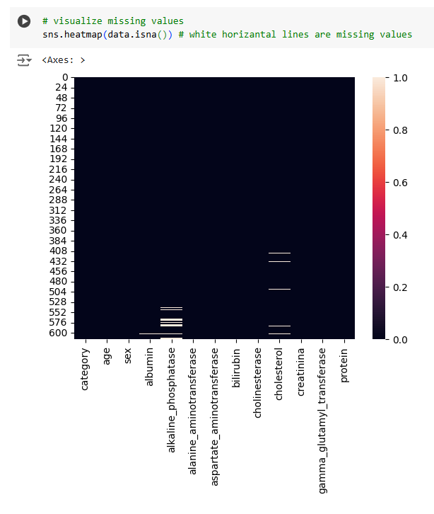
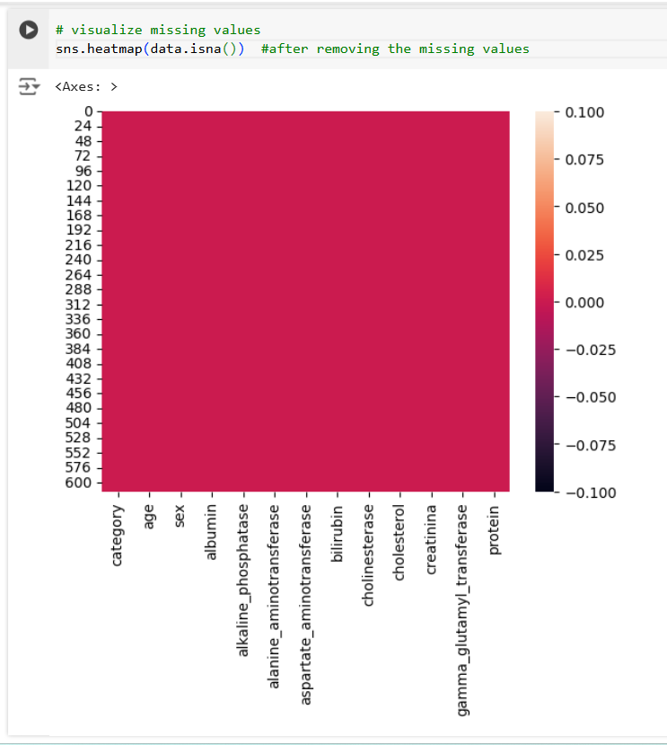
EDA
Visualize Missing values Cleaned Missing values

Slide 5
MODEL BUILDING
The model-building process involved the application of five machine learning algorithms, namely:
Logistic Regression
Support Vector Machine (SVM)
K-Nearest Neighbor (KNN) Classifier
Random Forest Classifier
Gradient Boosting Classifier
Model Evaluation and Selection
A confusion matrix and classification report were generated for all models to provide a detailed understanding of their performance. Among the five models, Logistic Regression outperformed the others, delivering the highest accuracy and balanced performance across all evaluation metrics.
The Logistic Regression model was finalized as the best-performing model for this classification task due to its simplicity, robustness, and superior accuracy.

Slide 6
CHALLENGES
Imbalanced Dataset The dataset had an uneven distribution of classes, with significantly fewer instances of liver disease. This imbalance posed challenges in training the models effectively and achieving unbiased predictions.
Feature Selection Irrelevant or redundant features could lead to overfitting or decreased model performance, requiring careful preprocessing and feature engineering.
Overfitting in Complex Models Advanced models like gradient boosting and random forest were prone to overfitting due to their complexity, especially on a smaller dataset.
Hyperparameter Tuning Achieving optimal performance for models like SVM, KNN, and gradient boosting required extensive hyperparameter tuning.

Slide 7
TO OVERCOME CHALLENGES:
Imbalanced Dataset: Resampled the dataset using oversampling and under sampling techniques during preprocessing to balance class distribution.
Feature Selection: Removed low-variance features and conducted preprocessing steps like normalization to ensure relevant data is retained
Hyperparameter Tuning: Employed grid search and randomized search for efficient hyperparameter optimization.

Slide 8
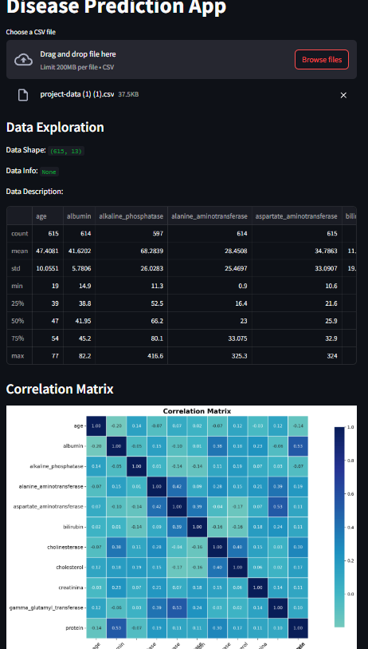
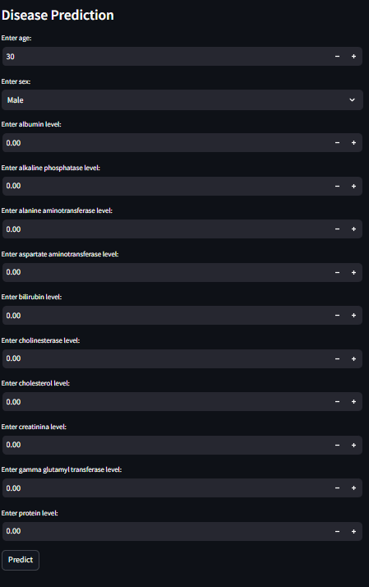
DEPLOYMENT
https://excelr-project-cqcpx3buzrdeav5wvmpcdu.streamlit.app/

Slide 9
Conclusion:
The liver disease prediction project demonstrated the effectiveness of machine learning models, with logistic regression emerging as the most accurate and interpretable model. This project addresses the gap by providing a reliable and efficient tool to predict liver disease using machine learning models. It empowers healthcare professionals with data-driven insights, improving diagnostic accuracy and enabling proactive patient care.

