Slide 1
I2S – Inter-IC Sound
Akshata Mukund Shetty

Slide 2
Contents
Introduction
Modes of I2S module
Features
Example
I2S configuration API's

Slide 3
Introduction
I²S (Inter-IC Sound) is an electrical serial bus interface standard used for connecting digital audio devices together.
The bus can handle audio data.
A 3-line serial bus is used consisting of a line for two time-multiplexed data channels, a word select line and a clock line.

Slide 4
Introduction
The bus has three lines:
• continuous serial clock (SCK);
• word select (WS);
WS = 0; channel 1 (left);
WS = 1; channel 2 (right).
• serial data (SD);
serial data (SD) can be called SDATA, SDIN, SDOUT, DACDAT,
ADCDAT, etc
The device generating SCK and WS is the master.

Slide 5
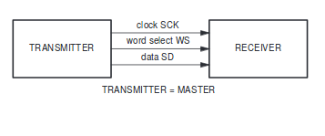
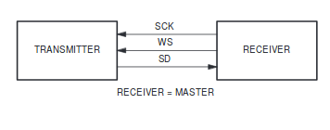
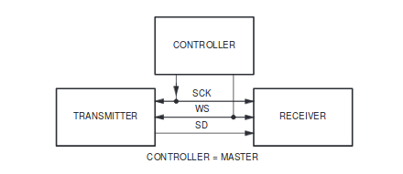
Introduction

Slide 6
Different modes of I2S module
The I2S module has three modes:
Master
Controller
Slave

Slide 7
Features
8 - 32 data bits per sample
16, 32, 48, or 64 bit word select period
Data rate up to 192 kHz with 64 bit word select period: 12.288 MHz.
Tx and Rx FIFO interrupts
DMA support
Independent left and right channel FIFOs
Independent enable of Rx and Tx

Slide 8
Example of I2S configuration
#include "driver/i2s.h"
#include "freertos/queue.h"
static const int i2s_num = 0; // i2s port number
static const i2s_config_t i2s_config = {
.mode = I2S_MODE_MASTER | I2S_MODE_TX,
.sample_rate = 44100,
.bits_per_sample = 16,
.channel_format = I2S_CHANNEL_FMT_RIGHT_LEFT,
.communication_format = I2S_COMM_FORMAT_I2S|I2S_COMM_FORMAT_I2S_MSB,
.intr_alloc_flags = 0, // default interrupt priority
.dma_buf_count = 8,
.dma_buf_len = 64,
.use_apll = 0
};

Slide 9
Example of I2S configuration
static const i2s_pin_config_t pin_config = {
.bck_io_num = 26,
.ws_io_num = 25,
.data_out_num = 22,
.data_in_num = I2S_PIN_NO_CHANGE
};
…
i2s_driver_install(i2s_num, &i2s_config, 0, NULL); //install and start i2s driver
i2s_set_pin(i2s_num, &pin_config);
i2s_set_sample_rates(i2s_num, 22050); //set sample rates
i2s_driver_uninstall(i2s_num); //stop & destroy i2s driver

Slide 10
I2S configuration API's
void I2S_init(void) : Enables the I2S interface
void I2S_start(void) : Starts the I2S interface.
void I2S_stop(void) : Disables the I2S interface.
void I2S_enableTx(void) : Enables the Tx direction of the I2S interface.
void I2S_disableTx(void) : Disables the Tx direction of the I2S interface.
void I2S_enableRx(void) : Enables the Rx direction of the I2S interface.
void I2S_disableRx(void) : Disables the Rx direction of the I2S interface.

Slide 11
I2S configuration API's
uint8 I2S_readRxStatus(void) : Returns state in the I2S Rx status register
uint8 I2S_readTxStatus(void) : Returns state in the I2S Tx status register
uint8 I2S_readByte(uint8 word_Select) : Returns a single byte from the Rx FIFO.
void I2S_writeByte(uint8 wrData, uint8 word_Select) : Writes a single byte into the Tx FIFO.
void I2S_clearRxFIFO(void) : Clears out the Rx FIFO.
void I2S_clearTxFIFO(void) : Clears out the Tx FIFO.
void I2S_sleep(void) : Saves configuration and disables the I2S interface
void I2S_wakeUp(void) : Restores configuration and enables the I2S interface

