Slide 1
IPL MATCHES ANALYSIS
2008-2023

Slide 2
POWER BI FUNCTIONALITIES YOU WILL LEARN
How to connect POWER BI to PostgreSQL
Data modelling with three tables
Data cleaning in power query
Time intelligence function
Creating KPI's
DAX queries
Creating and formatting charts
Different DAX functions like Calculate, Sum, Sumx, Filter, Allselected, Values, Selected Value, Return, Concatenate, Divide, Etc
Creating different shapes and formatting
Generating insights from charts
Export report

Slide 3
Steps
Requirement Gathering
Stakeholders in Project
Import Data PostgreSQL DB
Connecting Power BI to Database
Data Cleaning
Data Modelling
Time Intelligence Function
Data Visualization
Creating Dashboard
Generating Insights

Slide 4
R EQUIREMENT
Develop a IPL dashboard for season 2008 to 2023 to have a detailed insight on below problem statements
Find the title winner, orange cap winner, purple cap winner, tournament 6's and 4's for the respective seasons on IPL.
Develop IPL batting and bowling stats and add a filter where user can select the bowler and batsman to see these stats.
Winning percentage based on the toss decision.
Matches win by venue.
Total wins by team in a season.
Matches won based on the result type.

Slide 5
STAKEHOLDERS
BCCI (Board Of Control For Cricket In India)
Franchise/ Team owners
Team Mangement
Coaches
Players
Media
Public

Slide 6
Import Data Into PostgreSQL
Use required SQL queries
To create database
To create table
To enter data into created table

Slide 7
Connect Power BI to PostgreSQL
To load the data from PostgreSQL to Power BI we need to connect these two tools.
In power bi we can get data through more than 70 different sources.
In home tab of Power BI > click on get data > search for PostgreSQL database.
Enter your server and password. Click on connect.

Slide 8
Data Cleaning
We need to do some data cleaning in our data. First check the data, what type of values column contain, spellings, errors and everything.
In our data we have some typos
In match table in column Team 1, Team 2, Winning Team Rising Pune Supergiant is misprinted as Rising Pune Supergiants. We need to replace Rising Pune Supergiants with Rising Pune Supergiant
In Venue column Bangalore and Bengaluru are two different values. We need to replace Bengaluru with Bangalore.

Slide 9
Data Modeling
To use Time Intelligence Function we need to create new table in power bi name as ‘Calender Table’ which refers to all the data on in calender starting from first date of year 2008 on which first match took place to last date on which last match of year 2023 took place.
For that we need to use our Table View
Table Tools > New Table > In formula bar ‘Calender Table = CALENDAR(min('public ipl_matches_2008_2023'[date]), max('public ipl_matches_2008_2023'[date]))’
Add one more column ‘Year’ to table
New Column > In formula bar ‘Year = Year('Calender Table'[Date])’
Make a relationship between new table and two existing table in Model View using ‘Date’ Column.

Slide 10
Visualization
Different type of visualizations have used in this dashboard to get the thorough knowledge of KPIs, Slicers, Pie-charts, Bar Graphs and Time Intelligent Function.
KPIs (Key Performance Indicators):
Key Performance Indicators (KPIs) serve as pivotal metrics that encapsulate the essence of IPL match performance. Our dashboard incorporates KPIs such as total runs scored, wickets taken, average run rate, and other essential metrics. These indicators provide at-a-glance insights into the overall performance and dynamics of IPL matches, enabling stakeholders to quickly assess team and player performances.
Slicers:
Slicers offer users dynamic filtering capabilities, allowing them to slice and dice IPL match data based on various dimensions and criteria. Our dashboard features slicers that enable users to filter data by team, player, match venue, and date range. This interactive functionality empowers users to tailor their analysis and focus on specific aspects of IPL matches, facilitating deeper exploration and understanding of the data.
Bar Graphs:
Bar graphs are instrumental in visually representing quantitative data and comparing different metrics across teams, players, and matches. Within our dashboard, bar graphs illustrate key performance metrics such as total runs scored by each team, the distribution of wickets taken by bowlers, and the frequency of boundary hits (sixes and fours) during matches. These visualizations provide clear and concise insights into the performance trends and statistical distributions within the realm of IPL matches.
Pie Charts:
Pie charts offer a concise representation of categorical data and aid in understanding the composition or distribution of specific metrics within IPL matches. Our dashboard utilizes pie charts to depict insights such as the distribution of runs scored by different batting orders, the proportion of wickets taken by individual bowlers, and the distribution of match outcomes (wins, losses, ties) across teams. These visualizations enable stakeholders to grasp the relative significance and contribution of various factors within the context of IPL matches.

Slide 11
Insight and Analysis
Through the amalgamation of KPIs, slicers, bar graphs, and pie charts, our Power BI dashboard offers comprehensive insights and analysis into the intricacies of IPL matches. Users can uncover trends, patterns, and correlations within the data, gaining valuable insights into team strategies, player performances, and match dynamics. By leveraging the interactive features of the dashboard, stakeholders can delve deeper into the data, derive actionable insights, and make informed decisions to enhance their understanding and engagement with IPL matches.

Slide 12
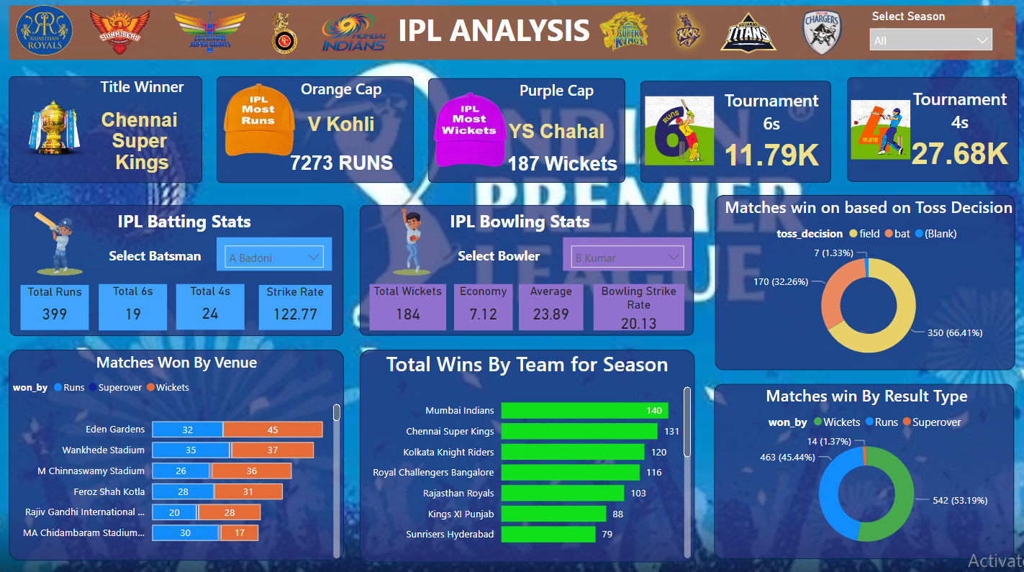
Dashboard

