Slide 1
Cache-Aware Request Routing for LLM Replicas
GPU A
GPU B
GPU C
GPU D
Sending each request to the GPU that already holds the beginning of its prompt
Notes:
This project is a request router that sits in front of several GPU servers running the same language model. The goal is simple: when a prompt shares its beginning with an earlier prompt, send it to the GPU that already processed that beginning, so the work is not repeated. The highlighted tile on the right represents the one GPU that holds the cached prefix.

Slide 2
Each GPU keeps its own cache
Prefill reads the whole prompt. The model processes every prompt token and stores the attention state it will reuse while generating, called the KV cache.
Prefix caching skips repeated work. vLLM keeps the KV cache for finished prompts. A new prompt that starts with the same full 16-token blocks skips that part of prefill.
Caches are not shared. With several replicas, only the one that handled the earlier prompt holds it. A balancer that ignores this sends the request to a replica that must start from scratch.
Request with a shared prefix
GPU A
GPU B
GPU C
GPU D
prefix cached
no cache
no cache
no cache
Only one replica can skip the repeated prefill. Where the request lands decides whether the cache is used.
Notes:
Explain the two phases of generating text. Prefill is the cost of reading the prompt, and it grows with prompt length. vLLM can reuse earlier prefill work if a new prompt begins with exactly the same tokens, in whole blocks of sixteen. The catch is that each GPU keeps its own cache. If four replicas serve traffic and a repeated prompt lands on the wrong one, the saved work is not available.

Slide 3
What a cache hit is worth
2,061 ms
74 ms
1,600 of 1,617
time to first token, empty cache
time to first token, prefix cached
prompt tokens reused from cache
Time to first token
Cold
Cached
74 ms
Measured on one Tesla T4 running vLLM with Qwen2.5-3B-Instruct. The same system prompt of about 1,600 tokens was sent in three requests; only the first met an empty cache.
Notes:
This is a direct measurement on one of the GPU nodes, calling the model server without the router. The first request had to process the whole prompt and took about two seconds to produce the first token. The next two requests reused sixteen hundred of the sixteen hundred and seventeen prompt tokens and took about seventy-four milliseconds. The bars are drawn to scale. This gap is what a cache-aware router tries to capture.

Slide 4



The idea
Send each request to the replica that already holds the start of its prompt, unless that replica is too busy.
Remember
Match
Protect
The router keeps an index of which replica holds which blocks of which prompts.
The replica with the longest shared prefix is the best candidate.
A latency estimate rules out a candidate that would miss the response-time target.
Notes:
The idea has three parts. First, remember: the router tracks which replica has seen which prompt blocks. Second, match: among the replicas, prefer the one with the longest shared prefix. Third, protect: a cached replica that is overloaded is worse than an idle one, so a latency estimate can veto the match.

Slide 5
System architecture
Replica A
T4 GPU · vLLM
Router
Web console
Admission control
Replica B
T4 GPU · vLLM
Playground
Load test
Live routing
Dashboard
Routing policy
Replica C
T4 GPU · vLLM
HTTPS tunnels
Proxy with retries
Replica D
T4 GPU · vLLM
Requests flow left to right. Each routing step is also published as an event that the console draws live.
Notes:
The browser console sends requests to the router. The router applies admission control, runs the routing policy to pick a replica, and proxies the request, retrying connection errors. Each replica is a Colab T4 GPU running vLLM, reached through an HTTPS tunnel because the nodes have no public address. In parallel, the router publishes an event for every step so the console can show what happened to each request.

Slide 6
How the router decides
1
Split the prompt
The chat is tokenized and cut into 16-token blocks, matching the block size vLLM caches.
2
Chain the hashes
Each block's hash includes the hash before it, so one hash identifies an entire prefix.
3
Find the longest match
The index lists which replicas hold each hash. A match counts if it covers half the prompt or at least 256 tokens.
4
Check the response-time target
A latency estimate from queue depth and recent latency rules out a replica that would be too slow.
5
Fall back to load
With no usable match, the least-loaded replica is chosen. The chosen replica's index then records the prompt's blocks.
Notes:
Walk through the five steps. The prompt is split into blocks of sixteen tokens. Each block is hashed together with the previous hash, which means a single hash stands for everything before it too. The router looks those hashes up in its index to see which replica holds the longest run. A match is only used if it is large enough to matter and if the replica is predicted to answer within the response-time target. Otherwise the router picks the least-loaded replica. After choosing, it records the prompt's blocks against that replica so that similar requests follow.

Slide 7
Four policies compared
Policy | What it looks at | Strength | Weakness
round_robin | Nothing. Replicas take turns. | Simple and perfectly even. | Ignores both load and cache.
least_connections | Requests currently in flight on each replica. | Adapts as load changes. | Ignores which replica holds the cache.
swiftserve | Session affinity, then a prefix trie over whole messages. | Keeps a conversation on one replica. | Needs two shared messages. Single-turn traffic falls back to load.
prefix_aware | 16-token block hashes, a load estimate and the response-time target. | Reuses shared prefixes across different users. | The index can go stale after cache evictions or failures.
Notes:
These are the four routing policies implemented in the router. Round robin and least connections are the baselines: neither knows anything about the cache. Swiftserve is the earlier policy, which tracks conversations and a trie of whole messages, so it needs at least two shared messages before it can match. Prefix-aware matches at the level of 16-token blocks, so it can reuse a shared system prompt across different users and different conversations.

Slide 8
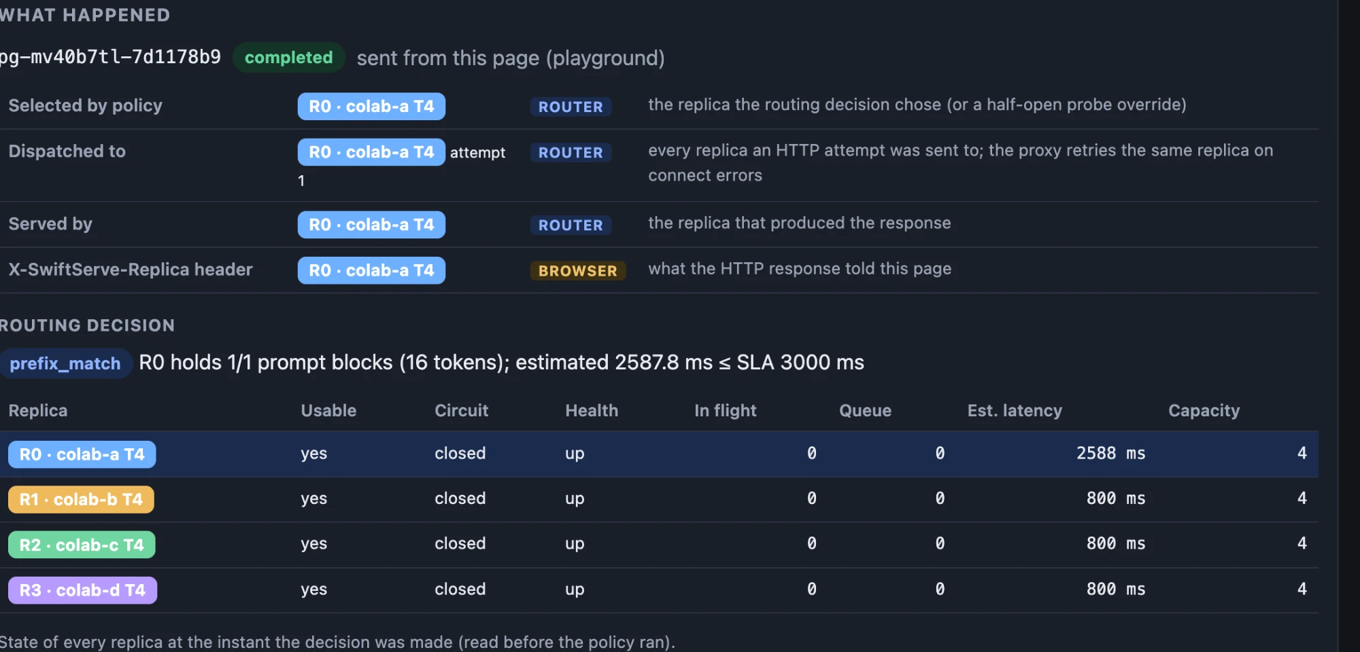
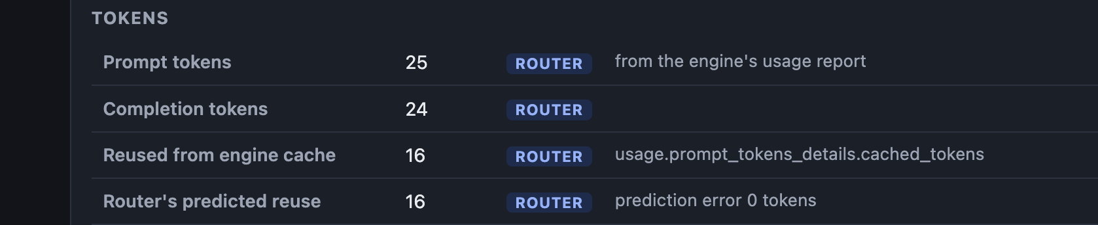
Every request is traceable
Which replica was selected, dispatched to and served the request
The routing decision and the reason for it
Time to first token, inter-token latency and total time, measured at the router
Cached tokens reported by the engine, next to the router's prediction
Notes:
Each request gets an identifier, and the router records what it decided and what happened. The screenshot shows one request: the policy chose the replica because it held the prompt's first block, and the router's predicted cache reuse matched what vLLM reported afterward. Selected, dispatched and served are kept separate because they can differ when a request is retried.

Slide 9
How latency is measured
TTFT
ITL: gaps between tokens
Request received
First token
Last token
TTFT
ITL
Cache reuse
Time to first token
Inter-token latency
Prompt tokens reused
From the request arriving at the router to the first response chunk that contains text.
Time between the first and last text chunks divided by the number of gaps. Reported as a mean, because tunnels deliver chunks in bursts.
Taken from the engine's own usage report and compared with the router's prediction.
Notes:
Time to first token is how long the user waits before anything appears; it contains the prefill, which is exactly what caching shortens. Inter-token latency describes the pace once generation starts. Network tunnels can bunch several tokens into one chunk, so single gaps are not reliable, but the mean over the whole span is. Cache reuse comes from the engine's usage report, so it is a measurement and not an estimate.

Slide 10
A run through the router on four GPUs
60 of 60
requests completed, concurrency 8
374 / 4,944 ms
time to first token, median / 95th percentile
34.2 ms
mean inter-token latency under load
16 and 16
cached tokens predicted, and reported
The prompts in this run were only 40 tokens, so very little could be cached. It shows load spreading across four real GPUs and the router's prediction matching the engine. It is not a cache benchmark.
Notes:
This run sent sixty requests at a concurrency of eight through the router to the four Colab GPUs, using the prefix-aware policy. All sixty completed. The distribution shows work spreading over all four replicas. The 95th percentile time to first token is much higher than the median, which points to the first requests reaching cold replicas and to queueing; that has not been broken down further. The prompts were very short, so this run is evidence that routing and measurement work end to end, not evidence of a cache speedup.

Slide 11
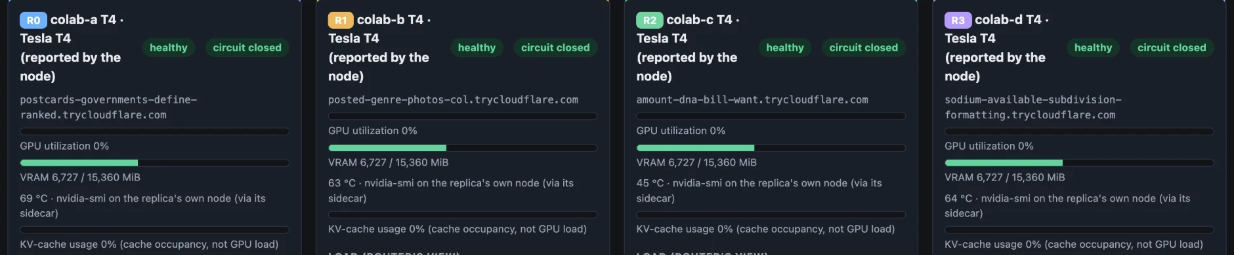
Live demonstration
1
Dashboard
2
Playground
3
Load test
four GPUs with memory and temperature reported by each node
one request twice: cold, then with the prefix cached
sixty concurrent requests spread across the replicas
Notes:
Run the demonstration in this order. Start on the dashboard to show the real GPUs. Then use the playground to send the same long system prompt twice and point at the cached token count and the time to first token. Finish with the load test and the live routing view to show concurrent requests being spread across replicas.

Slide 12
Limits and next steps
Current limits
Next steps
A failed request can leave a stale entry in the router's cache index.
Connection errors retry the same replica; there is no failover to another one.
Latency measured through tunnels includes network delay.
Results so far come from short runs on a single model.
Run every policy on one long shared-prefix workload and report the differences.
Rebuild the index from the engine's cache events instead of predictions.
Fail over to another replica on connection errors.
Keep the index across router restarts.
Notes:
Be direct about the limitations. The index is a belief about what each replica holds, and it can drift after cache evictions or failed requests. Retries stay on the same replica. The measurements so far are short and on one model. The next steps address each of these, starting with a fair comparison of all four policies on the same workload.

Slide 13
Summary
Caches are per replica
A balancer that ignores them wastes the work vLLM could reuse.
Route by prefix, protect by latency
Hash prompts in 16-token blocks, pick the longest match, and veto replicas that would be too slow.
Measure every step
Each request records its decision, its replica and its timings, so claims can be checked.
Notes:
Close with the three points. Caches are per replica. Routing by prefix and protecting with a latency check lets the router reuse cached work without overloading a replica. And every request is measured, so the claims in this presentation can be checked against the recorded data.

