Slide 1

SMART INDIA HACKATHON 2026
RoadTwin — a what-if lab for Indian roads
Problem Statement ID – SIH25100
Problem Statement Title – Accelerating High-Fidelity Road Network Modeling for Indian Traffic Simulations
Theme – Transportation & Logistics
PS Category – Software
Team ID – «TEAM ID»
Team Name (Registered on portal) – «TEAM NAME»

Slide 2
RoadTwin — a what-if lab for Indian roads
«TEAM NAME»
Turn any Indian road area into a simulation-ready digital twin in seconds — then test a road change in the model before it is built in the real world.
USER FLOW — under 2 minutes end to end
1. Pick area
Koramangala, Bengaluru
2. Generate twin
1,010 junctions in ~0.1 s
3. Run baseline
How the road behaves today
4. Ask “what if”
Plain English → validated scenario
5. Simulate
Mixed Indian traffic in SUMO
6. Compare & decide
Evidence before intervention
WHO IT IS FOR
▪ City traffic police & control rooms
▪ Urban local bodies and city planners
▪ Transport consultants & DPR teams
▪ Transportation researchers
WHAT IT DOES
▪ Builds a high-fidelity road model from OpenStreetMap automatically
▪ Simulates heterogeneous Indian traffic — 2-wheelers, autos, buses, trucks
▪ Runs what-if scenarios and measures the difference
HOW IT HELPS THE USER
▪ Answers “will this change actually help?” with numbers, not opinion
▪ Days of manual network modelling → seconds
▪ Test lane closures, signal plans and demand growth with zero road risk
INNOVATION & UNIQUENESS
▪ Sublane physics: a 0.75 m motorcycle shares a lane and filters through queues — lane-based models cannot represent this and over-predict congestion on Indian roads.
▪ Effective capacity, not nominal: kerbside parking, vendors and encroachment remove ~33% of the capacity OSM implies. We model that per segment.
▪ AI never runs the simulation — it only writes a scenario that is schema-validated before SUMO sees it. Congestion causes are computed from simulation state, not narrated by a model.

Slide 3
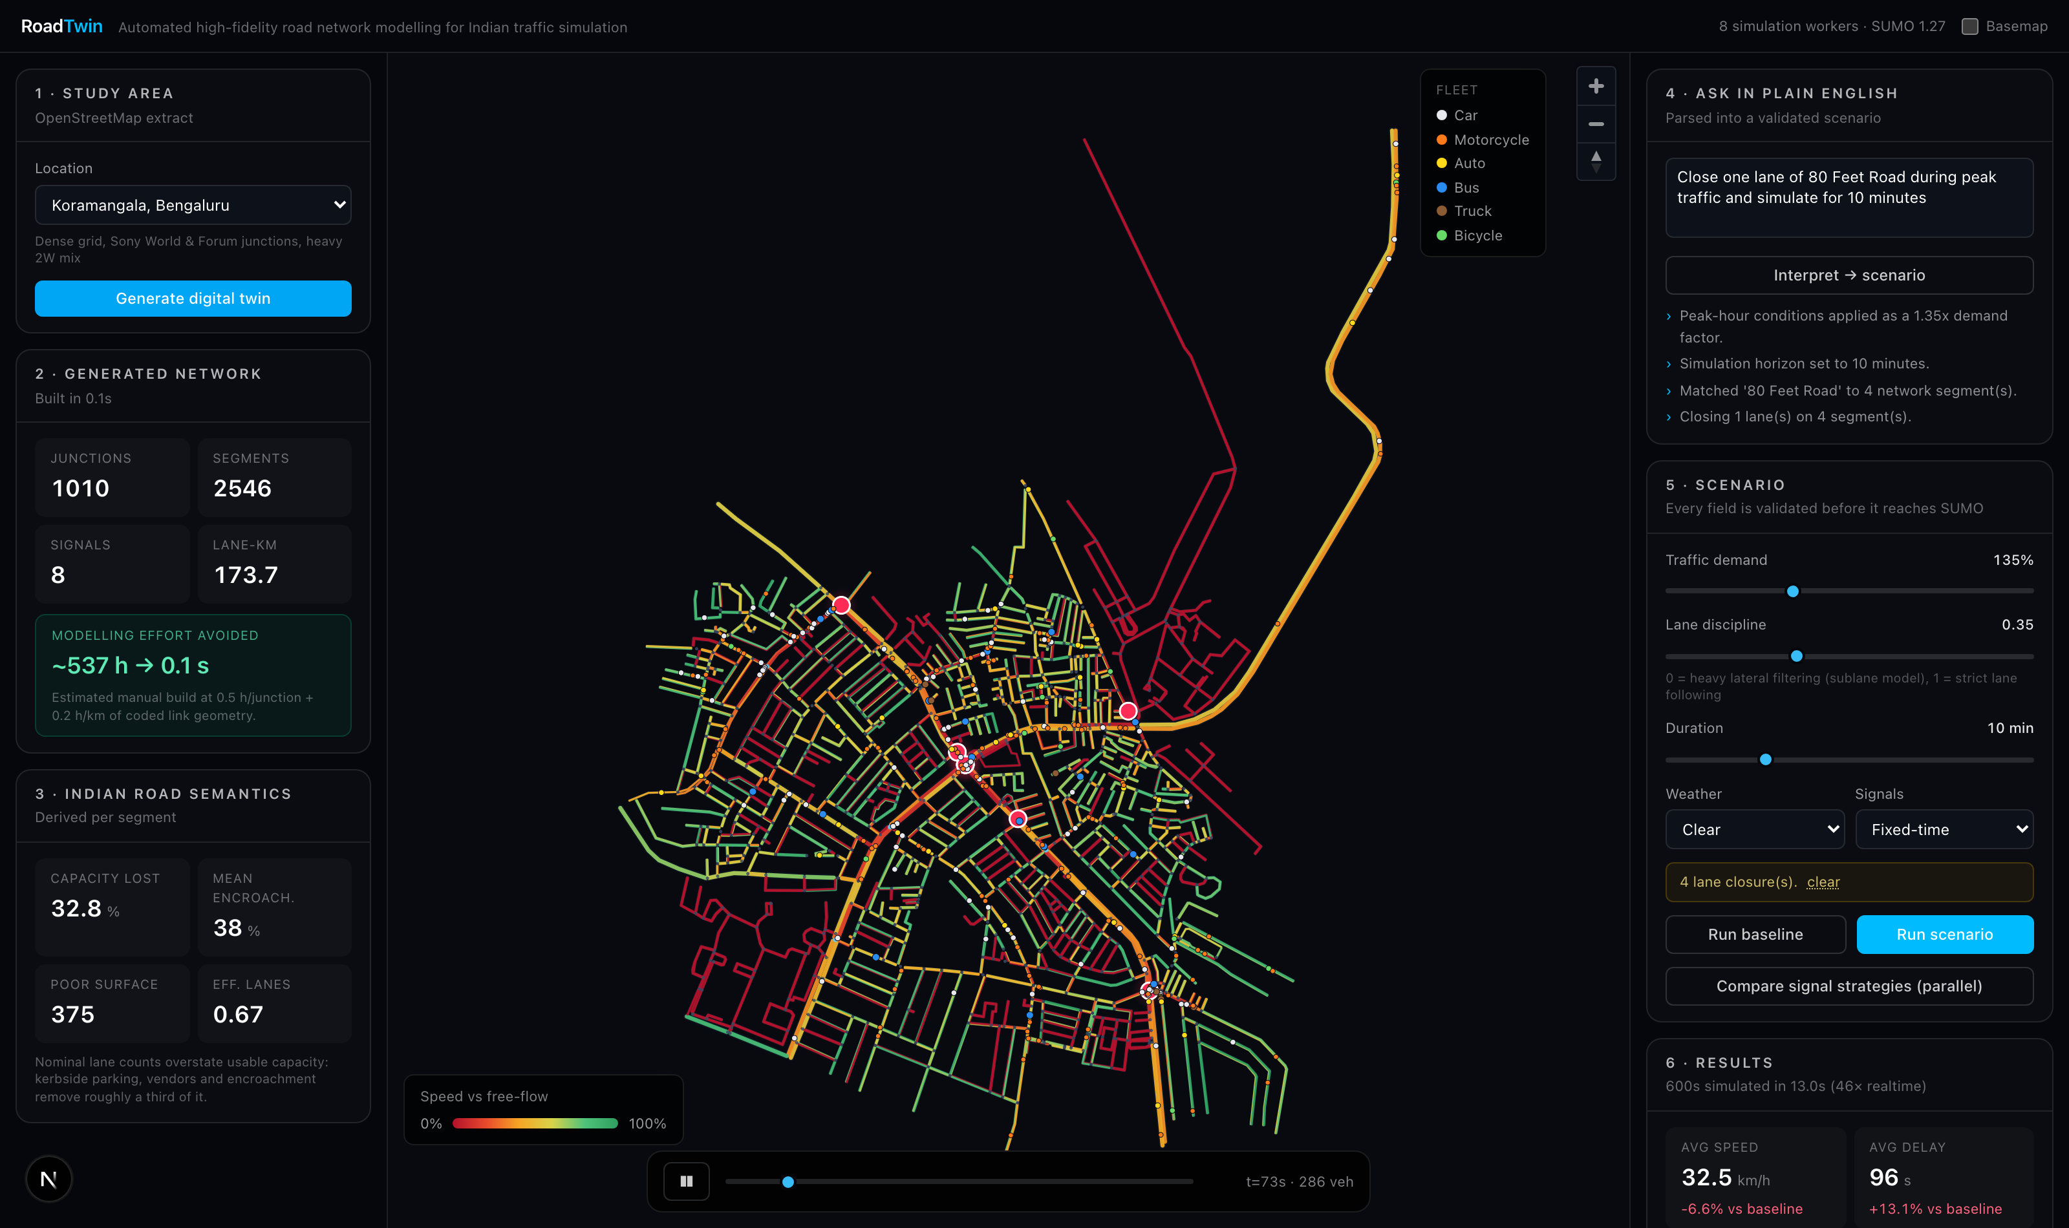
TECHNICAL APPROACH
«TEAM NAME»
AUTOMATED PIPELINE — location in, decision out
Study area
map bbox
OpenStreetMap
Overpass API
netconvert
left-hand traffic, junction joining, turn lanes, signals
RoadNetwork
typed contract (the frozen schema)
Indian enrichment
effective lanes, encroachment, PCU
SUMO + TraCI
sublane mixed traffic, signal control
Results
metrics, bottlenecks, comparison
TECHNOLOGY STACK
▪ Simulation: Eclipse SUMO 1.27 + TraCI (live control)
▪ Backend: Python 3.13, FastAPI, pydantic contracts
▪ Geodata: OpenStreetMap / Overpass, netconvert, sumolib, pyproj
▪ Frontend: Next.js 16, React 19, MapLibre GL, Recharts
▪ Scale-out: process-pool workers, one SUMO per core
WORKING PROTOTYPE — live congestion heat-map and vehicle playback
WHY IT IS FAST ENOUGH TO EXPERIMENT WITH
▪ We do not rebuild traffic physics. SUMO and netconvert carry decades of junction and car-following work; we build the automation and intelligence layer on top.
▪ Aggregate metrics come from SUMO's native outputs; TraCI is reserved for dynamic events and playback via subscriptions — roughly 200× real time.
▪ Scenarios run in parallel across worker processes: 6 scenarios in 8.1 s versus 34.0 s serially (4.2× measured).

Slide 4
FEASIBILITY AND VIABILITY
«TEAM NAME»
ALREADY BUILT AND MEASURED — not a concept
1,010
junctions reconstructed Koramangala, Bengaluru
~0.1 s
to generate the twin (vs ~537 h manual estimate)
46–200×
faster than real time per simulation
6
Indian city areas pre-built and cached
RISKS AND HOW WE HANDLE THEM
OSM data is incomplete or mis-tagged for Indian roads
netconvert infers junctions and turn lanes; our enrichment layer supplies lane, capacity and encroachment defaults per road class. Every value is a visible, tunable assumption — not a hidden constant.
A model that assumes disciplined lane-following is simply wrong here
SUMO's sublane model plus a calibrated six-class fleet reproduces filtering and lateral weaving. A single lane-discipline control moves the whole fleet between orderly and Indian behaviour.
Simulation is too slow to explore many options
Native SUMO outputs for metrics, TraCI only for control, and parallel execution across cores. A 10-minute scenario returns in under 10 seconds.
Live dependence on external services during a demo or deployment
Every city network is cached on disk after first build; the natural-language layer is deterministic and needs no API key, so nothing critical depends on a network call.
Results could be mistaken for ground truth
Assumptions are stated on screen, SUMO teleports (gridlock events) are reported rather than hidden, and causes are attributed from simulation state so any number can be traced back.

Slide 5
IMPACT AND BENEFITS
«TEAM NAME»
MEASURED ON THE REAL NETWORK — Koramangala, 10-minute horizon
1 · THE PROBLEM IS DETECTED
Peak demand +40% on today's road
Average speed: 37.9 km/h → 35.9 km/h
Average delay: 59.5 s → 67.6 s
Vehicles gridlocked (teleports): 0 → 9
2 · AN INTERVENTION IS PROVEN
Same +40% demand, smarter signal control
Average delay: 67.6 s → 58.4 s (−13.6%)
Vehicles served: 538 → 559
Average speed: 35.9 km/h → 37.6 km/h
The city can see the congestion coming and confirm the fix works — before spending money or closing a road.
TRAFFIC POLICE
Retime a junction and see the delay it saves before issuing the order.
CITY PLANNERS
Justify a lane, bus lane or one-way change with simulated evidence in a DPR.
CITIZENS
Shorter journeys and fewer failed road experiments carried out on live traffic.
ENVIRONMENT
Idling time, fuel burn and CO₂ are reported per scenario, so lower-emission options can be chosen.
WIDER IMPACT
▪ Economic: road interventions are tested in software first, so failed experiments are not paid for in concrete, contractor time and public disruption.
▪ Social: the same evidence base is available to a ward engineer as to a large consultancy, because building the model no longer takes weeks of specialist effort.
▪ Scalable: any Indian city area can be modelled from open data — no survey, no proprietary dataset and no per-city licence.

Slide 6
RESEARCH AND REFERENCES
«TEAM NAME»
Eclipse SUMO — microscopic traffic simulator (EPL-2.0)
https://eclipse.dev/sumo/ · used as an unmodified upstream dependency
OpenStreetMap / Overpass API (ODbL)
https://www.openstreetmap.org · https://overpass-api.de
TraCI — Traffic Control Interface
https://sumo.dlr.de/docs/TraCI.html · live control of a running simulation
IRC:106 — Guidelines for Capacity of Urban Roads in Plain Areas
Indian Roads Congress · PCU factors and lane capacity used in our enrichment layer
SUMO sublane model — lateral dynamics
https://sumo.dlr.de/docs/Simulation/SublaneModel.html · basis of our filtering behaviour
Varaiya, P. — “Max pressure control of a network of signalized intersections”
Transportation Research Part C, 2013 · basis of our max-pressure controller
netconvert — network import from OSM
https://sumo.dlr.de/docs/netconvert.html · junction joining, turn lanes, signal synthesis
Project source code — RoadTwin
https://github.com/Akshatb2006/RoadTwin
All third-party components are open source and used within their licences; OSM-derived networks carry ODbL obligations.

