Slide 1
A Prevention Framework for Cyber Crimes: SQL Injection Case Study
Project Title: A Prevention Framework for Cyber Crimes: SQL Injection Case Study
Student Details: [Your Name]
Mentor Name: [Mentor's Name]

Slide 2

Introduction to Cyber Crimes
Definition and Importance: Cyber crimes refer to criminal activities involving computers and networks. These include hacking, identity theft, and data breaches. Cybersecurity is crucial to protect sensitive information and maintain trust in digital systems.
Overview of SQL Injection: SQL Injection is a code injection technique that exploits a security vulnerability in a website's software. It allows attackers to interfere with the queries an application makes to its database, potentially accessing or manipulating sensitive data.
Photo by Adi Goldstein on Unsplash

Slide 3

Problem Statement
SQL Injection Vulnerability: SQL Injection attacks exploit vulnerabilities in web applications to execute malicious SQL statements. This can lead to unauthorized access to the database, data leaks, and manipulation of data.
Implications: Such attacks can result in data breaches, financial losses, and damage to the reputation of organizations. Addressing this vulnerability is crucial for maintaining data security and integrity.
Photo by noshad AHMED on Unsplash

Slide 4
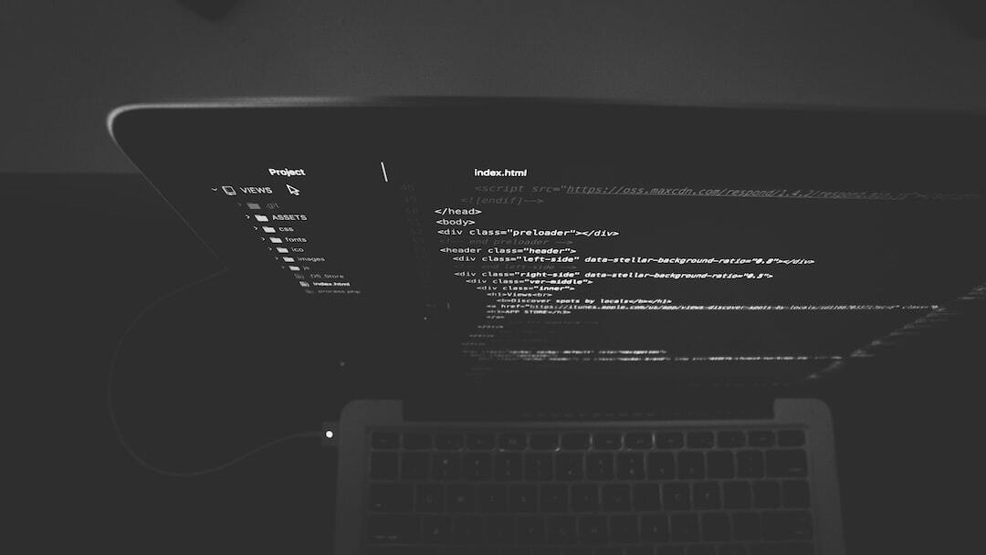
Website Vulnerability Description
Website Overview: The website contains a list of students that can be modified only when the admin is logged in. This functionality is essential for maintaining data integrity.
Admin Login Vulnerability: The admin login page is vulnerable to SQL Injection, allowing attackers to bypass authentication and gain admin access without knowing the password.
Photo by Nate Grant on Unsplash

Slide 5
SQL Injection Exploit Demonstration
Steps Involved: 1. Identify the vulnerable admin login page. 2. Inject SQL code to bypass authentication. 3. Gain admin access without password.
Impact: Successful exploitation allows unauthorized access to admin functionalities, leading to potential data manipulation and security breaches.

Slide 6
Prevention Measures
Secure Coding Practices: Implement parameterized queries and prepared statements to prevent SQL Injection. Avoid dynamic SQL queries.
Input Validation: Validate and sanitize user inputs to ensure they do not contain malicious code. Use whitelisting techniques.
Regular Security Audits: Conduct regular security assessments and code reviews to identify and fix vulnerabilities.

