Slide 1

REPORT ON
FRONT-END ENGINEERING PROJECT-
Tic-Tac-Toe Game using react js
Submitted By:
Submitted To:
Akshat dhir 2110990125
Mrs. pritpal kaur
Group- 19
Department of Computer Science & Engineering Chitkara University Institute of Engineering & Technology,
Rajpura, Punjab.

Slide 2
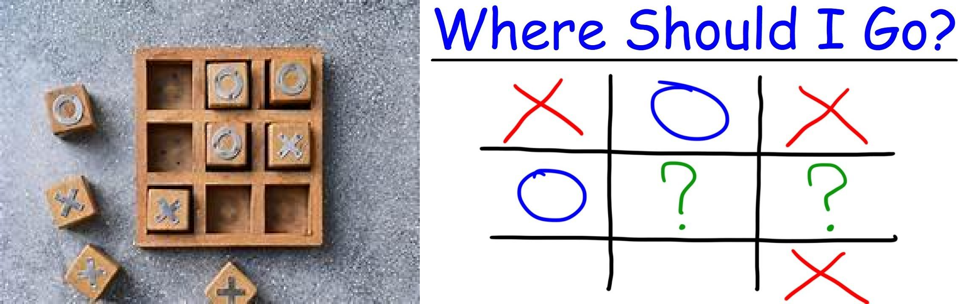
Introduction
INDEX
S. No. | Title | Page No. | Signature
1 | Introduction
2 | Project Overview
3 | Project Components
4 | Counclusion
This is a project report on “ONLINE TIC TAC TOE GAME”
This is a web based application which helps people to play “TIC-TAC- TOE” online. The game is very popular and is fairly simple by itself. In this game, there is a board with n X n squares. In our game ,it is 3X3 squares. The goal of Tic-Tac-Toe is to be one of the players to get three same symbols in a row-horizontally, vertically or diagonally- on a 3X3 grid.

Slide 3
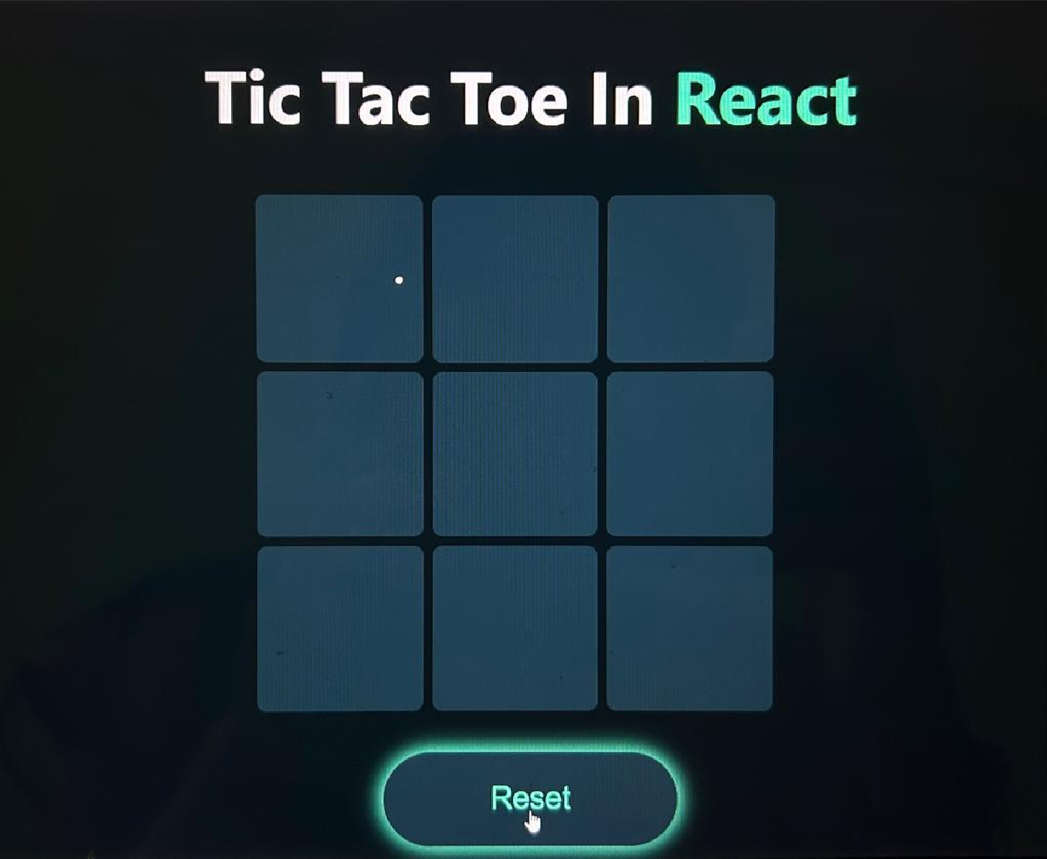
OVERVIEW
A player can choose between two symbols with his opponent, usual games use “X”and “O”. If first player choose “X” then the second player have to play with “O” and vice versa .A player marks any of the 3x3 squares with his symbol (may be “X” or “O”)and his aimisto createa straight line horizontally orvertically ordiagonallywith two intensions :a) Create a straight line before his opponent to win the game. b) Restrict his opponent from creating a straight line first. In case logically no one can create a straight line with his own symbol, the game results a tie. Hence there are only three possible results – a player wins, his opponent wins or it’s a tie.

Slide 4
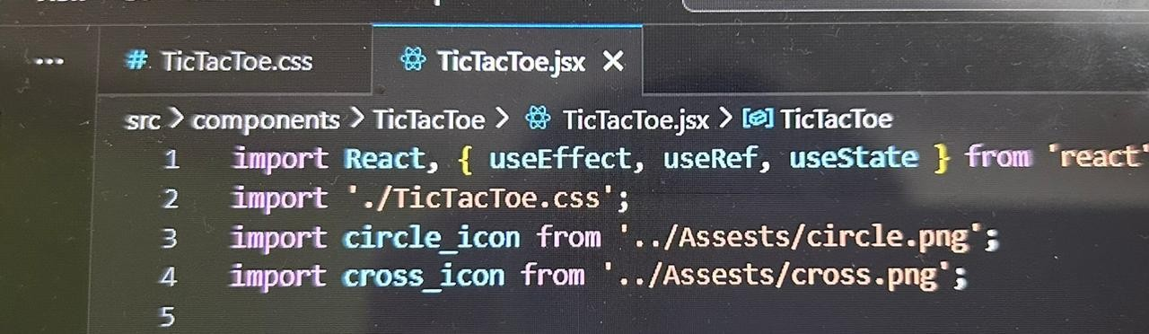
Project Components
React Components: The project consists of a single React component named TicTacToe. This component handles the game logic, rendering the game board, and managing game state.
The Three hooks used are useEffect, useRef and useState.
CSS Styling: The project uses CSS for styling. The
TicTacToe.css
file
is used to define the visual layout and appearance of the game.
Assets: The project includes image assets for the X and O icons.
Game Logic The game logic is implemented within the TicTacToe
component. Key components of the game logic include:
Maintaining the game board state using the data state variable.
Tracking the number of moves using the count state variable.
Checking for a win or a draw using the checkWin function.
Handling the end of the game and displaying the result.
Gameplay
Players take turns to click on empty cells on the game board to place their 'X' or 'O'.
The game keeps track of the number of moves and checks for a win or a draw after each move.

Slide 5
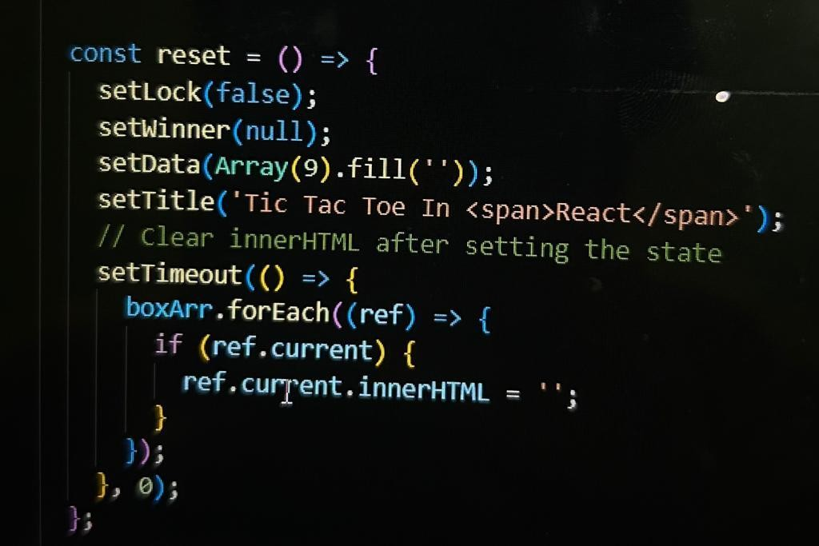
When a player wins, the game displays a congratulatory message and locks further moves.
If the game ends in a draw, a message is displayed, and further moves are locked.
User Interface
The game interface is user-friendly and responsive.
The title of the game is dynamically updated to reflect the game status, such as who won or if it's a draw.
X and O icons are displayed in the cells to represent the moves of the players.
Reset Functionality
The 'Reset' button allows users to restart the game. When pressed, it resets the game state and clears the innerHTML of the cells to start a new game.
•
Refactoring and Best Practices
The code structure is well-organized, making use of React state management and useEffect for checking the game state.
Variables and functions are named descriptively, enhancing code readability.
The use of ref callbacks to access DOM elements for updating innerHTML is in line with React best practices.

Slide 6
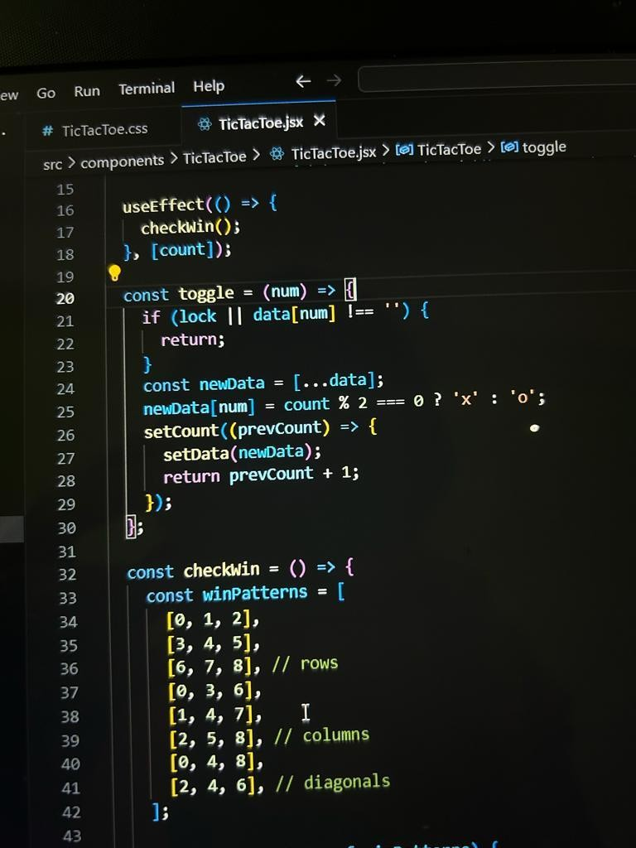
•
Future Improvements
Implementing a scoring system to keep track of wins for each player.
Enhancing the user interface with more interactive features.
Implementing an option to play against an AI opponent.
Conclusion The Tic Tac Toe game in React is a well-implemented project that provides an enjoyable gaming experience. It demonstrates the use of React for building interactive web applications and serves as a foundation for potential enhancements and features.
9.
Project Repository
The project's source code is hosted on a code
repository. Developers and contributors can find the project's code and resources there for further study and collaboration.
GAME OUTCOMES
1) If one of the two players wins:

Slide 7
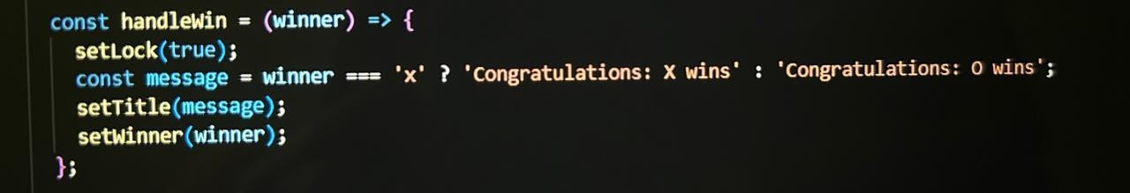
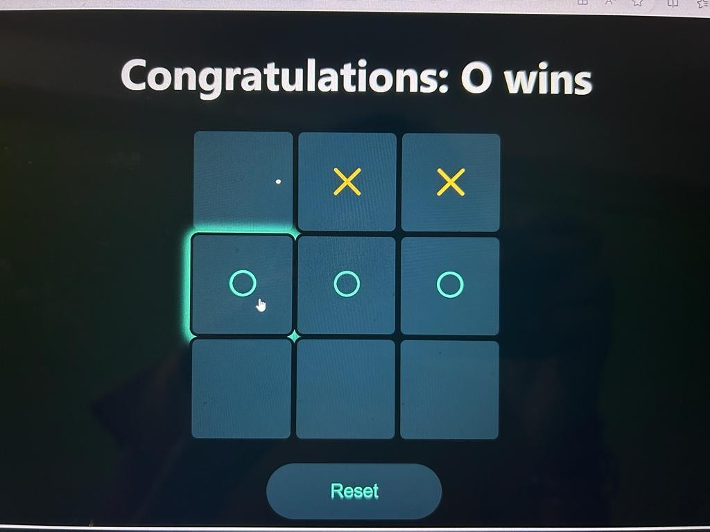
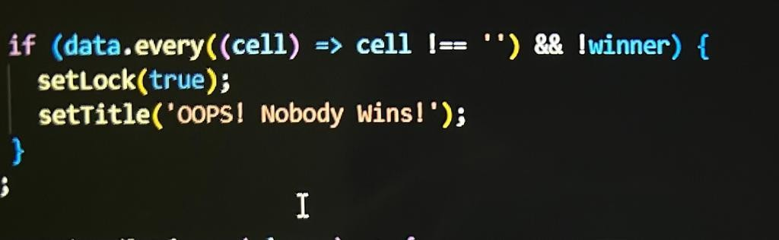
2) If it’s a tie:

Slide 8
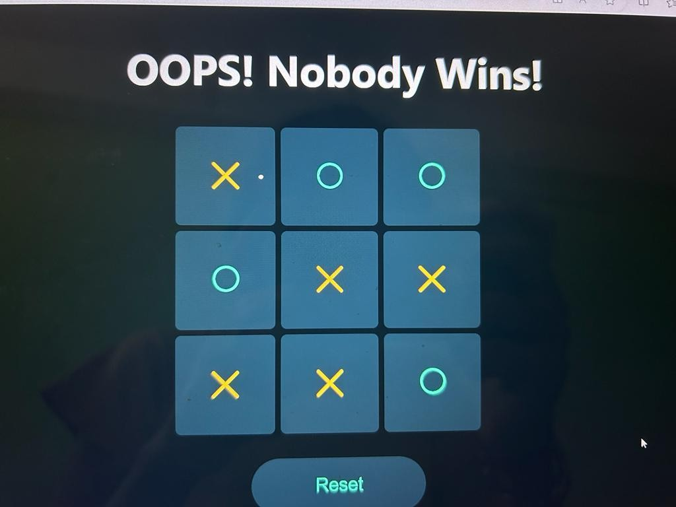
Please note that this project report provides an overview of the Tic Tac
Toe game in React, highlighting its key components, features, and potential for future improvements.

