Slide 1
Unit - V
FILES

Slide 2
Files
A file is a collection of records where each record consists of one or more fields.
The primary objective of file organization is to provide a means for record retrieval and update.
The update of a record could involve its deletion, changes in some of its fields or the insertion of an entirely new record.
Certain fields in the record are designated as key fields.
Records may be retrieved by specifying values for some or all of these keys.
A combination of key values specified for retrieval will be termed a query.

Slide 3
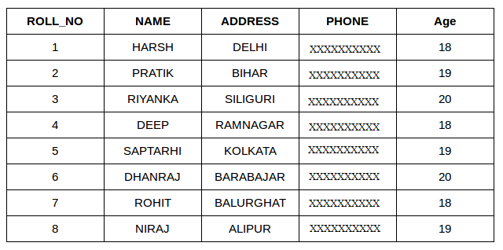
File Example

Slide 4
Query Types
Q1: Simple Query: The value of a single key is specified.
Q2: Range Query: A range of values for a single key is specified
Q3: Functional Query: Some function of key values in the file is specified (e.g. average or median)
Q4: Boolean Query: A boolean combination of Q1 - Q3 using logical operators and, or, not

Slide 5
Query Types
Q1:Name =Dhoni
Q2: AGE>19
Q3: AGE > average AGE of all the students
Q4: (ADDRESS=DELHI and AGE = 18)

Slide 6
Mode of Retrieval
The mode of retrieval may be either real time or batched.
In real time retrieval the response time for any query should be minimal (say a few seconds from the time the query is made). In a bank the accounts file has a mode of retrieval which is real time since requests to determine a balance must be satisfied quickly.
In the batched mode of retrieval, the response time is not very significant. Requests for retrieval are batched together on a "transaction file" until either enough requests have been received or a suitable amount of time has passed. Then all queries on the transaction file are processed.

Slide 7
Mode of Update
The mode of update may be either real time or batched.
Real mode : With real-time processing, as soon as the transaction takes place, the master file is updated at the same time
Batched mode : The Master File (The organization’s big data) is not always kept up to date.

Slide 8
Sequential Organization
Magnetic tape
The records are placed sequentially.
Magnetic disk
Direct Access storage device (DASD)
Sequentially ordered
Logical and physical sequence of records are same
Sequentially unordered
Logical and physical sequence of records are not same

Slide 9
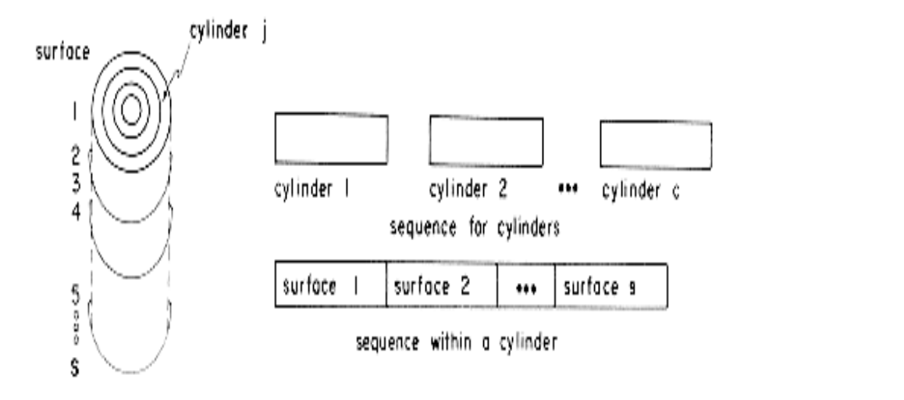
Interpreting Disk Memory as Sequential Memory

Slide 10
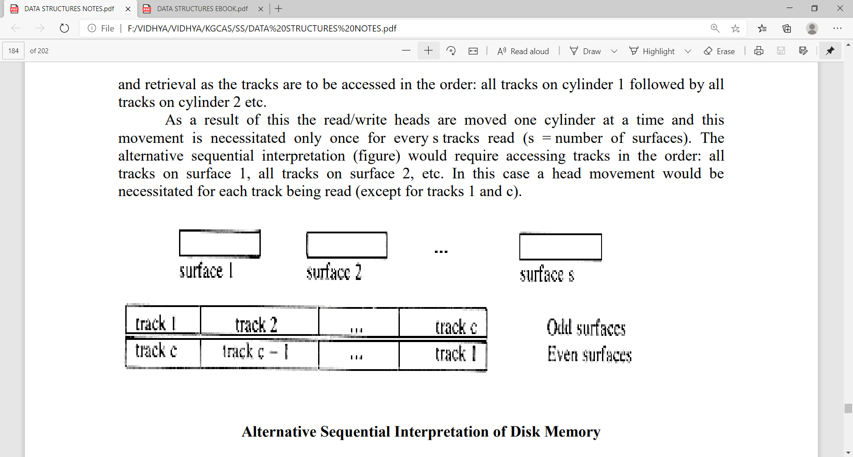
Alternative Sequential Interpretation of Disk Memory

Slide 11
Retrieval of records
Fixed size records
Use binary search to obtain the records
Variable size records
Binary search cannot be used

Slide 12
Retrieval of records
This is an advanced sequential file organization method. Here records are stored in order of primary key in the file. Using the primary key, the records are sorted. For each primary key, an index value is generated and mapped with the record. This index is nothing but the address of record in the file.

Slide 13
Dense Index: It has index entries for every search key value (and hence every record) in the database file. The dense index can be built on order as well as unordered fields of the database files.

Slide 14
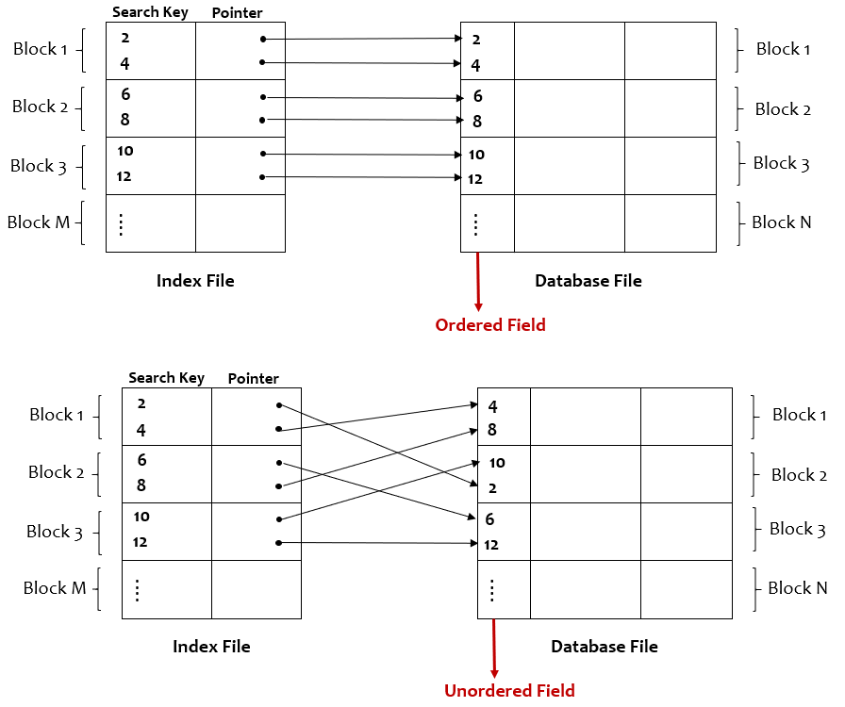

Slide 15
Sparse Index: It has index entries for only some of the search key values/records in the database file. The sparse index can be built only on the ordered field of the database file. The first record of the block is called the anchor record.

Slide 16
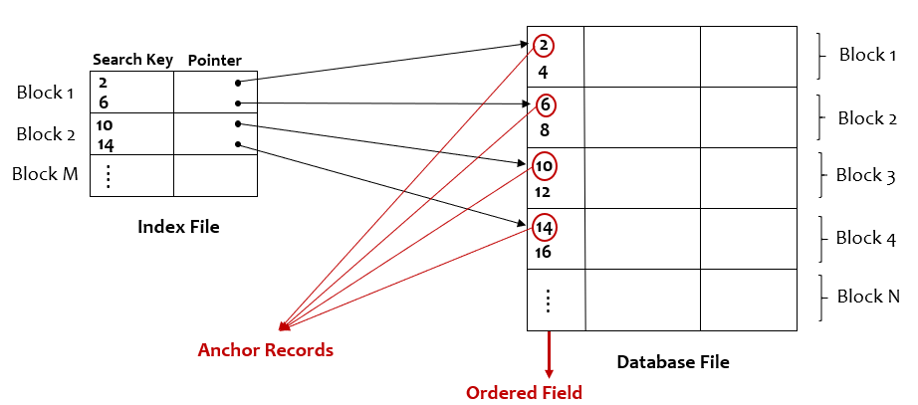

Slide 17
01
Cylinder surface Indexing
02
Hashed Indexes
Indexing Techniques
03
Tree indexing
04
Trie indexing

Slide 18
Cylinder surface indexing
The simplest type of index organization is the cylinder-surface index. It is useful only for the primary key index of a sequentially ordered file. The records are stored sequentially in increasing order of the primary key. The index consists of a cylinder index.
The cylinder index is searched to determine which cylinder possibly contains the desired record. This search can be carried out using binary search in case each entry requires a fixed number of words.

Slide 19
Hashed indexing
Hashing is an effective technique to calculate the direct location of a data record on the disk without using index structure. It uses hash functions with search keys as parameters to generate the address of a data record.

Slide 20
Hash table
Consider the hash function f(x) = first character of X and the values B, B1, B2, B3, A. Using a hash table with b = 6 and s = 1.
When the same table space is divided into 3 buckets each with two slots and f' (X) = f (X)/2 the assignment of key values to buckets. b=3 and s= 2
The number of bucket retrievals needed now is 1 (for each of B and B1) + 2(for each of B2 and B3) + 3(for A) = 9.

Slide 21
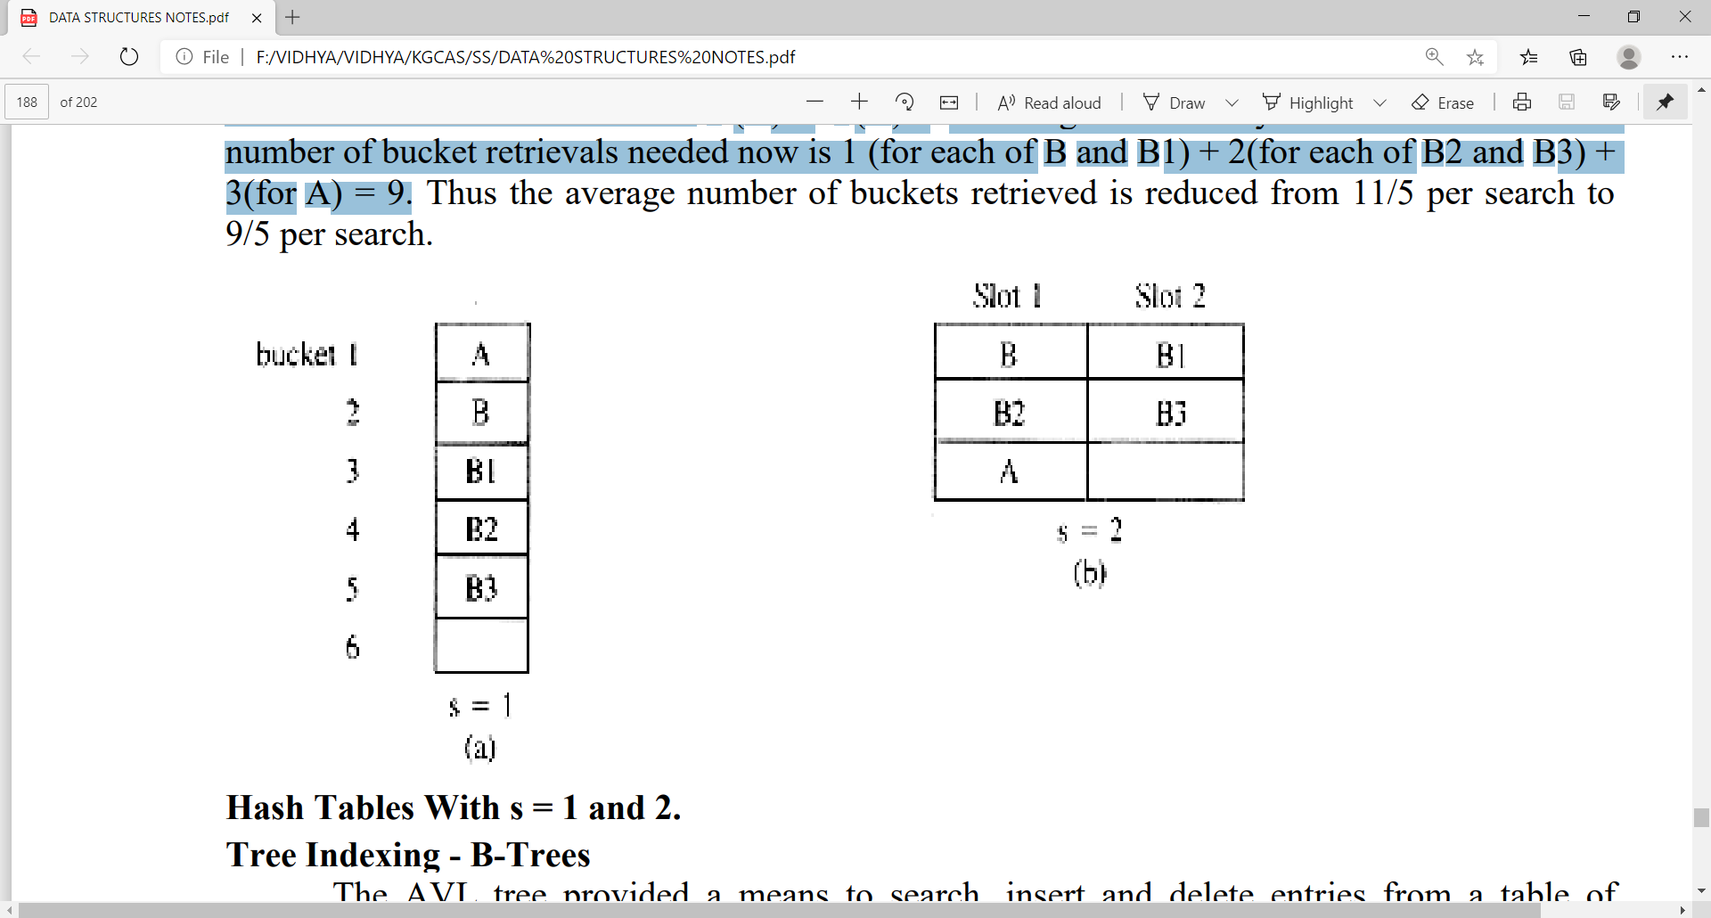
Hash table

Slide 22
Tree indexing
B-Tree is a self-balanced search tree in which every node contains multiple keys and has more than two children. A special type of search tree called B-Tree in which a node contains more than one value (key) and more than two children.

Slide 23
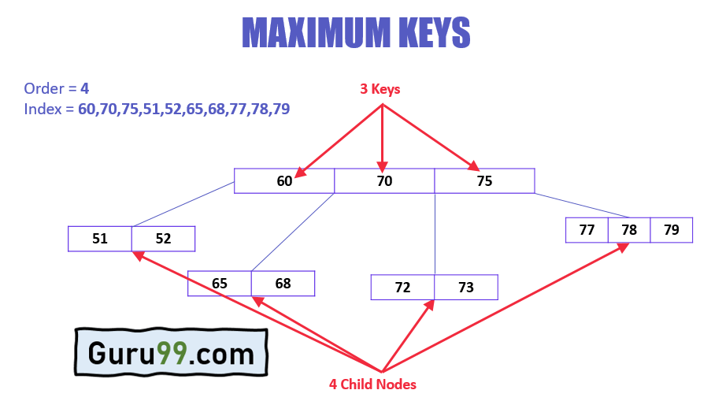

Slide 24
All leaves will be created at the same level.
B-Tree is determined by a number of degree, which is also called "order"
The maximum number of child nodes are m
The maximum number of keys m-1
B Tree keys and nodes are arranged in ascending order.
The search operation of B Tree is the simplest one, which always starts from the root and starts checking if the target key is greater or lesser than the node value.
Properties of B trees

Slide 25
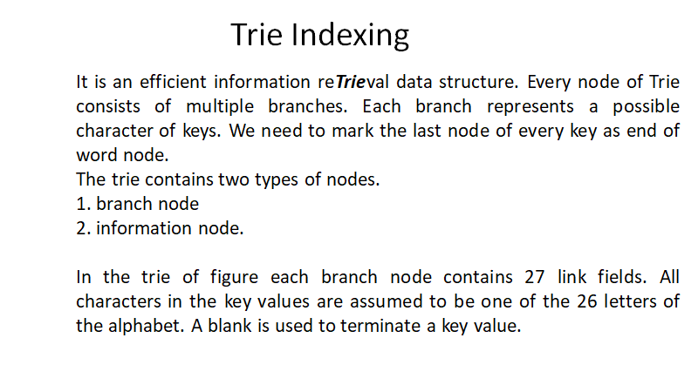

Slide 26
