Slide 1
Unit – IV
the elements of e-commerce

Slide 2
ELEMENTS
The basic element of Internet e-Commerce are an e-shop on a server, as user with a web browser and an Internet Connection between them
Visibility →Getting the site noticed and online customer visiting the store
Ease of Use → Easy to implement
Order Processing →Online Orders have to be processed
Online Payments →Goods bought online normally have to be paid for electronically
Security →Online Payments need to be Secure and Customer have to be Confident they are Secure
Delivery Systems → Home Delivery
After Sales →Queries and Faults need to be processed online

Slide 3
e-Commerce Facilities
e-SHOP
CUSTOMER
INTERNET
Browser
Store Systems
Search
Orders
Payment
Delivery
After-Sales

Slide 4
e-VISIBILITY
Site Name → URL, Eg.: amazon.com
Conventional Advertising → Media, Newspaper, Banner, Pamphlets
Portals → Advertisement via Portals (Banners, Menus and so on)
Malls → Shared Advertising, Common Facilities, e-Cash, Common Customer Files
Search Engines → Manual Indexing and Automatic Indexing
Links → Hypertext Links, Variety of Deals, Good way of getting Customers
Personal Recommendations → One to One Marketing People

Slide 5
The e-SHOP
It comes in all Shapes and Size
Company Information → Customer Support
Customer Registration → Online Mailing , Special Offers
Dynamic Web Sites → Product Databases & Individual Customization
Site Indexes & Search Facilities
Online Order Entry & Payment Systems
Sophisticated Security Protection Systems
After-Sales Service & Support
Feedback Systems to Improve

Slide 6
ONLINE PAYMENTS
The way of paying for e-Commerce transactions can be classified as
Credit Cards
Common Payment
CNP (Customer Not Present)
Concerns for Security of Online Credit Card Payments include:
Fraudulent Use of Credit Cards
Interception of Credit Card Details
Remote Storage of Credit Card Details
Debit Cards
Stored Value Cards
e-Cash → Micro Payments
Delayed Payments →Pay off-line

Slide 7
DELIVERING THE GOODS
It depends on the Size of the Product, its Nature, Urgency and Distance that Packet will have to travel
Examples of Delivery Systems are:
Post
Packet
Local Delivery
Collect Your Own
Electronic Delivery
No Delivery

Slide 8
AFTER-SALES SERVICE
The Internet can have considerable advantages in the area of after-sales
A good website can provide excellent product identity and diagnostic support
Advantages are as follows:
No Printing Costs
Materials is Readily Corrected and Updated
Hyperlink Indexes and Search Facilities can be Provided
No Mailing Costs
For Software, Bug Fixes and Updates can be Downloaded

Slide 9
INTERNET e-COMMERCE SECURITY
Security Breaches are most frequently discussed in terms of the Internet and the changes that hackers will intercept messages, misuse the information or modify the content of the message
Customer Side → Stolen Credit Card Details
Vendor Side → Can Trade Inappropriately or Dishonestly – Customer Details are Stolen – Bogus Traders
4 Pillars of Security
Authentication → Identified Precisely
Confidentiality → Content of the Message is Secure – Not Scanned
Integrity → Changes in the Messages is impossible
Non-Repudiation → Sender of the Message is directly connected to the content of the message

Slide 10
INTERNET e-COMMERCE SECURITY
The Internet e-Commerce Security involves in the following aspects:
Encryption
Digital Signature
Trusted Third Parties

Slide 11
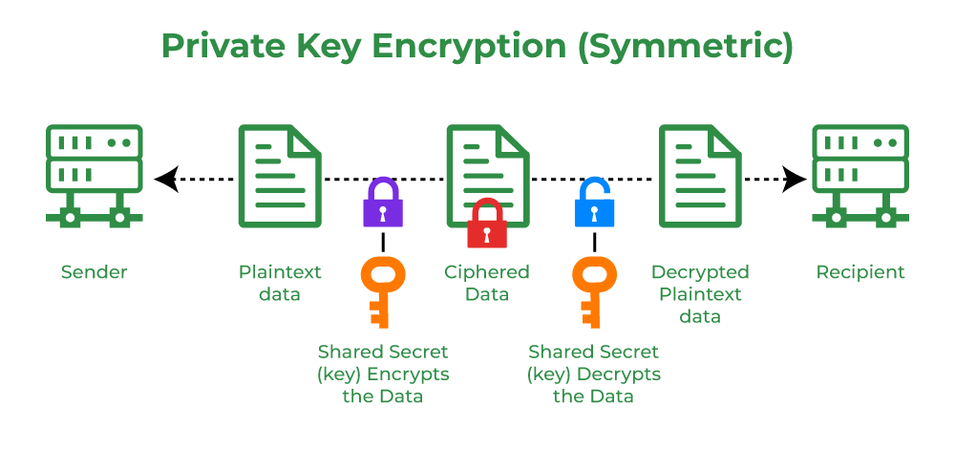

Slide 12
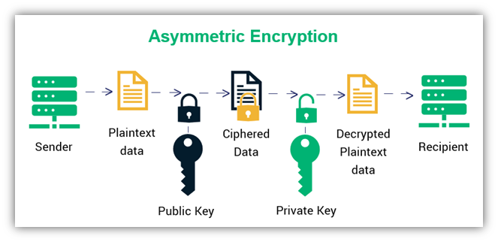

Slide 13
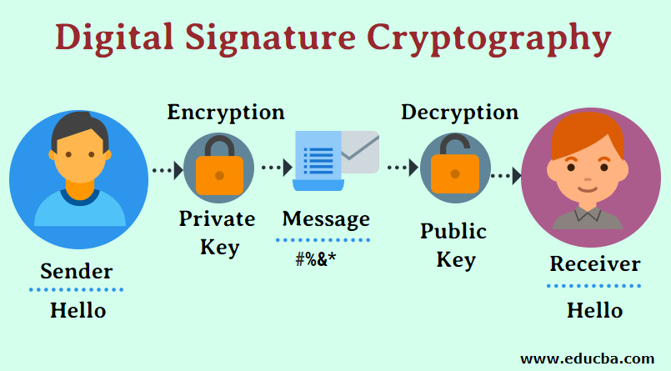

Slide 14
Thank you!

