Slide 1
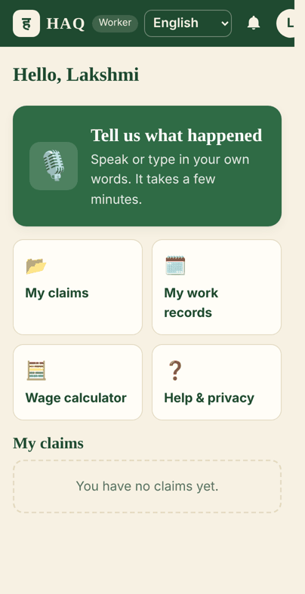
HAQ
हक़ · ಹಕ್ಕು · "what is rightfully yours"
An app that helps workers get the money they earned. They tell their story in their own language, and HAQ turns it into a clear letter for the employer.

Slide 2




Why workers lose their pay
Proof is all over the place
Chats, payment screenshots and voice notes are spread across the phone
Meet Lakshmi
She worked as a cook for two months. She was promised ₹9,000 a month but got only ₹12,000 in total. Then the family stopped picking up her calls.
She has proof on her phone, but she does not know how to make a proper complaint.
Complaining is hard
Forms are long and full of difficult words
Language is a problem
Most apps are only in English, but workers speak many languages
No clear message
The employer gets angry phone calls, not a clear claim, so nothing gets fixed

Slide 3






How HAQ works
WORKER
Talk or type
Add proof
A few questions
HAQ checks
Letter is ready
You send it
In your own language
Photos, PDFs, voice notes
Only the important ones
Spots things that don't match
You can change any word
You choose what to share
EMPLOYER
Sees only the claims sent to them
Can reply or ask questions
Can offer money to settle
Says when they have paid
Worker says "Yes, I got it" → Done

Slide 4
How HAQ is made
The app (on any phone)
Opens in a phone browser
One side for workers, one for employers
13 Indian languages + any other
Talk or type
The HAQ brain (server)
Keeps each person's data private
Keeps proof files safe
Reads text from files
Does the money maths
Builds the letter
Checks the AI's work
Safe storage
Saves claims
Saves files privately
IBM Granite (AI)
Helps write the letter
Can work without internet
The AI only helps write the story part. It is not allowed to make up money or dates. If it does, HAQ ignores it. All money is counted by the computer, not guessed.

Slide 5
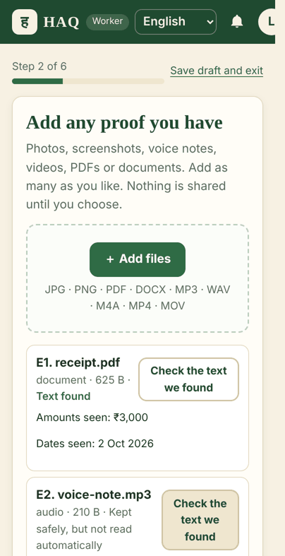
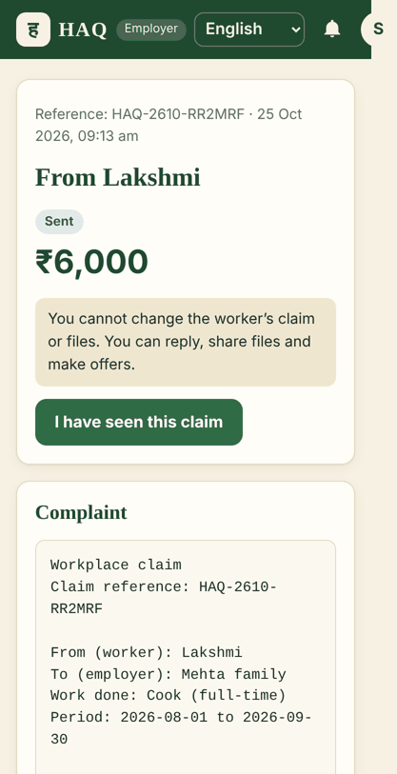
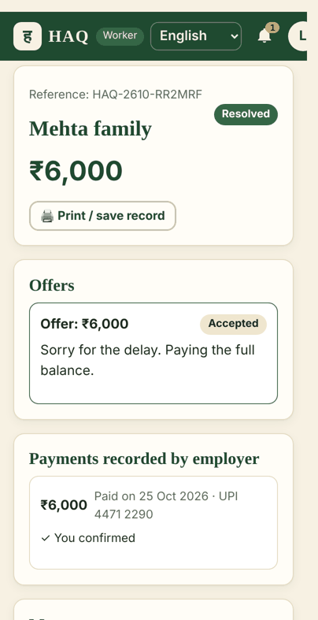
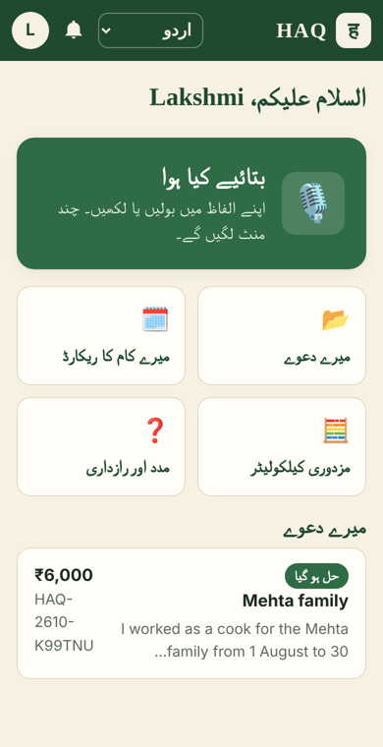
What the app looks like
Worker home: one big button
Adding proof
What the employer sees
Worker got the money, claim closed
Same app in Urdu

Slide 6




How IBM Bob helped us build HAQ
Explain
Check
Bob explained how our code works, step by step, so we understood every part.
Bob checked our code for safety problems, and we fixed what it found.
Test
Plan
Bob wrote extra tests to make sure the app works the right way.
Bob helped us plan what to build next.
IBM Bob is an AI helper inside the code editor. We kept passwords and workers' private files hidden from it.

Slide 7

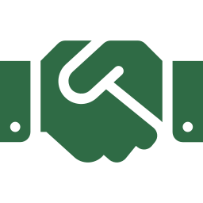
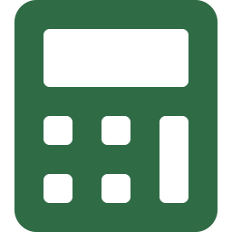



Why people can trust HAQ
The worker decides what the employer sees
Nothing is sent until the worker says yes
Money is counted by the computer, not AI
AI cannot make up money or dates
Proof can never be deleted
Pay counts only when the worker confirms

Slide 8
Thank you
धन्यवाद · ধন্যবাদ · நன்றி · ಧನ್ಯವಾದ · شکریہ
HAQ

