Slide 1

KLE Society’s
KLE College of Engineering & Technology, Chikodi
Department of Computer Science and Engineering
Presentation on,
“Internship Project – Hospital Management System”
Presented by:
Siya Sunil Patil 2KD21CS100
Under the Guidance of:
Prof. Sunita Karabasannavar

Slide 2
CONTENTS
Introduction
Problem Definition
Objectives
System Architecture
Software Requirements and Hardware Requirements
Methodology
Implementation
Results and discussions
Advantages and Applications
Conclusion

Slide 3
ABOUT THE ORGANIZATION
Company Name: Pentagon space
Duration: 15/02/2025 to 15/05/2025
Role: Java Full Stack
Founder : Mr. Ravi Shankar Aradhya
Vision: To become a global leader in digital transformation by offering innovative, reliable, and scalable IT solutions that empower clients to excel in the digital era.
Mission: Pentagon will work closely with customers to ensure that they achieve their short term and long term objectives.
Services Provided by the Company
Web design and development
Services

Slide 4
INTERNSHIP EXPERIENCE & ACTIVITIES
Role: Java Full Stack Intern
Key Responsibilities:
Skills Acquired
Database Design and Management
API Development and Integration
Collaboration with Cross-Functional Teams
Deployment, Testing, and Maintenance
Frontend and Backend Development
Hands-on Experience with Java and Spring Boot
Ability to Build Responsive UIs using React.js/Angular
Proficiency in Writing and Managing SQL Queries

Slide 5

PROJECT DETAILS
A Hospital Management System (HMS) is a computer program that helps hospitals run smoothly by managing all their important tasks in one place. It takes care of things like keeping patient records, setting appointments, managing medicines and supplies, and organizing staff work. By using this system, hospitals can save time, reduce mistakes, and make sure all departments work well together. This helps doctors and nurses give better care to patients and makes the hospital more efficient overall.

Slide 6
OBJECTIVES
Better Patient Care: To help doctors and nurses give fast and accurate care to patients by having all information in one place.
Easy Record Keeping: To store patient details, medical history, and reports safely and neatly, so they are easy to find when needed.
Quick Appointments: To make booking, changing, or canceling appointments easier for both staff and patients.
Smooth Staff Management : To help with staff scheduling, attendance, and other tasks.
Better Communication: To improve how departments and staff members share information and work together.
Save Time and Costs: To make hospital work faster and reduce extra costs by using technology instead of doing everything by hand.

Slide 7
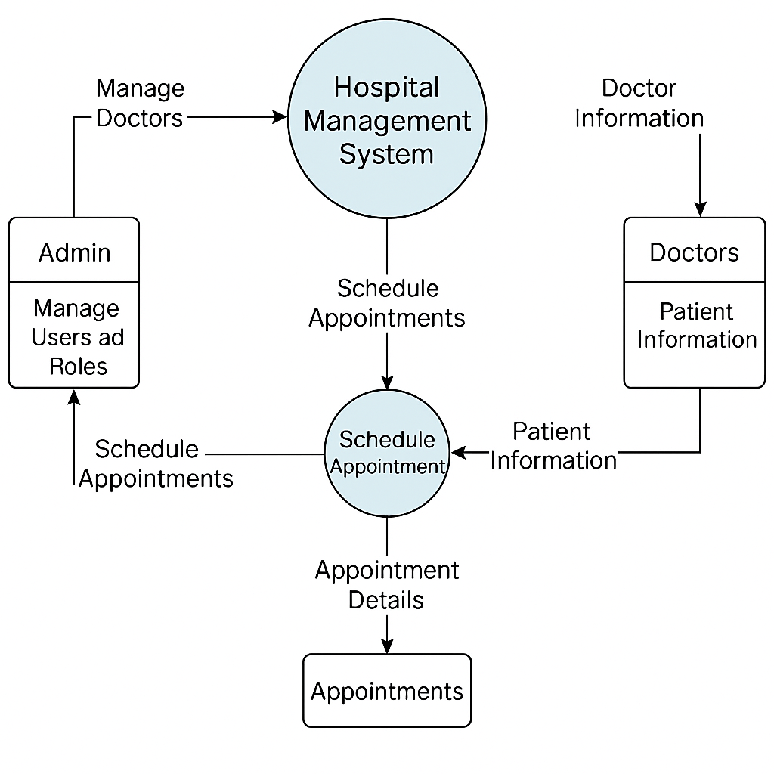
SYSTEM ARCHITECTURE
Fig : Architecture diagram

Slide 8
SOFTWARE AND HARDWARE REQUIREMENTS
Hardware Requirements:
Software Requirements:
Processor: Intel Core i5 / Xeon or higher
RAM: 8 GB (minimum), 16 GB (recommended)
Storage: SSD with at least 500 GB
Network: High-speed internet (≥100 Mbps)
Backup: External or cloud backup drive for daily data backups
Java (Backend Programming Language)
Spring Boot (Backend Framework)
PostgreSQL (Relational Database)
HTML, CSS, JavaScript (Frontend Technologies)
Eclipse IDE (Development Environment)
Apache Tomcat (Deployment Server)

Slide 9
METHODOLOGY
1. Requirement Gathering: First, we collect all the necessary information from hospital staff, administrators, and patients. We note what the system should do (like booking appointments and managing bills) and how it should perform (like being secure and fast).
2. System Design: We plan how the system will work. It’s divided into layers to keep it organized and scalable. The backend uses Spring Boot to build secure APIs, while the frontend is designed to be simple and easy to use.
3. Database Modeling: We create diagrams to show how different parts of the system (like Patients, Doctors, Appointments) are connected and what data they will store.
4. Implementation: We use the Agile method, building the system step-by-step. Backend APIs are developed first, then connected to the frontend using API calls for real-time updates.

Slide 10
5. Testing: Each part of the system is tested individually and together. Real users (like doctors and staff) also try the system to make sure it works well in real situations.
6. Deployment: After testing, the system is installed on a live server, using cloud platforms like AWS or Azure to make it reliable and scalable. Automated tools help with future updates.
7. Maintenance and Support: We regularly check and improve the system. User feedback helps add new features, and we keep the system secure with updates and patches.

Slide 11
IMPLEMENTATION
Frontend Development
Designed user interfaces using HTML, CSS, JavaScript for different users like Admin, Doctors, Nurses, and Patients.
Created responsive dashboards to manage appointments, patient records, billing, and reports.
Implemented form validations, dynamic data rendering (e.g., patient history, appointment schedules), and interactive UI components.
Backend Development (Spring Boot)
Developed RESTful APIs for login/authentication, patient registration, doctor/staff management, appointment booking, and billing.
Implemented OTP-based login using email verification for secure user access.
Created modular services for managing prescriptions, lab reports, messaging, notifications, and user sessions, following clean code principles.

Slide 12
Database Integration (PostgreSQL)
Used PostgreSQL for its reliability, scalability, and support for complex queries.
Ensured data integrity through primary/foreign key constraints, normalization, and indexing on frequently queried fields (e.g., patient ID, appointment date).
Real-Time Features
Developed a real-time chat system using WebSockets for communication between patients and hospital staff (e.g., for appointment or test inquiries).
Implemented a notification system for alerts like new appointments, test result availability, and payment reminders using event-driven logic.
Testing & Deployment
Conducted unit testing (using JUnit) and integration testing for key modules such as login, appointment management, and billing.
Deployed the system locally on Apache Tomcat, with full live demo support for Admin, Doctors, and Front Desk Staff.

Slide 13
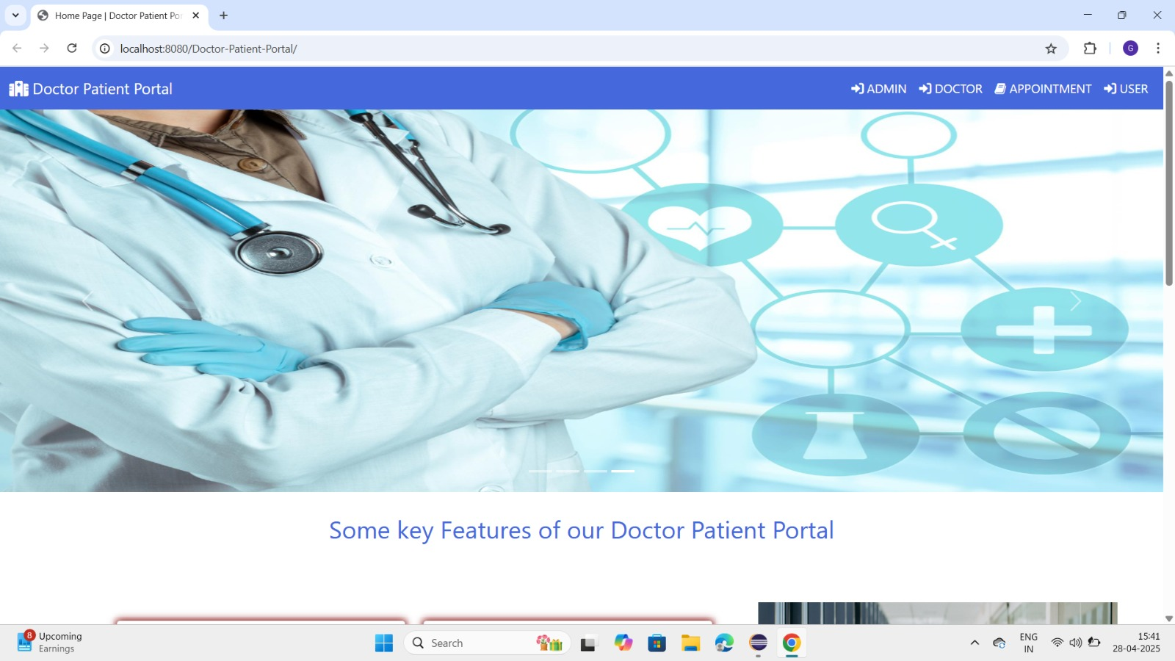
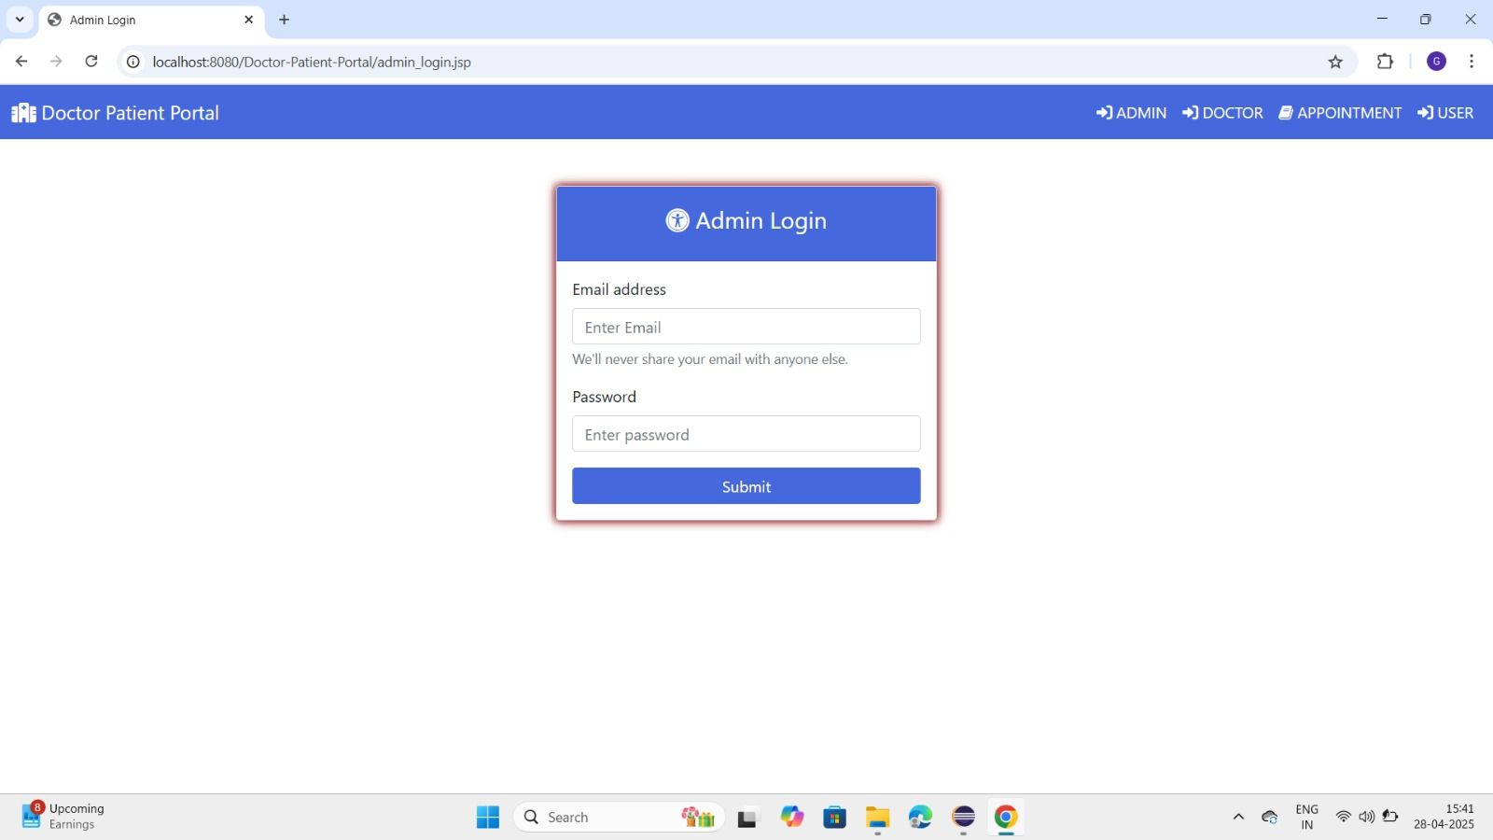
RESULTS AND DISCUSSIONS
Snapshot 1: Home Page
Snapshot 2: Admin Login Page

Slide 14
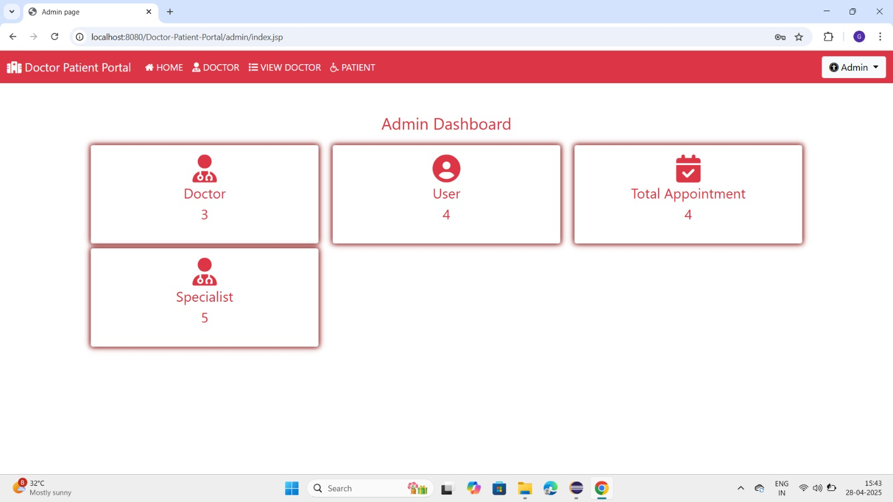
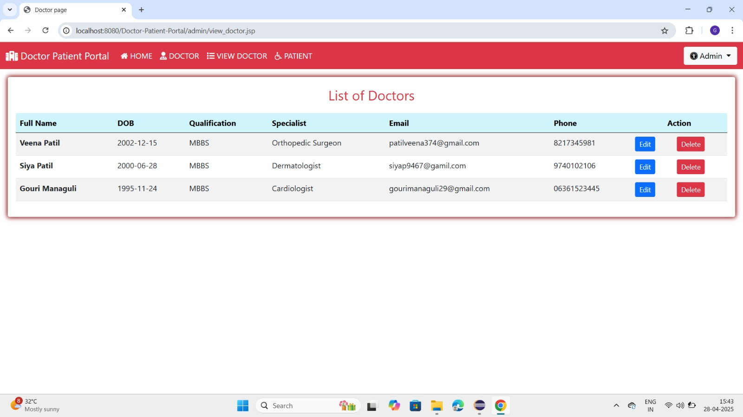
Snapshot 3: Admin Dashboard
Snapshot 4: List of Doctors

Slide 15
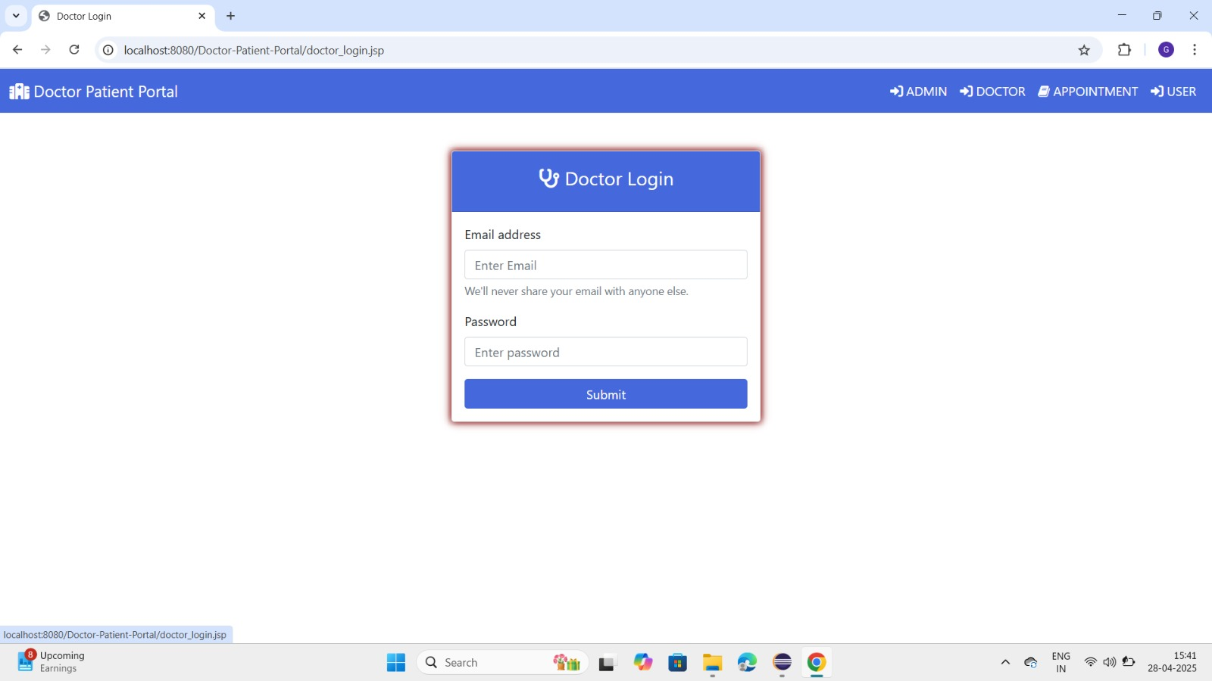
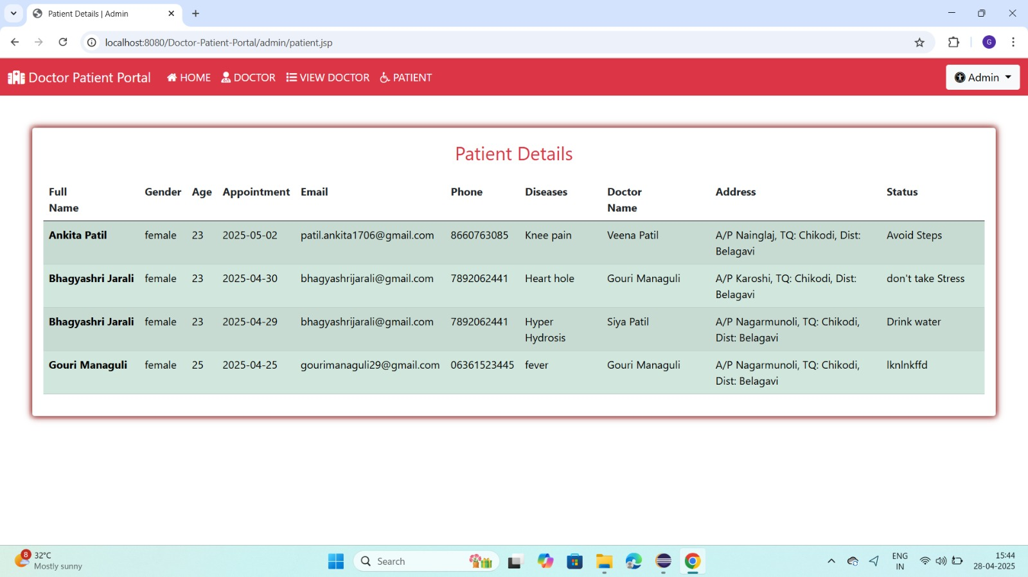
Snapshot 5: Doctor Login Page
Snapshot 6: Patients Details list

Slide 16

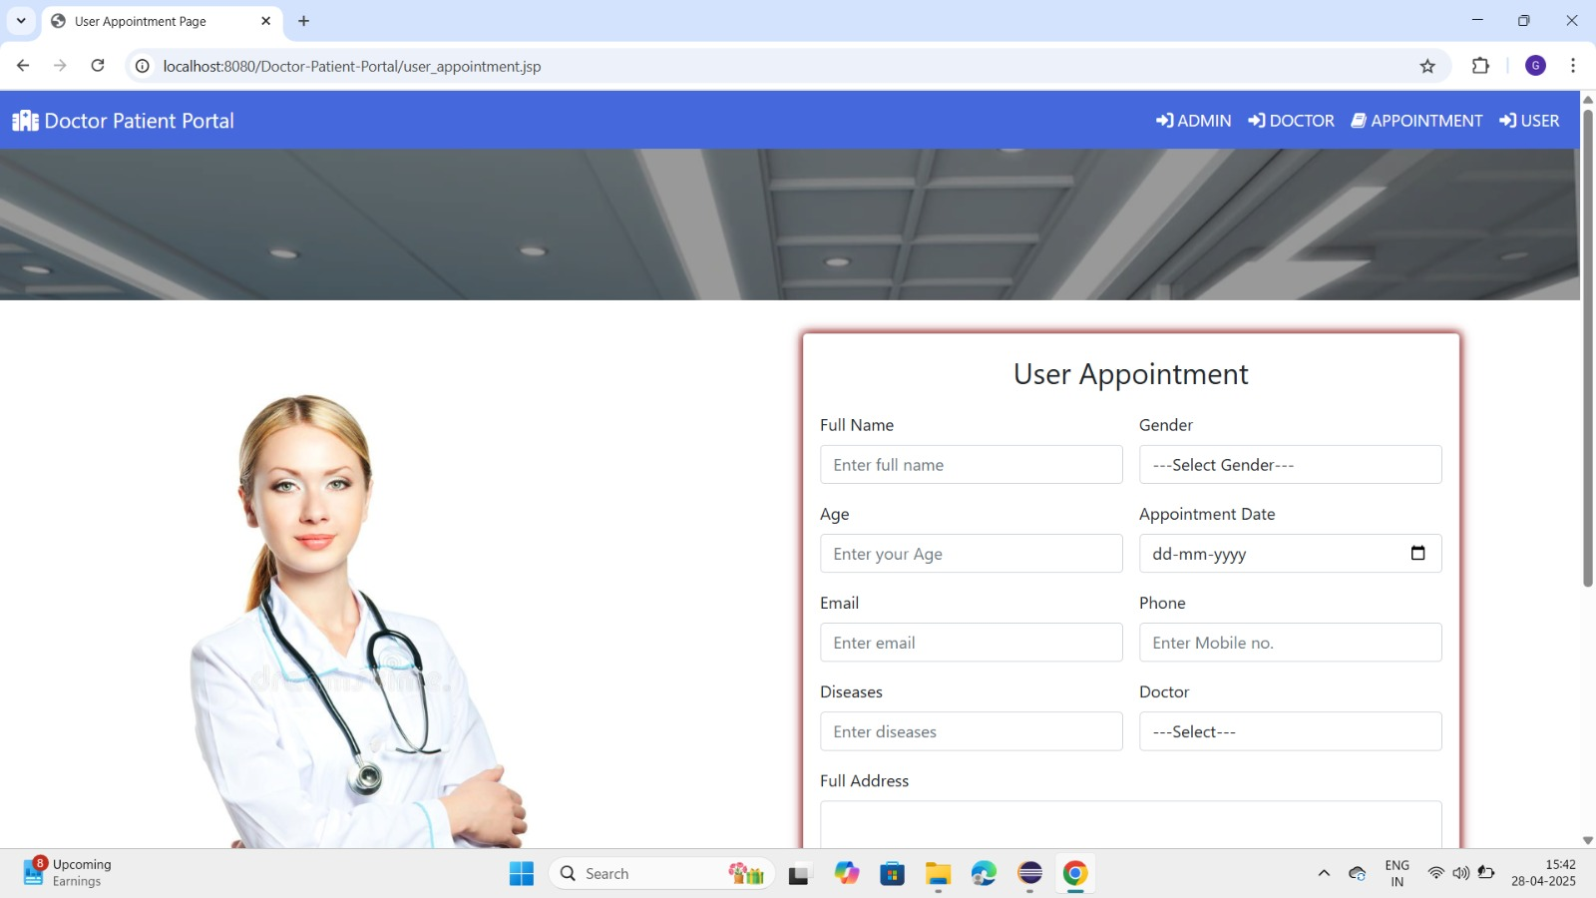
Snapshot 7: User Login Page
Snapshot 8: User Appointment Page

Slide 17
ADVANTAGES AND DISADVANTAGES
ADVANTAGES
Better Organization: All patient, doctor, and hospital data is stored in one place, making it easy to manage and access.
Time Saving: Tasks like booking appointments, and record-keeping are automated, saving time for staff and doctors.
Real-Time Information: Staff can access up-to-date information instantly, which helps in quick decision-making.
Security: Patient records are protected with passwords and access control, keeping sensitive information safe.
DISADVANTAGES
High Initial Cost: Buying the software, setting up servers, and training staff can be expensive at first.
Training Required: Hospital staff may need time and training to get used to the new system.
Data Security Risks: If not properly secured, the system may be vulnerable to hacking or data loss.

Slide 18

CONCLUSION
A Hospital Management System plays a vital role in improving the efficiency, accuracy, and speed of hospital operations. It helps in organizing patient records, managing appointments, and improving communication between departments. By automating daily tasks, it reduces paperwork and allows hospital staff to focus more on patient care. Although there may be initial costs and technical challenges, the long-term benefits in terms of better service quality, faster processes, and secure data management make HMS a valuable solution for modern healthcare institutions.

Slide 19
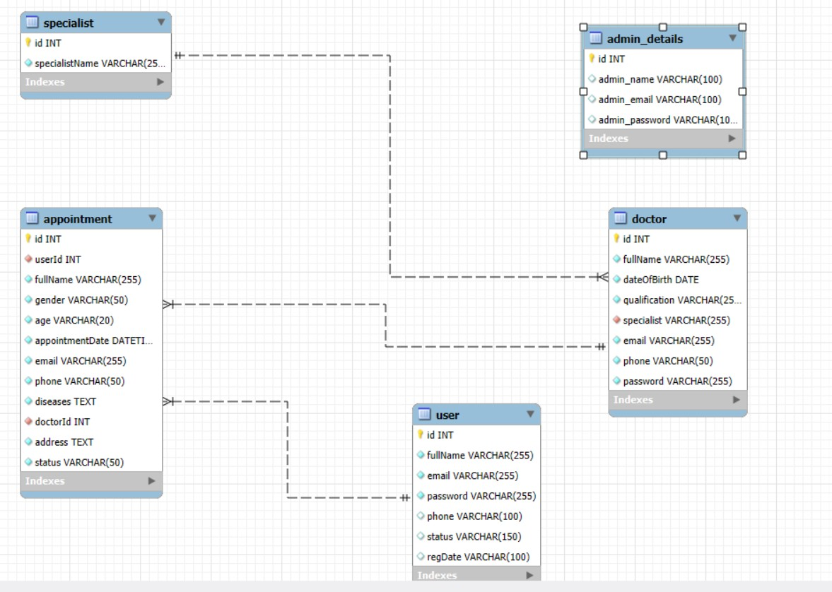

Slide 20
THANK YOU

