Slide 1
Adaptive Traffic Signal Control Using RL
By Akshat Jhawar

Slide 2
Agenda
We will cover:
Brief recap of problem
Algorithms implemented
Performance metrics comparison
Analysis of results

Slide 3
Objective
To implement and compare reinforcement learning algorithms (Q-Learning, SARSA, DQN) for managing traffic signals at a 4-way intersection, with focus on minimizing delay.

Slide 4
Environment
Custom gym environment (TrafficInstersectionEnv)
Includes cars and pedestrians from 4 directions
Actions: GREEN_NS, YELLOW_NS, GREEN_EW, YELLOW_EW
Rewards penalize delay and frequent signal switching
Observations included queue length and wait time

Slide 5
Implemented Agents
Q-Learning
  Tabular method
  Off-policy; Learns optimal policy via epsilon-greedy exploration
SARSA
  Tabular on-policy agent
  Updates using action taken
DQN
  Deep Q-Network with experience replay
  Utilizes a neural network to approximate the Q-function
Fixed-time baseline
  Non-RL reference agent with static signal intervals

Slide 6
Common Environment Settings
Environment: Custom Gym intersection simulator with:
  2-phase traffic light system (NS-EW)
  Cars and pedestrians arriving from all 4 directions
Metrics tracked per episode:
  Total reward
  Average car wait time
  Average pedestrian wait time
  Number of signal switches

Slide 7
Training Details
Episodes per agent: 600
Steps per episode: 200
Consistent hyperparameters across all agents (learning rate, gamma, epsilon)
JSON-based logging and visualizations with Matplotlib

Slide 8
Reward Shaping
Though it was decided to just have negative rewards, RL agents performed much better when positive incentives were added
The current reward function is (for each step)-
  -1 per car in waiting
  -0.5 per pedestrian in waiting
  -10 for switching before minimum duration
  +2 per car that crosses
  +1 per pedestrian that crosses
  -5 for switching signals (to reduce frequent switching)
  +5 as bonus if all car queue lengths are below 3
  -10 if any car queue is above 7

Slide 9
Performance Metrics Comparison
Total reward per episode
  RL agents consistently outperformed the fixed-time controller after learning converged
  Though all agents were close, DQN seemed to be the one with the smoothest curve
Average Car wait time
  Significant reduction in wait times for RL agents
  Fixed-time agent had higher wait times
Average Pedestrian Wait time
  RL agents were significantly better in pedestrian wait time as well
Number of signal switches
  RL agents had higher switches, likely handling tradeoff better than fixed-agent

Slide 10
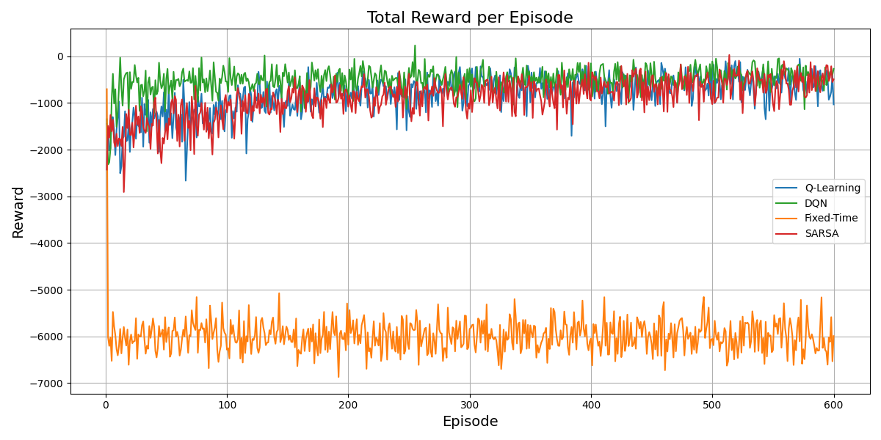
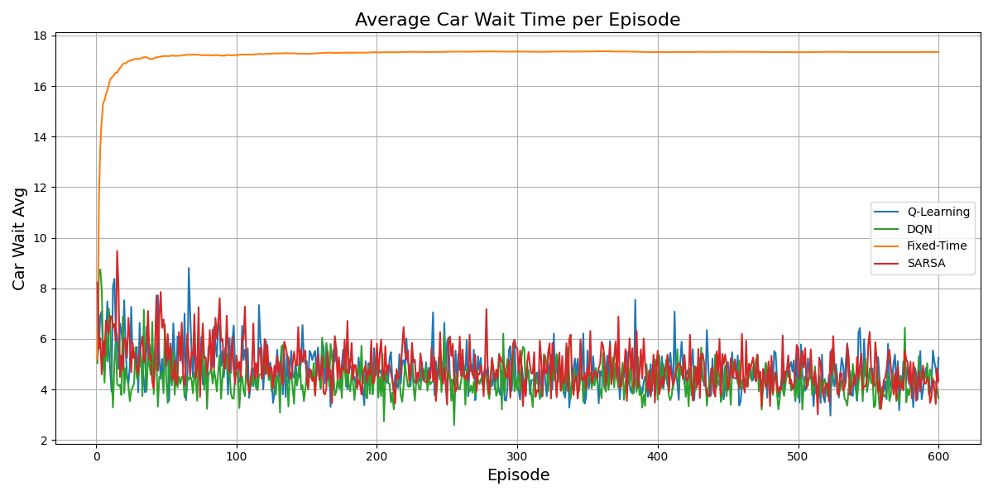
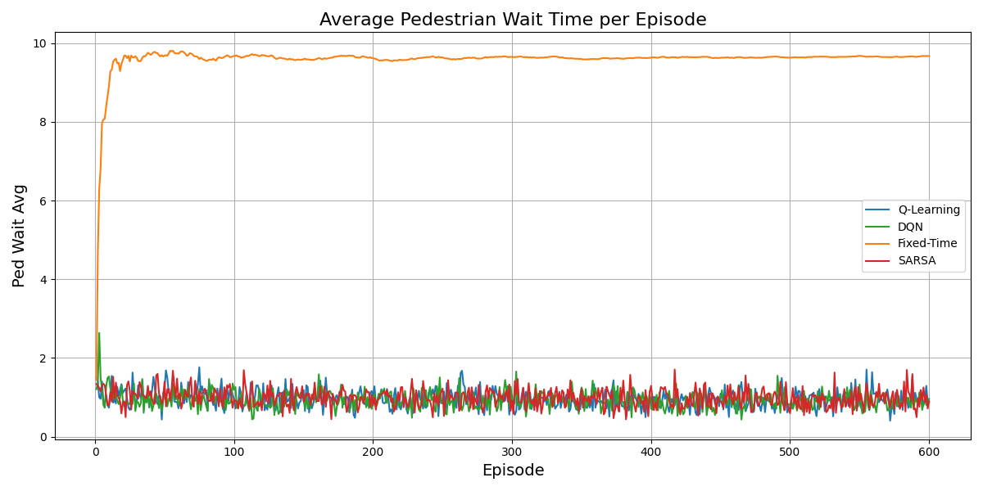
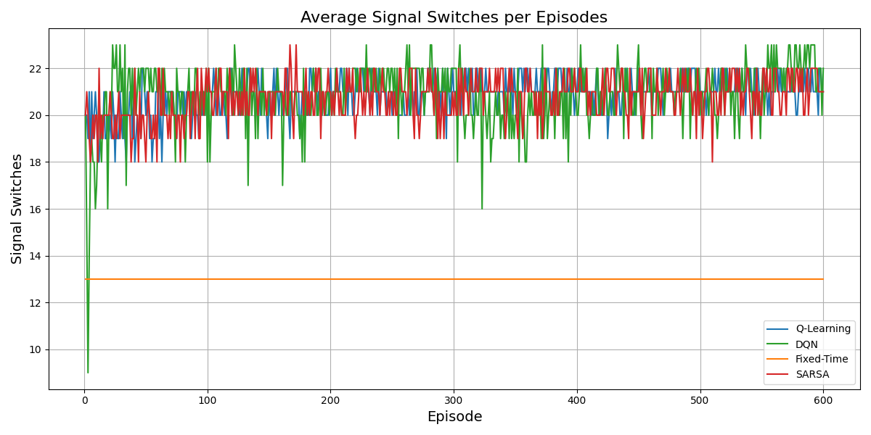

Slide 11
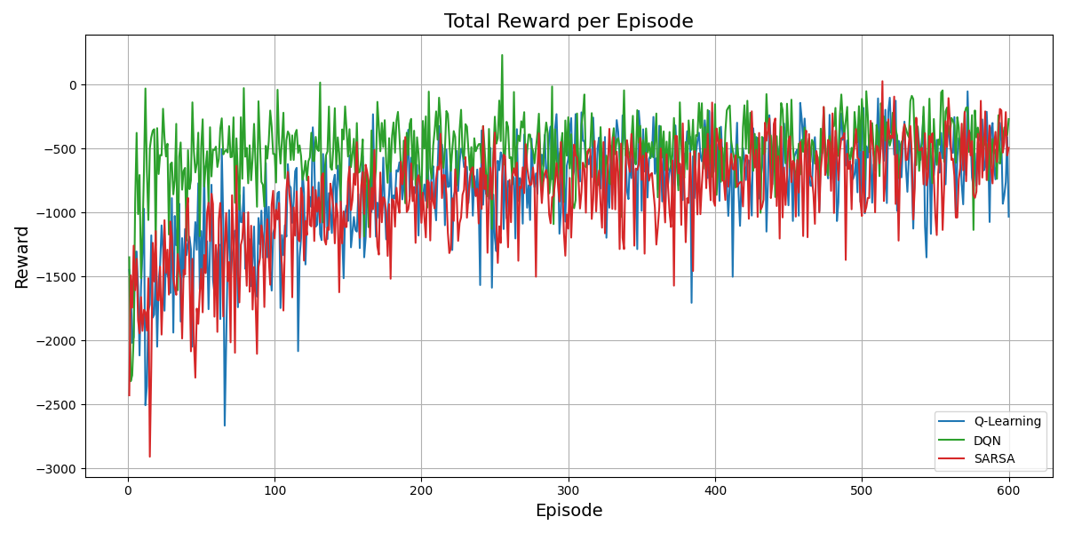
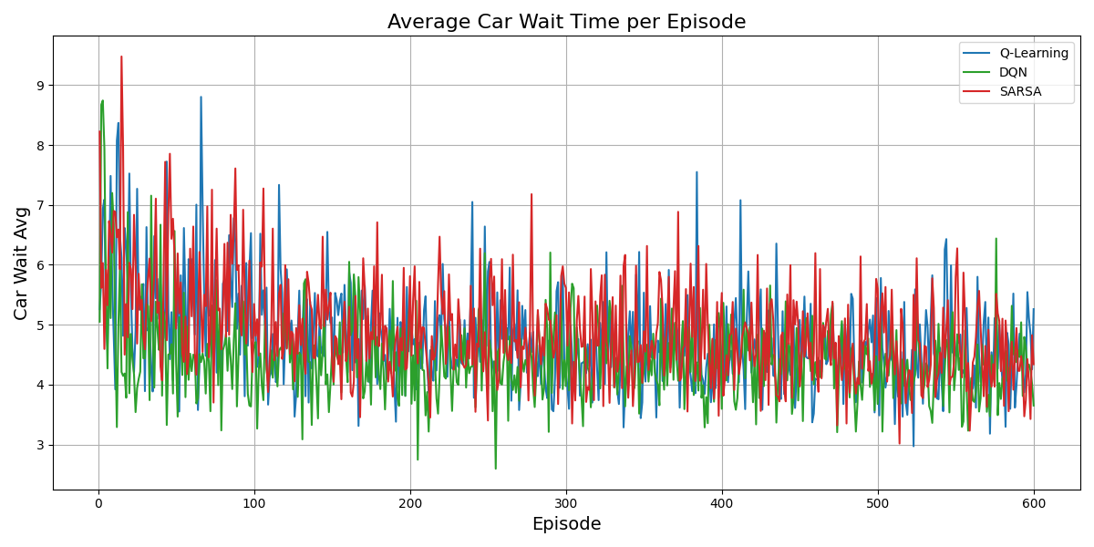
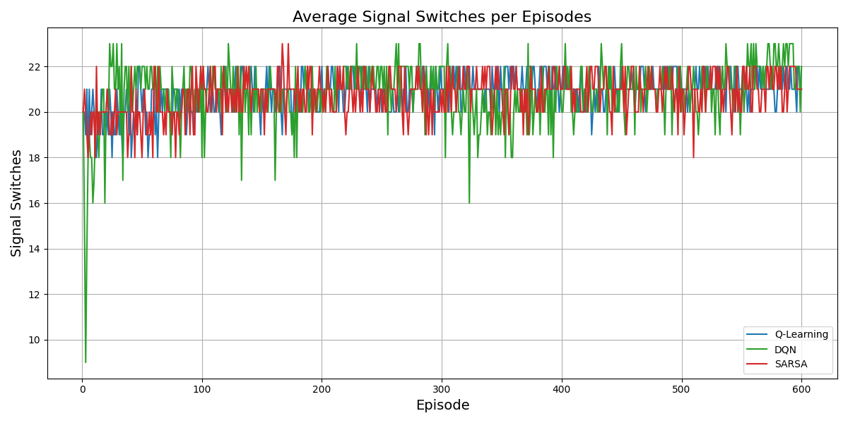
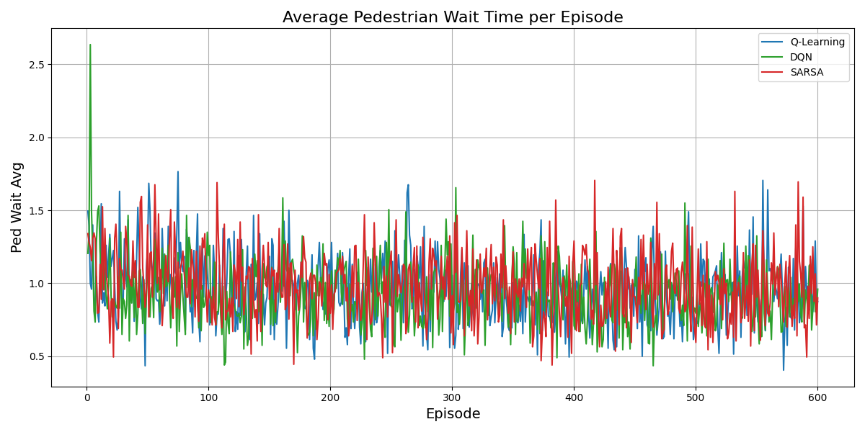

Slide 12
Final Results
Rewards
  All RL agents were significantly better than the baseline fixed-timer
  DQN was the quickest and smoothest, while SARSA seems a bit more stable than Q-Learning
Car Wait Time
  All RL agents had much lower wait times
  DQN was once again the best, with SARSA looking better than Q-Learning
Pedestrian Wait Time
  Fixed-timer remained the worst, and DQN remained the best
  Q-Learning here looks better than SARSA
Signal Switches
  All RL agents choose to switch a lot more than the fixed baseline
  DQN here looked the most variable while Q-Learning the least. This could be because DQN reacted differently to different traffic situations

