Slide 1



BEE-LINE
CSET202 – 2023-24 (Odd Semester)
MD SHAHIL (E22CSEU0017)
AKSHAT SINGH (E22CSEU0014)
HAMDAN KHAN (E22CSEU0018)

Slide 2
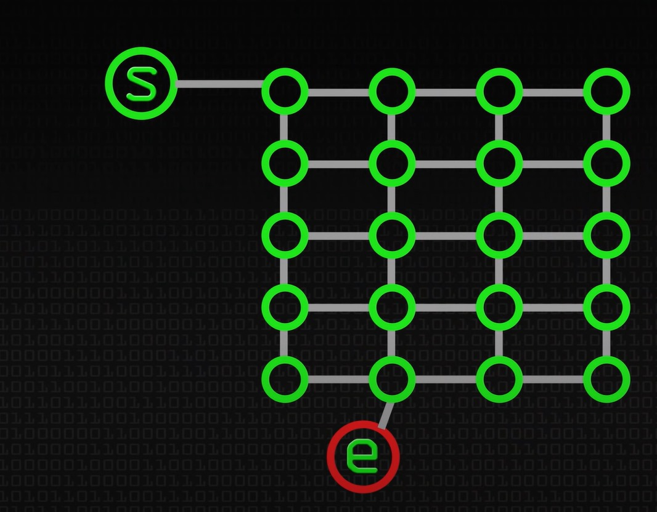
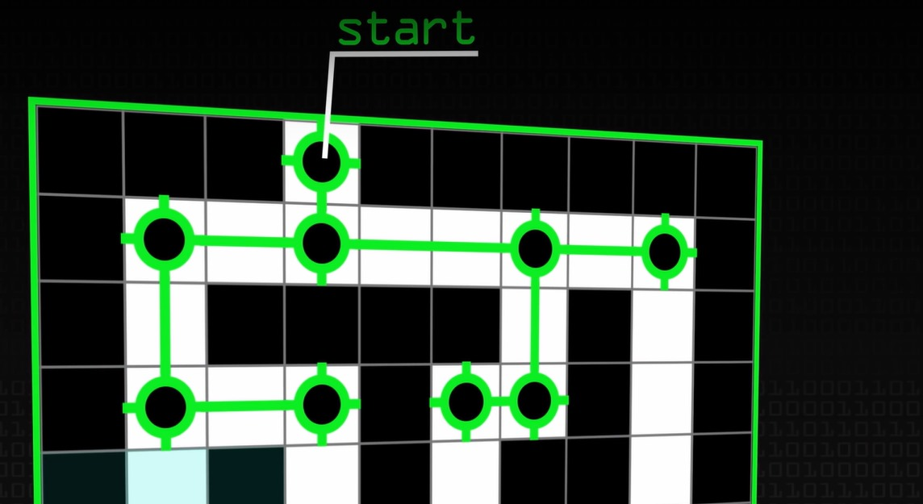
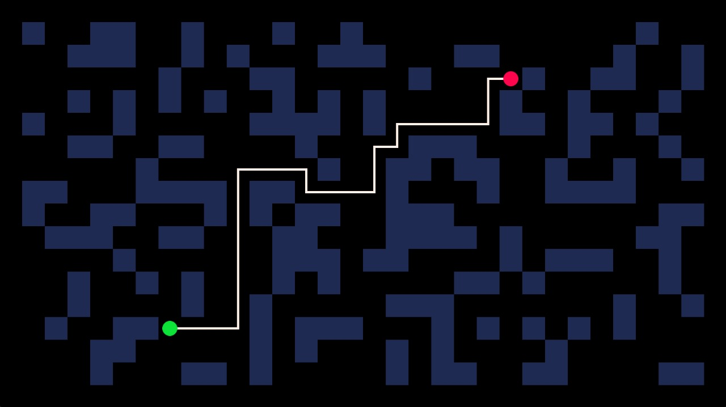
Contents
Introduction
Problem
Solution
Software Requirements (Major features)

Slide 3
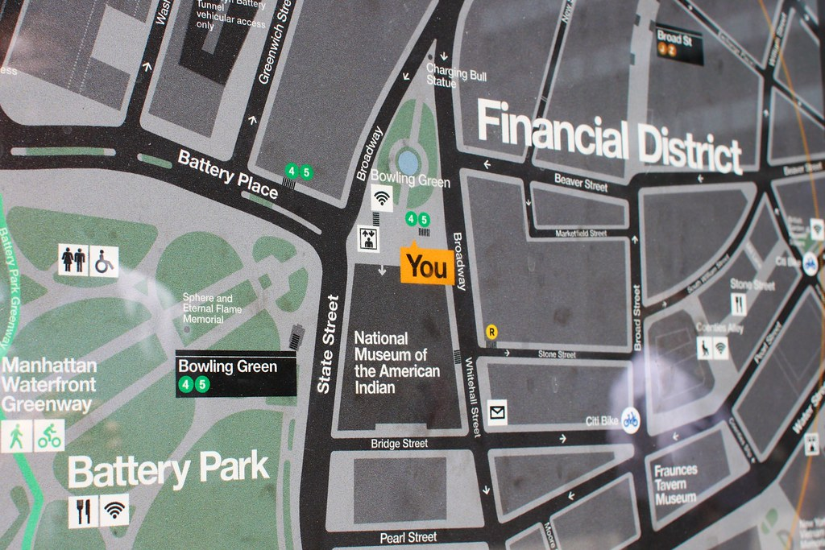
Introduction
Navigation's Limitations: Despite widespread use, current navigation systems struggle to optimize routes with multiple coordinates.
Local Delivery Complexity: Industries like local delivery (e.g., water, newspapers) require optimized routes to save time and resources. Existing systems fall short, impacting effectiveness.
Solution Urgency: This presentation tackles the gap in multi-destination navigation, with a focus on local deliveries.

Slide 4
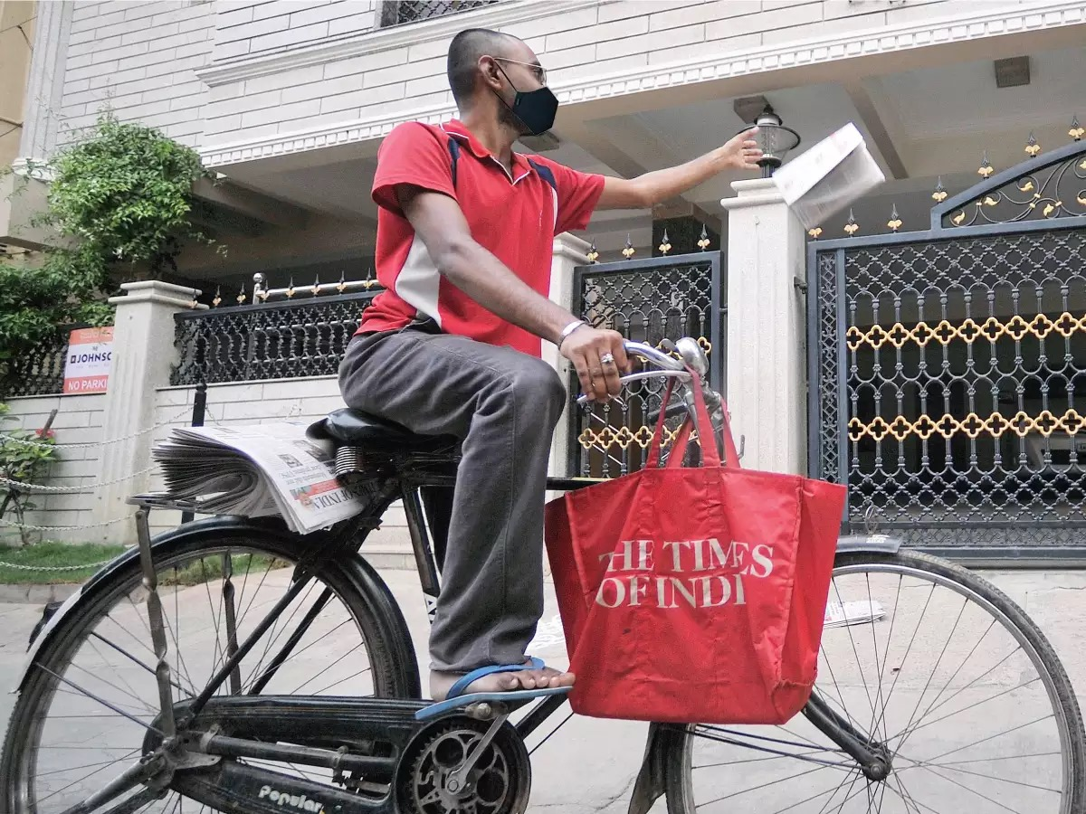
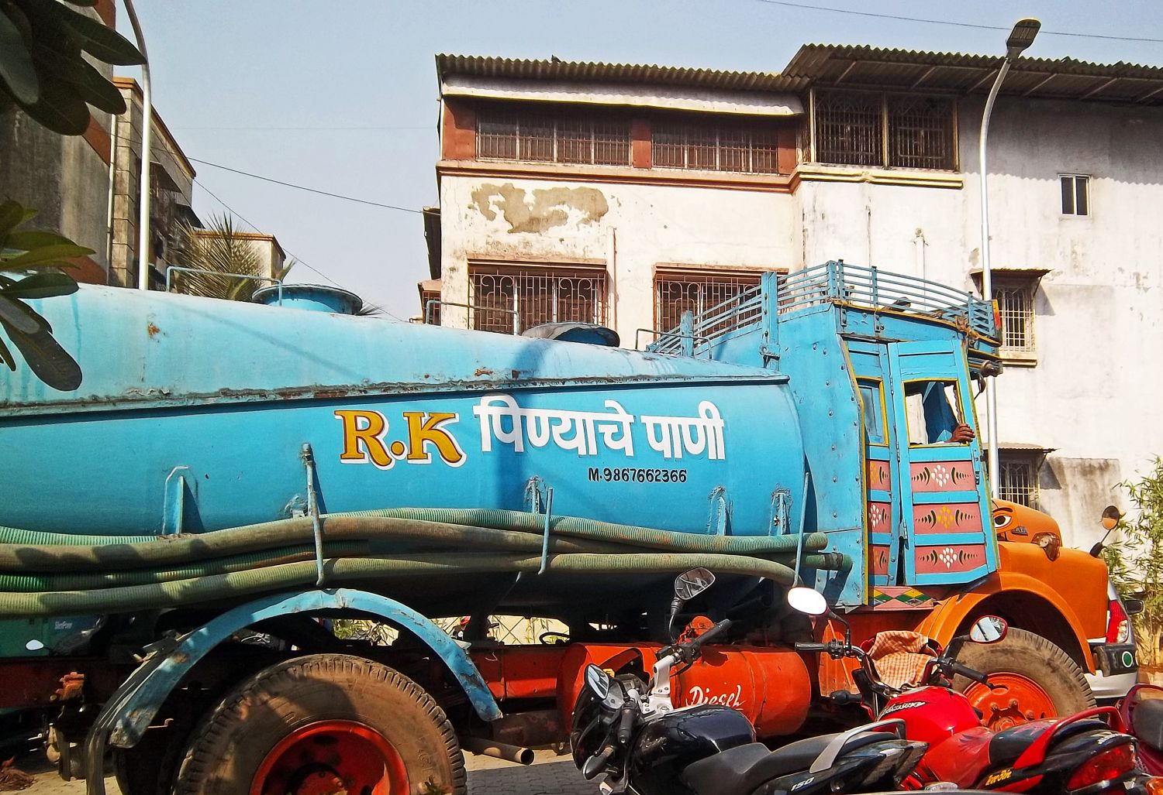

Problem
If navigator have to reach multiple Co-ordinates, the navigation systems available does not provide an optimised course of action.
<Case study> (Newspaper delivery)
<Case study> (Water supply)
<Case study> (Dairy supply)

Slide 5
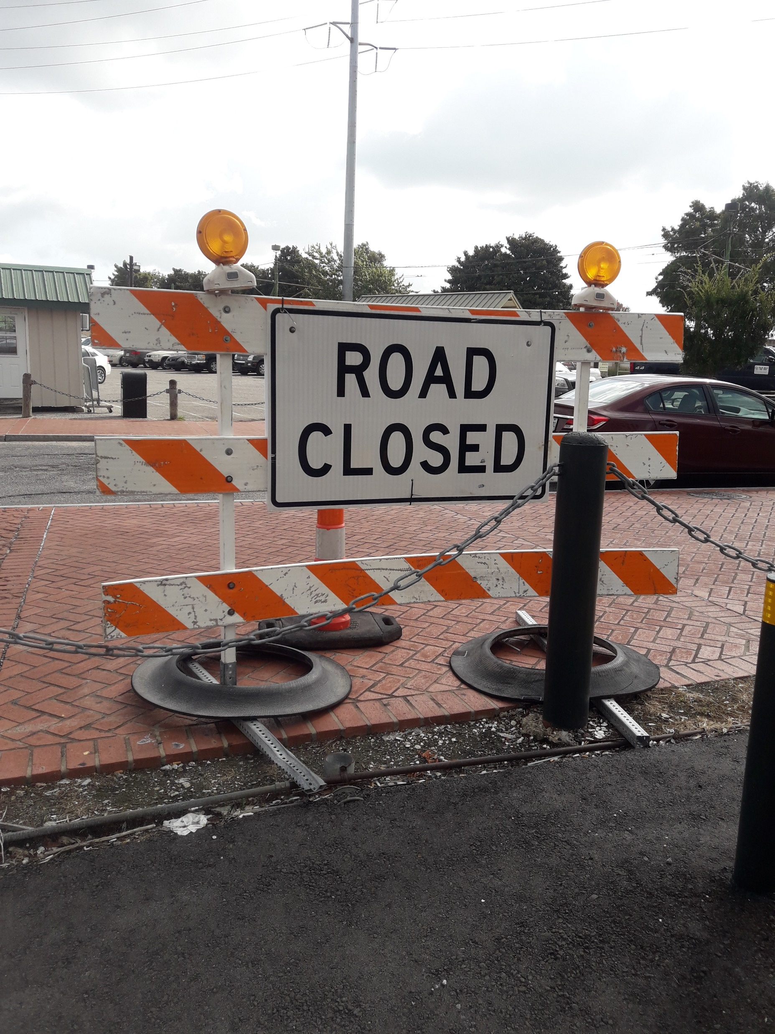
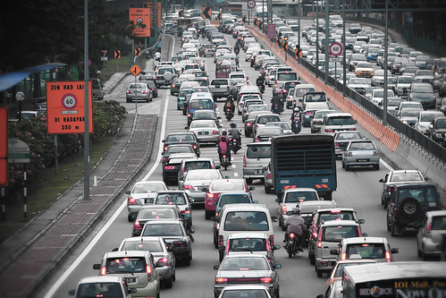
Solution
Optimize navigation system using algorithms like BFS(Breadth-First Search), DFS(Depth-First search), Dijkstra’s algorithm, A*(A Star)
Find the (time-efficient or path-efficient) routes accounting chaos of the routes(like traffic, road type, blockage, etc.).
BFS
DFS
A*(A STAR)
DIJKSTRA

Slide 6


Software Requirements (Major Features)
Software Requirements
Operating System : Windows 10/8/7 (32-bit or 64-bit)/ Linux
Software : Text Editor/Turbo C/DevC
Compiler : GCC
Hardware Requirements
Processor : Dual Core 2.7 GHz or better
RAM : 512 MB or higher

Slide 7

Thank You

