Slide 1


INNOVATHON 2.0
NATIONAL INSTITUTE OF TECHNOLOGY, ROURKELA • 2026
PROJECT OVERVIEW & SPECIFICATIONS
KISAN MITR (किसान मित्र)
• Problem Statement Title: Smart Crop Advisory System for Small and Marginal Farmers
• Theme / Category: Agriculture, FoodTech & Rural Development (Software)
• Team Name: Team Loop
• Target Users: Smallholders, Marginal Farmers & Rural Women
• Core Capabilities: Voice-First Multilingual Advisory, 100% Offline Loopback, Certified Soil-to-Cultivation Pipeline, Real-Time APMC Mandi Radar
• GitHub Repository: [Repository Link: Coming Soon / Link will be updated]
• Working Prototype: http://localhost:5173 (React 19 PWA + Node.js Engine)
OFFICIAL PROJECT MASCOT

Slide 2
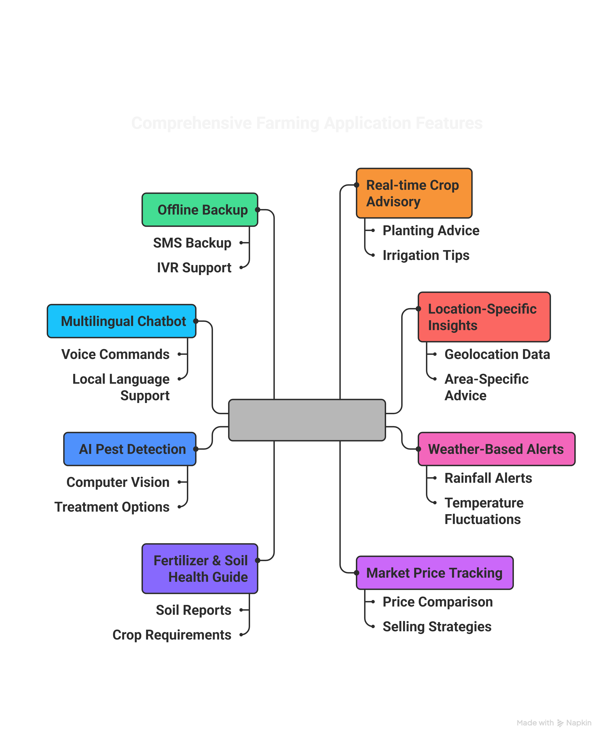
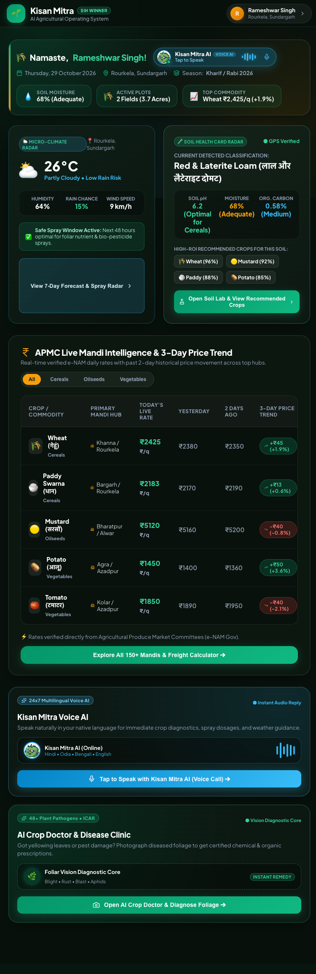
PROPOSED SOLUTION
Team Loop
INNOVATHON 2.0 • NIT ROURKELA 2026
PROTOTYPE & REPO LINK:
Live Web App: http://localhost:5173
GitHub: [Repository Link: Coming Soon]
KISAN MITR
Kisan Mitr — Smart Crop Advisory & Rural Lifecycle System | Innovathon 2.0 NIT Rourkela
Slide 2

Slide 3
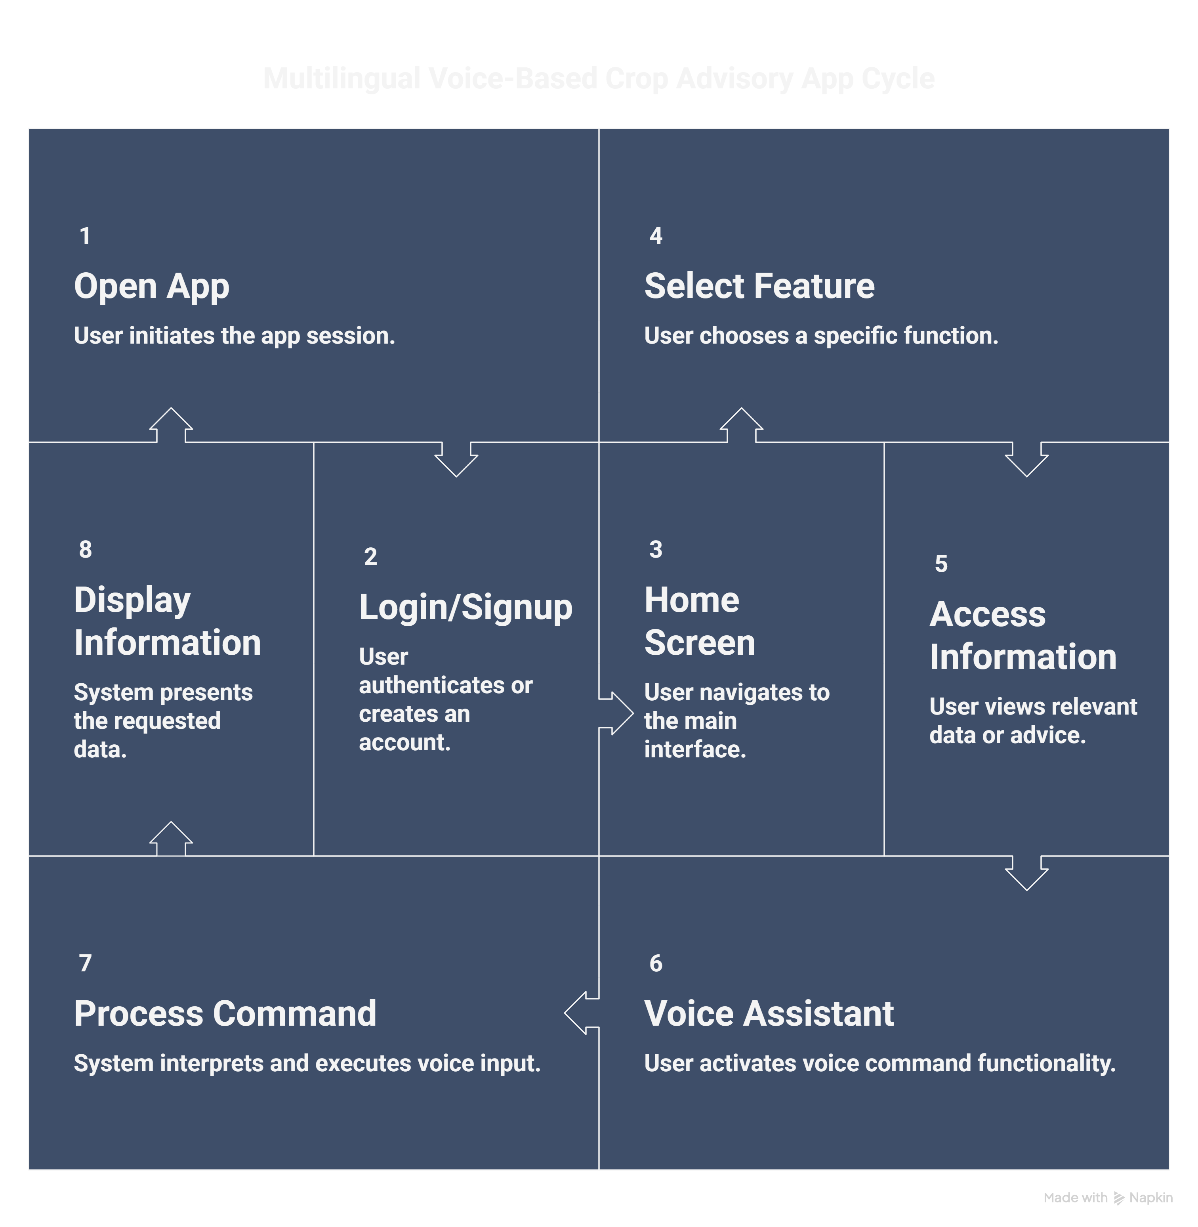










TECHNICAL APPROACH
Team Loop
INNOVATHON 2.0 • NIT ROURKELA 2026
TECH STACKS USED
FRONT-END: (React 19, Vite 7 PWA, HTML5, CSS3, JavaScript)
BACK-END: (Node.js Express / Python API)
DATABASE & DOMAIN ENGINE: (SQLite / In-Memory State & ICAR Standards)
OTHERS & REPOSITORIES:
Kisan Mitr — Smart Crop Advisory & Rural Lifecycle System | Innovathon 2.0 NIT Rourkela
Slide 3

Slide 4
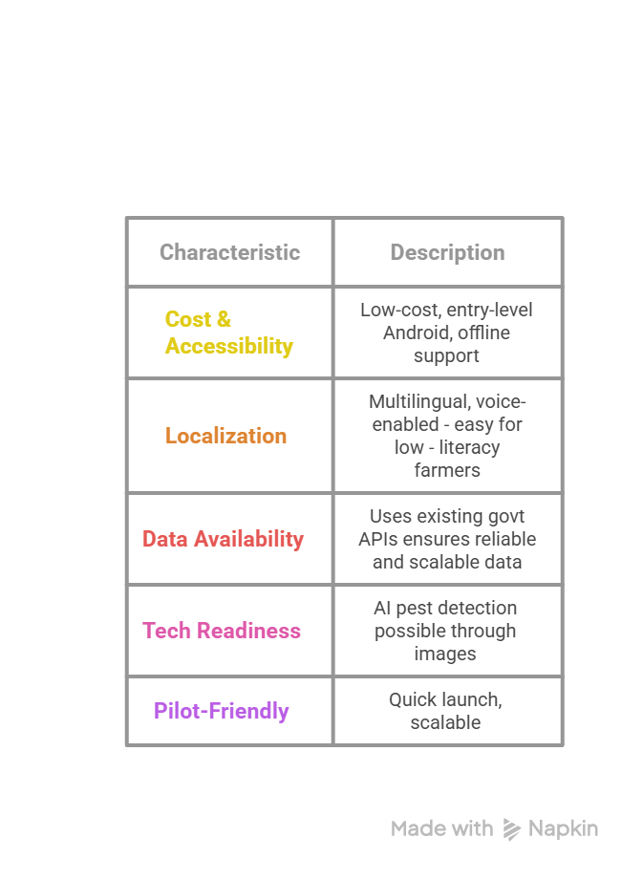
FEASIBILITY AND VIABILITY
Team Loop
INNOVATHON 2.0 • NIT ROURKELA 2026
PROJECT UNIQUENESS & CORE ADVANTAGES
⭐ ACCURATE AGRO-WEATHER FORECASTING
Hyper-local weather station delivers immediate spray suitability warnings, frost alerts, and rainfall safety metrics.
⭐ 100% OPERATIONAL IN OFFLINE MODE
Zero dependency on remote cloud servers. Complete soil advice, disease diagnosis, and voice Q&A work seamlessly over local loopback in remote fields.
⭐ FIT FOR SMALL & MARGINAL FARMERS
Voice-first interface in regional mother tongues, zero complex menus, low memory footprint, and runs on entry-level Android devices.
Potential Challenges | Strategies for Overcoming These Challenges
Digital Literacy | Features like Voice-first interface, Icon-driven UI, Local languages & dialects, and Interactive Helpline.
Connectivity Blackouts | Offline-first design, local loopback architecture (127.0.0.1:8000), SMS & voice fallback.
AI Accuracy & Hallucination | ICAR & PAU certified scientific agronomic packages, Human-in-the-loop validation, eco-safe defaults.
Farmer Adoption | Partner with local FPOs, Krishi Vigyan Kendras (KVKs), NGOs & live demo-based community adoption.
Kisan Mitr — Smart Crop Advisory & Rural Lifecycle System | Innovathon 2.0 NIT Rourkela
Slide 4

Slide 5
IMPACT AND BENEFITS
Team Loop
INNOVATHON 2.0 • NIT ROURKELA 2026
POTENTIAL IMPACT ON TARGETED AUDIENCE
✔ Small & Marginal Farmers
15–30% higher crop yield, 10–20% lower input costs, +₹8,000–₹14,000 net gain per acre per season.
✔ Women & Low-Literacy Farmers
Voice-first, local language speech support enables independent farming and crop health decisions.
✔ FPOs & Cooperatives
Digital produce aggregation leads to stronger market bargaining power and higher collective village returns.
✔ Government & Agriculture Officers
Wider scheme delivery outreach, targeted subsidy savings, and real-time localized crop pest surveillance.
✔ Environmental Sustainability
20–30% reduction in indiscriminate chemical runoff, protecting groundwater and soil microbiomes.
✔ Future Generations & Climate
~20,000 Liters of water saved per acre through precision Crown Root Initiation irrigation schedules.
BENEFITS OF THE SOLUTION (SOCIAL & ECONOMIC)
🌱 Higher Farmer Incomes
+15–30% yield boost, 10–20% input savings, +₹8k–₹14k/acre higher profit discovery through APMC price tracking.
🌱 Women & Low-Literacy Empowerment
Voice-first advisory eliminates literacy barriers, allowing women farmers to lead household farm choices.
🌱 Family Welfare & Nutrition
Higher sustained disposable farm incomes directly enhance family nutrition, children's education, and healthcare.
🌱 Community Strength
FPOs leverage collective crop intelligence, adding ₹4 Lakh+ in collective value per farming cluster.
🌱 National Rural Uplift
Scaling across 10 Million marginal farmers can generate ₹10,000+ Crore in annual rural GDP growth.
🌱 Ecological Resilience
Replacing over-spraying with certified ICAR dosages protects pollinator bees and preserves soil organic carbon.
Kisan Mitr — Smart Crop Advisory & Rural Lifecycle System | Innovathon 2.0 NIT Rourkela
Slide 5

Slide 6
RESEARCH AND REFERENCES
Team Loop
INNOVATHON 2.0 • NIT ROURKELA 2026
📚 UNIVERSITIES, GOVERNMENT DATA & SCIENTIFIC CITATIONS
🏛️ Punjab Agricultural University (PAU), Ludhiana
Crop practices, seed rates (HD-2967 wheat @ 40kg/acre), fertilizer split schedules & integrated pest management. 🔗 https://www.pau.edu
🏛️ ICAR - NBSS&LUP, Nagpur
National Bureau of Soil Survey & Land Use Planning — Comprehensive soil health, nutrient degradation & fertility mapping. 🔗 https://www.nbsslup.in
🏛️ India Meteorological Department (IMD)
Agricultural Meteorology Division — Agromet Advisory Service bulletins for rainfall, frost alerts, and safe spray windows. 🔗 https://mausam.imd.gov.in
🏛️ National Agriculture Market (e-NAM) & APMC
Directorate of Marketing & Inspection — Daily wholesale market arrivals, modal rates, and MSP benchmarks. 🔗 https://enam.gov.in
🏛️ ResearchGate & Agricultural Climate Bulletins
Punjab and regional agro-climatic studies on sustainable groundwater and NPK conservation. 🔗 https://www.researchgate.net
🏛️ Government of India (Union Budget & Economic Survey)
Crop production statistics, Minimum Support Price (MSP) baselines, and agricultural credit data. 🔗 https://www.indiabudget.gov.in
📁 OUR RESEARCH SUMMARY:
Google Drive Folder:
https://drive.google.com/drive/folders/1foSW9cf4kISlui62Vm2K8BCk-hxyAlKU
📺 YOUTUBE VIDEO DEMO:
Watch Working Prototype:
https://youtu.be/EUIUTiEP8S0?si=tNotwFY4B7Cas0XD
💻 GITHUB REPOSITORY:
[Repository Link: Coming Soon / Link will be updated]
HAVE A LOOK AT OUR APP! 🌾
Live Demo at: http://localhost:5173
Team Loop • Innovathon 2.0 NIT Rourkela
Kisan Mitr — Smart Crop Advisory & Rural Lifecycle System | Innovathon 2.0 NIT Rourkela
Slide 6

