Slide 1
Using Reinforcement Learning FOR TRADING IN Cryptocurrency Market
TEAM 31:
Akshat Bansal
Afzal Ahammed Syed
Gowtham Bobbili

Slide 2
PROJECT DESCRIPTION:
The project aims to stimulate simultaneous cryptocurrency trading using Reinforcement Learning algorithms coded in python.
For the baseline, the agent randomly buys, holds or sells coins.
For advance part, trading is done using a fairly advanced algorithmic approach called Advantage Actor-Critic(A2C).
For visualizations, we used graphs generated by plotly library because we can zoom into the graphs to see the minor changes in a output parameters and also get the value by putting cursors on the lines in the graph which makes it highly interactive for getting feedback on the actions that the agent is taking.
The four cryptocurrencies used were: Bitcoin (BTC), Ether (ETH), Binance Coin (BNB), XRP(XRP)

Slide 3
ENVIRONMENT:
Random Agent:
We used OpenAI’s gym to create a simpe custom environment to stimulate trading of cryptocurrencies based on random decisions. It was built around a custom Python Class named ‘Random Agent’. The environment initially starts with an initial cash amount as set at $1,000,000.
The agent uses data of 2021. The agent randomly decides upon an action (buy, sell, or hold) for each currency.
The action decided leads to updates in agent’s portfolio. If there is no money left, then the agent will stop buying.
A2C:
We used custom trading environment using OpenAI’s gym framework to stimulate trading in cryptocurrency. Same as random agent the environment starts with an initial amount of $1,000,000
The number of steps were limited to 200 to make sure that each episode has a finite end.
We defined action space using MultiDiscrete which allowed three possible actions i.e. 0 (hold), 1(buy), 2(Sell).
To prevent the steps from being dormant in the initial stages, we introduced reward of 0.01 for each selling or buying action taking place.
Also, the buying or selling of each coin was limited to one for better interaction with the market.

Slide 4
METHOD:
a2c
__init__(self, evn): Initialize the agent with given env, setting the discount factor (gamma) of 0.99 and the learning rate for actor to 0.0005 and the critic to 0.001. The number of actions per asset is set to 2 (hold, buy, sell).
Build_actor(self): Uses ReLU activation to build the actor model with two hidden layers that are each 64 units in size. The output layer generates a probability distribution across the actions for each asset using softmax activation, with the shape num_assets * num_actions. The Adam optimizer is used to assemble the model with a learning rate of 0.0005.
Build_critic(self): Built the critic model using a structure resembling that of the actor model, consisting of one output node with linear activation that represented the state value and two hidden layers, each with 64 units and ReLU activation. The Adam optimizer was used to assemble the model, using a mean squared error loss and a learning rate of 0.001.

Slide 5
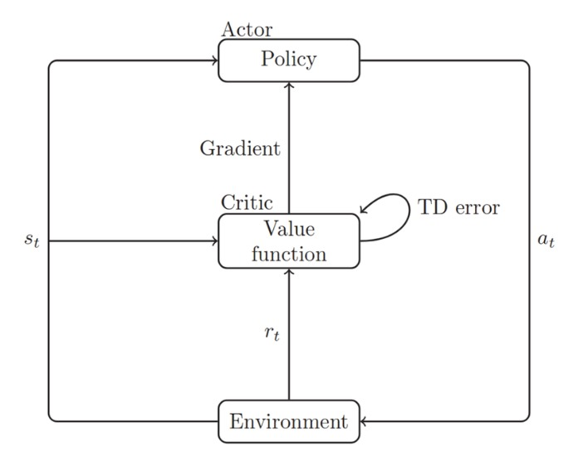
Get_action: Used the actor model to process the given state and extract action probabilities. It then reshaped these probabilities into a format suitable to each asset and determined the specific actions by sampling from these probabilities.
Train_step: This part used both the output from the critic model and the computed delta (the difference between in value estimates adjusted by the reward and discount factor) to update the actor and critic models. It basically involved computer gradients and applying them to update the model.
Train_Agent: The A2C agent is trained on given number of episodes, during which time metrics like cash balance, rewards and portfolio values were recorded.
Source for image: https://www.researchgate.net/figure/Advantage-Actor-Critic_fig3_334521853

Slide 6
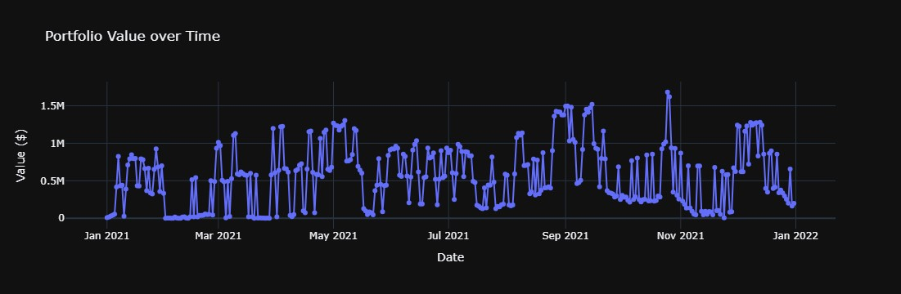
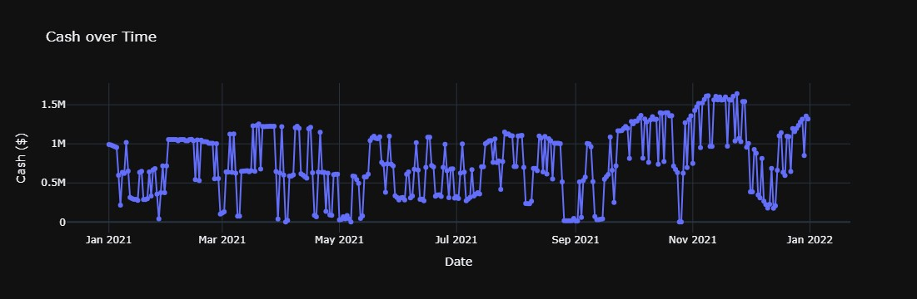
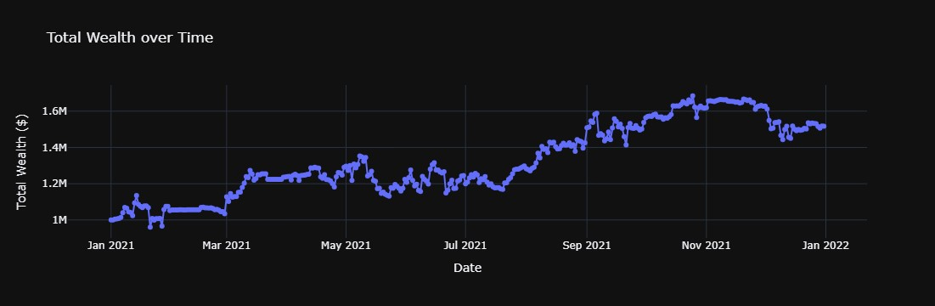
RESULTS:
RANDOM AGENT:
Despite of taking actions randomly, the agent still managed to increased the total wealth of $1 million to the maximum of $1.684 million on Oct, 25, 2021 and to the value of $1.517 million.

Slide 7
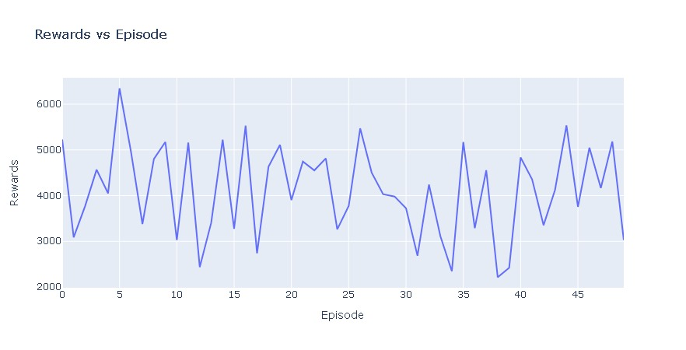
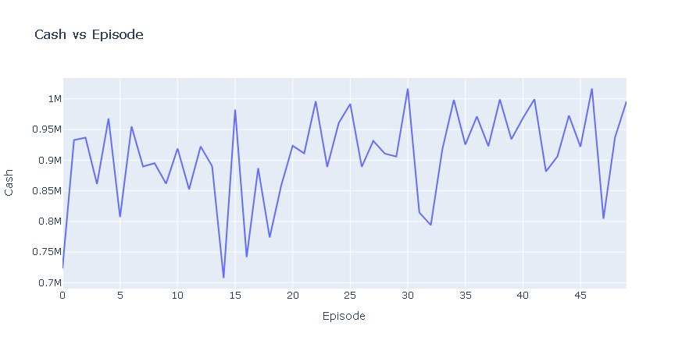
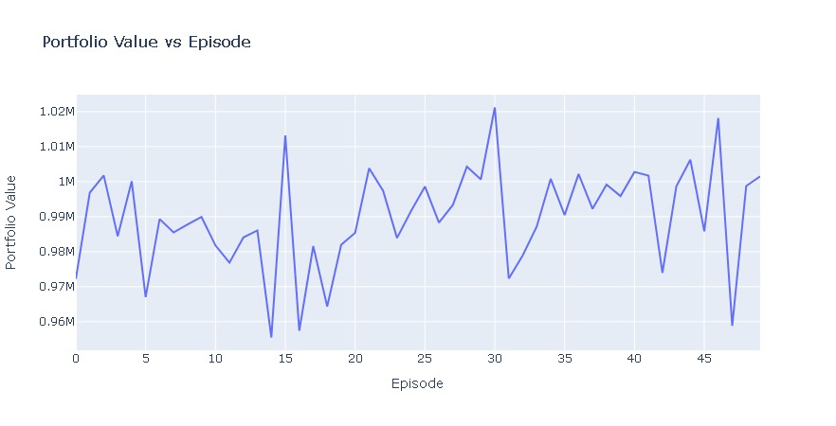
RESULTS:
A2C:
As it can be seen in the graph, the total wealth reached the maximum of $4.284 million and a value of $3.1695 million at the end i.e. episode 100 which is more than 3 times the initial value.
This was achieved by the training the agent for 50 episodes.
In the next slide we will show when the agent was trained for 100 episodes then what happened?

Slide 8
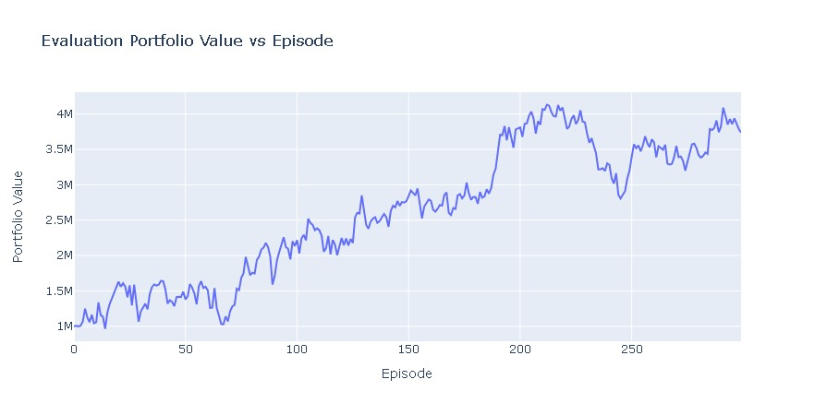
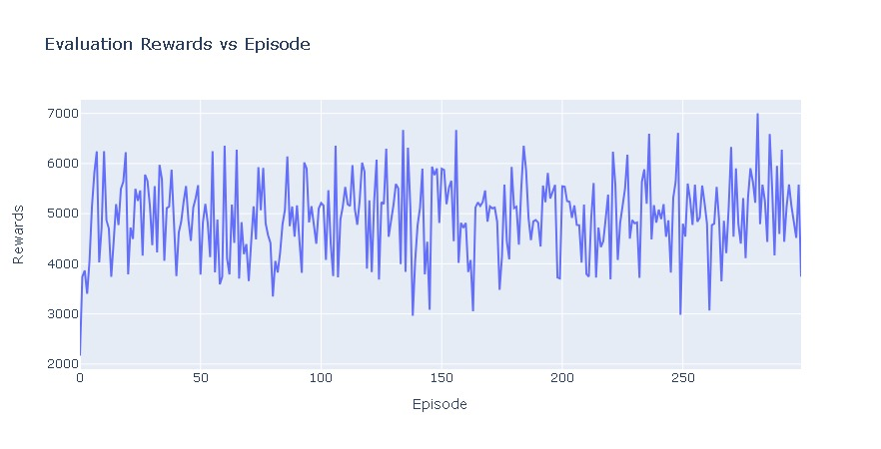
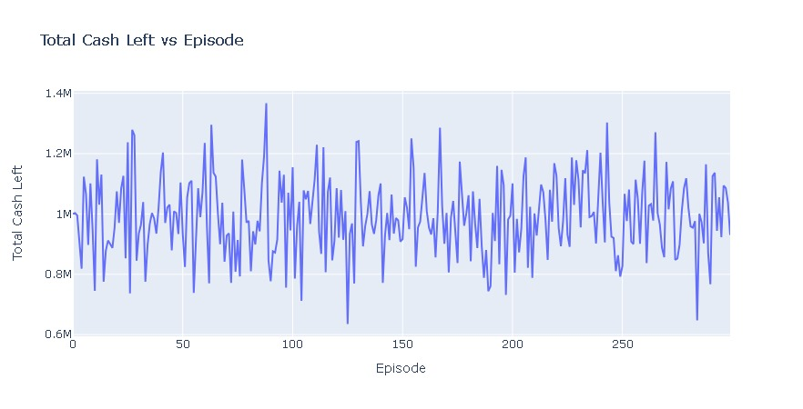
RESULTS:
A2C:
As it can be seen in the graph, the total wealth reached the maximum of $5.26 million and at the end of episode 300 it was $4.66 million which is more than 4 times the initial value.
This was achieved by the training the agent for 100 episodes.
The portfolio value (the value of cryptocurrencies held) was maximum of $4.116 million at episode 213 and at the end was the 3.73 million.

Slide 9
SUMMARY:
The main advantage of using Reinforce Learning algorithms is that it can learn policies which can maximize long term rewards but the variations in values of currencies is defined by market forces which can give variations which is unexpected for policy defined by RL methods.
Some human interference is still required for tweaking the algorithm like we did.
The main tweak we added to was to limit trading of only 1 coin in each step so as to not to make the trading dormant or erratic in later stages.
The other tweak we added was to give rewards for trading rather than holding to increase the trading.
Overall the algorithm worked really well as we have shown in the results page.

Slide 10
CONTRIBUTION:
Contribution:
Team Member |  | Contribution(%)
Akshat Bansal |  | 33.3
Gowtham Bobbili |  | 33.3
Afzal Ahammed Syed |  | 33.3

Slide 11
THANK YOU

