Slide 1


SMART INDIA HACKATHON 2025
TITLE PAGE
Problem Statement ID –SIH250172
Problem Statement Title- Transformer based end-to-end Web Application Firewall (WAF) pipeline
Theme- Blockchain and cybersecurity
PS Category- Software
Team ID-
Team Name: Byte Blasters

Slide 2
IDEA TITLE
BYTE BLASTERS
IDEA / SOLUTION :
Problem Resolution :
High false positive rates in traditional WAFs
Inability to detect novel attack patterns
Performance degradation with complex rule sets
Manual rule configuration and maintenance burden
Limited scalability for high-throughput environments
Transformer-based pipeline for anomaly detection.
Components: Log ingestion → Parser → Transformer training → Real-time detection.
Non-blocking FastAPI sidecar integrated with Nginx/OpenResty.
Incremental fine-tuning for continuous updates.
Unique Value Propositions (UVP) :
ML Anomaly Detector - 91%+ accuracy, pattern-based detection
FastAPI Sidecar - Async inference API with <1ms overhead
OpenResty WAF - Non-blocking Lua-based protection
Docker Deployment - One-command production setup
Complete Test Suite - Unit, integration, performance tests
Demo - 15+ realistic attack scenarios

Slide 3
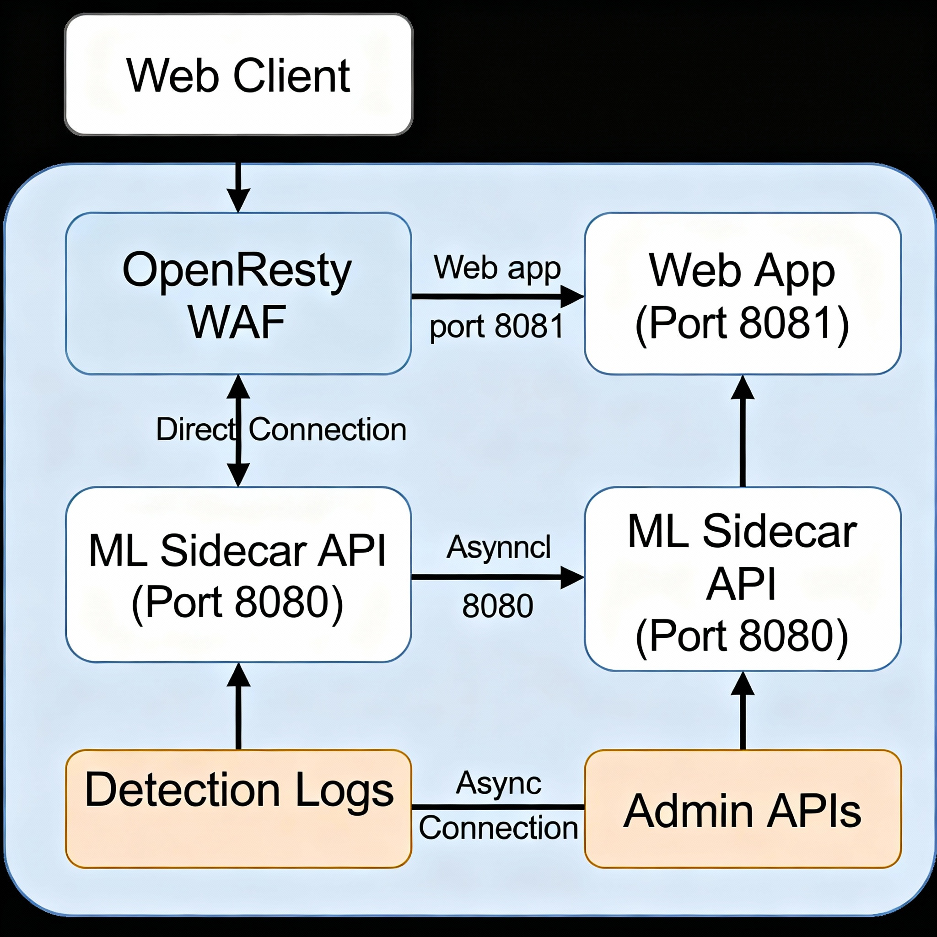
TECHNICAL APPROACH
BYTE BLASTERS
PROCESS FLOW ARCHITECTURE
Python,PyTorch
HuggingFace Transformers
FastAPI + Uvicorn (model sidecar)
OpenResty/Nginx (real-time traffic integration)
Docker & Docker Compose (deployment)
HTML/JS Dashboard (live logs visualization)
Lua
Ngnix
Bash
WSL
Product Status: 80% product built completed and further build is on progress. Testing,Training and validation process are next to be undergone

Slide 4
FEASIBILITY AND VIABILITY
BYTE BLASTERS
Feasibility
Minimal working prototype achievable within 48–72 hrs.
Pretrained small transformer (DistilBERT) ensures fast fine-tuning.
Async scoring avoids traffic blocking.
Viability for Real-world
Scales to enterprise & government use (plug into existing web servers).
Extensible: add attack datasets for supervised fine-tuning.
Incremental retraining → lowers operational overhead.
Blockers / Risks
Dataset availability (synthetic benign logs provided).
Requires tuning thresholds to minimize false positives.

Slide 5
IMPACT AND BENEFITS
BYTE BLASTERS
Benefits
🚀 Zero-day detection – ML learns patterns unseen in signatures.
⚡ Low latency – Non-blocking async design.
🔄 Continuous learning – Adaptive to new traffic.
📊 Real-time visibility – Dashboard for monitoring & auditing.
🔐 Scalable security – Works for ISRO apps, enterprise portals, govt sites.
Impact
Enhances national-level cybersecurity resilience.
Reduces reliance on signature updates.
Provides a research-to-production use case for AI in security.

Slide 6
RESEARCH AND REFERENCES
BYTE BLASTERS
>Research Papers
Vaswani et al. (2017): Attention Is All You Need (Transformers).
Sharafaldin et al. (2018): CICIDS2017 dataset for intrusion detection.
Zhang et al. (2020): Deep Learning for Web Security Anomaly Detection.
>Existing Tools / Competitors
ModSecurity (rule-based WAF) → limited against zero-days.
Cloudflare WAF / AWS WAF → commercial, closed-source.
Our solution → open-source, Transformer-powered, hackathon-ready.
>References
HuggingFace Transformers: https://huggingface.co
OpenResty (Nginx + Lua): https://openresty.org
ISRO Hackathon Problem Statement Docs

Slide 7
IMPORTANT INSTRUCTIONS
Please ensure below pointers are met while submitting the Idea PPT:
Kindly keep the maximum slides limit up to six (6). ( Including the title slide)
Try to avoid paragraphs and post your idea in points /diagrams / Infographics /pictures
Keep your explanation precise and easy to understand
Idea should be unique and novel.
You can only use provided template for making the PPT without changing the idea details pointers (mentioned in previous slides).
You need to save the file in PDF and upload the same on portal. No PPT, Word Doc or any other format will be supported.
Note - You can delete this slide (Important Pointers) when you upload the details of your idea on SIH portal.

