Slide 1


SMART INDIA HACKATHON 2025
Problem Statement ID - 25161
Problem Statement- Mitigating National Security Risks Posed by Large Language Models (LLMs) in AI-Driven Malign Information Operations
Theme - Blockchain & Cybersecurity
PS Category- Software
Team Name- Byte Blasters

Slide 2
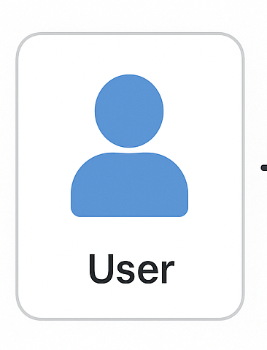


Mitigating National Security Risks Posed by Large Language Models (LLMs) in AI-Driven Malign Information Operations
Byte Blasters
Proposed Solution:
Content:
Detection -> Classifiers, stylometry, multi-modal signals.
Attribution -> Watermarking, forensic tracing.
Threat Intelligent -> GNN-Based disinformation mapping
Intelligence Sharing -> Federated + Blockchain-blocked protocols
Risk Assessment -> Dashboards, heatmaps, predictive modelling
Vendor Collaboration -> Guardrails, red-teaming
Privacy Integration -> Federated learning, differential privacy

Slide 3
TECHNICAL APPROACH
Byte Blasters
TECH STACK:
METHODOLOGY:
AI/ML Models: RoBERTa, T5, GPT Detectors
Stylometric Tools: Entropy analysis, token probability models
Forensics: Watermarking APIs, cryptographic hashing
Graph Analytics: Graph Neural Networks (GNNs)
Cyber Defense: SIEM platforms (Splunk, Elastic, Azure Sentinel)
Data Sharing: Blockchain audit trails, Federated APIs
Privacy: Federated Learning, Differential Privacy (DP)
Explainability: Explainable AI (XAI) frameworks
Detection → Classify AI vs. human content using transformers + stylometry
Forensics & Attribution → Apply watermarking & reverse engineering to trace source models
Threat Intelligence → Use GNNs to map disinformation clusters & propagation chains
Cross-Border Sharing → Secure collaboration via federated learning + blockchain logs
Risk Assessment → Provide real-time dashboards, heatmaps & predictive analytics
Collaboration → Partner with LLM vendors for guardrails & red-teaming simulations
Compliance → Integrate privacy-preserving techniques & XAI for accountability

Slide 4
FEASIBILITY AND VIABILITY
Byte Blasters
Feasibility:
Leverages existing AI & cybersecurity tools
Compatible with national SOCs & SIEM systems
Scalable via federated protocols & APIs
Extensible for multi-national collaboration
Challenges & Risks:
Detection Accuracy → Risk of false positives/negatives
Cross-Border Issues → Legal & data localization conflicts
Adversarial Adaptation → Rapid LLM evolution to bypass filters
Resource Intensive → High compute & dataset requirements
Civil Liberty Concerns → Risk of surveillance overreach
Mitigation Strategies:
Continuous retraining with adversarial datasets
Red-teaming simulations to expose vulnerabilities
Policy alignment for international cooperation
Privacy-first design: Differential Privacy (DP), Federated Learning (FL)
Explainable AI (XAI) to ensure transparency & public trust

Slide 5
IMPACT AND BENEFITS
Byte Blasters
Target Audience Impact:
National Security Agencies, Cyber Defense Teams, Policy Makers, Allied Nations
Benefits:
Real-time threat detection & attribution
Coordinated international response
Stronger defense against disinformation & phishing
Maintains balance between security & civil liberties

Slide 6
RESEARCH AND REFERENCES
Byte Blasters
REFERENCE LINKS:
GNN for Threat Detection: https://arxiv.org/abs/1812.08434
SIEM Integration (Splunk, Elastic): https://www.splunk.com
Differential Privacy (Google AI): https://research.google/teams/differential-privacy

