Slide 1
Hostel Management System
Design and Implementation of a Concurrency-Safe, Normalized Hostel Management System using PostgreSQL
PROJECT REVIEW – 2
Akshay Chandra
Manoj
2510080055
2510080052
Pranith Reddy
Sai Charan
2510080051
2510080053

Slide 2
Problem & Objectives
Problem Statement
Objectives
Manual hostel allocation causes paperwork, human errors and delays.
Automate student registration, room allocation, payments and maintenance.
Many existing academic HMS implementations focus mainly on basic CRUD operations.
Design a normalized 3NF relational schema using PostgreSQL.
Room/bed allocation can face conflicts when multiple users access the system simultaneously.
Ensure transaction-safe room allocation and prevent double-booking.
Database design and transaction safety are often insufficiently addressed.
Apply PostgreSQL constraints and transaction mechanisms for data integrity.
Bridge the gap between basic academic HMS implementations and more robust booking-system designs.

Slide 3

Literature Review Overview
9 SOURCES REVIEWED
The literature was grouped into three major categories:
1. Academic Hostel Management Systems
2. Allocation Algorithm Research
3. Booking & Database-System Research
Roommate compatibility
Personality-based allocation
Automated allocation logic
PHP/MySQL
VB/MS Access
Web-based HMS implementations
PostgreSQL booking systems
Database transactions
Concurrency and double-booking prevention
Normalized booking schemas
Overall Observation: Existing research addresses hostel management, allocation logic and database integrity, but these areas are often studied separately.

Slide 4

Literature Review: Academic HMS
Major Findings
HOMASY — LASU Case Study
Mufulira College HMS
PHP + MySQL + MVC
Automated room allocation and record keeping
Identified paperwork and manual-process problems
Developed PHP/MySQL MVC solution
VB + MS Access HMS
College of Agriculture Lafia
Authentication and access-control mechanisms
Improved usability
Used interviews and secondary research for requirements
Developed PHP/MySQL HMS
Common Limitation: Most implementations focus on functional CRUD operations, with limited discussion of 3NF normalization, transaction isolation and concurrency safety.

Slide 5
Recent & Allocation Research
Recent Academic Work — IRJMETS 2025
Allocation Research — PHAS
Node.js / React
Personality-Based Hostel Allocation System
Uses personality/temperament information
MySQL / MongoDB
Attempts to improve roommate compatibility
Design Science methodology
Goes beyond first-come-first-served allocation
Administrator interviews + resident surveys
Limitation: Focuses on allocation logic rather than database-level transaction safety.
Covers authentication, allocation, payments and maintenance
Strength: More rigorous methodology and broader functionality.
Limitation: Database design remains relatively schema-agnostic, rather than focusing deeply on relational design and PostgreSQL-specific integrity mechanisms.

Slide 6
Database & Industry Booking Research
Key Lessons from Booking-System Research
Normalized Booking Schema
PostgreSQL Booking Systems
Transactional Allocation Systems
Separates entities into normalized tables
Uses junction tables for complex relationships
Reduces duplication
Uses PostgreSQL for strong transactional/ACID guarantees
Uses row-level locking before confirming reservations
Addresses concurrent booking conflicts
Database transactions can prevent race conditions
Concurrency control is essential when multiple users compete for the same resource
Key Insight: Hostel room allocation has the same fundamental availability + reservation + concurrency problem found in hotel and booking systems.

Slide 7
Critical Analysis & Synthesis
What the Literature Shows
Area
Existing Research
Limitation
Hostel Management
Registration, rooms, payments, maintenance
Often CRUD-focused
Allocation
Compatibility/automated allocation
Database safety often not addressed
Database Design
Normalization and relational schemas
Rarely applied deeply to academic HMS
Booking Systems
Transactions, locking, ACID
Usually hotel/general booking domain
PostgreSQL
Strong integrity/concurrency mechanisms
Underutilized in academic HMS
Synthesis: Existing studies provide useful solutions to individual problems, but hostel functionality, allocation intelligence and database-level concurrency are not consistently integrated into one design.

Slide 8
Research Gaps
1
2
Concurrency Safety
Database Normalization
Existing HMS literature gives limited attention to concurrent room allocation.
Risk: Two users may attempt to allocate the same room/bed simultaneously.
Many academic implementations provide limited justification of relational schema design and normalization.
Risk: Redundancy and update anomalies.
3
4
Allocation + Data Integrity
PostgreSQL Features
Allocation algorithms and database integrity are often treated as separate concerns.
Need: Allocation logic must operate safely within database transactions.
Features such as foreign-key constraints, CHECK constraints, transactions, row-level locking, SERIALIZABLE isolation, and exclusion constraints are not commonly emphasized in the academic HMS implementations reviewed.

Slide 9
Proposed Solution & Contribution
Our Contribution
Core Contribution
1
Normalized Database
Bringing database design rigor and concurrency safety into an academic Hostel Management System.
A 3NF PostgreSQL schema for: Students, Rooms, Allocations, Payments, Wardens, Maintenance.
Integrated Modules
2
Concurrency-Safe Allocation
01
Use PostgreSQL transactions and appropriate locking/isolation mechanisms to prevent conflicting allocations.
Student Management
02
3
Constraint-Based Integrity
Room Allocation
Primary keys, foreign keys, CHECK constraints, appropriate uniqueness/exclusion constraints.
03
Payments
4
Integrated HMS
Combines: Student Management + Room Allocation + Payments + Maintenance + Administration
04
Maintenance
05
Administration

Slide 10

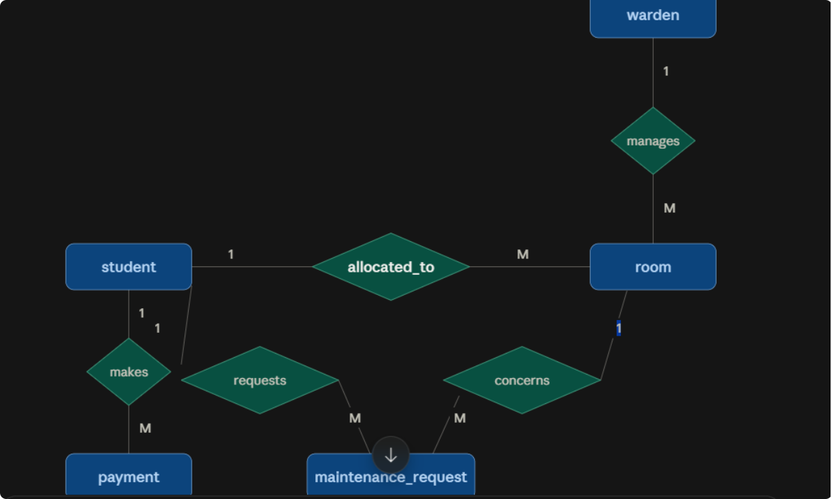




Proposed System & Database Design
System Modules
ER Diagram
Registration
Allocation
Payment
Additional modules: Maintenance Requests, Warden/Admin Management.
Core Entities
Student
Allocation
Room
Payment
Design Principles
3NF normalization
Referential integrity
Transaction-safe allocation
Prevention of overlapping/conflicting allocations

Slide 11
Conclusion & Future Scope
Conclusion
Future Scope
Literature shows that existing HMS solutions successfully automate basic hostel operations.
Roommate Compatibility
Personality-based allocation logic integrated at the database level.
However, database-level normalization and concurrency control receive comparatively less attention in the academic systems reviewed.
Real-Time Dashboard
Live occupancy monitoring and reporting.
Booking-system research demonstrates the importance of transactions, locking and strong database integrity.
Automated Fee Reminders
Scheduled payment notifications and reminders.
Our project combines these ideas in a PostgreSQL-based, normalized and concurrency-safe Hostel Management System.
Advanced Analytics
Hostel analytics and predictive occupancy/demand analysis.
Our goal is not simply to digitize hostel management, but to build a database system that remains correct and reliable even when multiple operations occur simultaneously.

