Slide 1
PROJECT-BASED LEARNING · REVIEW 3
Hostel Management System
Frontend Design & Implementation (React + Vite)
Group 6 · Department of AI & DS
Akshay Chandra (2510080055) · Manoj (2510080052)
Sai Charan (2510080053) · Pranith Reddy (2510080051)

Slide 2
Frontend Overview
2
A single-page React application for hostel administrators.
Purpose
Frontend Goals
Give the admin one place to manage students, rooms and bed allocations
Show live data from the Flask / PostgreSQL backend
Keep the interface simple and fast to use
Clean, responsive dashboard layout
Easy forms with validation
Instant feedback after every action
Reusable components
Placeholders for future modules

Slide 3
Technology Stack & Project Structure
3
Tool | Use
React | Component-based UI, state with hooks
Vite | Fast dev server and build tool
lucide-react | Icon set for menus and buttons
CSS (index.css) | Custom styling, responsive layout
Fetch API | HTTP calls to the Flask backend
Folder structure
src/App.jsx – all pages and components
src/main.jsx – app entry
src/index.css – styles
index.html – root page
package.json – dependencies

Slide 4
Application Architecture & State
4
State (React useState)
Data flow
page – current screen
students, rooms, allocations, dashboard – data from API
query – search text
studentModal, allocationModal – pop-up forms
toast, loading – feedback and loader
sidebarOpen – mobile menu
App loads data once with useEffect
loadData() calls 4 APIs together using Promise.all
Database fields are mapped to frontend names (e.g. student_id → id)
Data is passed to pages as props
After add or cancel, loadData() refreshes everything

Slide 5
Component Structure
5
App is the parent; pages and reusable parts are separate components.
App (state + routing)
Dashboard
Students
Rooms
Allocations
Payments / Maintenance /
Administration
Reusable: Stat · AllocationRow · PageHead · Modal · ModalActions · Field · StudentModal · AllocationModal · ComingSoon

Slide 6
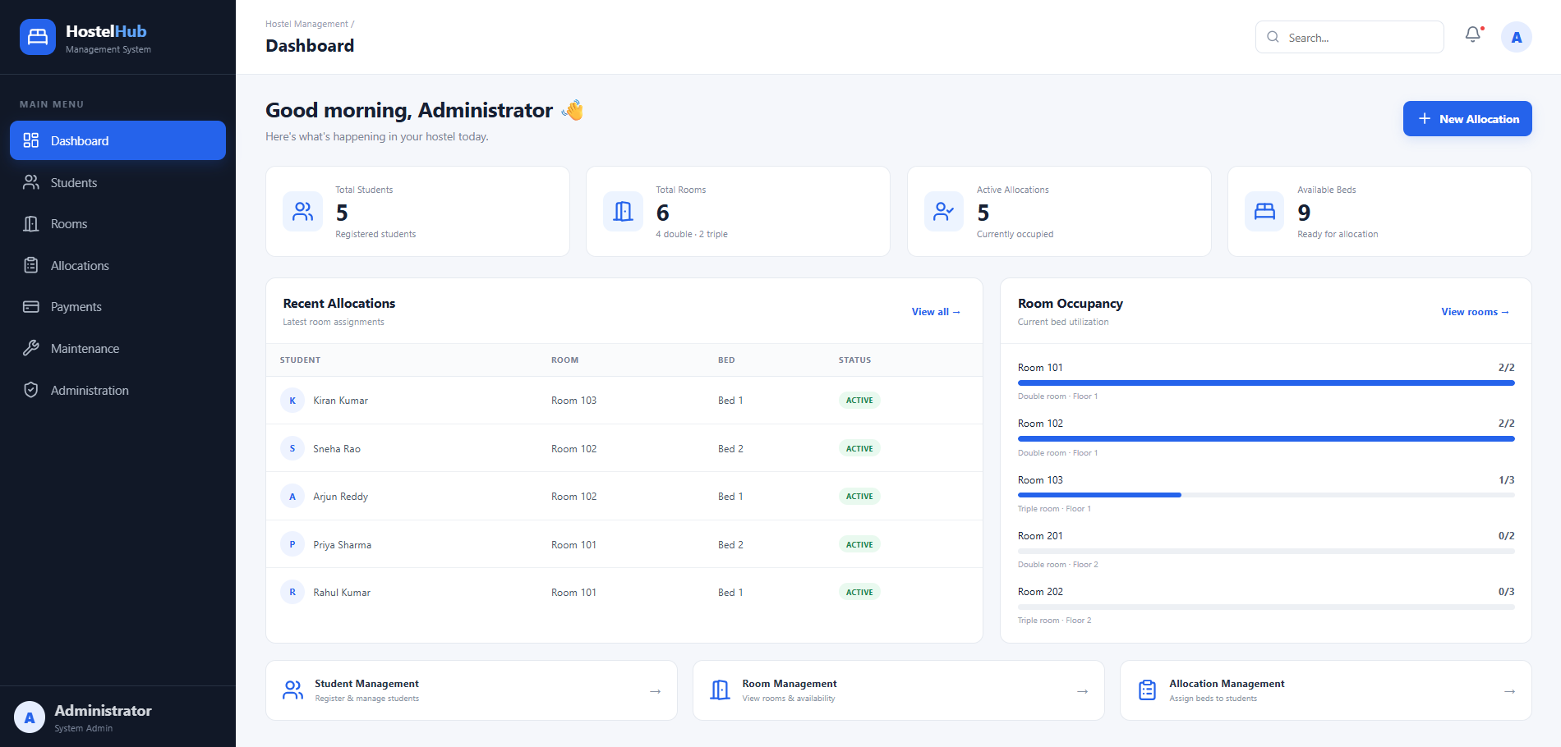
Dashboard Screen
6
What it shows
4 stat cards
Recent allocations table
Room occupancy bars
Quick links to modules
Add Students, Rooms and Allocations screenshots on extra slides if required.

Slide 7
Key Frontend Features
7
Sidebar Navigation
Live Search
7 menu items; hamburger menu on small screens
Filters students and allocations as you type
Modal Forms
Smart Bed Picker
Register Student and New Allocation pop-ups
Occupied beds are shown and disabled in the dropdown
Room Cards
User Feedback
Each bed shown as occupied or free with Full / Available tag
Loading panel and toast messages for success and errors

Slide 8
Frontend–Backend Integration & Summary
8
UI Action | API Call
Load pages | GET /students, /rooms, /allocations, /dashboard
Register Student | POST /api/students
Allocate Bed | POST /api/allocations
Cancel Allocation | PATCH /api/allocations/:id/cancel
Summary & Next Steps
Frontend is complete for Dashboard, Students, Rooms and Allocations
Next: login, payments, maintenance, edit/delete students

