Slide 1
PROJECT-BASED LEARNING · REVIEW 4
Hostel Management System
React · Flask REST API · PostgreSQL
Team Member | Roll Number
Akshay Chandra | 2510080055
Manoj | 2510080052
Sai Charan | 2510080053
Pranith Reddy | 2510080051
Group 6
Department of AI & DS
Academic Year 2026–27

Slide 2
Project Objectives
2
Replace paper registers with one reliable, real-time system.
Digitise Records
Smart Bed Allocation
Store student, room and allocation data centrally in PostgreSQL.
Assign beds to students with conflict-free, validated rules.
Live Availability
Full-Stack Integration
Show real-time room occupancy and free beds on a dashboard.
Connect a React UI to a Flask REST API and a relational database.

Slide 3
Project Development Approach
3
Iterative flow from requirements to a tested system.
Requirement
Analysis
Database
Design
Flask REST
API
React
Frontend
Integration
Testing &
Validation
Tables: students · rooms · allocations | Rules enforced in API: one active bed per student, no double-booking, valid bed numbers.

Slide 4
Project Implementation
4
Technologies and tools used.
Frontend
React (Vite), Lucide icons, custom CSS
Backend
Python Flask, Flask-CORS, python-dotenv
Database
PostgreSQL via psycopg2 (parameterised SQL, row locking)
APIs
8 REST endpoints returning JSON (GET / POST / PATCH)
Environment
VS Code, Node.js, Git & GitHub, localhost:5173 ↔ :5000

Slide 5
System Architecture
5
Request–response flow across three tiers.
User
Frontend
API / Backend
Database
Response
Admin in browser
React + Vite
:5173
Flask REST
:5000
PostgreSQL
hostel_management
JSON → UI update
HTTP (fetch) → SQL queries (psycopg2) → rows → JSON → rendered tables, cards & dashboard

Slide 6
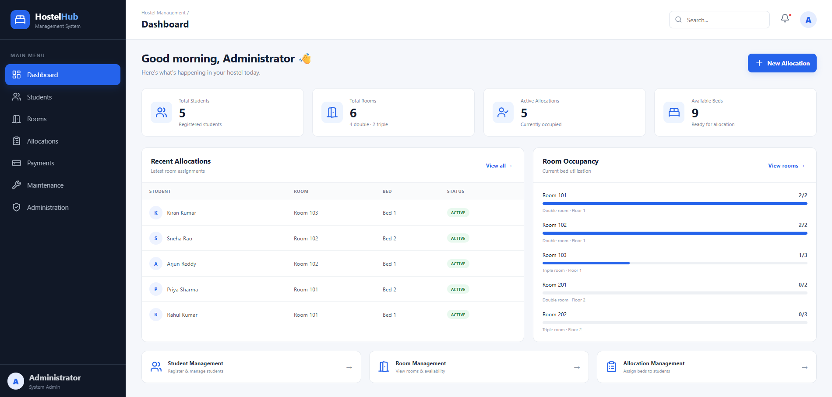
Screens / Working Demonstration
6
Modules shown
Dashboard & stats
Student form & list
Room & bed grid
Allocation form
Cancel allocation
Dashboard (live data)
Add the Students, Rooms and Allocation screenshots from localhost:5173 here.

Slide 7
Functional Results
7
What the system can actually do.
Student Registration
Room & Bed Tracking
Add students with validation and duplicate protection (roll no., phone, email).
Per-room capacity, occupied and free beds shown visually.
Bed Allocation
Cancel / Free Bed
Assign student → room → bed with transaction-safe checks.
Cancel an allocation; the bed instantly becomes available.
Search & Filtering
Dashboard Reports
Live search across students and allocations.
Totals, recent allocations and occupancy bars from the DB.

Slide 8
Testing Results
8
Test Case | Expected Result | Status
Health check /api/health | Backend & DB connected | Pass
Add student | Record saved, listed in table | Pass
Duplicate roll / email | Rejected with 409 message | Pass
Allocate free bed | Allocation created (ACTIVE) | Pass
Allocate occupied bed | Blocked: bed already occupied | Pass
Second bed for same student | Blocked: already allocated | Pass
Invalid bed number | Rejected with 400 | Pass
Cancel allocation | Status → CANCELLED, bed freed | Pass
Dashboard & search | Counts correct, filter works | Pass

Slide 9
Performance Analysis
9
Simple measurable results (local environment).
9
9
0%
Test cases
Passed
Error rate
< 100 ms
< 50 ms
8
API response
DB query time
REST endpoints

Slide 10
Results & Analysis
10
Summary of measurable outcomes.
Metric | Result
Registered students (demo data) | 5
Rooms (4 double, 2 triple) | 6
Total bed capacity | 14
Active allocations | 5
Available beds | 9
Occupancy | ≈ 36%
Test pass rate | 100%
Key Insight
Database-level checks plus row locking prevent double-booking, so allocation conflicts are eliminated while the dashboard always reflects live data.

Slide 11
Conclusion & Future Scope
11
Conclusion
Future Scope
Project objectives achieved
Working full-stack system: React + Flask + PostgreSQL
Conflict-free allocation and live availability
All test cases passed
Login & role-based access
Payments & fee management
Maintenance requests
Edit/delete students, reports export
Cloud deployment

