Slide 1
Chat Message Search System
Data Structures and Algorithms Project | Efficient String Pattern Matching in Chat Messages
Student Names & Roll Numbers
Department & College
Akshay Chandra — 2510080055
Manoj — 2510080052
Pranith Reddy — 2510080051
Balaji — 2510080046
Sai Charan — 2510080053
Department of AI&DS
KL University

Slide 2
Introduction
Background
Need for the Project
Messaging apps store thousands of messages. Finding a word or phrase in a long history means scanning text, so the choice of string-matching algorithm directly affects speed.
A naive linear scan is expensive and does not scale. There is a need to compare classical algorithms on real chat data with measurable results.
Project Scope
Implements and benchmarks five classical string-matching algorithms on a chat message dataset, connecting theoretical DSA study with practical text search.
Chat Message Search System
2

Slide 3
Problem Statement
As the number of chat messages grows, finding a specific word or phrase in a large conversation history becomes difficult and time-consuming. A naive linear scan over thousands of messages is computationally expensive and does not scale.
The system must search and retrieve relevant chat messages quickly, using string-processing algorithms, with fast and measurable pattern matching across the whole message collection.
Chat Message Search System
3

Slide 4
Objectives
Search for words or phrases within chat messages
Implement multiple string-matching algorithms
Compare algorithms by execution time and number of comparisons
Retrieve and display messages containing the searched pattern
Demonstrate the practical application of DSA to text search
Expected outcome: insight into how each algorithm performs under different search conditions, with a clear comparison by time, comparisons and accuracy.
Chat Message Search System
4

Slide 5
Literature Review
Work | Focus
Galal, Koopman & Zuccon (2024) | Search behaviour, intent and pain-points in professional instant messaging (Slack, Teams)
Zhang, Simoff & Debenham (2006) | Text mining for chat message analysis
Hui, He & Dong (2008) | Message retrieval and classification from chat-room servers using Bayesian networks
Avula et al. (2019) | Embedding search into a conversational platform for collaborative search
Schneider et al. (2024) | Review of applications, architectures and components of conversational search systems
Limitation: existing work targets user behaviour, NLP and system design. Few studies compare classical string-matching algorithms directly on chat data with empirical benchmarks.
Chat Message Search System
5

Slide 6
Proposed System
A DSA-focused chat search system that implements five classical string-matching algorithms on the same dataset and benchmarks them: five algorithms, one dataset, measurable and reproducible results.
Keyword or phrase search
Algorithm selection
Any word or multi-word phrase
Choose one of five, or compare all
Rich results
Built-in benchmarking
Message text, sender, timestamp, match position
Comparisons and execution time per run
Chat Message Search System
6

Slide 7
System Architecture
Chat Dataset
›
Preprocessing
›
User Query
›
Pattern Matching
›
Match Detection
›
Output & Metrics
Messages stored as objects: ID, sender, timestamp, content
Normalises message text and the search pattern
Keyword or phrase plus algorithm choice
Naïve, KMP, Rabin–Karp, Z, Aho–Corasick
Identifies matching messages and positions
Results, comparisons, time
Message structure: Message ID (unique identifier), Sender (author), Timestamp (date and time), Message Content (raw text searched).
Validation: results of all five algorithms are cross-checked for identical match sets.
Chat Message Search System
7

Slide 8
Methodology
1
2
3
4
5
6
Collect chat dataset
Preprocess text
Accept query
Run algorithm
Detect matches
Measure and compare
Algorithm | Technique | Preprocessing | Search time
Naïve | Check pattern at every position | O(1) | O(nm)
KMP | LPS array avoids re-comparisons | O(m) | O(n)
Rabin–Karp | Rolling hash, verify hash matches | O(m) | O(n) avg
Z Algorithm | Z-array on pattern + text | O(m) | O(n)
Aho–Corasick | Trie with failure links | O(total pattern) | O(n + matches)
Chat Message Search System
8

Slide 9
Tools & Technologies
Programming Language
Data Structures
Java: all algorithms, data structures and the console interface are implemented from scratch.
ArrayList for message storage; Trie with failure links for Aho–Corasick; LPS and Z arrays.
Software Requirements
Hardware Requirements
JDK 8 or higher, a Java IDE or terminal (for example IntelliJ, Eclipse or VS Code), Windows / Linux / macOS. [Confirm versions]
Standard PC or laptop, 4 GB RAM or more, dual-core processor or better. [Confirm specs]
Chat Message Search System
9

Slide 10
Implementation
Module | Role
Message module | Stores ID, sender, timestamp and content in an ArrayList
Preprocessing module | Normalises pattern and message text for consistent matching
Algorithm modules (×5) | Naïve, KMP, Rabin–Karp, Z Algorithm, Aho–Corasick
Metrics module | Counts character comparisons; times each search loop in ms
Validation and output | Cross-checks match sets; shows message, sender, timestamp, position
Working process: user enters a pattern → selects one algorithm (or "Compare All") → system scans every message → matches and performance metrics are displayed.
Chat Message Search System
10

Slide 11
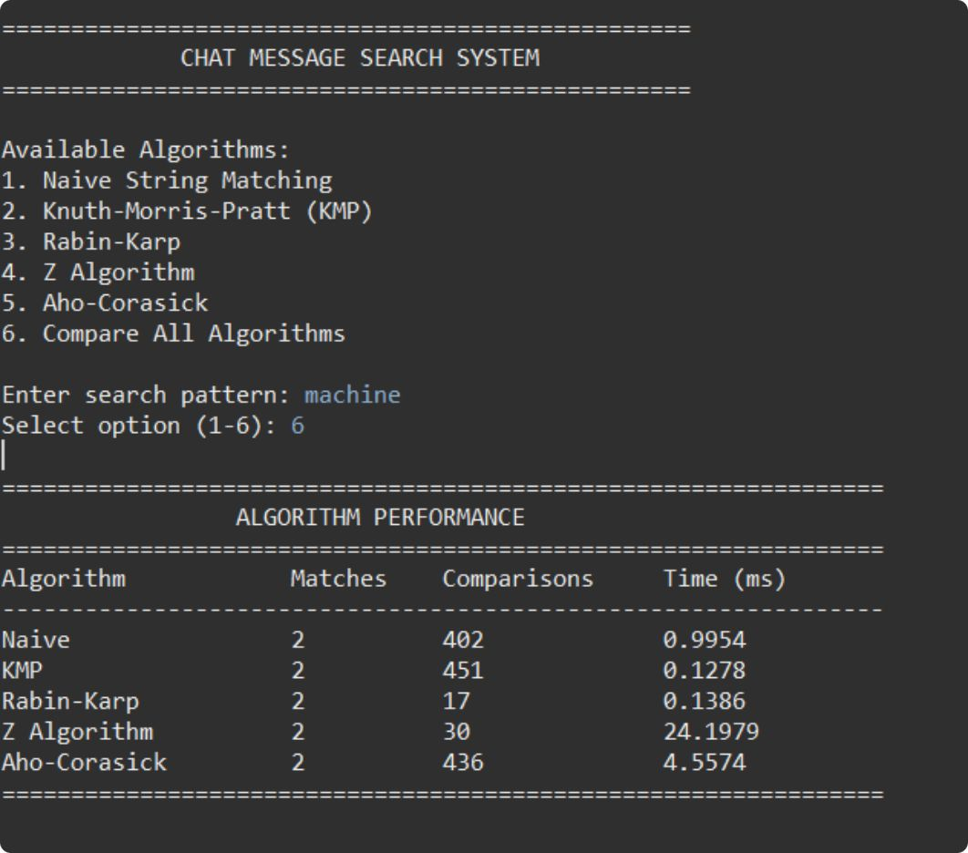
Results and Screenshots
Algorithm | Matches | Comparisons | Time (ms)
Naïve | 2 | 402 | 0.9954
KMP | 2 | 451 | 0.1278
Rabin–Karp | 2 | 17 | 0.1386
Z Algorithm | 2 | 30 | 24.1979
Aho–Corasick | 2 | 436 | 4.5574
Output screen: "Compare All Algorithms" for pattern "machine"
Chat Message Search System
11

Slide 12
Results: Performance Observations
All five agree
KMP fastest
Every algorithm found the same 2 matching messages for "machine".
0.1278 ms, even though it made 451 comparisons.
Rabin–Karp most efficient
Z Algorithm slowest
Only 17 comparisons because hash filtering rejects most positions; 0.1386 ms.
Only 30 comparisons but 24.1979 ms, the highest wall-clock time.
Aho–Corasick overhead
4.5574 ms: trie construction cost shows up; it is designed for multi-pattern search.
Chat Message Search System
12

Slide 13
Testing
# | Test case | Condition | Result
1 | Pattern "machine" | Existing word, small dataset | Pass: all 5 algorithms return 2 matches
2 | Non-existing pattern | Pattern not in any message | Expected: 0 matches from all algorithms
3 | Short pattern | Few characters | Expected: identical match sets
4 | Long pattern / phrase | Multi-word phrase | Expected: identical match sets
5 | Varying dataset size | Different numbers of messages | Time and comparisons recorded per size
6 | Varying message length | Short vs long messages | Time and comparisons recorded per length
Cross-algorithm validation: all five must return identical match sets before metrics are reported. Rows 2–6 are planned/expected; update with observed results.
Chat Message Search System
13

Slide 14
Advantages
Fast, accurate retrieval of messages containing a word or phrase
Five algorithms on one dataset give a fair, reproducible comparison
Tracks both comparisons and execution time, not just one measure
Results show sender, timestamp and match position for context
Cross-validation of all algorithms confirms correctness
Links theoretical DSA concepts to a practical application
Chat Message Search System
14

Slide 15
Applications
Messaging apps
Collaboration tools
Customer support logs
In-app search over chat history
Slack and Teams style workspace search
Locate past issues and keywords
Text mining
Education
Multi-keyword filtering
Keyword detection in conversation logs
Teaching and benchmarking string algorithms
Aho–Corasick for moderation or alerts
Chat Message Search System
15

Slide 16
Challenges Faced
Challenge | Solution
Fair comparison across algorithms | Same dataset and same queries for all five
Counting comparisons consistently | Counter incremented at each character-level comparison
Accurate timing | Wall-clock time captured around each algorithm's search loop
Verifying correctness | Cross-algorithm validation of match sets
Trie and Z-array complexity | Implemented from scratch and tested on small examples first
Chat Message Search System
16

Slide 17
Future Enhancements
Test on larger, real-world chat datasets with more messages
Add Boyer–Moore and other algorithms to the comparison
Support case-insensitive, fuzzy and regex search
Build a graphical or web interface
Index messages (inverted index, suffix tree) for faster repeated searches
Add multi-keyword search and ranking of results
Chat Message Search System
17

Slide 18
Conclusion
Built a Java chat message search system with five classical string-matching algorithms
All algorithms returned identical, correct matches for "machine"
Rabin–Karp used the fewest comparisons (17); KMP was fastest (0.1278 ms)
Fewer comparisons do not always mean less time: Z Algorithm and Aho–Corasick show overhead
The project connects DSA theory to practical text search
Five algorithms. One dataset. Measurable, reproducible results.
Chat Message Search System
18

Slide 19
References
Galal, Koopman & Zuccon (2024). Searching in Professional Instant Messaging Applications: User Behaviour, Intent, and Pain-points.
Zhang, Simoff & Debenham (2006). Text Mining for Chat Message Analysis.
Hui, He & Dong (2008). Message Retrieval and Classification from Chat Room Servers Using Bayesian Networks.
Avula et al. (2019). Embedding Search into a Conversational Platform to Support Collaborative Search.
Schneider et al. (2024). Engineering Conversational Search Systems: A Review of Applications, Architectures, and Functional Components.
Cormen, Leiserson, Rivest & Stein. Introduction to Algorithms (string matching chapter), MIT Press.
Chat Message Search System
19

