Slide 1


Chat Message Search System
TEAM MEMBERS
*2510080051- Pranith
*2510080052-Manoj
*2510080053-Sai Charan
*2510080046-Balaji
*2510080055-Akshay

Slide 2

The Problem Statement:
Performance
.
Traditional scrolling through chat history is time-consuming and inefficient, especially in large group chats or long-term conversations..
Modern chat applications generate thousands of messages, making it difficult for users to quickly locate specific conversations.

Slide 3

Project Objectives
01
Scalable storage & retrieval
Design a system that supports sharding and horizontal scale for billions of messages.
02
Low-latency search
Target sub-100ms query latency for typical lookups and <5s near-real-time indexing for new messages.
03
Secure, permission-aware results
Enforce user and workspace permissions at query time to return only authorized messages.
04
Accurate relevance
Combine textual relevance with recency and metadata filters for meaningful results.

Slide 4
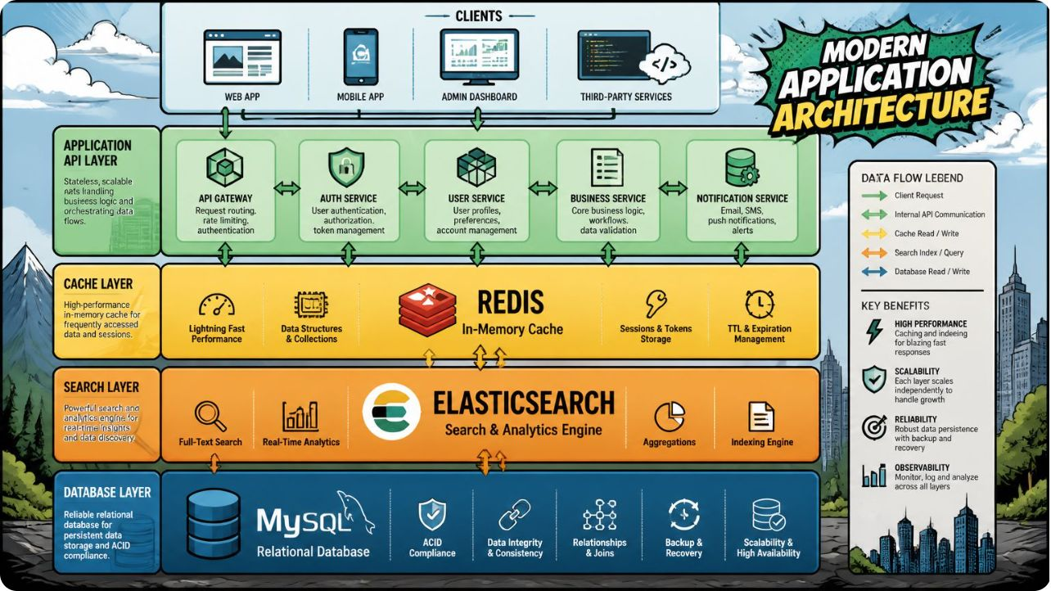
Technology Stack
Ingestion: Kafka — durable, ordered streams and decoupled producers/consumers
Search Engine: Elasticsearch (Lucene) — full-text, BM25, highlighting, sharding
Source of Truth: Vitess / MySQL — transactional message storage & consistency
Cache / Permissions: Redis — sub-ms permission lookups and access tokens
Workers & Orchestration: Kubernetes + consumer groups for indexers and ranking workers

Slide 5

Expected Outcome
Develop an efficient chat message search system that enables fast storage, retrieval, and searching of messages using appropriate data structures. The solution will:
Reduced search time
Improved message management
Sub-100ms query latency for common queries through sharded indices, caches and optimized query paths.
Scalable indexing and compact data structures to handle large chat datasets while keeping storage efficient.
Better discovery
Secure & auditable
Relevance ranking + metadata filters to surface the most useful results and reduce duplicate queries.
Permission-aware search results and logs to preserve privacy and support audits.

Slide 6



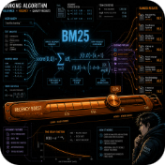
Project Modules
Data Ingestion Module
Search Indexer
Search API Service
Ranking Engine
Worker pool that normalizes text, extracts tokens, builds inverted indices and writes to shard-aligned Elasticsearch indices.
Kafka consumers that batch, validate, enrich (attachments, metadata) and push events to indexers and durable storage.
Query orchestration, permission enforcement, pagination, and routing to appropriate shards or replicas.
Combine BM25 relevance, recency decay, user-specific boosts and metadata filters for final scoring.

Slide 7
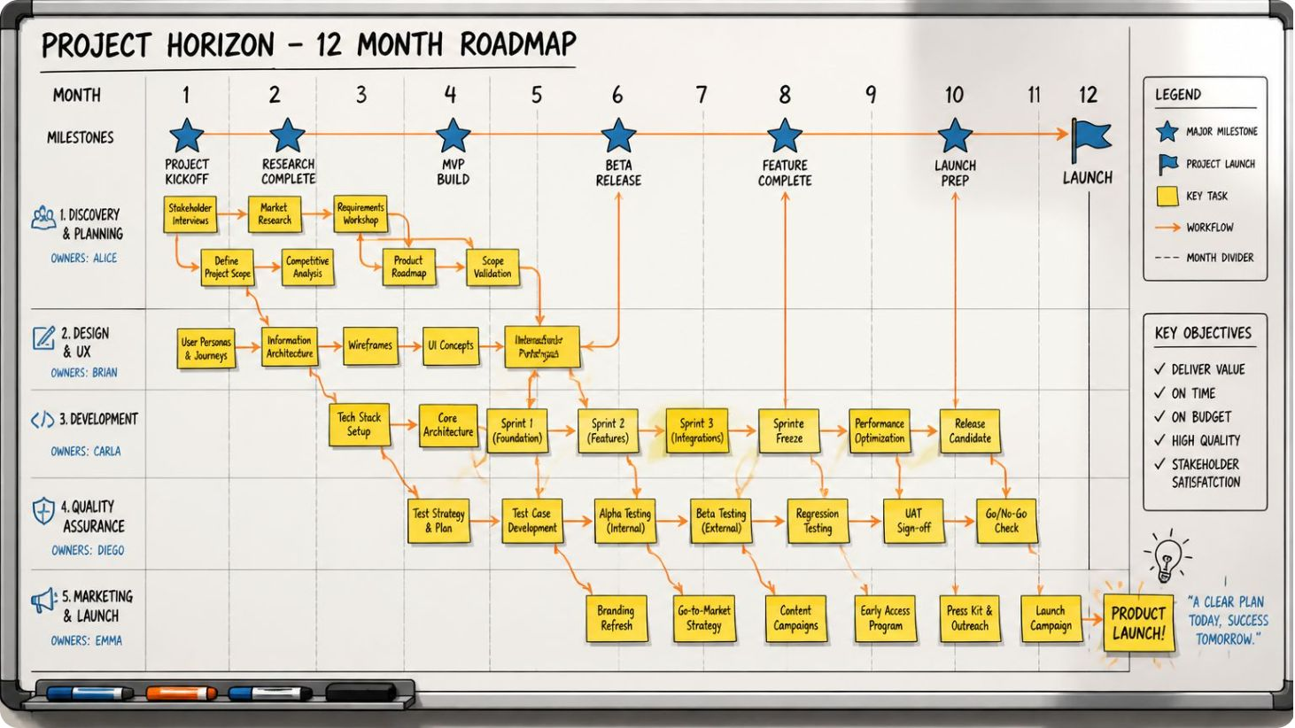

Project Plan (4-week Roadmap)
Weeks 1: Architecture design, schema for messages, Kafka setup, Vitess/MySQL provisioning
Weeks 2: Elasticsearch index design, sharding strategy, implement basic indexer workers
Weeks 3: Search API, permission enforcement, query optimization and ranking integration
Weeks 4: Load & performance testing (p99), caching tuning, end-to-end integration and deployment
Deliverables: System design doc, deployable indexer & API, benchmark reports, and final demo.

