Slide 1
Chat Message Search System
Data Structures and Algorithms Project
2510080055
2510080052
2510080051
AKSHAY CHANDRA
MANOJ
PRANITH REDDY
2510080046
2510080053
BALAJI
SAI CHARAN

Slide 2

Problem Statement & Objectives
As the number of chat messages increases, finding a specific word or phrase from a large conversation history becomes difficult and time-consuming.
The proposed system aims to efficiently search and retrieve relevant chat messages using Data Structures and Algorithms.
Objectives
Develop a system to search for words or phrases within chat messages.
Implement and study different string matching algorithms.
Compare the algorithms based on search time and number of comparisons.
Retrieve and display messages containing the searched pattern.
Apply DSA concepts to a real-world text-search problem.

Slide 3

Literature Review
Previous research has explored different aspects of searching and retrieving information from conversational and messaging data.
Key Research Areas
Search behaviour in instant messaging applications
Retrieval and classification of chat messages
Text mining of chat conversations
Search within collaborative messaging platforms
Conversational search system architecture
These studies establish the importance of efficient search and retrieval in large collections of conversational data.

Slide 4
Selected Research Papers
1
2
3
Galal, Koopman & Zuccon (2024)
Zhang, Simoff & Debenham (2006)
Hui, He & Dong (2008)
Text Mining for Chat Message Analysis. Investigates computational analysis and extraction of useful information from instant-messaging conversations.
Searching in Professional Instant Messaging Applications: User Behaviour, Intent, and Pain-points. Studies how users search in platforms such as Slack and Microsoft Teams and identifies challenges in existing messaging search.
Message Retrieval and Classification from Chat Room Servers Using Bayesian Networks. Explores automatic retrieval and filtering of messages from online chat-room servers.

Slide 5
String Matching Algorithms
Naïve String Matching
Knuth–Morris–Pratt (KMP)
Rabin–Karp
Basic approach that checks the pattern at every possible position.
Uses the LPS array to avoid unnecessary comparisons.
Uses rolling hash values to identify possible matches efficiently.
Boyer–Moore
Aho–Corasick
Uses mismatch information to skip sections of the text.
Supports efficient searching of multiple patterns simultaneously.

Slide 6
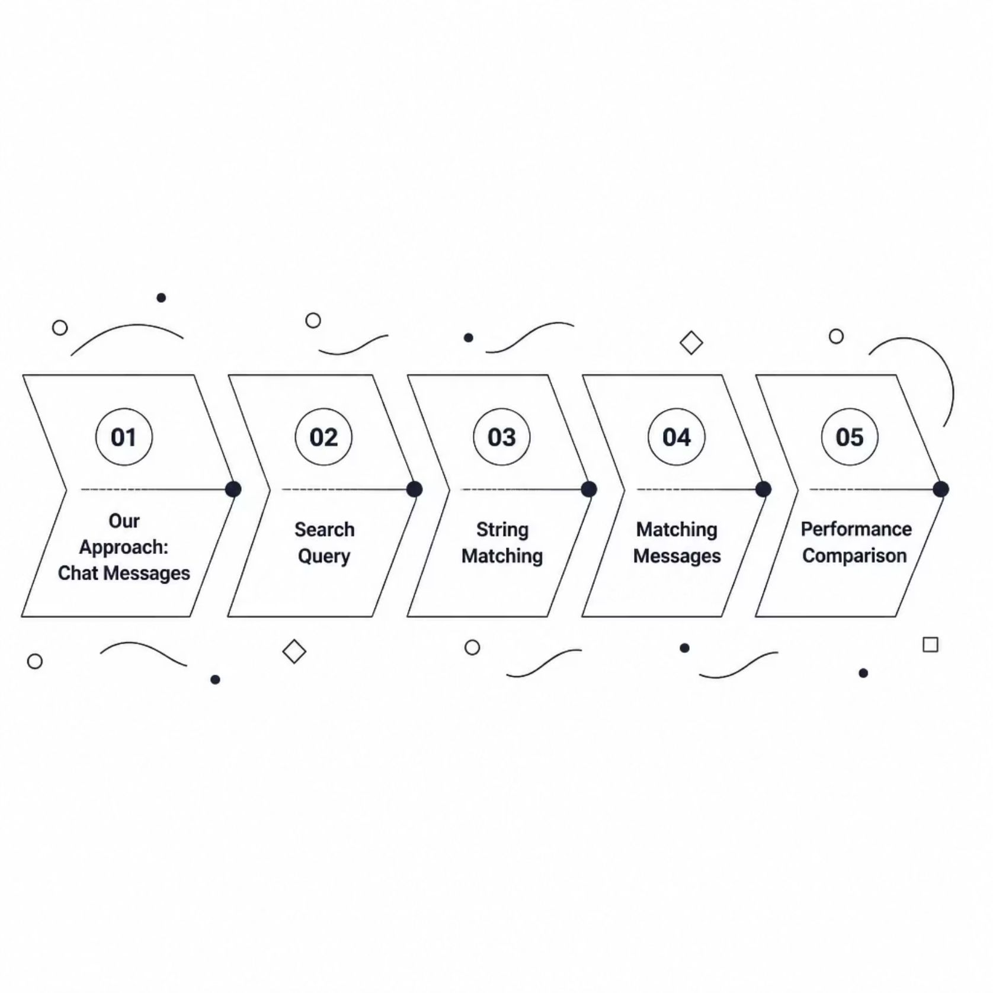
Research Gap
Existing studies mainly focus on:
User search behaviour
Message retrieval and classification
Text mining
Conversational search
Search-system architecture
However, there is an opportunity to develop a DSA-focused chat message search system that directly implements and compares classical string-searching techniques on the same dataset.

Slide 7
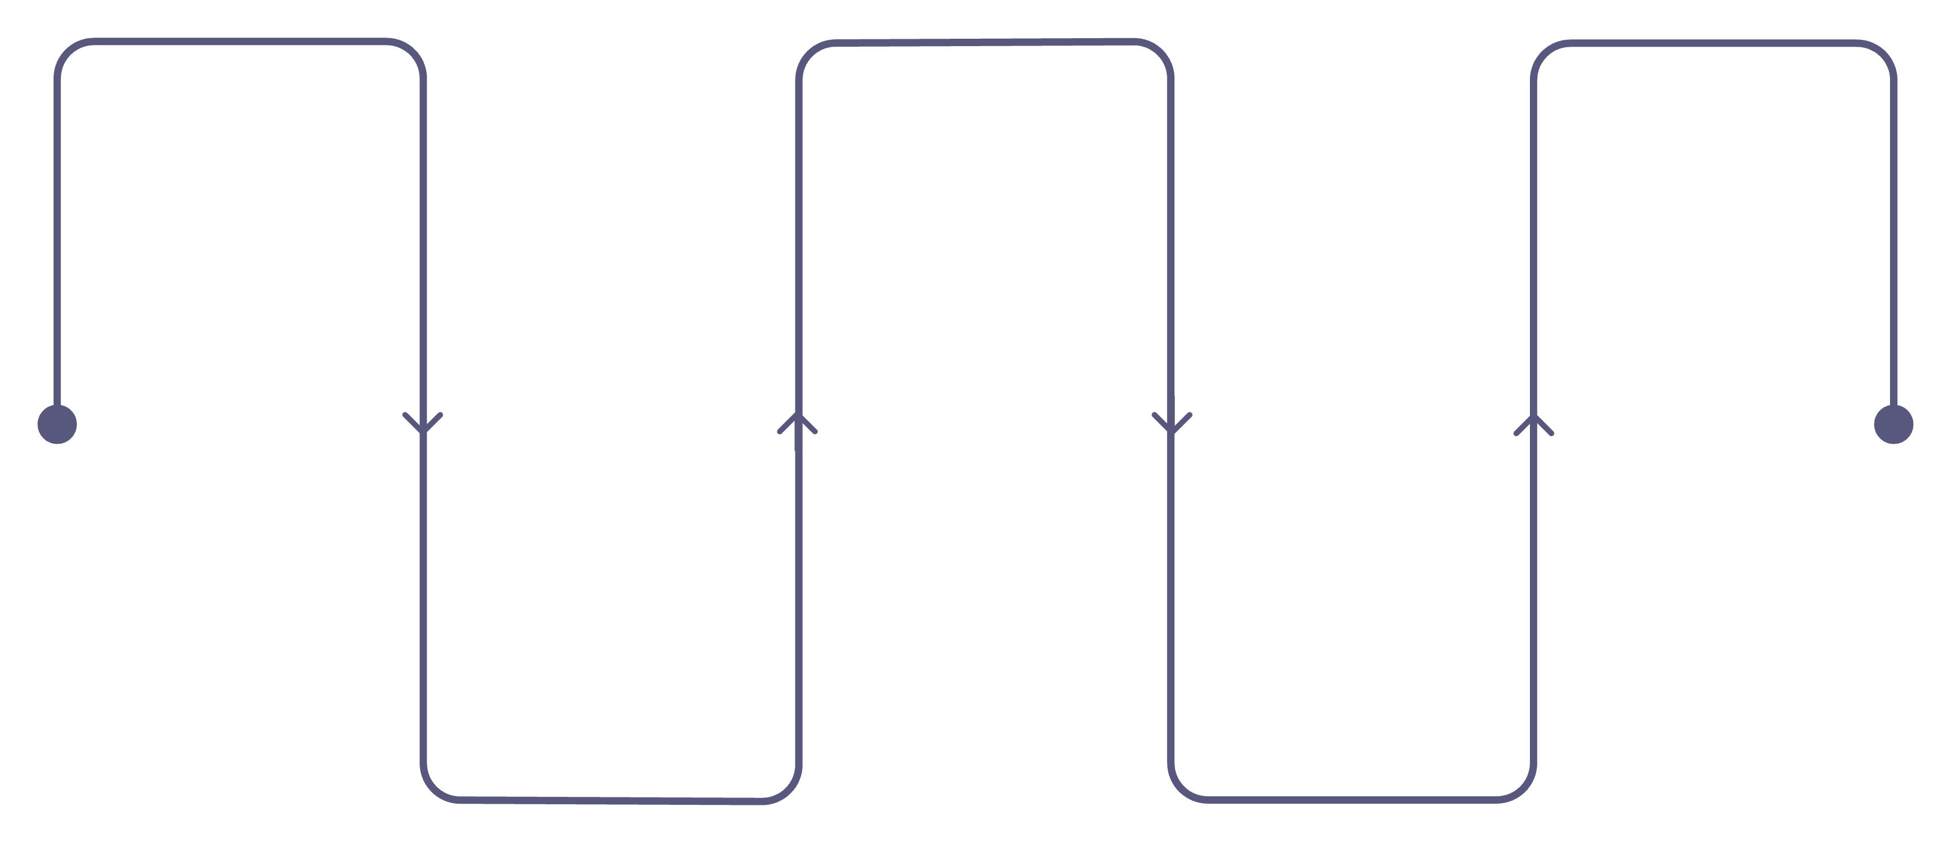
Proposed Methodology
Message Collection
Preprocessing
Match Detection
Normalize messages and pattern
Dataset with ID, sender, timestamp, content
Identify matching messages
Pattern Matching
Search Query
Apply matching algorithm
User input query
The methodology follows a structured pipeline from data collection through to performance analysis, ensuring consistent and reproducible evaluation of each algorithm.

Slide 8

System Workflow
Ingest Data
Preprocess Text
Search Query
Select Algorithm
The workflow illustrates the end-to-end pipeline of the system, from raw dataset ingestion through preprocessing, algorithm selection, pattern matching, and final performance reporting.

Slide 9
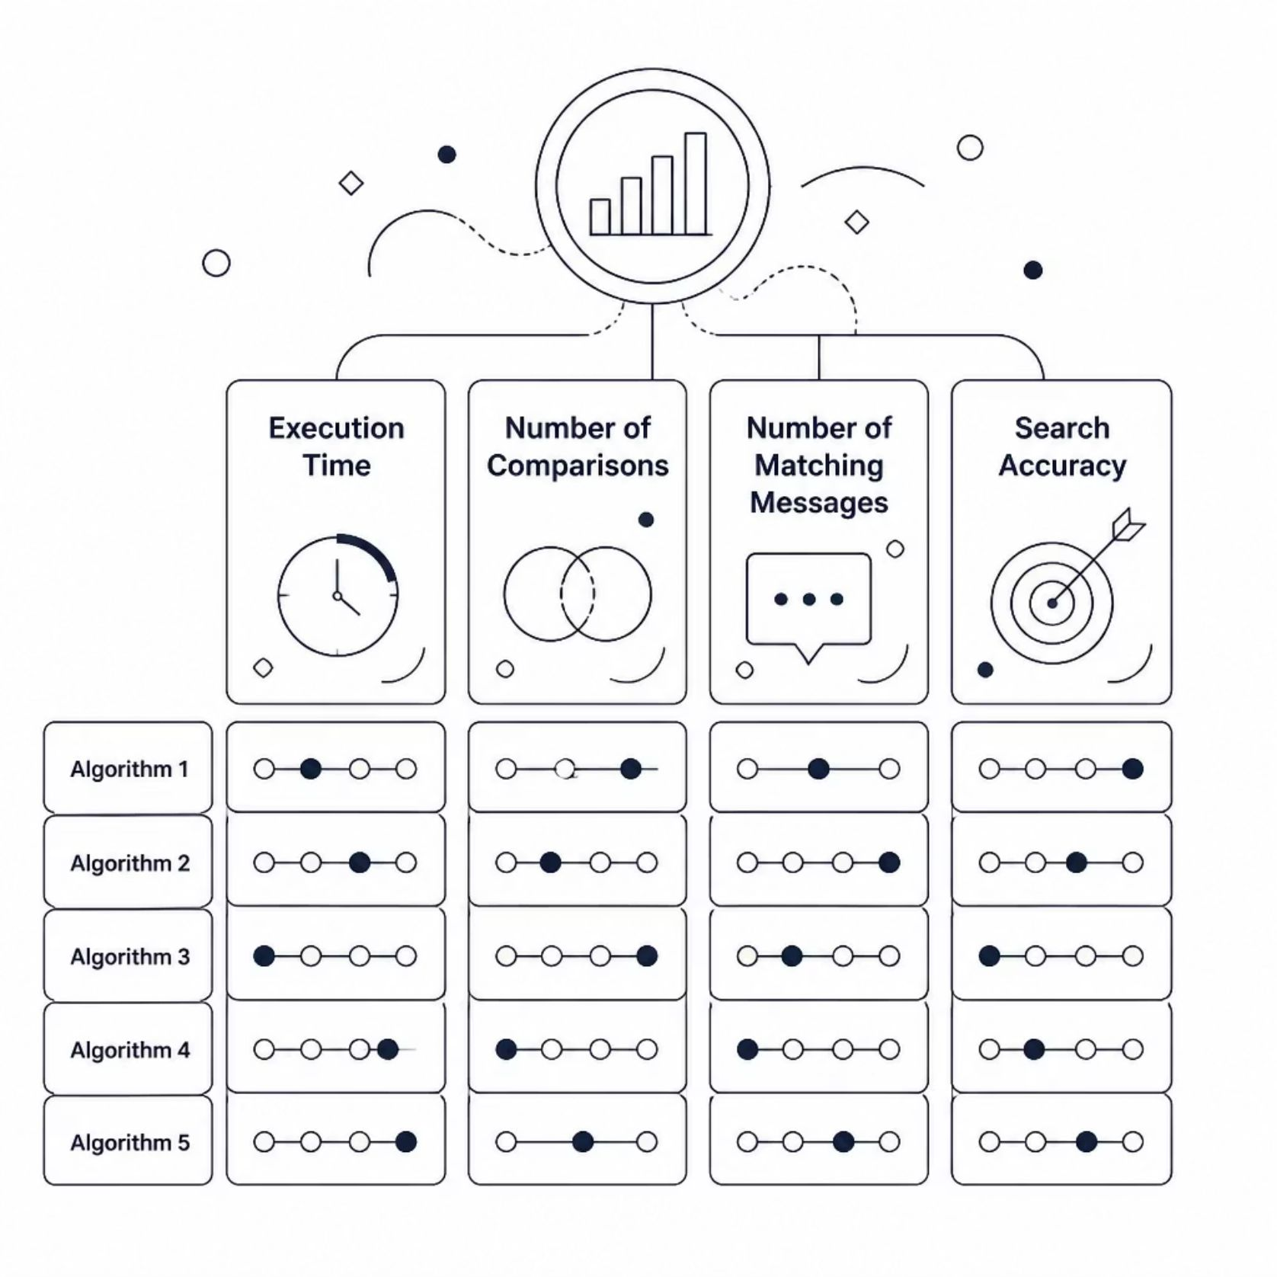
Performance Evaluation
All algorithms will be tested using the same datasets and search queries.
Test Conditions
Different numbers of messages
Different message lengths
Short and long search patterns
Existing and non-existing patterns

Slide 10

Expected Outcome
The project will identify how different algorithms perform under different search conditions and demonstrate the practical application of DSA in chat-message searching.
Algorithm Performance Insights
Identify how each string-matching algorithm performs under varying search conditions and dataset sizes.
Practical DSA Application
Demonstrate the real-world relevance of classical data structures and algorithms in a chat-message search context.
Comparative Analysis
Provide a clear comparison of algorithms by execution time, comparisons made, and search accuracy.

